Slide 1
An Enhanced Long Range PPDU
Date: 2024-05-09
Authors:

Slide 2
Introduction
In a typical scenario, a non-AP STA’s transmit power is about 10 dB lower than that of an AP STA
  Due to regulation: different transmit power restriction for an AP STA and a non-AP STA
  Due to implementation: an AP STA’s PA could be better than a non-AP STA’s PA (need to lower Tx power to meet Tx requirement)
  An AP STA may have more antennas than a non-AP STA: e.g. an AP STA with 4 antenna, a non-AP STA with 2 antenna
  This gives 6 dB link budget difference between downlink and uplink (10 dB transmit power difference can be closed by 6 dB link budget improvement + 3 dB from antenna and 1 dB from more diversity gain from more antennas)
Can we improve/reduce 10 dB transmit power or 6 dB link budget difference?
FCC | Indoor AP | Non-AP STA
5.15-5.25 GHz | 30 dBm and 17 dBm / MHz | 24 dBm and 11 dBm / MHz
5.725-5.895 GHz | 36 dBm and 20 dBm / MHz | 30 dBm and 14 dBm / MHz

Slide 3
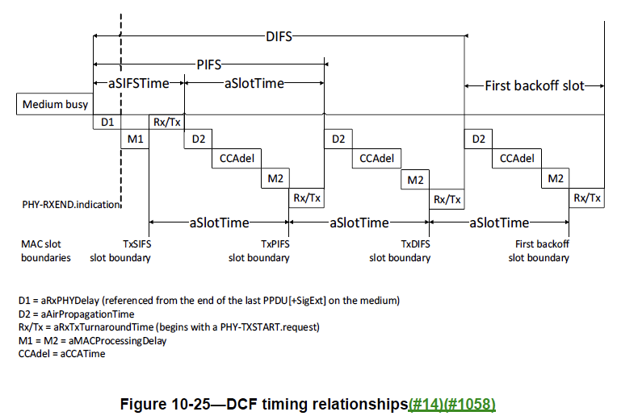
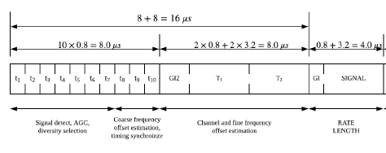
Packet Detection
Each STA need to check channel idle within a slot time (more specifically within aCCATime)
It is desired to perform packet detection based on the first field of a PPDU (e.g. L-STF) which is less than a slot time
aSlotTime is 9us for 5 and 6 GHz and 20us for 2.4 GHz
aSlotTime is 9 us and a STA needs to determine CCA busy or not within aCCATime, thus the packet detection shall be finished within L-STF (< 8 us)

Slide 4
Feasibility Study
Assumption
  A non-AP STA has two antennas
  An AP STA has four antennas
  Real packet detection based on L-STF
  An ELR PPDU is transmitted with some preprocessing
An ELR PPDU can perform 10 dB better than a non-HT PPDU at 10% PER

Slide 5
Discussion: UORA and Triggered Access
Why not using UORA?
  UORA is developed in 802.11ax but it is barely seen in products due to its low airtime efficiency
  EHT group has decided not to expand it for 320 MHz due to similar reasons
  There will be a lot of delay when the transmission fails due to collision in UORA case
Why not always using Triggered Access?
  AP implementations can vary quite a lot, from high-end to low-end, and depending on the AP implementation, we may prefer to use UL Trigger, and in other cases, we may prefer to use EDCA
  Triggered access should not be the only transmission alternative for the STA. EDCA needs to be available too, EDCA has been always used together with triggered access
  Some frames can’t be triggered, e.g.
    Immediate response frames such as ACK
    Probe Request, Association Request as unassociated STA does not have STA-ID
  Trigger involves unnecessary overhead and delay for some short frames
    E.g. QoS Null with PM bits (30 B, ~ 200 us)

Slide 6
Conclusion
In this contribution, we proposed to define an uplink enhanced long range (ELR) PPDU
  Improving uplink link budget in all 2.4/5/6 GHz bands by 6 dB
We showed that 6 dB uplink link budget improvement can be achieved without a long preamble
  When a number of antennas at an AP STA is twice more than that of a non-AP STA, a required SNR for an ELR PPDU can be 10 dB less than that of a non-HT PPDU MCS0
  In other words, we can close the gap between downlink and uplink link budget

Slide 7
SP
Do you agree to design an Enhanced Long Range (ELR) PPDU in IEEE 802.11bn with target as below?
  Uplink in 2.4 GHz, 5 GHz and 6 GHz
  Minimum data rate is higher than 1.5Mbps

