Slide 1
UHR PPDU PHY Version
Date: 2024-05-10
Authors:

Slide 2
EHT PPDU Format
EHT PPDUs are defined to have backward and forward compatibility
L-STF/L-LTF/L-SIG, RL-SIG provides backward compatibility
U-SIG field: version-independent field provides forward compatibility

Slide 3
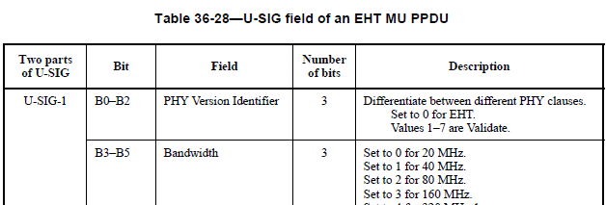
U-SIG Field

Slide 4
UHR PPDU
UHR PPDU should carry over the same design structure
inherit the benefits of backward/forward compatibility
Start with L-STF/L-LTF/L-SIG, RL-SIG
Followed by U-SIG
U-SIG version-independent field:
Same sub-field/bits location and interpretation
5 version independent fields:
PHY Version Identifier: indicates different PHY clauses
Bandwidth, UL/DL, BSS Color, and TXOP

Slide 5
PHY Version Identifier
Some proposal [1, 2] to define a hybrid UHR PHY mode
PHY Version Identifier = 0 (EHT) + Disregard bits (UHR)
The main benefit is to allow mixed generation MU transmission (EHT + UHR)
e.g. OFDMA: one RU assigned to an EHT STA with EHT modulation and one RU assigned to an UHR STA with UHR modulation
The benefit is limited without significant MU enhancement in UHR
Alternatively, EHT MU PPDU can be used for mixed-gen STAs
Downside:
Limitations to signaling format for version-dependent fields
EHT STAs need to process the entire EHT/UHR-SIG to abort.
UHR STAs need to parse Disregards or Validate bits to distinguish
Violate definition of PHY Version Identifier to differentiate PHY clauses

Slide 6
PHY Version Identifier (Cont.)
A cleaner solution is to set
PHY Version Identifier = 1 in any UHR PPDU U-SIG
PHY Version Identifier is a single bit logic to determine the Rx state machine after U-SIG
UHR STA will decide to how to parse U-SIG and following SIG based on PHY Version Identifier == 0 or 1
EHT STA will stop processing after U-SIG if PHY Version Identifier == 1 and report version-independent sub-fields

Slide 7
Summary
Discussed about UHR PPDU to inherit EHT preamble design for same forward/backward compatibility
L-STF/L-LTF/L-SIG, RL-SIG
U-SIG
Proposed the setting of “PHY version identifier” to 1 in U-SIG for any UHR PPDU definition.

Slide 8
Reference
[1] 11-24/0428, uhr-preamble-design-options
[2] 11-24/0774, uhr-preamble-design-follow-up

Slide 9
SP
Do you agree to add the following to 11bn SFD:
“PHY version identifier” is set to 1 in U-SIG for UHR PPDUs?

