Slide 1
UHR Enhanced Long Range Support
Date: 2024-05-10
Authors:

Slide 2
Introduction
During the UHR SG, several contributions discussed about enhanced long range feature [1, 2, 3, 4]
In this presentation, we will share our view on the need and design target for UHR long range.

Slide 3
Long Range Needs
STA’s UL range limitation due to lower Tx power:
  Full AP v.s. client STA Tx power asymmetry: ~10dB or so
    4x4 AP to 2x2 client or 2x2 AP to 1x1 client
    UL range is shorter than DL beacon
  General issue for all bands: 2.4GHz, 5GHz, 6GHz (AFC)
    For 6GHz LPI operation, client has 6dB lower PSD limitation.
Mobile AP or P2P range
  Smaller Tx power asymmetry with the similar hardware capabilities
  In 2.4GHz, range is longer with 11b beacon
    However, not compatible with later amendments and performance limitation
    Need to define a long range OFDM PPDU with better coex and performance

Slide 4
BSS range with power asymmetry
11ax with ER PPDU
11ax with UORA/UL TB
11ac
AP
Beacon range (6mbps)

Slide 5
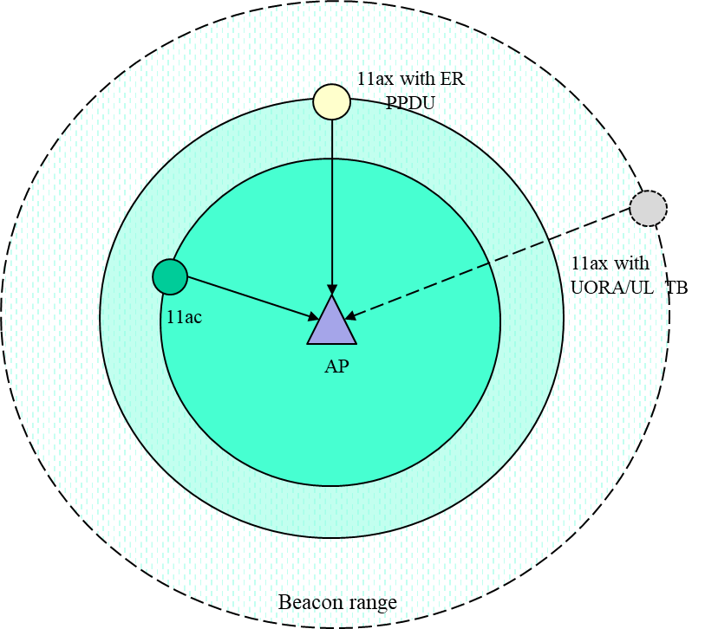
Devices up to 802.11ac support
WiFi 5 devices
  Beacon in legacy format: range is ~2x of service range
  Service range limited by UL range
    Association, BA/ACK, sounding FB, etc.
Current solution
  11b for UL in 2.4GHz, ~6dB
    Data, BA/ACK, RTS-CTS, etc.

Slide 6
11ax solutions
Technologies:
  UORA for association:
    26-tone RU in 20MHz to achieve ~10dB per-tone power gain
    Limitation for DFS channel and PSD limited channel
    Not popular in products on the market
  DL Data:
    MU-BAR to single user with 26-tone RU
    BFRP with single 26-tone RU, TB SU is optional, not popular
  UL Data:
    TB SU with smaller RU, e.g. RU26 in 20MHz
      Limitation for DFS channel and PSD limited channel
      Efficiency is low without effective BSRP report
    HE ER PPDU: ideally 6dB (106DCM)
      realistically ~4dB, beam change
Applies to 2.4/5/6GHz

Slide 7
11bn Response
11ax ER solution is complex and limited
  UORA, MU-BAR/BFRP with single user, TB PPDU with single user
11be only adds MCS14 for PSD limited channels
11bn (UHR) to define an UHR long range PPDU to
  Improve STA’s UL range due to DL/UL power asymmetry
    UL association request, sounding feedback, BA/ACK, UL SU data
  Improve coex and throughput in 2.4GHz, both DL/UL

Slide 8
Design Target
DL/UL link budget difference: ~6 dB
  E.g. 10dB Tx power difference between 4x4 AP and 2x2 STA
2.4GHz: typical 11b sensitivity is ~6dB better than 11a
  10.4dB spreading gain, ~6dB coding loss, 1~2dB Tx power gain
UHR target to define a low data rate about ¼ of 6mpbs → 1.5 Mbps

Slide 9
Summary
Evaluated the need for range enhancement for UHR.
  DL/UL link budget imbalance for all bands (2.4/5/6GHz)
  Support of better coex and throughput in 2.4GHz band at the longest range for Mobile AP and P2P applications
Analyzed the target for UHR enhanced long range design
  A definition of a minimum data rate of 1.5mbps or so.

Slide 10
Reference
[1] 22/1928, Enhanced Long Range-Usage Scenarios, Design Target and Feasibility
[2] 11-23/0042, thought-for-range-extension-in-uhr
[3] 11-23/1100, low-power-and-long-range-preamble
[4] 11-22/1908, uhr-rate-vs-range-enhancement-with-relay

Slide 11
SP1
Do you agree to add the following text to 11bn SFD
  11bn defines a PPDU format that support a minimum data rate of about 1.5mpbs?

