Slide 1
AMP Device-Initiated Secure Transaction
Date: 2024-5-10
Authors:

Slide 2
Summary
The basic secure transaction model (11-24/0178r0) and server-managed secure transaction model (11-24/0526r0) for AMP devices are briefly reviewed.
In above models, the transaction is initiated by a reading device with normal power, and the AMP device is in a responding role.
AMP device-initiated secure transaction models (with and without server) are proposed.
Notes:
https://unit42.paloaltonetworks.com/iot-threat-report-2020/

Slide 3
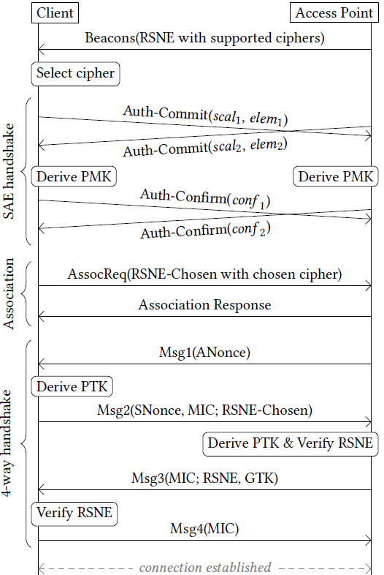
What is a suitable communication model for AMP devices?
If an AMP device follows current Wi-Fi MAC (maintaining a secure link for layered networking model)
  It will take 10+ frames to establish a secure association.
  The AMP device needs to have sufficient power to maintain the secure association and low power operating mode (e.g., TSF timer).
Questions
  Do AMP devices have sufficient power for such overhead?
  The layered networking model was designed to support multiple applications and large-volume data exchanges. Do AMP devices need this?
Arguments
  Layered networking model over conventional Wi-Fi MAC may not be the best fit for AMP devices that are often designed for a single application.
  Compact transaction-based communication model may be better.
Notes:
https://unit42.paloaltonetworks.com/iot-threat-report-2020/

Slide 4
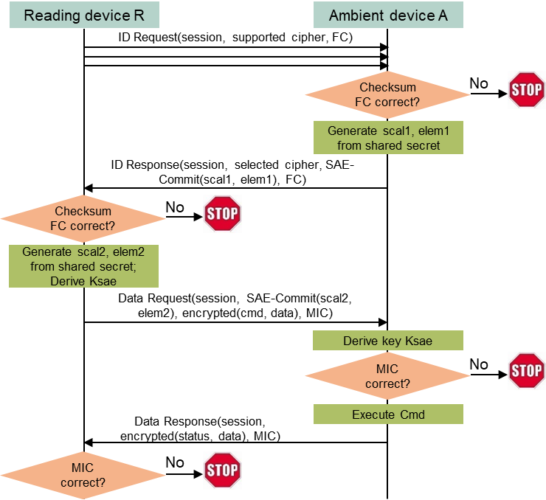
The basic secure transaction model for AMP devices
Assumptions
  AMP devices typically support one application (function).
  AMP devices do not have large data volume to exchange at each transaction.
  AMP devices do not need to maintain association and/or low power mode (they can simply power off or lose the power after communication).
Initial ideas
  A simple Request (by regular STA) + Response (by AMP device) transaction model.
  Integrated security based on a shared secret between the requester (regular STA) and the respondent (AMP device).
  Absolutely minimize exchanged messages during the aforementioned secure data transaction.
Solution
  Only 4 message exchanges are needed to finish secure transaction.
  Can co-exist with layered networking model over conventional MAC.
Notes:
https://unit42.paloaltonetworks.com/iot-threat-report-2020/

Slide 5
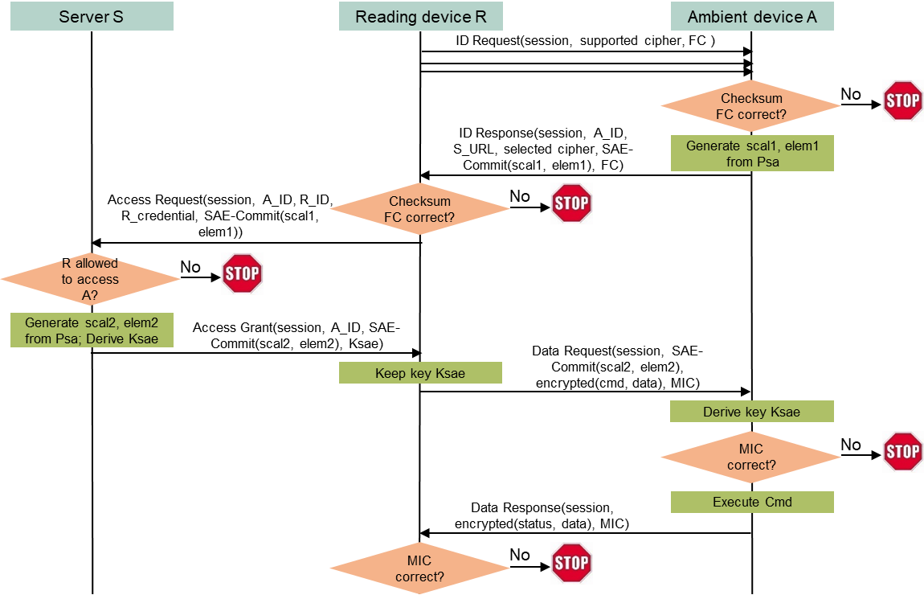
A server-managed secure transaction model for AMP devices
Use case
  An entity owning many deployed AMP devices may want to dynamically allow/disallow reading devices to access deployed AMP devices.
  Example: a contractor’s reading device may need the access, and the access right should be removed after finishing the contract.
Shared secret between a reading device and an AMP device is no longer suitable.
  It is impractical to maintain and update identifiers and shared secrets for different reading devices on every AMP device, especially deployed AMP devices.
Solution
  Let a server manage access rights dynamically without touching deployed AMP devices.
Notes:
https://unit42.paloaltonetworks.com/iot-threat-report-2020/

Slide 6
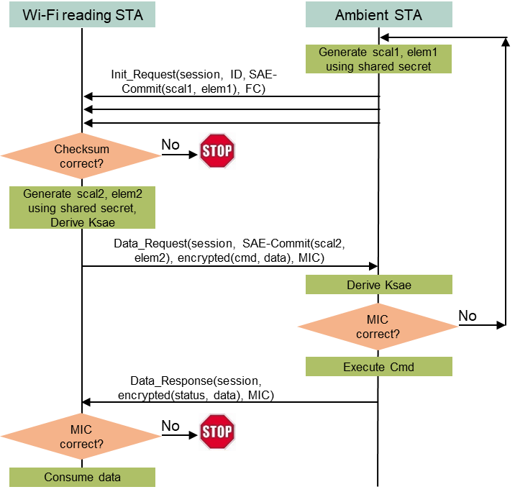
A basic AMP device-initiated secure transaction model (1)
Use case
  The AMP device could be a glass breaking sensor, must initiate the communication to report an alarm.
Assumptions
  The Wi-Fi reading device and the AMP device share a secret code, which is the foundation of the secure transaction.
  The AMP device can afford the energy of repeatedly sending a “complicated” Init_Request message until the message is detected by the reading device.
Solution
  Only 3 message exchanges are needed to finish mutual authentication and encrypted data exchange.
Notes:
https://unit42.paloaltonetworks.com/iot-threat-report-2020/

Slide 7
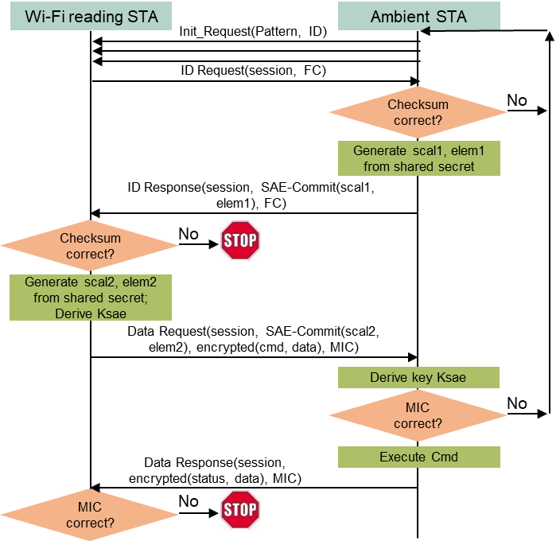
A basic AMP device-initiated secure transaction model (2)
Assumptions
  The Wi-Fi reading device and the AMP device share a secret code, which is the foundation of the secure transaction.
  The AMP device has very limited power, needing to preserve energy as long as possible while sending the Init_Request message.
Solution
  5 message exchanges are needed to finish mutual authentication and encrypted data exchange, with the first Init_Request message being very simple using a special PHY/MAC method to preserve energy.
Notes:
https://unit42.paloaltonetworks.com/iot-threat-report-2020/

Slide 8
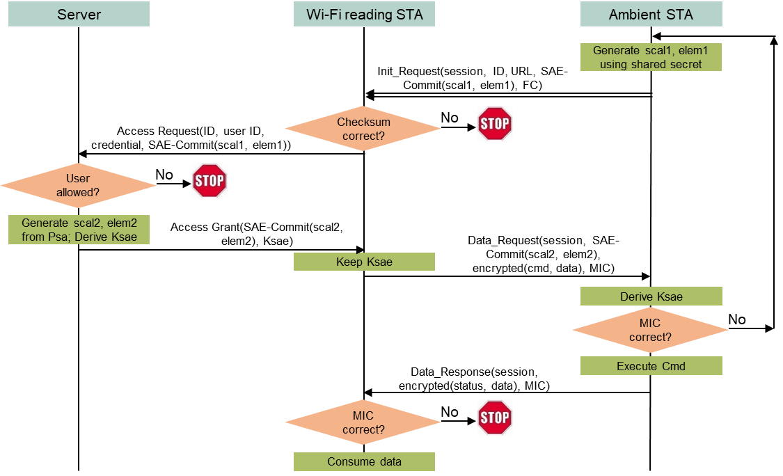
Server-managed AMP device-initiated secure transaction (1)
Use case
  An entity (e.g., a mall) owning many deployed AMP sensors may want to dynamically allow/disallow reading devices (e.g., stores’ reading devices) to access those AMP devices based on contract terms, without changing anything in the deployed AMP devices.
Assumptions
  The owner’s server and every AMP device share a secret code, which is the foundation of the secure transaction. The reading device cannot know the secret code.
  Every reading device has a user id and a credential managed by the server. The server determines if a reading device can access any AMP device based on such information.
  An AMP device can afford the energy of repeatedly sending a “complicated” Init_Request message until the message is detected by the reading device.
Solution
  Only 3 message exchanges are needed to finish mutual authentication and encrypted data exchange between an authorized reading device and an AMP device.
Notes:
https://unit42.paloaltonetworks.com/iot-threat-report-2020/

Slide 9
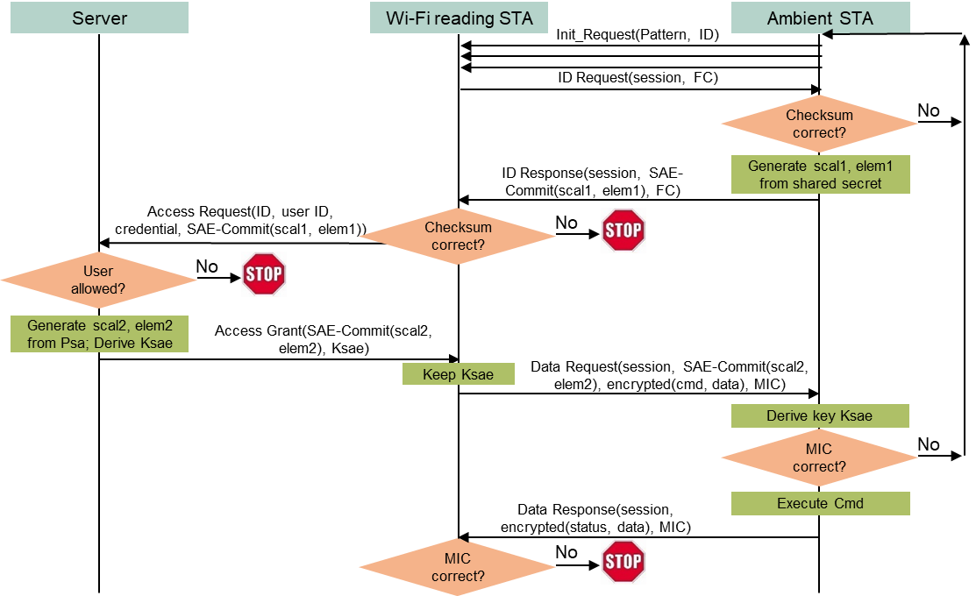
Server-managed AMP device-initiated secure transaction (2)
Assumptions
  The owner’s server and every AMP device share a secret code, which is the foundation of the secure transaction. The reading device cannot know the secret code.
  Every reading device has a user id and a credential managed by the server. The server determines if a reading device can access any AMP device based on such information.
  An AMP device has very limited power, needing to preserve energy as long as possible while sending the Init_Request message.
Solution
  5 message exchanges are needed to finish mutual authentication and encrypted data exchange, with the first Init_Request message being very simple using a special PHY/MAC method to preserve energy.
Notes:
https://unit42.paloaltonetworks.com/iot-threat-report-2020/

Slide 10
Conclusions
Four AMP-initiated secure transaction methods are presented for the combination of these conditions: (1) whether a server is used to dynamically manage a reading device’s right to access an AMP device; and (2) whether an AMP device has sufficient power to send the first message containing more information (thus reducing the number of frame exchanges).
These AMP-initiated secure transaction methods are necessary complement for reading device-initiated secure transaction methods. Now we have a complete set of compact transaction-based secure AMP device communication methods.
All these compact transaction-based secure AMP device communications methods can co-exist with existing layered networking model over current Wi-Fi MAC.
Notes:
https://unit42.paloaltonetworks.com/iot-threat-report-2020/

