Slide 1
Thoughts and Questions on AMP PHY
Date: 2024-05-16
Authors:
Name | Affiliations | email
Pooria Pakrooh | Qualcomm | ppakrooh@qti.qualcomm.com
Steve Shellhammer |  | shellhammer@ieee.org
Bin Tian |  | btian@qti.qualcomm.com

Slide 2
Introduction
Here we make some high-level comments on the AMP Downlink (DL) and Uplink (UL) PHYs
And we ask some question to the Task Group regarding the DL and UL PHYs

Slide 3
Outline
Terminology
Energizer Location
Link Budget
Possible AMP PHY Modes
Signal Bandwidth
  Sub-1GHz and 2.4 GHz
Clock Accuracy
Backscatter Downlink Waveform
Conclusions

Slide 4
Terminology (Used Here)
AMP STA
  This is often referred to as the AMP Tag
  Here we will call it the AMP STA to be consistent with IEEE 802.11 terminology
AMP AP
  This is the device that can read the AMP STA
  In some cases, this might be thought of as the AMP Reader
  This may be a physical AP or a mobile soft AP
AMP Downlink (DL)
  The transmission from the AMP AP to the AMP STA
  This may also be called the wake-up radio (WUR)
AMP Uplink (UL)
  The transmission from the AMP STA to the AMP AP
Note: More discussion on terminology will be likely be needed

Slide 5
Integrated Energizer
Here the AMP AP integrates
  Energizer
  Downlink Transmitter
  Uplink Receiver
The wireless communication links only need to meet the Energizer link budget
AMP AP
AMP Downlink
RF Energy
AMP Uplink
AMP STA

Slide 6
Separate Energizer
AMP AP
AMP Downlink
AMP Energizer
AMP Uplink
RF Energy
AMP STA
Here we have two separate devices to access the AMP STA
  AMP AP (DL TX and UL RX) and a Separate AMP Energizer
  This also includes the case where the energy source is different than RF (e.g., solar or thermal)
The wireless links are no longer constrained by the Energizer link budget

Slide 7
Link Budget
Integrated Energizer
  The Energizer link budget depends on the Energizer TX power and the required power level to harvest that energy at the AMP STA
  As an example, if the TX power is 30 dBm and the required RX power to harvest energy is -25 dBm, then the Energizer Link is limited to around 55 dB
  The DL/UL wireless links only need to meet the Energizer Link Budget or 8.5 dB more if operating in 2.4 GHz
    Path Loss in 2.4 GHz is approximately 8.5 dB higher than in sub-1 GHz
Separate Energizer
  If the AMP AP is separate from the Energizer, then the DL/UL Link Budgets are not limited by the Energizer Link Budget
  Then the DL/UL Link Budgets can be much larger
    For example, depending on the AMP STA capabilities, the DL/UL Link Budgets could be 100 dB or more.
  One possibility in this case, the DL could be handled using 802.11ba and the UL could be handled using 802.11b/n

Slide 8
Possible PHY Modes
There are many possible PHY Modes that could be specified in 802.11bp
  AMP RF Energizer
  AMP Downlink/WUR
  AMP Active Uplink
  AMP Backscatter
There are also different frequency bands to consider
  2.4 GHz
  Sub-1 GHz
It is important to understand which combinations are to be specified by the Task Group

Slide 9
Possible PHY Modes
PHY Mode | 2.4 GHz | Sub-1 GHz
AMP RF Energizer | N/A | ✓
AMP Downlink/WUR | ✓ | ?
AMP Active Uplink | ✓ | ?
AMP Backscatter | ✓ | ?
We would like to hear feedback from the Task Group on who is interested in developing these various PHY Modes
Should the 802.11bp DL/WUR focus on the Integrated Energizer case, at (high /mid) SNR?

Slide 10
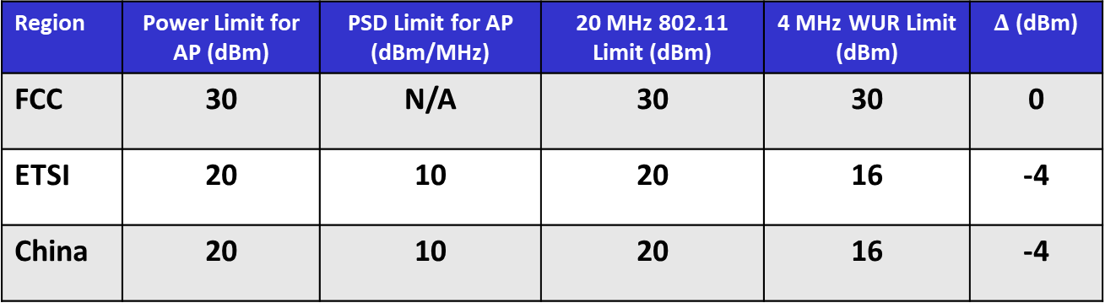
Signal Bandwidth (2.4 GHz)
The 802.11ba WUR Portion Bandwidth is 4 MHz [1, 2]
From [3] we know that the 2.4 GHz Regulations are:
Region | Power Limit for AP (dBm) | PSD Limit for AP (dBm/MHz) | 20 MHz 802.11 Limit (dBm) | 4 MHz WUR Limit (dBm) | $Δ$ (dBm)
FCC | 30 | N/A | 30 | 30 | 0
ETSI | 20 | 10 | 20 | 16 | -4
China | 20 | 10 | 20 | 16 | -4
There maybe some value in increasing above 4 MHz
There are no TX power benefits going beyond 10 MHz

Slide 11
Signal Bandwidth (sub-1 GHz)
In the TIG Report [4] the bandwidths listed, based on regulations in the sub-1 GHz, range from 200 kHz to 1 MHz
It also mentions that several sub-1 GHz signal bandwidths could be supported
There are two possible ways of addressing this topics
  Support 200 kHz Only
  Support Multiple sub-1 GHz Bandwidths
Question to the Task Group
  Should multiple sub-1 GHz bandwidth be supported or just one?
Which sub-1 GHz frequency bands should be supported?
  Communication bands (e.g., like 802.11ah)?
  RFID bands?

Slide 12
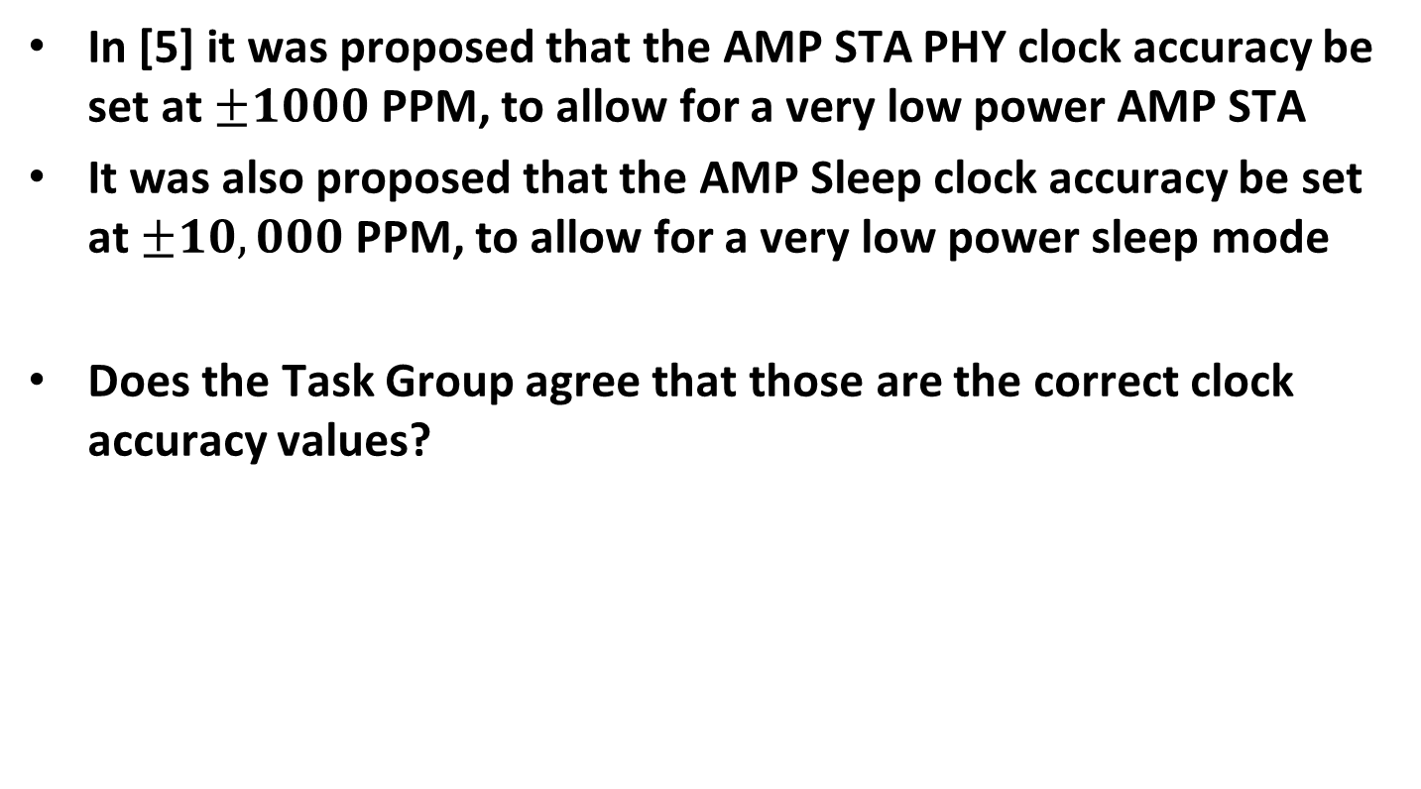
Clock Accuracy
In [5] it was proposed that the AMP STA PHY clock accuracy be set at $±1000$ PPM, to allow for a very low power AMP STA
It was also proposed that the AMP Sleep clock accuracy be set at $±10,000$ PPM, to allow for a very low power sleep mode
Does the Task Group agree that those are the correct clock accuracy values?

Slide 13
Backscatter Downlink Waveform
For cases where the uplink is generated by backscattering a downlink waveform, the Task Group needs to specify the downlink waveform to be back scattered
What downlink waveform should be used in 2.4 GHz to enable the backscatter uplink?
  Should it be the same bandwidth as the AMP Downlink, to meet regulatory requirements?
In the sub-1 GHz should a single carrier DL backscatter waveform be used, due to the narrowband channels?
  Or maybe some other waveform?

Slide 14
Conclusions
Here we have provided some initial thoughts on the AMP PHY for both 2.4 GHz and sub-1 GHz
We have raised some questions for the Task Group to consider and discuss
This will likely result in additional questions we will need to discuss and address

Slide 15
References
IEEE Std 802.11ba, IEEE Standard for Local and Metropolitan Area Networks: Wireless LAN Medium Access Control (MAC) and Physical Layer (PHY) Specifications. Amendment: Wake-up Radio Operation, 2021
Steve Shellhammer, Alfred Asterjadhi, and Yanjun Sun, IEEE 802.11ba: Ultra-Low Power Wake-up Radio Standard, Wiley-IEEE Press, 2023
Steve Shellhammer and Bin Tian, “Regulations and Noise Figure – Impact on SNR,” IEEE 802.11-17/365r0, March 2017
Weijie Xu, et. al., “Technical Report on support of AMP IoT devices in WLAN,” IEEE 802.11-23/2203r1, November 2023
Amichai Sanderovich, Sagi Kupferman, Yuval Amran, “Considerations for AMP Devices,” IEEE 802.11-23/1140r0, July 2023

