Slide 1
Uplink FDM for AMP
May 2024
Doc.: IEEE 802.11-24/0851r1
Date: 2024-05-15
Authors:
Name | Affiliation | Address | Phone | Email
Yinan Qi | OPPO |  |  | v-qiyinan@oppo.com
Weijie Xu
Chuanfeng He

Slide 2
Abstract
Doc.: IEEE 802.11-24/0851r1
In this contribution, we discuss the FDMed channel access for AMP devices to enhance the channel access efficiency

Slide 3
May 2024
Doc.: IEEE 802.11-24/0851r1
Background
The case where the AMP devices occupy the channel for long time should be avoided for backward compatibility
For example, the AMP devices are addressed one by one by the AP.
Channel access efficiency needs to be enhanced to allow more AMP devices to access channel simultaneously
TDM/CDM can be considered for multiplexing
FDM can be supported for active transmission in 20MHz WiFi Channel.
Slide 3
Yinan Qi (OPPO)

Slide 4
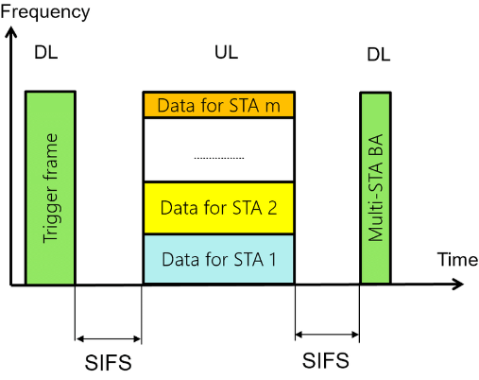
May 2024
Doc.: IEEE 802.11-24/0851r1
Background
In 802.11ax, UORA is proposed as a new feature for random channel access in wireless local area networks (WLANs) [1].
UORA specifically addresses the challenge of efficiently handling random access requests from a large number of devices in crowded wireless environments.
Similar to the legacy random access scheme in WLANs, UORA performs the OFDMA backoff (OBO) procedure.
Slide 4
Yinan Qi (OPPO)

Slide 5
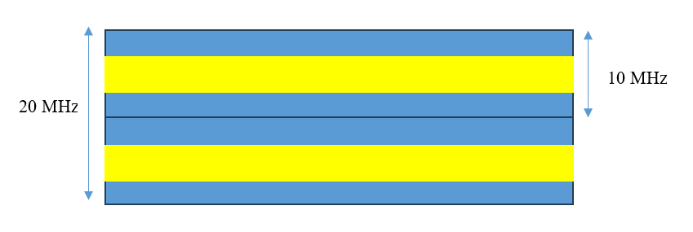
May 2024
Doc.: IEEE 802.11-24/0851r1
Possible FDM Solutions
One 20 MHz channel can be FDMed into 2 sub-channels, each with 10MHz bandwidth, and the number of AMP devices accessing the channel at the same time can be doubled.
In each sub-channel, the AMP frame can occupy only a part of the entire bandwidth of each sub-channel and can be placed in the middle of the sub-channel to reduce adjacent channel interference.
Slide 5
Yinan Qi (OPPO)

Slide 6
May 2024
Doc.: IEEE 802.11-24/0851r1
Possible FDM Solutions
However, FDM is limited by many factors and one of the most important factors is AMP oscillator accuracy.
For example, if the AMP oscillator can only achieve 1000ppm accuracy as aforementioned, when operating at 2.4 GHz the maximum frequency shift can be up to 2.4 MHz in each direction [2].
When sub-channel BW is 5MHz, in the worst case, the AMP frame of one UL transmission can generate severe interference to adjacent UL transmission.
Slide 6
Yinan Qi (OPPO)

Slide 7
May 2024
Doc.: IEEE 802.11-24/0851r1
Possible FDM Solutions
The maximum number of FDM UL transmission can be limited by the equation below,
where B_{AMP} is the bandwidth of AMP frame and f_{Δ} is the maximum frequency shift caused by oscillator inaccuracy.
Slide 7
Yinan Qi (OPPO)

Slide 8
May 2024
Doc.: IEEE 802.11-24/0851r1
Discussions
UORA is expected to be inefficient due to collision especially due to the massive amount of AMP devices:
Each AMP device randomly chooses one RU
When collision happens, AMP devices need to backoff and more energy can be consumed
Scheduled access by AP via FDMed sub-channels, i.e., RUs
No collision thus no need to do backoff
TF needs to carry FDM configuration
More suitable for sensors in the case that AP knows associated AMP devices
Slide 8
Yinan Qi (OPPO)

Slide 9
May 2024
Doc.: IEEE 802.11-24/0851r1
Summary
In this submission, UL FDM for AMP devices is discussed. We have the following observations and conclusions:
FDM can enhance the channel access efficiency by allowing more AMP devices to access the channel simultaneously
UL FDM may be limited by the oscillator inaccuracy
Slide 9
Yinan Qi (OPPO)

Slide 10
Reference
May 2024
Doc.: IEEE 802.11-24/0851r1
[1] Youngboo Kim, Lam Kwon, and Eun-Chan Park, “OFDMA Backoff Control Scheme for Improving Channel Efficiency in the Dynamic Network Environment of IEEE 802.11ax WLANs,” available at https://www.ncbi.nlm.nih.gov/pmc/articles/PMC8347211/
[2] 11-23-1140-00-0amp-considerations-for-amp-devices

