Slide 1
TXOP Bandwidth Expansion Related to Secondary Channel Access
Authors:
Date: 2024-8-19
Name | Affiliations | Address | Phone | email
Jerome Gu | Clourney Semiconductor |  |  | jeg150@clourneysemi.com
Shirley Yin
Jason Sheng

Slide 2
Introduction
The secondary channel access of 11bn has been discussed in several contributions.
  Non-Primary Channel Access [1, 12, 13]
  Secondary channel access and media sychronization. [2, 3]
  (MU-RTS)RTS/CTS, NAV [4, 5]
  RU allocation [6]
  Dynamic Subchannel Operation [7-9]
  Extend the Non-Primary Channel Access to MLO [10]
  TXOP bandwidth expansion [14]
  In this contribution, we would further discuss the TXOP bandwidth expansion problem.

Slide 3
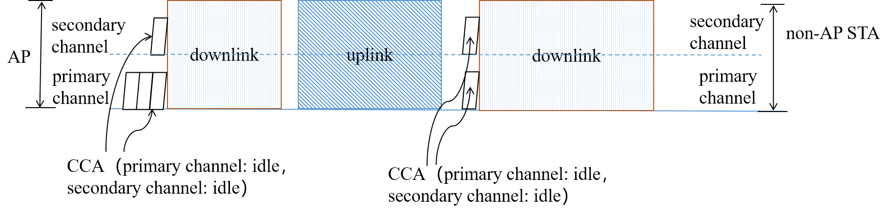
Recap
Channel access with EDCA in primary channel
  EDCA in primary channel and one CCA in both the primary channel and secondary channel before successful channel access.

Slide 4
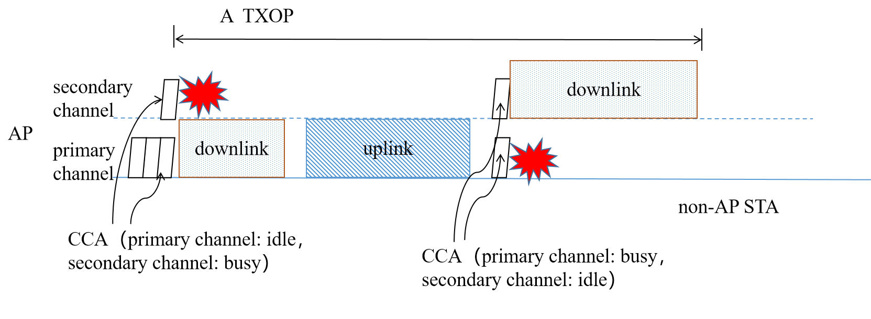
TXOP Bandwidth Expansion Case 1
The AP regains the TXOP with a busy primary channel and an idle secondary channel.
At least one CCA is needed before TXOP bandwidth expansion.

Slide 5
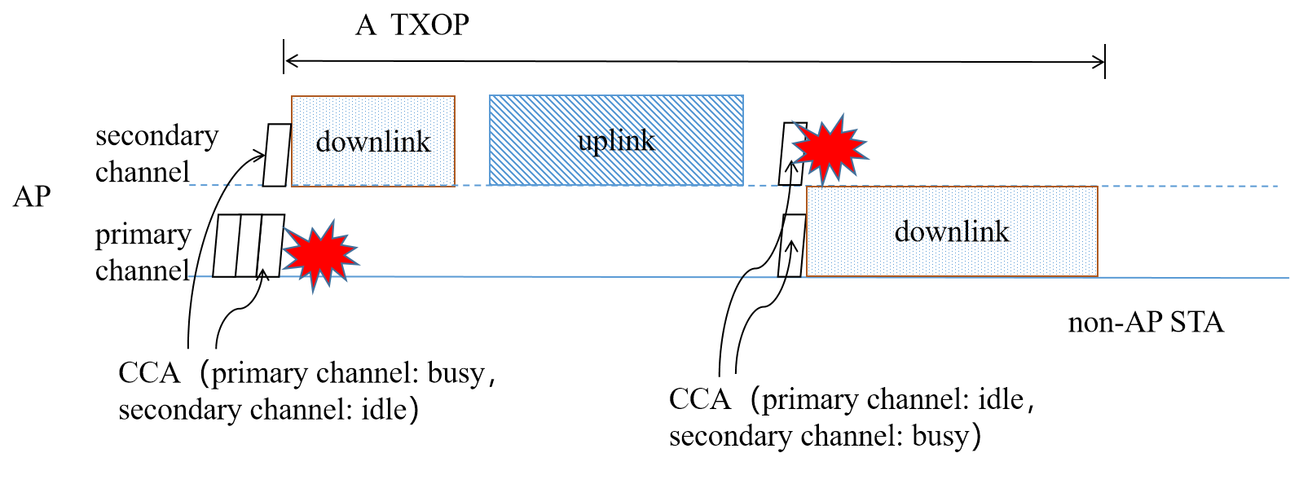
TXOP Bandwidth Expansion Case 2
AP regains the TXOP of secondary channel and expands it to primary channel
One CCA is not adequate for the TXOP switching back to the primary channel, for example, due to loss of media synchronization.

Slide 6
TXOP Bandwidth Expansion in Different TXOP Sharing Modes
TXOP bandwidth expansion can occur when the TXOP holder regains the channel.
  AP-to-STA TXOP Sharing: The AP gains the TXOP, and shares the TXOP to a non-AP STA for its uplink transmission.
  STA-to-STA TXOP Sharing: The AP gains the TXOP, and shares the TXOP to a non-AP STA for its transmission to other STAs.
  AP-to-AP TXOP sharing: The AP gains the TXOP, and shares the TXOP to another AP.
    E.g., the multi-AP coordination case

Slide 7
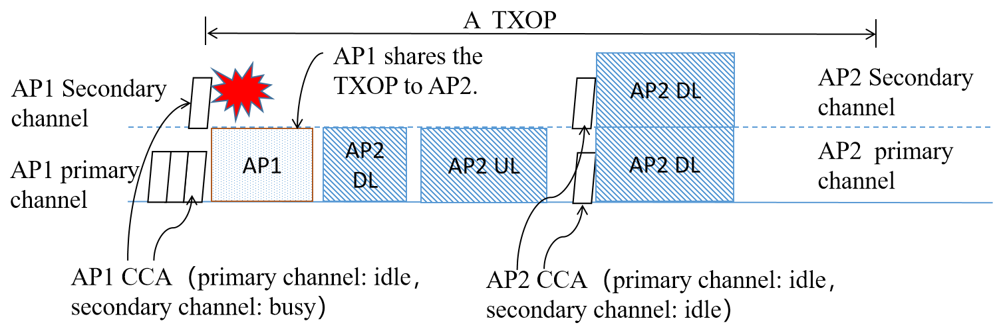
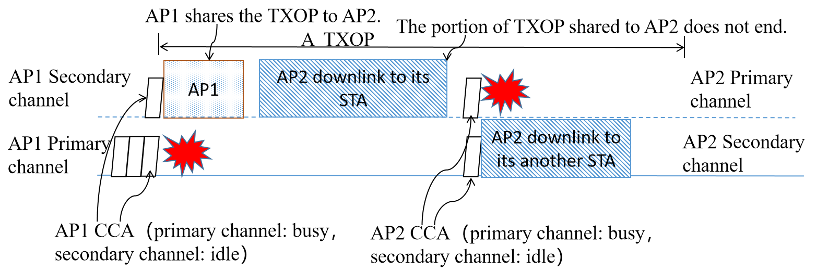
TXOP Bandwidth Expansion in AP-to-AP TXOP Sharing
The primary channel mismatch problem
  AP2 regains the TXOP within a shared TXOP.
The primary channel and secondary channel of AP1 and AP2 overlap.
For AP1 and AP2: The TXOP of primary channel is expanded to secondary channel.
The primary channel and secondary channel of AP1 and AP2 mismatch.
For AP2: The TXOP of primary channel is expanded to secondary channel.
For AP1: The TXOP of secondary channel is expanded to primary channel.

Slide 8
Discussions
The TXOP bandwidth expansion can occur in different TXOP sharing modes.
The TXOP bandwidth expansion scenarios:
  Scenario 1: A TXOP of primary channel is expanded to seconday channel.
  Scenario 2: A TXOP of secondary channel is expanded to primary channel.
  Scenario 1 can recur in scenario 1, or scenario 2 can recur in scenario 2, e.g., when the primary channels overlap in AP-to-AP TXOP sharing.
  Scenario 1 can recur in scenario 2, or scenario 2 can recur in scenario 1, e.g., when the primary channels mismatch in AP-to-AP TXOP sharing.
  A simple and general rule is needed, to enable the TXOP bandwidth expansion.
  Eg., whether to take CCA or back-off before the expansion.
    The NAV of primary channel can be considered for scenario 2.

Slide 9
Summary
The TXOP bandwidth expansion is discussed for the secondary channel accesss problem.
A simple and general rule for TXOP expansion is to be studied.

Slide 10
References
[1] 11-23/0034 Non-primary Channel Utilization
[2] 11-23/1419 Nonprimary Channel Access Discussions
[3] 11-23/1913 Secondary Channel Access Operation
[4] 11-23/0797 Non-primary channel access
[5] 11-23/0961 UHR secondary channel access
[6] 11-23/1935 Secondary Channel Usage Follow Up
[7] 11-22/2204 Dynamic Subchannel Operation
[8] 11-23/2141 Further-discussion-on-dynamic-subband-operation
[9] 11-23/1496 EMLSR Dynamic Subband Operation
[10] 11-23/1365 Discussions on Non-primary Channel Access
[11] 11-23/1865 Discussion on SST and A-PPDU
[12] 11-23/0631 Secondary channel usage and secondary 20MHz channel backoff
[13] 11-23/1951 Concurrent CCA for Non-Primary Channel Access
[14] 11-23/2211 TXOP bandwidth expansion

