Slide 1
Padding Time in Dynamic Power Save
Date: 2024-04-29
Authors:

Slide 2
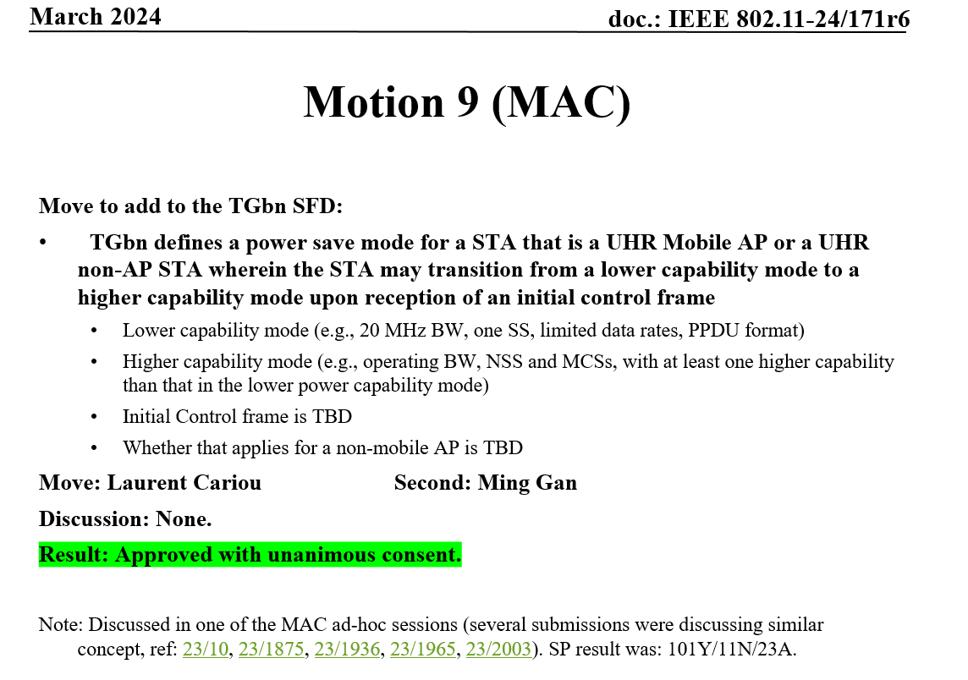
Introduction
Low power listen mode was proposed by [1]. References[2-6] continue to develop the low power listen mode to dynamic power save (DPS) and provide more details.
References[4, 5, 7] propose to add a new Intermediate FCS field before the padding so that the STA can use the padding time to change bandwidth (BW).

Slide 3
Motivation
Compared with EMLSR, dynamic power save introduces bandwidth switching.
Due to the introduction of bandwidth switching, the padding settings need to be reconsidered.
Bandwidth switching requires recalibration of phase-locked loop (PLL) and RF, which takes a longer time [8]. Changing NSS/MCS only takes microseconds, while changing BW takes hundreds of microseconds. (It varies depending on implementation. Low-cost devices take even longer to change BW.)
Changing bandwidth depends on channel conditions and is therefore uncertain.
When considering the setting of the padding time, it is necessary to ensure that the capability switching is completed during the padding time, and it is also expected that the padding time should be as short as possible to achieve low-latency dynamic power save, thus helping DPS to be applied in a wider range of scenarios.
When switching between different capability states, a unified padding time may produce unnecessary delays, because different capability (e.g., BW, NSS, MCS) adjustments require different transition times.

Slide 4
Proposal: Padding Setting Procedure
During the DPS capability reporting period, the STA reports transition delay information, including multiple padding times or a mapping table, for different capability adjustments.
AP performs channel contention before transmitting the Initial Control Frame (ICF).
AP selects one padding time based on channel availability and specific capability changes.
AP transmits ICF with the padding (actual padding time ≥ indicated padding time).
DPS Capability Reporting (Multiple Padding Times)
Channel Contention
Padding Time Selection
Transmitting ICF

Slide 5
Example. Multiple Padding Times
Whether changing bandwidth results in different delays.
[BW, NSS, MCS] Padding time = $D_{1}$
[BW, NSS, MCS] Padding time = $D_{1}$
[BW, NSS, MCS] Padding time = $D_{1}$
[BW, NSS, MCS] Padding time= $D_{2}$
[BW, NSS, MCS] Padding time= $D_{2}$
[BW, NSS, MCS] Padding time= $D_{2}$
[BW, NSS, MCS] Padding time= $D_{2}$
E.g. $D_{1}$=8µs ${ D}_{2}$=512µs

Slide 6
Summary
In this contribution, we consider the setting of padding times to cope with the transition time in dynamic power save.
Changing bandwidth depends on channel conditions and is therefore uncertain. Hence, we propose to set different minimum padding times for different capabilities transition.
STA reports multiple padding times or a mapping table.
Based on the actual situation, AP selects one as the minimum padding time.
Classifying the padding time can reduce unnecessary delays in DPS, thus helping DPS to be applied in a wider range of scenarios.

Slide 7
References
[1] 11-22-1414-00-0uhr-low-power-listening-mode
[2] 11-23-0010-00-0uhr-considerations-for-enabling-ap-power-save
[3] 11-23-1875-01-00bn-power-save-proposal-for-non-ap-mobile-ap
[4] 11-23-2003-00-00bn-client-power-save
[5] 11-23-1965-00-00bn-dynamic-power-save-follow-up
[6] 11-24-0485-00-00bn-low-power-listening-mode-for-clients
[7] 11-23-1873-00-00bn-post-fcs-mac-padding
[8] 11-23-1942-00-00bn-inter-ppdu-low-power-listening-scheme

