Slide 1
Some details on TXOP sharing in C-TDMA
Date: 2024-07-15
Authors:
Name | Affiliation | Address | Phone | Email
Geonhwan Kim | LG Electronics | 19, Yangjae-daero 11gil, Seocho-gu, Seoul 137-130, Korea |  | geonhwan.kim@lge.com
Insun Jang |  |  |  | insun.jang@lge.com
Hongwon Lee |  |  |  | hongwon.lee@lge.com
Jinsoo Choi |  |  |  | js.choi@lge.com
Sunhee Baek |  |  |  | sunhee.baek@lge.com
Yelin Yoon |  |  |  | yl.yoon@lge.com
Dongju Cha |  |  |  | dongju.cha@lge.com
HanGyu Cho |  |  |  | hg.cho@lge.com
Sanggook Kim |  | 10680 Treena St, San Diego CA 92131 , USA |  | sanggook.kim@lge.com

Slide 2
Introduction
In UHR SG and TGbn, specific or rough procedures for C-TDMA have been presented [1–3].
There are several phases in this procedure that are considered either essential or optional.
Since each phase has a different role/purpose, there needs to be a discussion about the appropriate frame type for each phase.
Especially, some frames may be usable not only for C-TDMA but also for other Multi-AP coordination (MAPC) based schemes (e.g., C-SR, C-BF, etc.).
We need to consider selecting or defining an optimal frame with diversity for MAPC.
In this contribution, we discuss in detail the types of frames each AP can send in the C-TDMA procedure and what needs to be considered to transmit them.
TXOP sharing (or Coordination triggering)
TXOP return
Coordination announcement (or Multi-AP selection [3])

Slide 3
Frame exchanges between APs
For Multi-AP negotiation, Management frames (defined as Class 1) may be exchanged between “unassociated” APs.
By receiving beacon frames, each AP obtains information of neighboring APs.
Including MAPC capabilities and MAPC related information
Based on information obtained from beacon frames, a Public Action frame (newly defined) may be used to initiate the Multi-AP set configuration (i.e. negotiation) procedure [3].
In addition, several frames should be exchanged btw APs for MAPC-based Tx.
However, it appears that there is no suitable Class 1 frame that can be used as control frames in the MAPC scheme-specific procedures.
Because the APs participating in MAPC are unassociated with each other.
Therefore, for efficient MAPC operation btw APs, exceptions are required for some Trigger frames classified as Class 3 (e.g. MU-RTS TXS TF, BSRP TF).
To enable transmission to unassociated AP(s) based on specific conditions or state.

Slide 4
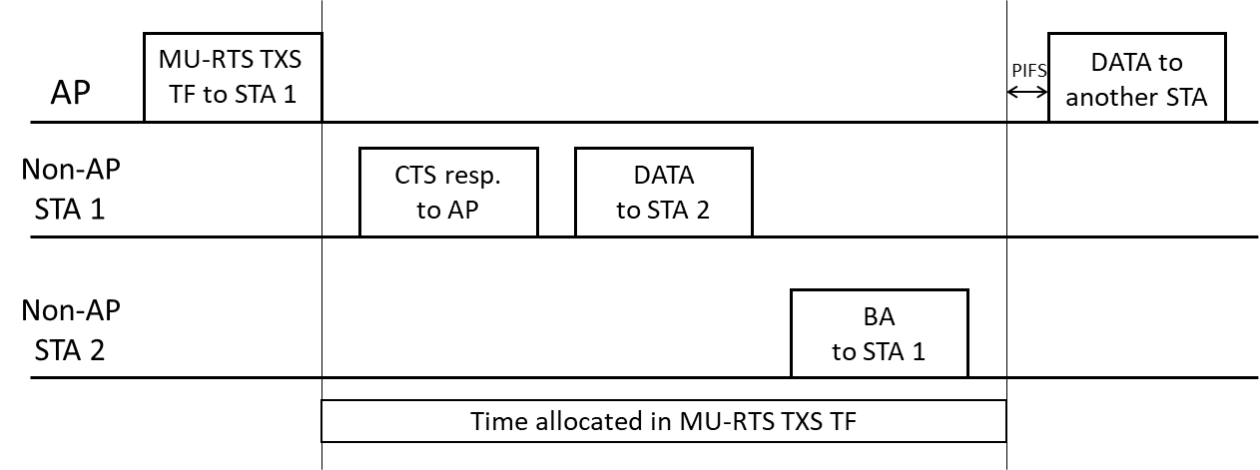
TXOP sharing in C-TDMA (1/2)
C-TDMA is an extension of EHT’s TXOP sharing (TXS) protocol.
In EHT’s TXS, MU-RTS TXS TF is used as a frame for time allocation to STA.
Although MU-RTS TXS TF cannot be transmitted to unassociated STAs, it seems to be the best and simplest way to allocate time to the negotiated AP by reusing MU-RTS TXS TF in C-TDMA.
11bn shall define an exception rule that allows it to be transmitted to the negotiated AP.
This exception allows the sharing AP to send MU-RTS TXS TF to a shared AP.
In addition to the exception rule, the format (e.g., signaling details) of the MU-RTS TXS TF should be considered for C-TDMA based transmission.

Slide 5
TXOP sharing in C-TDMA (2/2)
Duration/ID field
This is important for protection issues and has been discussed in several contributions [4–7].
RA field: should be set to broadcast to follow the baseline
If the Duration/ID field is set to a non-zero value, the RA field can be set to unicast to avoid protection issues [2].
(EHT)Reserved field in Common Info field
If the MU-RTS TXS TF is also used to trigger the transmission of other MAPC schemes, the (EHT)Reserved field can be used to indicate a MAPC scheme type (e.g., C-SR/BF/TDMA..).
AID12 field in User Info field
Instead of the RA field, we can put the local AP ID into the AID12 field to identify negotiated AP(s) [8].
Allocation Duration field in User Info field: reuse
Reserved field in User Info field: can contain new information for C-TDMA
e.g., TXOP Return Indication: Whether the TXOP return is required.

Slide 6
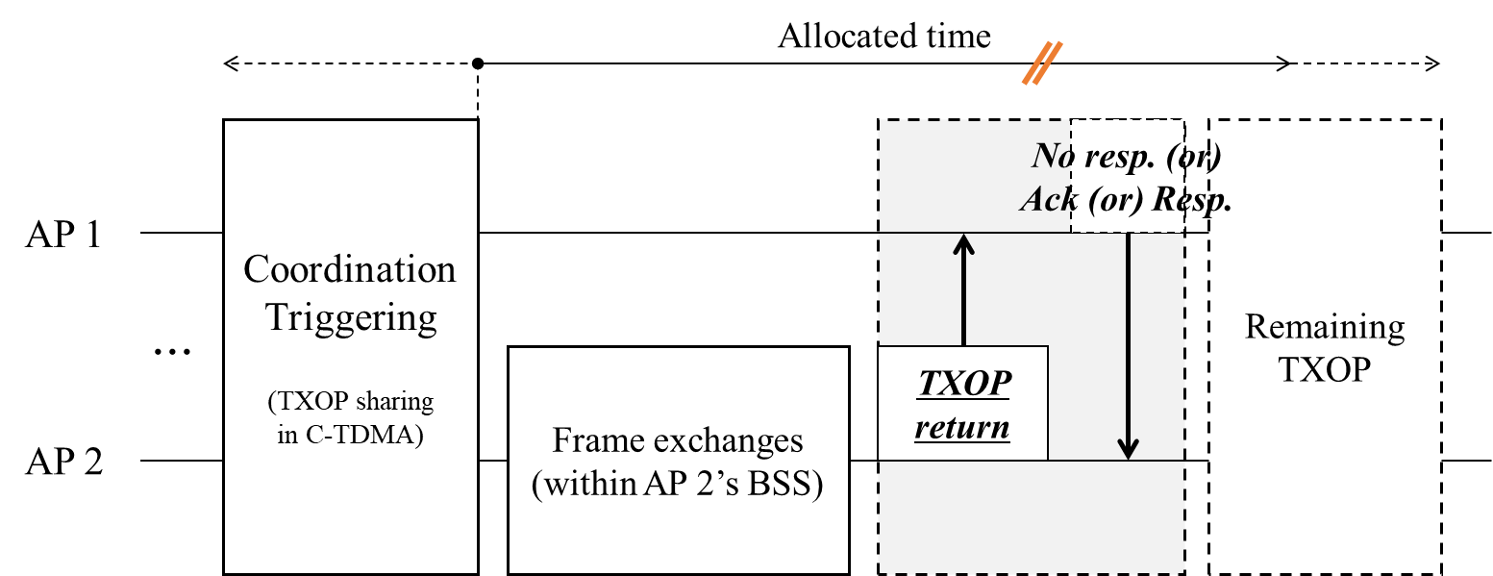
TXOP return in C-TDMA
An AP that has been allocated a time can transmit a TXOP return frame when there is time remaining in the allocated time (or when it indicates the end of the allocated time).
We presented several candidate frames for TXOP return for C-TDMA in [9].
CF-End frame: Allows nearby STAs to immediately invoke backoff by resetting their NAV.
Class 1 frame & low overhead (short frame size & no response frame is needed).
Action frame: Define a new Public Action frame using a reserved value of Public Action field.
MU-RTS TXS TF: If the TXS protocol btw APs is allowed in UHR, MU-RTS TXS TF may be transmitted from the shared AP according to exception rule (as described in slide 4).
(2) and (3) frames can return the remaining TXOP to the sharing AP without causing NAV reset of neighboring STAs.

Slide 7
Coordination announcement in C-TDMA (1/2)
Coordination announcement (or Multi-AP selection) allows a sharing AP to select potential shared AP(s) and announce that a MAPC based TX is scheduled [3].
Additionally, this procedure allows potential shared AP(s) to report their short-term traffic requirements and the need for time allocation.
If all of the potential shared APs report that MAPC is not required or do not respond, the sharing AP performs only individual frame exchanges.
i.e., the sharing AP can recognize in advance whether MAPC based TX is needed/available.
If at least one AP responds, the sharing AP performs a TXS to that AP for C-TDMA based transmission.
* CA (Coordination announcement)

Slide 8
Coordination announcement in C-TDMA (2/2)
Opt 1) MU-RTS (TXS) TF may also be used for CA frame if TXS btw APs is allowed.
In this case, an Indication field may be added to distinguish each procedure in C-TDMA.
However, information related to MAPC cannot be included in the response frame.
Moreover, only a limited number of negotiated APs can respond, and the sharing AP can only roughly know whether they have responded or not.
Opt 2) BSRP TF is useful for getting additional info. from potential shared AP(s).
Potential shared AP(s) may respond with an Action (or) Multi-STA BA frame containing their intent to participate and additional information about MAPC operation.
Information related to MAPC may be included in the BSR Control field (modified) or in the frame body of an Action frame.
Alternatively, a Multi-STA BA frame can be sent in response to a BSRP TF [10].
Then the sharing AP may adjust its triggering schedule based on what is obtained from potential shared AP(s). (e.g., intent to participate, LLT requirements, etc.)
Opt 3) New TF
A common/unified TF for MAPC may be newly defined for the purpose of selecting shared AP(s) or announcing MAPC-based transmission.
* CA (Coordination announcement)

Slide 9
Summary
In this contribution, we discussed in detail the types of frames that an AP(s) participating in MAPC can transmit in each C-TDMA procedure.
By analyzing the specific sequences of C-TDMA in detail, it is possible to implement the C-TDMA protocol by reusing existing frames as much as possible.
For efficiency and scalability,
In Coordination announcement, BSRP TF can be transmitted from the sharing AP;
The coordination announcement frame can serve as an initial control frame for MAPC.
Negotiated AP(s) may respond with Action (or) Multi-STA BA frame.
In TXOP sharing, MU-RTS TXS TF can be reused identically to the TXS of EHT.
In TXOP return, (Public) Action frame can be transmitted from the time allocated AP.

Slide 10
References
[1] 23/0739r1, “Follow-up on Coordinated TDMA (C-TDMA)”
[2] 23/1895r2, “Coordinated TDMA (C-TDMA) Follow-up”
[3] 23/1912r1, “Coordinated TDMA Procedure”
[4] 23/0249r1, “Extended TXOP Sharing”
[5] 23/0093r2, “C-TDMA Follow-up”
[6] 23/1910r1, “Coordinated TDMA (Follow up)”
[7] 24/0227r1, “TXOP Protection in C-TDMA”
[8] 24/0842r0, “Multi-AP set configuration for C-TDMA”
[9] 24/0411r0, “TXOP Return in C-TDMA”
[10] 24/834r0, “Some Details on In-Device Coexistence”

Slide 11
Straw Poll 1
Do you agree to add the following text to the TGbn SFD?
As part of the C-TDMA procedure, a sharing AP shall send a MU-RTS TXS Trigger frame to another AP to share a time portion of its TXOP.

Slide 12
Straw Poll 2
Do you agree to add the following text to the TGbn SFD?
As part of the C-TDMA procedure, TGbn defines a mechanism for an AP, that received a time portion of a TXOP from a sharing AP, to return the remainder of the allocated time (if any) back to the sharing AP.
Signaling details are TBD.

