Slide 1
TGbp Timeline Discussion
May 2024
Date: 2024-05-12
Authors:
Name | Affiliations | Address | Phone | Email
Lei Huang | Huawei | Singapore |  | lei.huang1@huawei.com
David, Xun Yang |  | Shenzhen, China
Notes:
September 2012

Slide 2
Introduction
May 2024
This contribution intends to trigger the discussion on TGbp timeline.
We think TGbp timeline should be similar to TGbf timeline in terms of project scope and number of expected active contributors

Slide 3
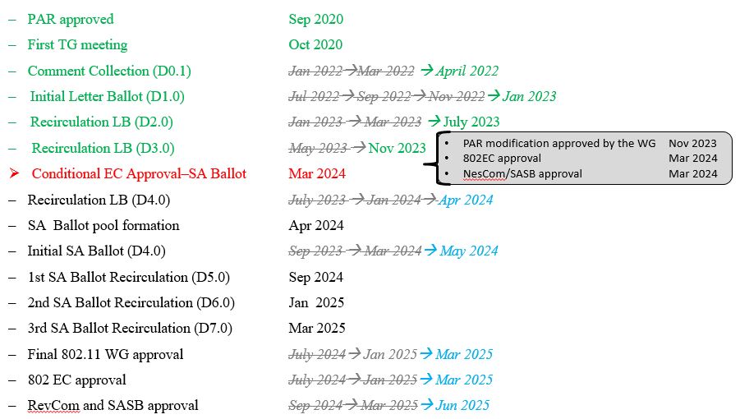
Recap: TGbf Timeline [1]
May 2024
18 months
9 months
6 months
4 months
5 months

Slide 4
Proposed TGbp Timeline
May 2024
PAR approved Mar 2024
First TG meeting May 2024
Comment Collection (D0.1) Sep 2025
Initial Letter Ballot (D1.0) May 2026
Recirculation LB (D2.0) Nov 2026
Recirculation LB (D3.0) Mar 2027
Recirculation LB (D4.0) Jul 2027
Initial SA Ballot (D4.0) Sep 2027
Final 802.11 WG approval May 2028
802 EC approval May 2028
RevCom and SASB approval July 2028
16 months
8 months
6 months
4 months
4 months

Slide 5
References
May 2024
[1] 11-24-0239-13-00bf-tgbf-meeting-agenda-2024-03-plenary

