Slide 1
System-Level Evaluation of Coordinated Spatial Reuse
Date: 2024-07-14
Authors:

Slide 2
Introduction
Multi-AP coordination is a candidate feature for TGbn as a technology to realize the several objectives and use cases of UHR [1].
Coordinated Spatial Reuse (SR) is a candidate technology to improve throughput in multiple BSS environments, and many link-level evaluation results show good performance for various scenarios [2-4].
However, only link-level simulation is difficult to evaluate, including the following points:
Collision between APs
MCS Selection
Hidden node
This contribution presents the results of system-level simulation evaluation of Coordinated SR considering the above points.

Slide 3
(Recap) Coordinated Spatial Reuse Protocol
APs measure interference links for SINR estimation in advance [5]
Sharing AP (AP that obtains TXOP) negotiates with Shared APs (other APs) and determines Tx Power of all APs based on the STA's SINR estimate. Start concurrent transmission [6]
After negotiation, APs may not start concurrent transmission and only Sharing AP may start transmission for some reasons (e.g, AP2’s channel condition is busy, AP2 must decrease Tx power too much, etc)
AP1’s TXOP
AP2’s TXOP
Measurement
Phase
Negotiation
Step
Negotiation
Step
AP1
DATA Tx
DATA Tx
AP2
DATA Tx
DATA Tx
time
AP1
AP2
Transmit power
control
Transmit power
control
AP1
AP2
AP1
AP2
Interference Link Measurement
Required
SINR
Adequate
SINR
Required
SINR
Adequate
SINR

Slide 4
Simulation Topology
Simulation topology is the following 2 APs scenario
Distance(D) between APs is 15m/20m/25m. Radius(R) of the cell is D * 0.33
APs can detect each other at PD-level (-82dBm/20MHz), but not at ED-level (-62dBm/20MHz) from 80MHz data signal. This can cause collision between APs sometimes.
2 STAs are dropped randomly within the cell for each BSS.
An AP has DL full traffic to 1 STA in each BSS.
The other STA in BSS may have UL traffic (CBR 1Mbps) to an AP which it associates with.
I evaluated both “non-UL Traffic case” and “UL Traffic scenario” to evaluate the impact of hidden node.
In the UL traffic scenario, AP may have an OBSS STA with UL traffic that is not detectable at the PD level (Hidden Node), which solicits collisions between APs.
As D increases, the probability of hidden nodes increases.
AP1
D
AP2
R

Slide 5
MCS Selection Method
MCS selection in this simulation is “Genie”.
AP manages two types of MCS for each STA: Regular MCS and Coordinated MCS.
Regular MCS means AP set MCS without considering the interference level from OBSS AP.
Typically, AP can set high MCS (from estimated SNR level) because it assumes other AP detects its own signal and set NAV properly.
However, in some cases, for some reason collisions occur more frequently, so APs set lower MCS (that gives higher throughput than setting MCS from estimated SNR level).
Coordinated MCS means AP set MCS with considering the interference level from OBSS AP.
Coordinated MCS is determined from estimated SINR level on each Tx power for each AP
Tx power for each AP is determined by coordination type (detail from the next slide)

Slide 6
Comparison(1/2)
Baseline: Conventional TDMA
After obtaining TXOP, Sharing AP starts its data transmission at max Tx power / Regular MCS without negotiation to other AP.
Other AP suspends its data transmission if it can detect the signal from Sharing AP.
Coordination Level 1: Only Negotiation
After obtaining TXOP, Sharing AP negotiates with other AP to determine its own MCS.
If negotiation is successful, it starts data transmission at max Tx power / Coordinated MCS.
Otherwise, it starts its data transmission at max Tx power / Regular MCS.
Other AP suspends its data transmission if it can detect the signal from Sharing AP.

Slide 7
Comparison(2/2)
Coordination Level 2: Coordinated SR w/o TPC
After obtaining the TXOP, Sharing AP negotiates with other AP to determine whether to start concurrent transmission with other AP.
If negotiation is successful, it starts concurrent transmission at max Tx power / Coordinated MCS.
Otherwise, it starts its data transmission at max Tx power / Regular MCS.
For other AP, ..
If negotiation is successful, it starts concurrent transmission at max Tx power / Coordinated MCS.
Otherwise, it suspends its data transmission if it can detect the signal from Sharing AP.
Coordination Level 3: Coordinated SR w/ TPC
Same operation as Coordinated SR w/o TPC, other than Sharing AP and Shared AP use each Pre-determined Tx power for concurrent transmission.
The “Pre-determined Tx power” is calculated form pre-measured interference link information so that Sharing AP meets the target SINR at the STA which Sharing AP transmits data to.
In this simulation, target SINR is set to use max MCS calculated by SNR.

Slide 8
Simulation Parameters
Parameters
BW: 80 MHz
Channel: AWGN
Tx/Rx Ant = 1
Uniform pathloss exponent of 3.5
MCS: 0-11
Assumption
Test in the case of inaccurate CSI with 3db backoff when SNR estimation.
There is no time-varying channel (doppler frequency = 0Hz)
Criteria
System Throughput (Total throughput value of each STA). Throughput gain is calculated at point at cdf = 0.05/0.50/0.95.
7 dB Noise Figure
100 Drops
HE PPDU, long GI (1.6us), 256 Aggregation
Max Tx power = AP: 21dBm, STA:15dBm
Sounding Interval = 200ms
RTS/CTS: Enabled

Slide 9
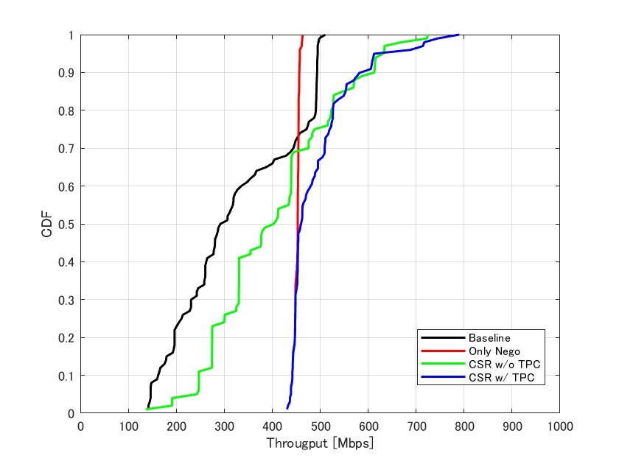
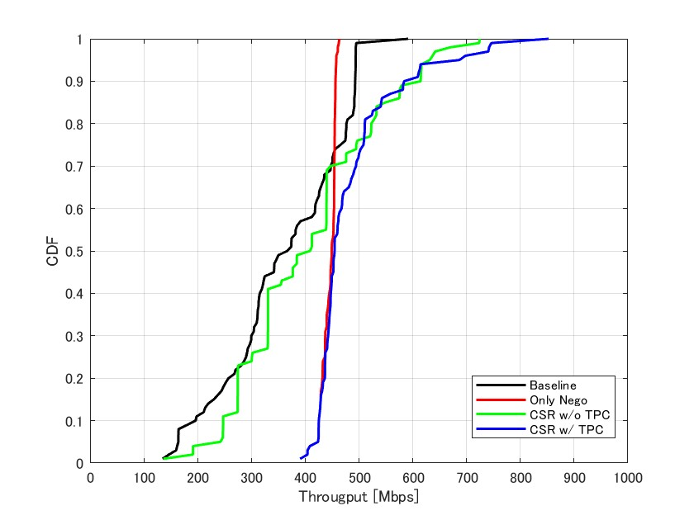
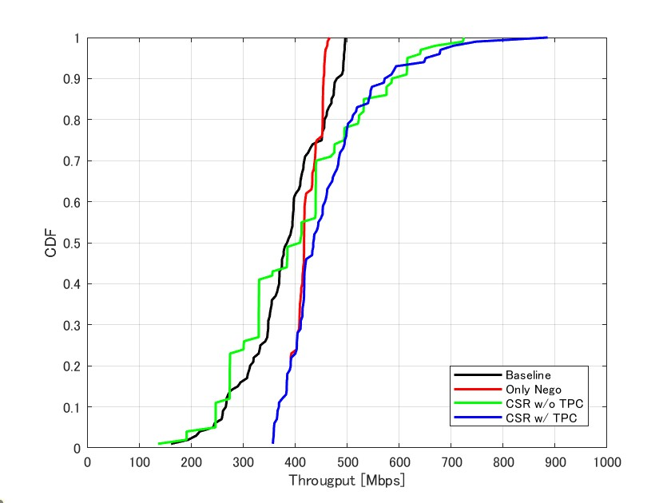
Simulation Results.1 (No UL Traffic Scenario)
D=15m
D=20m
D=25m
Throughput Gain | Only Nego | CSR w/o TPC | CSR w/ TPC
5%-tile | x3.00 | x1.66 | x3.00
mean | x1.55 | x1.38 | x1.58
95%-tile | x0.92 | x1.28 | x1.39
Throughput Gain | Only Nego | CSR w/o TPC | CSR w/ TPC
5%-tile | x2.58 | x1.48 | x2.58
mean | x1.22 | x1.11 | x1.24
95%-tile | x0.92 | x1.28 | x1.39
Throughput Gain | Only Nego | CSR w/o TPC | CSR w/ TPC
5%-tile | x1.48 | x1.02 | x1.48
mean | x1.08 | x1.06 | x1.13
95%-tile | s0.93 | x1.25 | x1.32
In No UL traffic scenario, the performance of Coordinated SR with Tx power control can achieve throughput gain stably and no degradation from Baseline was observed.

Slide 10
Observation.1
The benefit of concurrent transmission between APs (CSR without TPC, CSR with TPC) becomes apparent around the 95%-tile.
STAs with high SINR can receive high MCS data even if multiple APs transmit data concurrently, depending on their location. This is a major factor in increasing throughput gain.
In this situation, the gain from only negotiation is not visible, and conversely, the additional frame exchange may result in worse performance than Baseline.
The benefit of negotiation between APs (Only Negotiation, CSR with TPC) becomes apparent around the 5%-tile.
Non-coordination is prone to collisions between APs, especially when they cannot detect each other’s by ED.
When Regular MCS is high to increase data rate, many packet collisions decreases the throughput.
When Regular MCS is low to avoid packet collision, low data rate decreases the throughput.
Therefore, pre-negotiation prevents interference from OBSS AP and selecting higher MCS is more likely to improve throughput.

Slide 11
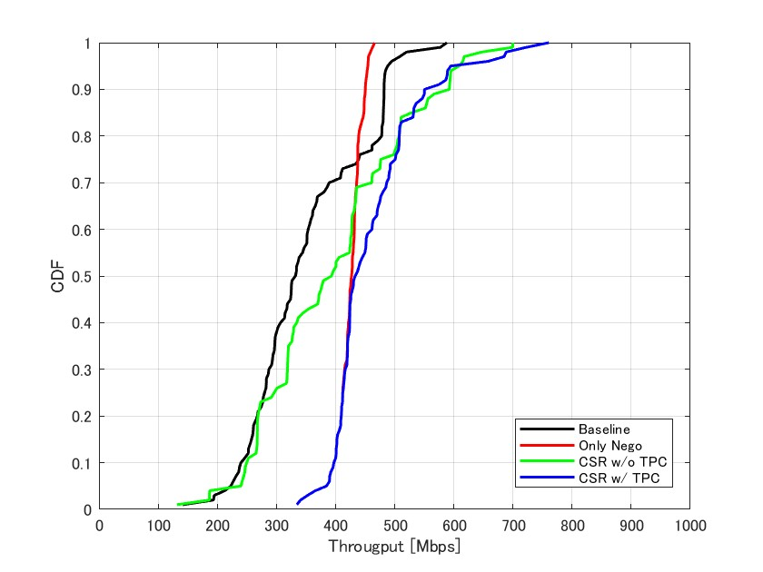
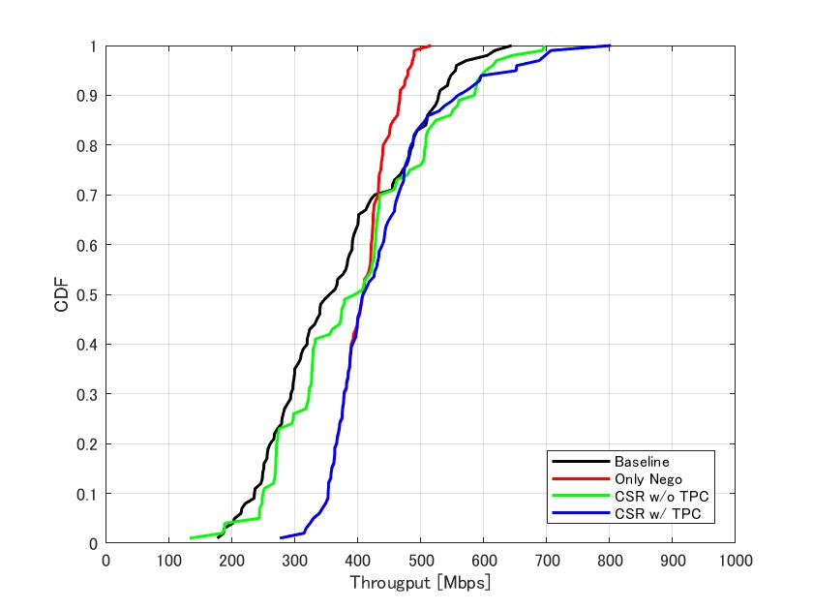
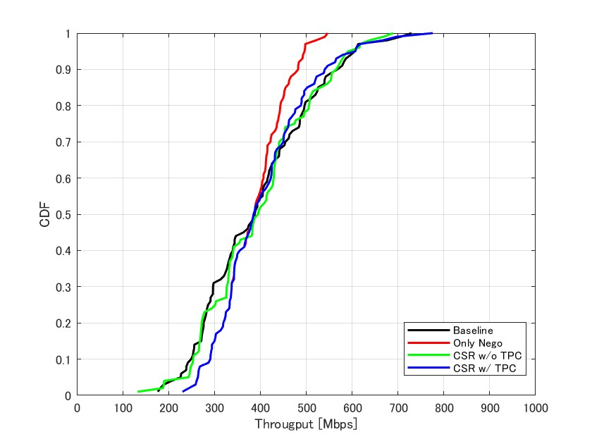
Simulation Results.2 (UL Traffic Scenario)
D=25m
D=15m
D=25m
D=15m
D=20m
D=20m
Throughput Gain | Only Nego | CSR w/o TPC | CSR w/ TPC
5%-tile | x1.73 | x1.08 | x1.73
mean | x1.29 | x1.18 | x1.30
95%-tile | x0.93 | x1.25 | x1.22
Throughput Gain | Only Nego | CSR w/o TPC | CSR w/ TPC
5%-tile | x1.61 | x1.19 | x1.61
mean | x1.15 | x1.11 | x1.16
95%-tile | x0.86 | x1.09 | x1.17
Throughput Gain | Only Nego | CSR w/o TPC | CSR w/ TPC
5%-tile | x1.17 | x1.08 | x1.17
mean | x0.99 | s1.02 | x0.99
95%-tile | x0.82 | x0.98 | x1.00
In UL traffic scenario, the performance of Coordinated SR with Tx power control can still achieve throughput gain comparing Baseline while getting closed to Baseline if D increases.

Slide 12
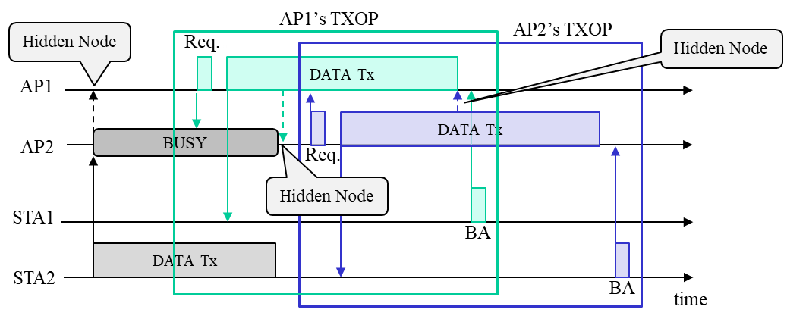
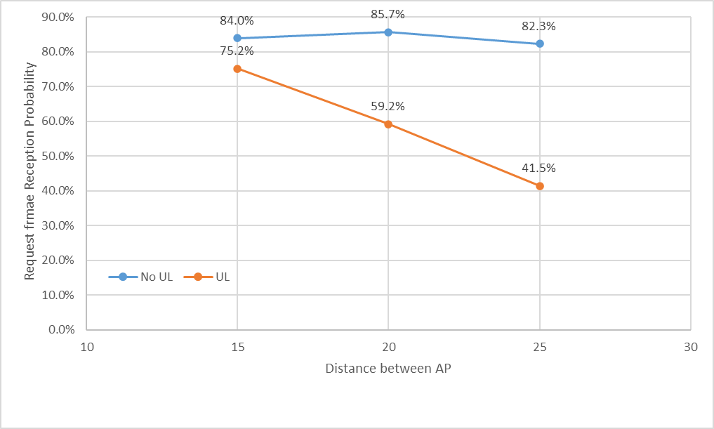
Observation.2
As the distance between APs increases, the likelihood of the hidden node condition (where AP cannot detect signals from OBSS STA) increases, reducing opportunities for coordination.
To increase the effectiveness of Coordinated SR, methods to increase opportunities for coordination are needed.
For example, setting R-TWT SP to initiate coordination [7]
Coordination Response Acquisition Rate

Slide 13
Summary
We evaluated performance of Coordinated SR using system-level simulation.
In no UL traffic scenario, the performance of Coordinated SR with Tx power control can achieve throughput gain stably and no degradation from Baseline was observed.
The benefit of concurrent transmission between APs (CSR without TPC, CSR with TPC) becomes apparent around the 95%-tile from concurrent transmission with high MCS.
The benefit of negotiation between APs (Only Negotiation, CSR with TPC) becomes apparent around the 5%-tile from collision avoidance between APs .
In UL traffic scenario, the performance of Coordinated SR with Tx power control can still achieve throughput gain comparing Baseline while getting closed to Baseline if D increases.
To increase the effectiveness of Coordinated SR more, methods to increase opportunities for coordination are needed.

Slide 14
References
[1] Laurent Cariou (Intel), “UHR proposed PAR,” 23/0480r3, July 2023
[2] Kosuke Aio (Sony Group Corporation), “Recap on Coordinated Spatial Reuse Operation,” 22/1822r0, November 2023.
[3] Gary Anwyl (MediaTek), “Coordinated Spatial Reuse in a 4 AP Topoplogy,” 23/1023r2, July 2023
[4] Kanke Wu (Qualcomm), “Performance of Coordinated Spatial Reuse,” 23/1037r0, July 2023
[5] Kosuke Aio (Sony Corporation), “Coordinated Measurement,” 23/0668r2, August 2023.
[6] Kosuke Aio (Sony Corporation), “Overhead Analysis of Coordinated Spatial Reuse,” 23/0616r0, May 2023.
[7] Laurent Cariou (Intel), “r-TWT for multi-AP follow up,” 23/2022r1, January 2024.

Slide 15
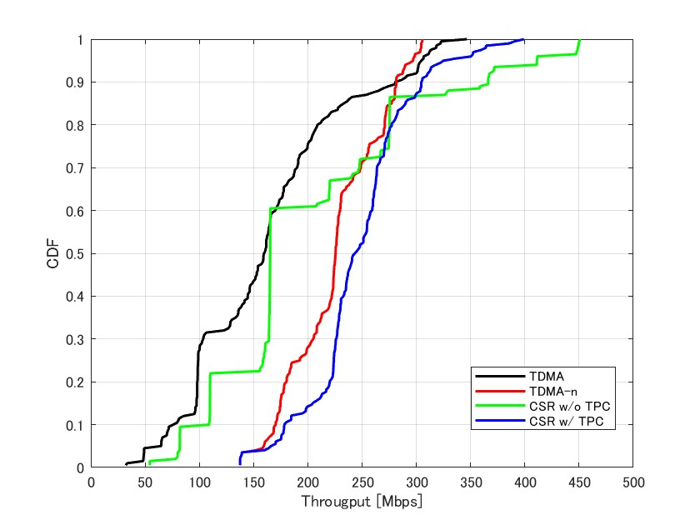
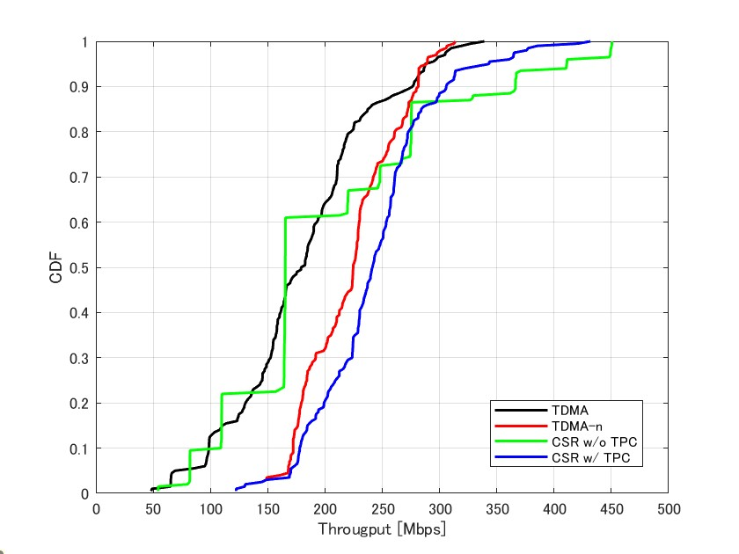
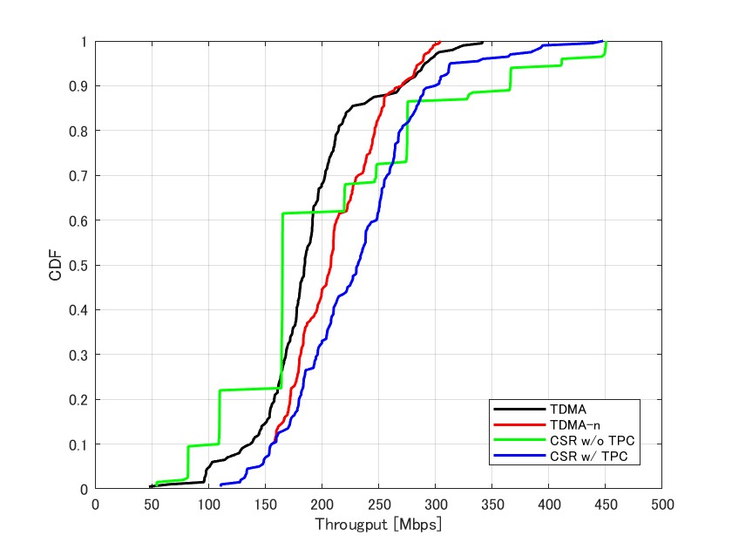
Appendix.1: Each Throughput of STA (No UL Traffic)
D=15m
D=20m
D=25m
Throughput Gain | TDMA-n | CSR w/o TPC | CSR w/ TPC
5%-tile | x1.97 | x0.96 | x1.94
mean | x1.47 | x1.06 | x1.39
95%-tile | x0.91 | x1.13 | x1.22
Throughput Gain | TDMA-n | CSR w/o TPC | CSR w/ TPC
5%-tile | x2.43 | x1.18 | x2.46
mean | x1,.25 | x0.92 | x1.35
95%-tile | x1.01 | x1.43 | x1.19
Throughput Gain | TDMA-n | CSR w/o TPC | CSR w/ TPC
5%-tile | s1.43 | x0.81 | x1.43
mean | x1.12 | x0.89 | x1.25
95%-tile | x0.99 | x1.41 | x1.08

Slide 16
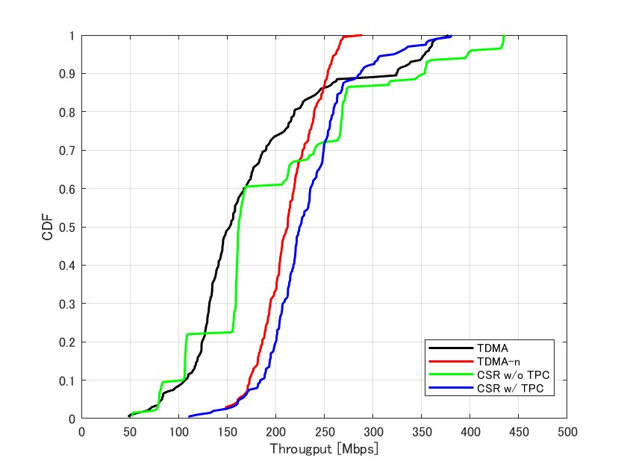
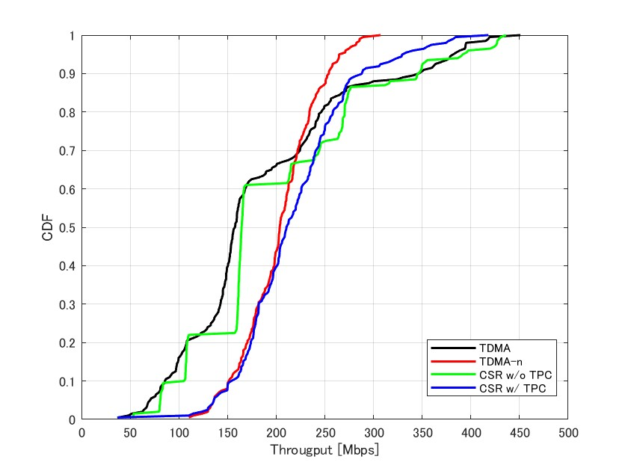
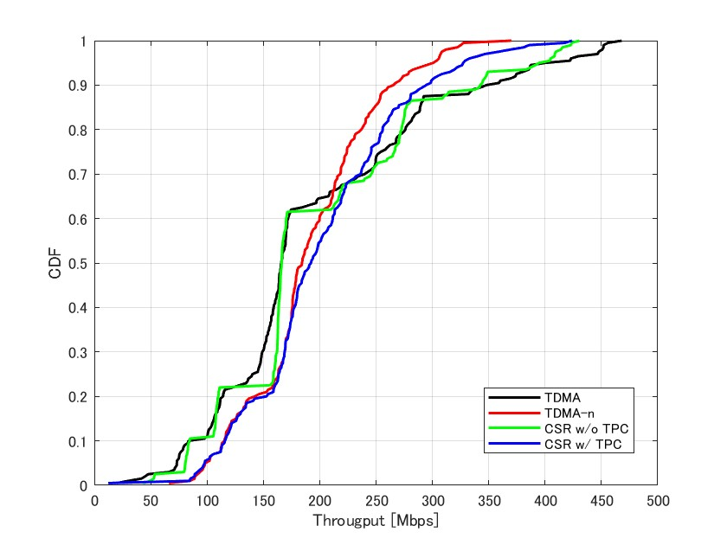
Appendix.2: Each Throughput of STA (UL Traffic)
D=15m
D=20m
D=25m
Throughput Gain | TDMA-n | CSR w/o TPC | CSR w/ TPC
5%-tile | x1.97 | x0.97 | x1.97
mean | x1.39 | x1.06 | x1.47
95%-tile | x0.74 | x1.13 | x0.91
Throughput Gain | TDMA-n | CSR w/o TPC | CSR w/ TPC
5%-tile | x1.93 | x1.15 | s1.93
mean | x1,.30 | x1.04 | x1.34
95%-tile | x0.69 | x1.03 | x0.89
Throughput Gain | TDMA-n | CSR w/o TPC | CSR w/ TPC
5%-tile | x1.34 | x1.10 | x1.33
mean | x1.11 | x1.00 | x1.16
95%-tile | x0.75 | x0.99 | x0.82

