Slide 1
Indication of Use Case in 11bn
Date: 2024-3-DD
Authors:
Name | Affiliations | Address | Phone | e-mail
Akira Kishida | NTT | 1-1, Hikarinooka Yokosuka-Shi, Kanagawa 239-0847, Japan | +81-46-859-2093 | akira.kishida@ntt.com
Yusuke Asai | NTT
Yasushi Takatori | NTT

Slide 2
Introduction
In TGbn, various technologies to achieve KPIs in the PAR[1] and use cases in the CSD[2] are actively being discussed.
  E.g., multi-AP coordination (coordinated R-TWT and coordinated TDMA, etc) [3]-[12], preemption [13][14], TXOP sharing enhancement [15][16].
The effectiveness of those technologies strongly depends on the operating use case because the reliability requirement is different according to each use case[17][18].
  Unlike previous amendments before 11be, 11bn (UHR) aims to achieve both throughput and reliability and the features that we should deploy depend on the environment and the use case.
In this contribution, we discuss the indication of the use case to utilize 11bn features more effectively.

Slide 3
Use case dependent 11bn features
In specific use cases such as industrial automation [19], supporting traffic type for controlling AGV (Automated Ground Vehicle) or AMR (Autonomous Mobile Robot) should be required in addition to video transmission.
  In such use cases, network type will be managed network [20] or private network, and coordinated control (e.g., multi-AP coordination, coordinated TDMA) or collision-free access control (e.g., preemption, TXOP sharing enhancement) will be effective.
On the other hand, connectivity enhancement (e.g., rate-vs-range, hitless handover) based on existing EDCA mechanisms will be important in use cases such as apartments, residents, or public places like stations and plazas.
  Complex coordination controls or collision-free access might cause fairness issues or connectivity degradation in such environments.

Slide 4
Indication of use case in 11bn
If the identification of the use case would be realized, appropriate 11bn features could be applied.
  Knowing the use cases of BSS and OBSS would help apply appropriate 11bn features to operate.
If an AP can notify the use case and network type (e.g., managed or public) and an STA can indicate its STA type (e.g., AGV or AMR), the following advantages will be realized.
  Appropriate selection of 11bn features considering the environment.
    By knowing what type of use cases are operated, specific 11bn features can be determined whether to use.
  Efficient use of frequency resources by compartmentalization of managed and public networks.
    For instance, if the use case of the BSS is industrial automation and handles latency sensitive traffic, the other BSSs can avoid using the channels or links that the BSS utilizes by knowing its use case.
  Optimization of parameters according to the use case by defining the parameter set for each use case.
    This can reduce indication information size and avoid bloating management frames.

Slide 5
Discussion on indication mechanism
There are several possible mechanisms to indicate the use case.
Option 1: reuse and extend the existing information elements (IEs).
  11u defined an Interworking element, indicating access network type and detailed use cases (venue group).
    This IE is intended to interact with external networks and is used for Passpoint (Hotspot 2.0).
    However, this IE can be reused to inform the use case for 11bn features.
  11ah defined Update EDCA Info field in EDCA Parameter Set element to override EDCA parameter set for specific STA type (i.e., sensor STA).
    There is room for consideration in extending this field to indicate STA types other than sensor STA.
Option 2: define a new information element or signaling mechanism.
  The information element regarding the indication of the use case and the network type could be defined in TGbn.
    This IE is assumed to be included in the Beacon frame, Probe Request, and Probe Response frame.
    Including KPIs and requirements for those KPIs together in this IE would help to enhance reliability.

Slide 6
Summary
Unlike previous primary amendments, IEEE 802.11bn aims to improve reliability, and the reliability requirement is different according to each use case.
The effectiveness of various technologies discussed in TGbn depends on use cases and environments.
  Indicating the use case leads to applying appropriate 11bn features.
Possible mechanisms of the indication are discussed.

Slide 7
SP
Do you agree that indicating the use case is beneficial in 11bn?
  -Yes
  -No
  -Abstain

Slide 8
Reference
[1] Laurent Cariou, et al., “UHR proposed PAR,” IEEE 802.11-23/0480r3
[2] Laurent Cariou, et al., “IEEE 802.11 UHR Proposed CSD,” IEEE 802.11-23/0079r10
[3] Arik Klein, et al., “M-AP Coordinated Transmission framework,” IEEE 802.11-23/1871r2
[4] Yanchun Li, et al., “Discussion on UHR enhanced channel access,” IEEE 802.11-23/1973r0
[5] Laurent Cariou, et al., “R-TWT for Multi-AP,” IEEE 802.11-23/0297r0
[6] SunHee Baek, et al., “R-TWT Coordination in Multi-BSS,” IEEE 802.11-23/1916r1
[7] Liuming Lu, et al., “Coordinated R-TWT for Multi-AP scenarios - Follow up,” IEEE 802.11-23/1952r1
[8] Jeongki Kim, et al., “Discussion on Enhanced R-TWT for UHR,” IEEE 802.11-23/2084r0
[9] Xiangxin Gu, et al., “R-TWT protection in 11bn,” IEEE 802.11-23/2212r0
[10] Liuming Lu, et al., “Multi-AP Coordination for Low Latency Traffic Delivery,” IEEE 802.11-23/1556r1
[11] Abhishek Patil, et al., “Coordinated TDMA (C-TDMA) Follow-up,” IEEE 802.11-23/1895r2
[12] Geonhwan Kim, et al., “Coordinated TDMA Procedure,” IEEE 802.11-23/1912r0
[13] Giovanni Chisci, et al., “Preemption techniques to meet low-latency (LL) targets,” IEEE 802.11-23/1886r1
[14] Kiseon Ryu, et al., “TXOP Preemption Follow Up,” IEEE 802.11-23/1174r0
[15] Sindhu Verma et al., “Reverse TXOP sharing,” IEEE 802.11-23/1874r0
[16] Dibakar Das et al., “TXOP optimizations to support XR use-cases,” IEEE 802.11-23/1387r0
[17] Inaki Val, et al., “High Criticality Use Cases and Requirements,” IEEE 802.11-23/1834r0
[18] Brian Hart, et al., “Overview of Enterprise Policy and Goals,” IEEE 802.11-23/2026r0
[19] Akira Kishida, et al., “Considerations on UHR PAR and KPIs,” IEEE 802.11-22/1919r4
[20] Inaki Val, et al., “Managed Networks under highly congested scenarios,” IEEE 802.11-23/1920r2

Slide 9
APPENDIX

Slide 10
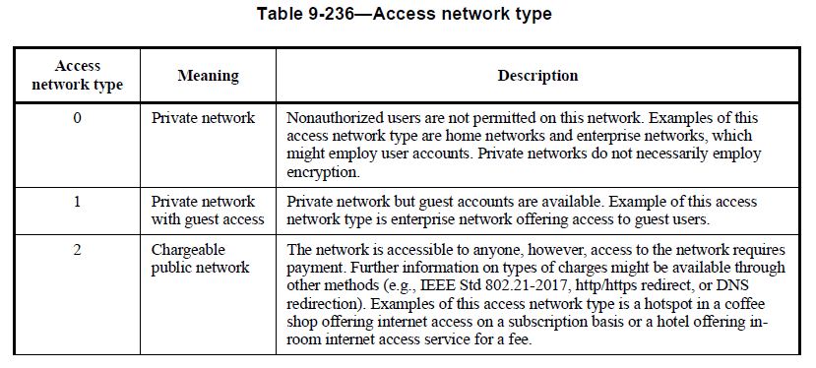
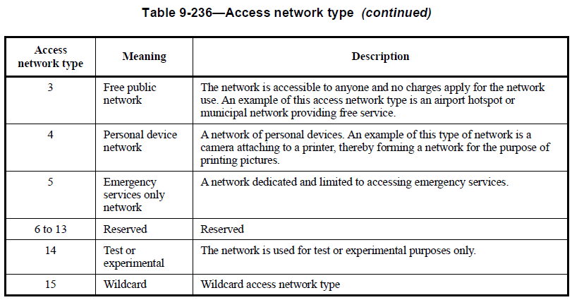
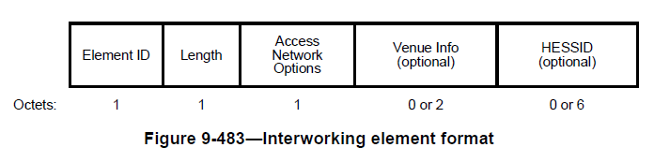
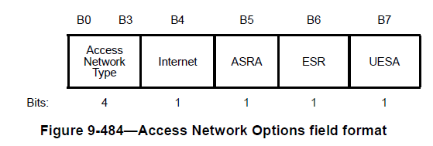
Reuse and extend the existing IEs
Interworking element (defined in 11u)
  Interworking element is utilized for active scanning for DMG STAs, generic advertisement service (GAS) protocol, WLAN interworking with external networks procedures, and access network query protocol (ANQP).
    It is used in Hotspot 2.0 as well.
  The Access Network Options field in the Interworking element can identify the type of access network, such as private or public networks.
Akira Kishida, NTT

Slide 11
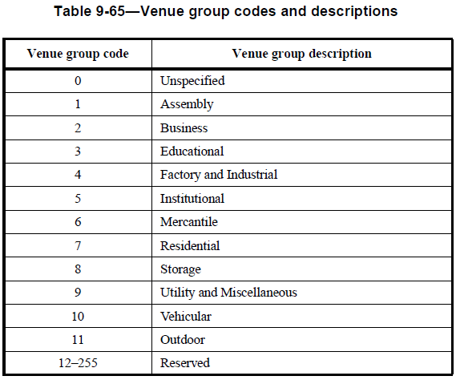
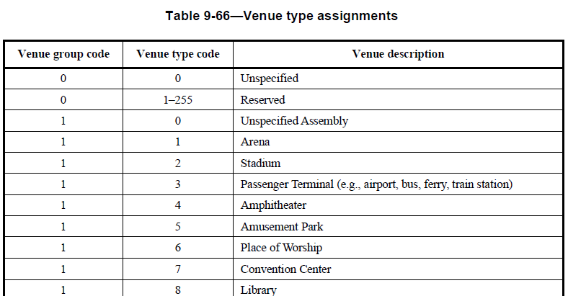
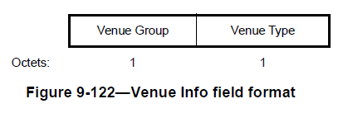
Reuse and extend the existing IEs – cont’d
The venue Info field in the Interworking element can indicate the venue group and the detailed use case.
  Reusing the Interworking element and these information fields in the element would help to specify the use case for indication.

Slide 12
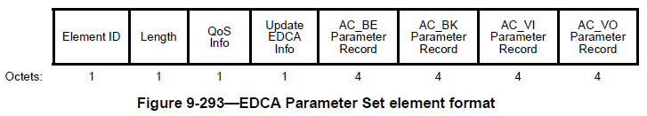
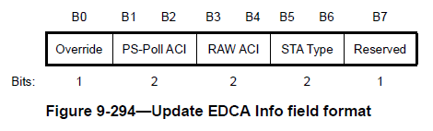
Reuse and extend the existing IEs – cont’d
Update EDCA Info field in EDCA Parameter Set element.
  The S1G AP uses the STA Type field in Update EDCA Info field to specify STA types and validate information described in this field.
  Sensor STAs and non-sensor STAs are defined in S1G. STA Type field to
    — 0 to indicate that the information provided by this element is valid for STAs (i.e., both sensor STAs and non-sensor STAs)
    — 1 to indicate that the information is valid for sensor STAs
    — 2 to indicate that the information provided by this element is valid for non-sensor STAs
    — 3 to indicate a reserved value
  11bn STA could use reserved value 3 and would create a subfield to describe more detailed use case type information.

