Slide 1
Thoughts on AMP UHF RFID Tags
Date: 10 May 2024
Name | Affiliation | Address | Phone | Email
Rojan Chitrakar | Huawei | Singapore |  | rojan.chitrakar@huawei.com
Lei Huang
Shuqiao Chen
Ian Bajaj
Notes:
Jul 12, 2010
Page 1

Slide 2
Introduction
The concept of AMP + UHF Tag, i.e., using one dual-purpose tag for both B2B and B2C applications was introduced in [1].
  B2B: UHF operation in sub-1GHz for 2B scenarios with 10+m range
  B2C: Consumer usage in 2.4GHz with Wi-Fi device in close range
The feasibility of using existing Wi-Fi hardware as a reader for the AMP + UHF tags was further explored by the authors in [2].
  AMP tag can have good synergy with UHF RFID to enable cost-effective integrated tag design to support many end-to-end to-Business and to-Consumer applications.
  Wi-Fi 2x2 device can achieve AMP reader function with common impairment parameters
In this contribution we share our high level thoughts on the MAC design to achieve this goal.

Slide 3
Terminologies
For the ease of discussion, we introduce the following terminology:
AMP RFID protocol: The RFID protocol* used by AMP STAs
AMP RFID Reader: An AMP STA (e.g., a smartphone) that can read an AMP RFID tag using the AMP RFID protocol.
AMP RFID Tag: An AMP non-AP STA that supports the AMP RFID protocol.
Note – To differentiate from the UHF RFID protocol specified by GS1

Slide 4
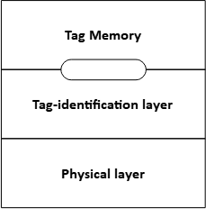
UHF RFID Protocol
The UHF RFID Standard and the corresponding air interface protocol is published by EPCglobal and is the de facto standard for UHF passive RFID (aka RAIN RFID) implementations.
The latest version of the standard (Gen2v3) [3] was released in January 2024 and is 204 pages.
The UHF RFID protocol is composed of:
  Physical layer: defines the data coding and modulation waveforms used for the signaling between an Interrogator and a Tag.
  Tag-identification layer: defines the set of functions and commands used by an Interrogator to interact with Tags.
The UHF RFID protocol provides access to the Tag memory, which may be further categorized into:
  Reserved memory
  EPC memory
  TID memory
  User memory

Slide 5
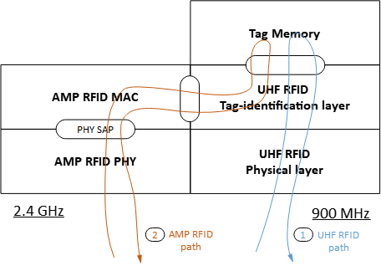
Protocol flow
Since an AMP + UHF RFID dual purpose tag also needs to support the UHF RFID protocol, to simplify the UHF protocol for AMP, AMP RFID protocol should reuse the UHF RFID protocol as much as possible.
For the conventional UHF RFID operations (e.g., reading the EPC memory), the UHF RFID commands/responses are tunneled via the AMP PHY/MAC layers.

Slide 6
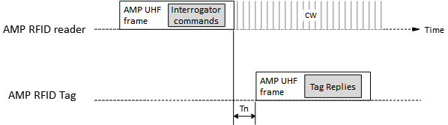
Frame design
AMP frame(s) may be defined for the AMP RFID protocol, but they are only used to encapsulate the UHF RFID Interrogator commands and Tag replies.

Slide 7
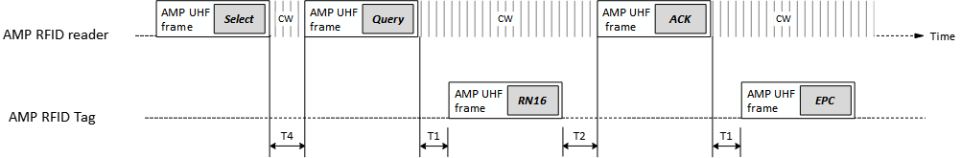
Example
An example of reading a single AMP RFID Tag:
Note: Select, Query, ACK are Interrogator commands while RN16 and EPC are Tag replies defined by the UHF RFID standard.

Slide 8
Conclusion
In this contribution we shared our high level thoughts on the MAC design for the AMP + UHF RFID dual purpose tags. We think that:
To simplify the UHF protocol for AMP, AMP RFID protocol should reuse the UHF RFID protocol as much as possible.
The UHF RFID commands/responses can be tunneled via the AMP PHY/MAC layers.
AMP frames can be used to encapsulate the UHF RFID Interrogator commands and Tag replies.

Slide 9
References
[1] 11-23/2038r1, Close-range AMP Backscattering in 2.4GHz (Rui Cao, et. al.)
[2] 11-24/537r0, Close-range AMP WiFi Reader Feasibility Study (Rui Cao, et. al.)
[3] EPC® Radio-Frequency Identity Generation-2 UHF RFID Standard Version 3 (EPCglobal)

