Slide 1
Overview of S1G and RFID Spectrum
Date: 2024-05-11
Authors:
Name | Affiliation | Address | Email
Panpan Li | Huawei | Singapore | lipanpan25@huawei.com
Lei Huang |  | Singapore
Bin Qian |  | Shenzhen, China
Wei Lin |  | Shenzhen, China
David Yang |  | Shenzhen, China

Slide 2
Introduction
This contribution gives the overview of S1G and RFID global spectrum availability based on [1] and [2]-[6].

Slide 3
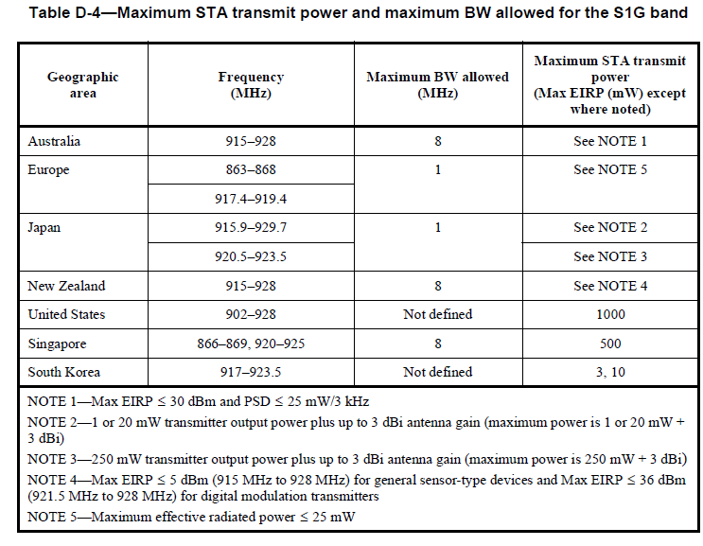
Recap: 802.11ah S1G spectrum [7]

Slide 4
Overview of S1G Spectrum (1/2)
 | Country | Band(s) | Notes
ITU region 1 | Kenya | 863-868 MHz | 25 mW ERP, Duty cycle 10% for APs and 2.8% for STAs
 | Bahrain, United Arab Emirates (UAE) | 863-870 MHz
Europe | Albania, Austria, Bosnia and Herzegovina, Croatia, Cypress, Czech Republic, Denmark, Estonia, Germany, Greece, Hungary, Latvia, Luxembourg, Malta, Netherlands, Norway, Poland, Romania, Slovakia, Spain, | 863-868 MHz | 25 mW ERP, Duty cycle 10% for APs and 2.8% for STAs
 | Belgium, Iceland, Ireland, Liechtenstein, Lithuania, Moldova, North Macedonia, Portugal, Slovenia, Sweden, Switzerland, Turkey | 863-868 MHz 915.8-919.4 MHz | 25 mW ERP, Duty cycle 10% for APs and 2.8% for STAs
 | Bulgaria, Finland, France, Italy, United Kingdom | 863-868 MHz 917.4-919.4 MHz
ITU region 2 | United States | 902-928 MHz | Maximum output power <= 1W Max BW: 16 MHz
 | Canada
 | Bolivia, Costa Rica, Dominican Republic, Ecuador, Guyana, Mexico, Paraguay, Peru, Uruguay, Venezuela
 | Brazil | 902-907.5 MHz
 |  | 915-928 MHz
 | Colombia, Guatemala | 915-928 MHz
 | Argentina |  | Same power restrictions as USA

Slide 5
Overview of S1G Spectrum (2/2)
ITU region 3 | Country | Band(s) | Notes
 | Australia | 915-928 MHz | Max e.i.r.p. <= 1 W, PSD <= 25 mW/3 kHz, Max BW: 8 MHz
 | Brunei Darussalam | 923-925 MHz
 | India | 865-868 MHz | 25 mW ERP, Duty cycle 10% for APs and 2.8% for STAs
 | Indonesia | 920-923 MHz | <= 400mW EIRP
 | Iran (Islamic Republic of) |  | RFID in 865 to 868 MHz and 915 to 921 MHz
 | Japan | 920.5-922.3 MHz | 20 mW (16 dBm EIRP), Channel bandwidth <= 1 MHz
 |  | 922.3-928.1 MHz | 20 mW (16 dBm EIRP), Channel bandwidth <= 1 MHz
 | New Zealand | 915-928 MHz | Max e.i.r.p. <= 30 dBm, Max BW: 8 MHz
 | Singapore | 866-869 MHz | Max e.r.p. <= 500 mW, Max BW: 2 MHz
 |  | 917-925 MHz | Max e.r.p <= 100 mW, Max BW: 4 MHz
 | Vietnam | 918-923 MHz | Tx power limit: ≤ 25 mW ERP
 | South Korea | 917-920.6 MHz 920.6-923.5 MHz | 917-920.6 MHz: 3 mW EIRP, 920.6-923.5 MHz: 10 mW EIRP 1, 2 and 4 MHz channels
 |  | 925-931 MHz | Bandwidth: 1 MHz or 2 MHz EIRP: ~17 dBm EIRP in 1 MHz; 20 dBm EIRP in 2 MHz
 | Taiwan | 920-925 MHz | Indoor power limit 1 W conducted, Outdoor power limit 0.5 W Max BW: 4 MHz
 | Thailand | 920-925 MHz | Tx power limit < 50 mW EIRP, Max BW: 4 MHz

Slide 6
Overview of UHF RFID Spectrum
Country | Band(s) | Power
Albania, Estonia, Ireland, Moldova, Luxembourg, Norway, United Kingdom | 865.6 – 867.6 | 2 W ERP
 | 915 – 921 | 4 W ERP
Algeria | 870 – 876 | 100 mW EIRP
 | 880 – 885
 | 915 – 921
 | 925 – 926
Argentina, Canada, Costa Rica, Dominican Republic, Mexico, Panama, United States, Uruguay | 902 – 928 | 4 W EIRP
Australia | 920 – 926 | 4 W EIRP
 | 918 – 926 | 1 W EIRP
Armenia, Austria, Belarus, Belgium, Bulgaria, Cyprus, Czech Republic, Denmark, Finland, France, Hungary, Lithuania, Malta, Slovak Republic, Slovenia, Sweden | 865.6 – 867.6 | 2 W ERP
 | 916.1 - 918.9 | 4 W ERP
Azerbaijan | 865.6 – 867.6 | 2 W ERP
Bangladesh | 925.0 – 927.0
Brazil | 902 – 907.5 | 4 W EIRP
 | 915 – 928 | 4 W EIRP
Brunei Darussalam | 866 – 869 | 0.5 W ERP
 | 923 – 925 | 2 W ERP
Country | Band(s) | Power
Chile | 913 – 919 | 1 W EIRP
 | 915 – 928 | 500 mW EIRP
 | 925 – 928 | 1 W EIRP
China | 840 - 845
 | 920.5 – 924.5 | 2 W ERP
Colombia, Peru | 915 – 928 | 4 W EIRP
Bosnia and Herzegovina, Croatia, Germany, Greece, Iceland, Italy, Latvia, Macedonia, FYR, Netherlands, Nigeria, Oman, Poland, Portugal, Romania, Saudi Arabia, Serbia, Spain, United Arab Emirates | 865.6 – 867.6 | 2 W ERP
Hong Kong, China | 865 – 868 | 2 W ERP
 | 920 – 925 | 4 W EIRP
India | 865 – 867 | 4 W ERP
Indonesia | 923 – 925 | 2 W ERP
Iran, Islamic Rep. | 865 – 868 | 2 W ERP
Israel | 915 – 917 | 2 W ERP
Japan | 916.7 – 920.9 | 4 W EIRP
 | 916.7 – 923.5 | 0.5 W EIRP
Jordan | 865 – 868 | 2 W ERP
Korea, Rep. | 917 – 920.8 | 4 W EIRP
 | 917 – 923.5 | 200 mW EIRP
Liechtenstein, Switzerland | 865.6 – 867.6 | 2 W ERP
 | 915 – 918 | 4 W ERP
Country | Band(s) | Power
Malaysia | 919 – 923 | 2 W ERP
Morocco | 865.6 - 865.8 | 2 W ERP
 | 867.6 - 868.0 | 500 mW ERP
New Zealand | 864 – 868 | 6 W EIRP
 | 920 – 928
Russian Federation | 866.0 – 867.6 | 100 mW ERP
 | 866 – 868 | 500 mW ERP
 | 866.0 – 867.6 | 2 W ERP
 | 915 – 921 | 1 W ERP
Singapore | 866 – 869 | 0.5 W ERP
 | 920 – 925 | 2 W ERP
South Africa | 865.6 – 867.6 | 2 W ERP
 | 916.1 – 920.1 | 4 W EIRP
Taiwan | 922 – 928 | 1 W ERP (Indoor)
 | 922 – 928 | 0.5 W ERP (outdoor)
Thailand | 920 – 925 | 4 W EIRP
Venezuela, RB | 922 – 928 | 4 W EIRP
Vietnam | 866 – 868 | 0.5 W ERP
 | 918 – 923 | 0.5 W ERP
 | 920 - 923 | 2 W ERP (exclusively)

Slide 7
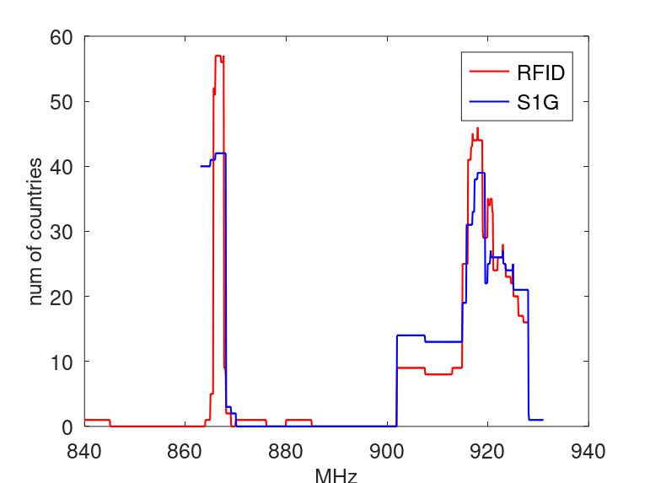
Observation
The S1G and RFID spectrum are quite diversified among countries.
Regardless of countries, the S1G spectrum are spread over 863-870 MHz and 902-931 MHz
Some countries has no S1G regulations yet (China, Malaysia…).
Regardless of countries, the RFID spectrum are spread over 840-845 MHz, 864-869 MHz, 870-876 MHz, 880-885 MHz and 902-928 MHz
RFID spectrum in some countries are exclusive, e.g. China.
RFID spectrum in some countries overlaps with S1G spectrum.
In this case, RFID spectrum typically is a subset of S1G spectrum.
Bandwidth information:
S1G: different countries have different maximum BW: 1MHz, 2 MHz, 4 MHz, 8 MHz, 16 MHz.
RFID: different countries have different maximum BW: 150 kHz, 200 kHz, 250 kHz, 400 kHz, 500 kHz.

Slide 8
Open Discussion
Discussion Point 1: In a certain regulatory domain, are Type-A and Type-B AMP STAs allowed to operate in RFID spectrum which does not overlap with S1G spectrum?
Discussion Point 2: In a certain regulatory domain, are Type-C AMP STAs allowed to operate in S1G spectrum which does not overlap with RFID spectrum?
Discussion Point 3: Is the coexistence of AMP and existing UHF RFID a concern?
Note: Definitions of AMP STA types refer to [8]:
Type-A AMP STA: An AMP non-AP STA that support existing WLAN standards (e.g. 2.4 GHz 11b/n).
Type-B AMP STA: An AMP non-AP STA that only support low power active transmitter which is not compliant with existing WLAN standard.
Type-C AMP STA: An AMP non-AP STA that only support backscatter operation.

Slide 9
Reference
Technical Note: Wi-Fi HaLow™ Global Spectrum Availability.
https://www.gs1.org/docs/epc/uhf_regulations.pdf.
https://www.lscm.hk/files/content/file/content-49742-file_eng.pdf.
https://www.law.cornell.edu/cfr/text/47/15.247.
https://www.etsi.org/deliver/etsi_en/302200_302299/302208/03.04.01_60/en_302208v030401p.pdf.
https://www.imda.gov.sg/-/media/imda/files/regulation-licensing-and-consultations/ict-standards/telecommunication-standards/radio-comms/imdatssrd.pdf.
IEEE 802.11ah-2016.
IEEE 802.11-24/0482r1, AMP Terminology.

Slide 10
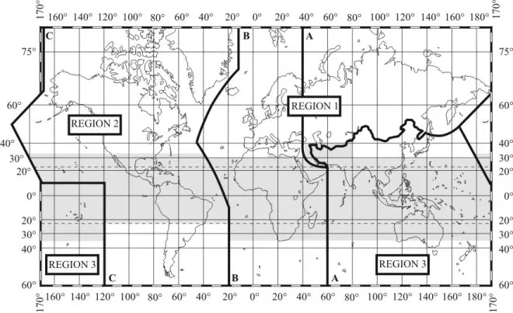
Appendix 1: ITU Regions for Regulation
The International Telecommunication Union (ITU) organizes countries by regions. Radio regulatory requirements may be similar in each region; however, each country may adopt different standards and spectrum plans.
ITU region 1 countries include Europe, Africa, the Former Soviet Union (FSU), Mongolia, and the Middle East west of the Persian Gulf, including Iraq.
ITU region 2 includes the Americas including Greenland, and some of eastern Pacific Islands.
ITU region 3 includes Asia and the Pacific (non-FSU Asia east of and including Iran, and most of Oceania).

Slide 11
Appendix 2: Further Information on RFID
 | Operating range (MHz) | Maximum Bandwidth (MHz) | Channels | Max power
China | 840 - 845 | 0.25 | 20 | 2W ERP
 | 920 – 925 | 0.25 | 20 | 2W ERP
US | 902 - 928 | 0.5 | 52 | 4 W EIRP
EU | 865 – 868 | 0.2 | 15 | 2W ERP
 | 915 - 921 | 0.4 | 14 | 4W ERP
India | 865 - 867 | 0.2 | 10 | 4W ERP

