Slide 1
Periodic IDC use cases and considerations for signaling
Date: 2024-07-15
Authors:
Name | Affiliation | Address | Phone | Email
Hongwon Lee | LG Electronics | 19, Yangjae-daero 11gil, Seocho-gu, Seoul 137-130, Korea |  | hongwon.lee@lge.com
Insun Jang |  |  |  | insun.jang@lge.com
Geonhwan Kim |  |  |  | geonhwan.kim@lge.com
Jinsoo Choi |  |  |  | js.choi@lge.com
Sunhee Baek |  |  |  | sunhee.baek@lge.com
Yelin Yoon |  |  |  | yl.yoon@lge.com
Dongju Cha |  |  |  | dongju.cha@lge.com
HanGyu Cho |  |  |  | hg.cho@lge.com
Sanggook Kim |  | 10680 Treena St, San Diego CA 92131 , USA |  | sanggook.kim@lge.com

Slide 2
Introduction
Many presentations [1]-[8] already addressed the importance of handling unavailability due to in-device-coexistence (IDC) and several methods to resolve the IDC issues
According to several contributions[1][3][4][6][8], IDC can be classified as ‘Periodic or Predictable’ and ‘Aperiodic or Unpredictable’
In this contribution, we share our view on how to handle the 'Periodic' IDC issue through discussing use cases and signaling methods

Slide 3
Recap: Periodic(or Predictable) IDC
Some interference may be predictable [1]
  For such interference, tools are needed in order to define properly the period during which the interference occurs, and possibly characterize the interference
    Some BT can be scheduled in some cases
Long term indication can be split into 3 different parts [6]
  1) Identification of periods of time during which the STA is completely unavailable
  2) Identification of interference levels on specific 20 MHz subchannels (all the time or possibly only during specific SPs)
  3) Description of reduced Tx/Rx parameters in possible presence of interference (all the time or possibly only during specific SPs)

Slide 4
Periodic IDC use case (1/2)
During periodic BLE advertising periods in a device with a BT/Wi-Fi combo chipset, in-device-coexistence(IDC) events may occur
Bluetooth Low Energy(BLE) Advertising
  Packet size: 16 ~ 256 bits
  Packet duration: 360 microseconds with max packet size and 1Mbps
  Advertising interval: 20ms ~ 10.24sec
  Packet duration and Advertising interval depend on the advertising data size
  Bluetooth Low Energy Advertising example
    PPDU duration 50 microseconds(us), Advertising interval 500ms
    3 Advertising channels: 2402, 2426, 2480 MHz
    Unavailability time during 100 us in every 500ms due to in-device-coexistence between Wi-Fi and BLE
In this application, only three BLE advertising channels are used. Therefore, another frequency band can be utilized during unavailable time caused by BLE transmission

Slide 5
Periodic IDC use case (2/2)
During periodic Bluetooth A2DP streaming in a device with a BT/Wi-Fi combo chipset, in-device-coexistence(IDC) events may occur
Bluetooth Audio Play(BR/EDR A2DP streaming)
  Frame duration and interval depends on the codec and sampling rate
  Bluetooth Audio Play example
    SBC(codec), 44.1KHz(Sampling Rate)
      Media Packet duration and interval: approximately 11.61ms
      Media Packet size: approximately 476 bytes
      Media Packet transmission time: approximately 2ms with EDR(2 Mbps)
    Unavailability time during 2ms in every approximately 11.61ms due to in-device-coexistence between Wi-Fi and Bluetooth
In this case, an IDC event may occupy a longer period, so another method to transmit Wi-Fi packets should be considered during unavailable time caused by Bluetooth transmission

Slide 6
Periodic IDC signaling – information
IDC Information
  Unavailable time
    IDC start time: When “unavailability” starts (i.e., start time)
    IDC duration: How long “unavailability” lasts (i.e., duration)
    IDC interval: Interval between Periodic IDC Service Period(SP)s
    * Periodic IDC SP refers to the recurring unavailable time due to IDC
  Frequency / Channel
    IDC Channel: Unavailable (or available) channels during IDC duration
      One useful piece of information to improve Wi-Fi latency during the IDC period(e.g. The IDC device may use some available channels during the IDC SP)
  Other information’s
    Number of Spatial Stream can be considered information to avoid IDC situation
We are considering that all types of IDC information should be included in a single container for signaling to minimize signaling overhead

Slide 7
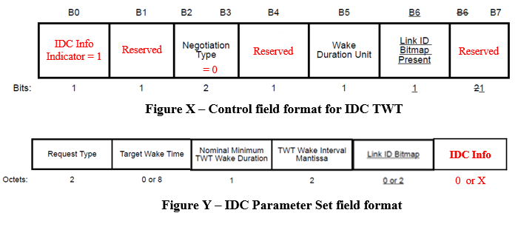
Periodic IDC signaling – container(1/3)
TWT element variant to include IDC information
  TWT element especially Individual TWT is one of the good options to indicate periodic IDC events as IDC Service Period(SP) for non-AP STA
  Negotiation Type in the Control field shall be set to 0 to reuse the Individual TWT Parameter set
  NDP Paging/Unavailability Mode(set to 1) can be utilized to indicate that TWT element contains IDC information for a UHR device
* For Individual TWT, the STA shall set the Implicit subfield to 1 and the NDP Paging Indicator/Unavailability
Mode subfield to 0 in all TWT elements that it transmits during the TWT setup
* Request Type can be redefined for the IDC parameter set(see next slide)

Slide 8
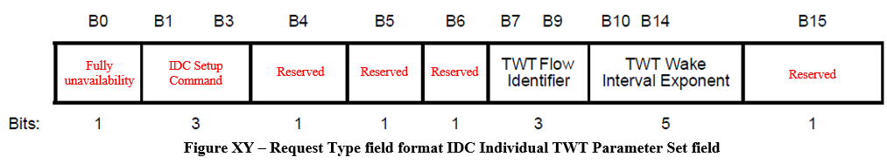
Periodic IDC signaling – container(2/3)
TWT element variant to include IDC information(continue)
  Request Type field can be redefined as shown below
    Fully unavailability field indicates whether IDC SP is fully unavailable or not. If it is set to 1, IDC SP is fully unavailable. If it is set to 0, IDC SP is partially unavailable.
    * If the IDC SP is partially unavailable, Wi-Fi data exchange may be performed using other methods such
    as using another available channel, spatial stream, and so on. If the Fully unavailability field is set to 0,
    other IDC information (e.g., Channel, NSS or other information) can be included
    IDC Setup Command can be defined for Periodic IDC to request, update, suspend or teardown IDC SPs
Value | Meaning
0 | Request
1 | Update
2 | Suspend
3 | Teardown
4-7 | Reserved
Figure. IDC Setup Command

Slide 9
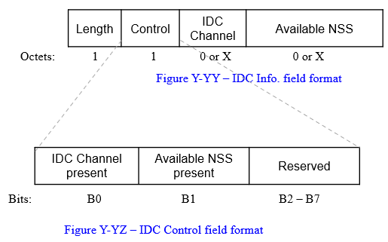
Periodic IDC signaling – container(3/3)
TWT element variant to include IDC information(continue)
  IDC Info may include IDC Channel, Available NSS, etc.
    IDC Channel can be range of frequency band, channel(including subchannels), Resource Unit(RU) and so on
    Available NSS may be the maximum available number of spatial streams in an IDC situation

Slide 10
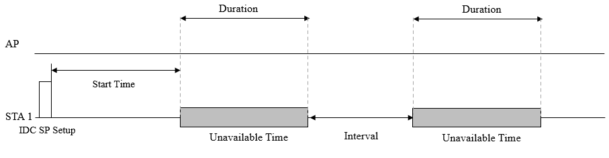
Periodic IDC signaling frame (1/2)
TWT Setup frame to signal periodic IDC Service Period(SP)
  IDC SP is not an agreement but an announcement because it is not negotiable
    Unsolicited IDC SP Setup can be considered
  TWT Setup frame with IDC Individual TWT manner can be used
    Reused Individual TWT element for Periodic IDC can be included

Slide 11
Periodic IDC signaling frame (2/2)
Channel Usage Request/Response frame [6]
  TWT Elements are included in Channel Usage Request frame
  These can be utilized if a UHR device has IDC signaling capabilities
Both the TWT Setup and the Channel Usage Request/Response frame can be used to signal the IDC information of a non-AP STA

Slide 12
Conclusion
Two IDC use cases with Bluetooth(BLE Advertising and Bluetooth Audio Streaming) are discussed
Based on the observed use cases, IDC information may include not only time-domain information but also frequency-domain and/or other types
The IDC information can be provided by reusing the TWT element to include more IDC information
  Individual TWT may be reused to include IDC info
The reused TWT element for IDC can be signaled through the TWT Setup frame and/or the Channel Usage Request/Response frame

Slide 13
Straw Poll 1
Do you agree to include the following into the 11bn SFD?
  11bn defines a mechanism to allow a non-AP STA to indicate a periodic unavailability in time to its associated AP
Note: Some harmonization based on [23/0816, 23/1934, 23/2002, 23/2078, 24/0420, 24/0831]

Slide 14
Straw Poll 2
Do you agree to include the following into the 11bn SFD?
  11bn defines a mechanism to allow a non-AP STA to update a periodic unavailability in time to its associated AP

Slide 15
Straw Poll 3
Do you agree to include the following into the 11bn SFD?
  11bn reuses the TWT element in which a non-AP STA indicates a periodic unavailability in time to its associated AP
    Signaling detail is TBD

Slide 16
References
[1] 11-23/293r0, Improved reliability in presence of interference or other device activities
[2] 11-23/816r1, Enhancements for latency sensitive traffic and in-device-coexistence - Part 1
[3] 11-23/1103r0, In-Device Interference Discussion
[4] 11-23/1934r0, In-Device Interference Mitigation Follow Up
[5] 11-23/1964r1, Coexistence Protocols for UHR
[6] 11-23/2002r2, In-device Coexistence and P2P – follow-up
[7] 11-24/420r0, Enabling Flexible Coexistence Operation
[8] 11-24/436r0, SP Based In-Device Coexistence

Slide 17
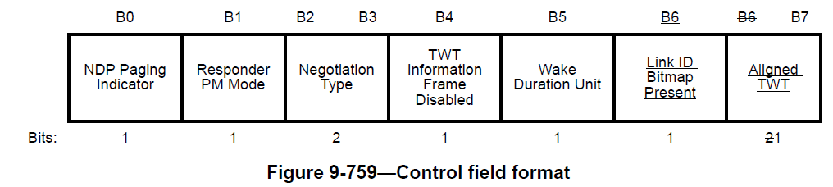
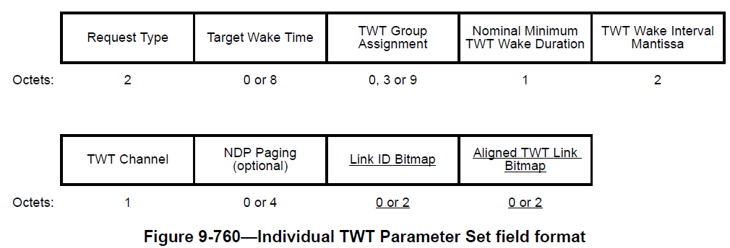
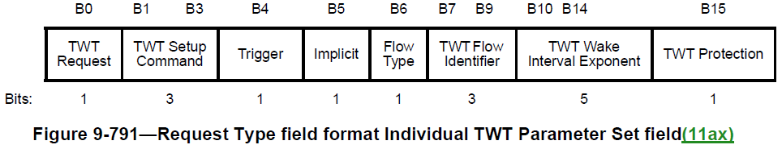
Appendix. Individual TWT element

