Slide 1
Further Simplifications To Promote IMMW Adoption
Date: 2024-05-08
Authors:

Slide 2
Abstract
Amendment should also support a simpler IMMW user-device that may operate in DL-only (RX-only) mode in mmWave
  At times, capability of an IMMW user-device will get reduced to DL-only (RX-only) operation in mmWave, for various reasons
  A simpler IMMW user-device without mmWave TX hardware may prove a catalyst for IMMW adoption
AP-MLD
non-AP-MLD
Common MAC
DL
Common MAC
sSTA
sSTA
MAC SAP
UL
MAC SAP
DL
mSTA
mSTA
UL temporarily disabled
Or TX not implemented at non-AP mSTA

Slide 3
Many arguments already presented are also valid arguments for DL-only mode in mmWave
23/1819r0
  “success of integrated 802.11 systems depends significantly on the ability to offset the substantial area and complexity of mmWave RF/antenna technology.”
  Reduce power consumption, support asymmetric links, push higher complexity to AP
23/1905r0
  “commercial success of IMMW technology depends on whether complexity, cost and power consumption are given high priorities in the design”
23/2004r0
  “limited scope is critical to… minimal implementation complexity and larger market adoption ”
24/0066r0
  “collaborative operation between sub-7 GHz and mmWave bands may be one of the most important factors”
23/1977r1, 24/0008r2
  Some of the demanding applications and use-cases are naturally DL heavy (projector, display, dock)

Slide 4
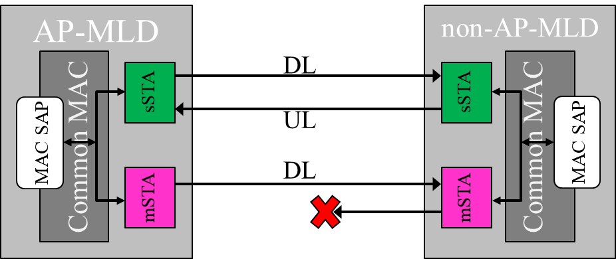
Motivation
Why support a DL-only mode in mmWave:
Large DL vs UL coverage mismatch in mmWave
MPE* requirements will at times force further mmWave UL power reduction, essentially prohibiting UL in mmWave
  E.g., based on user grip or location in proximity to the TX array
Significant cost, power consumption, and area to add mmWave TX chains
  As a byproduct of removing TX chain, slight improvement in RX (~1.5dB) due to removal of T/R switch
Some applications and use-cases that motivate IMMW are naturally DL heavy (projector/TV/display, dock)
Supporting user devices with RX-only in mmWave could be a stepping stone to IMMW success, increasing number of IMMW user devices, thus promoting adoption of IMMW on AP side too.
*MPE: Maximum Permissible Exposure

Slide 5
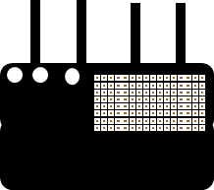

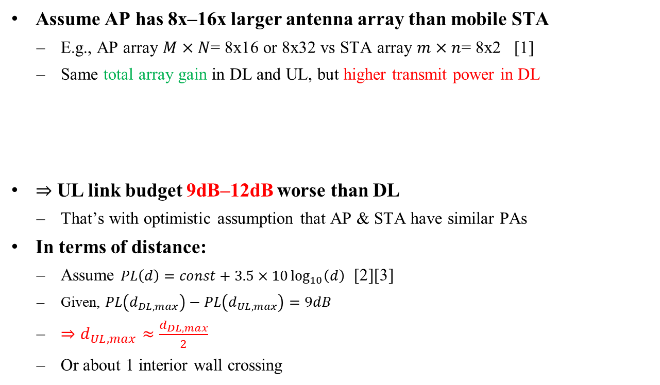
1. Large DL vs UL coverage mismatch in mmWave
Assume AP has 8x‒16x larger antenna array than mobile STA
  E.g., AP array $M×N$= 8x16 or 8x32 vs STA array $m×n$= 8x2 [1]
  Same total array gain in DL and UL, but higher transmit power in DL
$⇒$ UL link budget 9dB‒12dB worse than DL
  That’s with optimistic assumption that AP & STA have similar PAs
In terms of distance:
  Assume $PL\left(d\right)=const+3.5×10\log_{10}\left(d\right)$ [2][3]
  Given, $PL\left(d_{DL,max}\right)−PL\left(d_{UL,max}\right)=9dB$
  $⇒d_{UL,max}≈\frac{d_{DL,max}}{2}$
  Or about 1 interior wall crossing
Total array gain between AP & STA
Total TX power
$${DL: P}_{out,AP }+10\log\left(M⋅N\right)+G_{AP}+10\log\left(M⋅N\right)+G_{STA}+10\log\left(m⋅n\right)$$
$${UL: P}_{out,STA}+10\log\left(m⋅n\right)+G_{AP}+10\log\left(M⋅N\right)+G_{STA}+10\log\left(m⋅n\right)$$
DL coverage
UL coverage
Sub-7 coverage

Slide 6
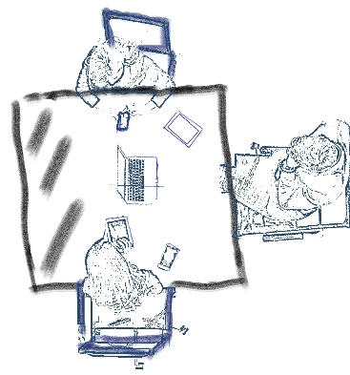
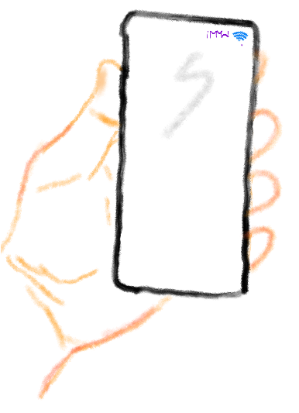
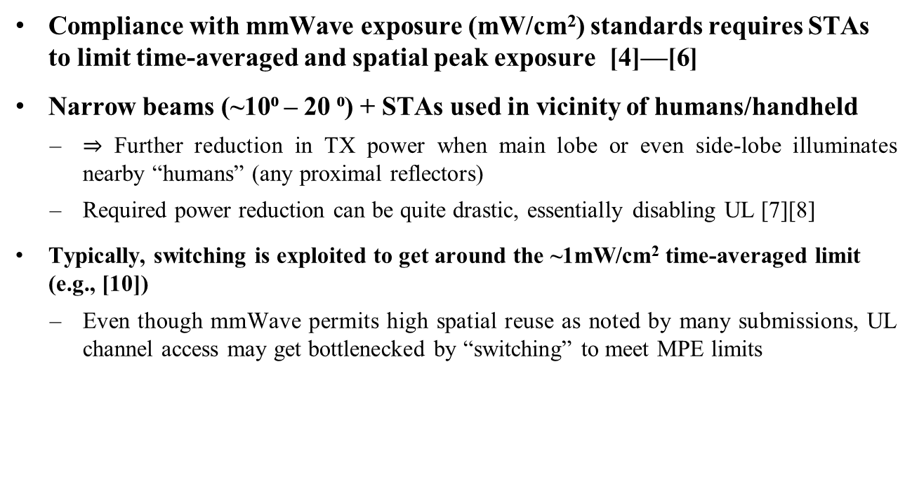
2. Further UL power reduction due to MPE
Compliance with mmWave exposure (mW/cm²) standards requires STAs to limit time-averaged and spatial peak exposure [4]—[6]
Narrow beams (~10⁰ ‒ 20 ⁰) + STAs used in vicinity of humans/handheld
  $⇒$ Further reduction in TX power when main lobe or even side-lobe illuminates nearby “humans” (any proximal reflectors)
  Required power reduction can be quite drastic, essentially disabling UL [7][8]
Typically, switching is exploited to get around the ~1mW/cm² time-averaged limit (e.g., [10])
  Even though mmWave permits high spatial reuse as noted by many submissions, UL channel access may get bottlenecked by “switching” to meet MPE limits

Slide 7
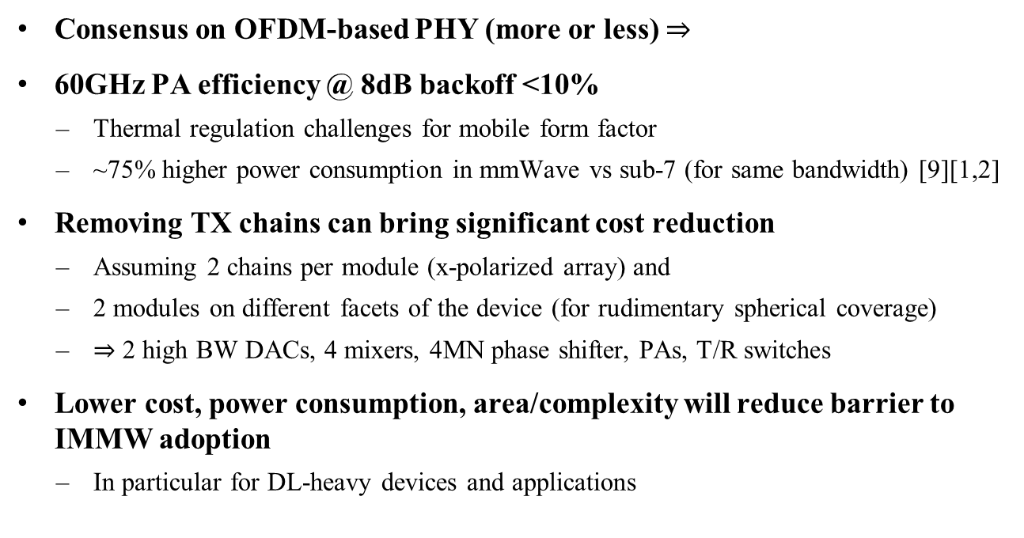
3. Cost, power consumption, area
Consensus on OFDM-based PHY (more or less) $⇒$
60GHz PA efficiency @ 8dB backoff <10%
  Thermal regulation challenges for mobile form factor
  ~75% higher power consumption in mmWave vs sub-7 (for same bandwidth) [9][1,2]
Removing TX chains can bring significant cost reduction
  Assuming 2 chains per module (x-polarized array) and
  2 modules on different facets of the device (for rudimentary spherical coverage)
  $⇒$ 2 high BW DACs, 4 mixers, 4MN phase shifter, PAs, T/R switches
Lower cost, power consumption, area/complexity will reduce barrier to IMMW adoption
  In particular for DL-heavy devices and applications

Slide 8
Conclusion
Third time’s a charm? Are we sure?
From previous attempts at mmWave, we’ve learnt that NSA (Non-StandAlong) is perhaps the key, as already captured in PAR draft
Now we better use this key to (at least) design a Minimum Viable System
  We need to use NSA to get around the limitations of mmWave UL, so that IMMW can be adopted for mainstream use-cases
*MPE: Maximum Permissible Exposure

Slide 9
Straw Poll
The IMMW non-standalone operation should also support a DL-only mode in mmWave.
  Yes, No, Abstain

Slide 10
References
[1] 15/0866r4, 11ay Evaluation Methodology
[2] 14/0882r4, 11ax Channel Model Document
[3] 3GPP TR 38.901, Study on channel model for frequencies from 0.5 to 100 GHz
[4] C95.1-2019 - IEEE Standard for Safety Levels with Respect to Human Exposure to Electric, Magnetic, and Electromagnetic Fields, 0 Hz to 300 GHz
[5] ICNIRP. Guidelines for limiting exposure to electromagnetic fields (100 kHz to 300 GHz). Health Phys 118(00):000–000; 2020
[6] FCC-19-126A1
[7] He et al., Implications of Incident Power Density Limits on Power and EIRP Levels of 5G Millimeter-Wave, IEEE Access, 2020
[8] 3GPP TS 38.321 (See MPE P-MPR in Power Headroom Report)
[9] 3GPP TR 38.840, Study on User Equipment (UE) power saving in NR
[10] Qualcomm Smart Transmit

Slide 11
Appendix

Slide 12
PAR text proposal (TBD)
Sample new text in PAR:
“The amendment requires that an 802.11 device supporting this amendment also supports at least one of the 2.4 GHz to 7.25 GHz (sub-7 GHz) unlicensed bands. The amendment expands the multi-link operation defined in the sub-7 GHz band specifications to support non-standalone operation in the unlicensed bands between 42 GHz and 71 GHz. The non-standalone operation includes support of a DL-only operation in the unlicensed bands between 42 GHz and 71 GHz.”

