Slide 1
Using Multi-Layer Transmission with Legacy Devices
Date: 2024-05-13
Authors:

Slide 2
Motivation
Multi-layer transmission as in [1] has a number of advantages
Enhancing the throughput when the channels are hard to predict
Supporting two different data streams with vastly different reliability requitements
Alternative way of multiplexing data streams
To support multi-layer transmission, the TX and RX need to slightly updated
It would be advantageous if the benefits of multi-layer transmission to some extent could be used to improve the system performance also with legacy devices present
This presentation shows how this can be achieved

Slide 3
Approach
The idea is to enable legacy RX to receive the N most robust bits of the multi-layer transmission
N = 2 means QPSK, N = 4 means 16QAM, N= 6 means 64QAM etc.
N = 2 is probably the only case that is practically interesting
The legacy RX has no knowledge about the other layers, but knows what N to use
The legacy RX decodes the data as if it was 2^N-QAM
The Gray mapping ensures that the bits are in the “correct region”
Because of the other layers, the bit will on average be less reliable than if the modulation had been 2^N-QAM

Slide 4
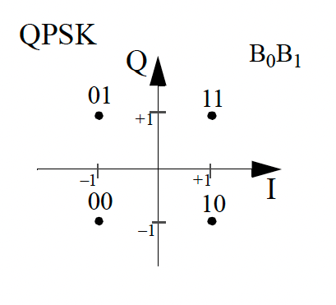
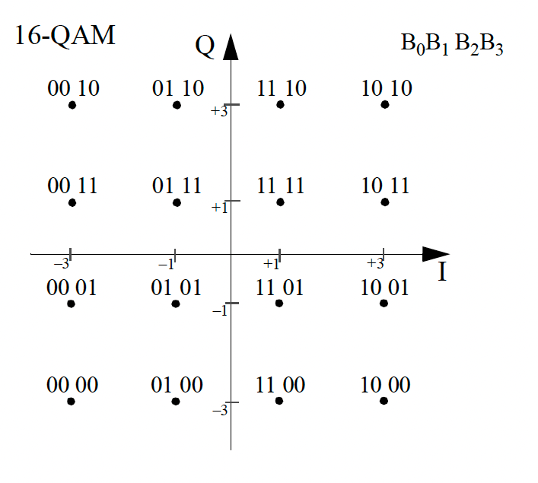
Illustration of the idea – QPSK and 64-QAM
For QPSK, the decision boundaries are trivial, just the real and imaginary axes
Note that for 16-QAM, bit 0 and bit 2 correspond to the QPSK bits

Slide 5
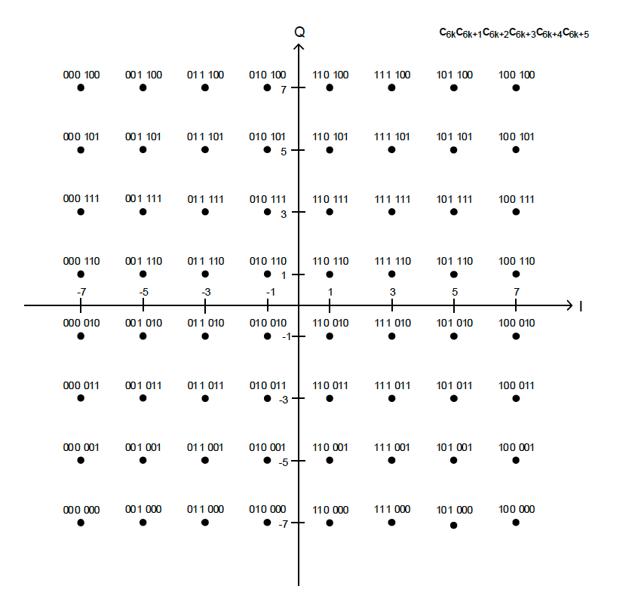
Illustration of the idea – 16-QAM and 64-QAM
For 16-QAM, additional decision boundaries need to be determined
Note that the four bits in 16-QAM correspond to bits 0,1,3, and 4 in 64-QAM
Normalizing the constellation points to unit energy, the decision boundaries are very close
2/sqrt(10) = 0.633 for the upper figure
4/sqrt(42) = 0.614 for the lower figure
Because the decision regions are very similar, the decoding works assuming another modulation than actually used

Slide 6
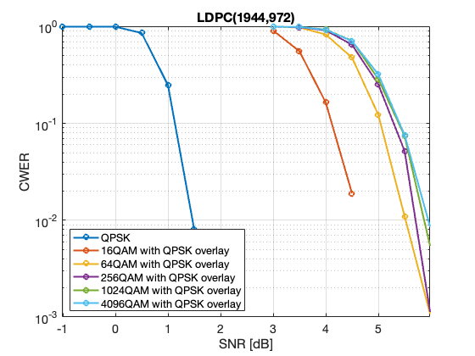
Simulation results - QPSK
The (approximate) LLRs are calculated as if the correct point is at one of the four QPSK constellation points
The ideal LLR would take into account the 16 possible constellation points
The loss in sensitiviy for QPSK by transmitting additional bits is 3-4 dB, irrespective of the modulation used

Slide 7
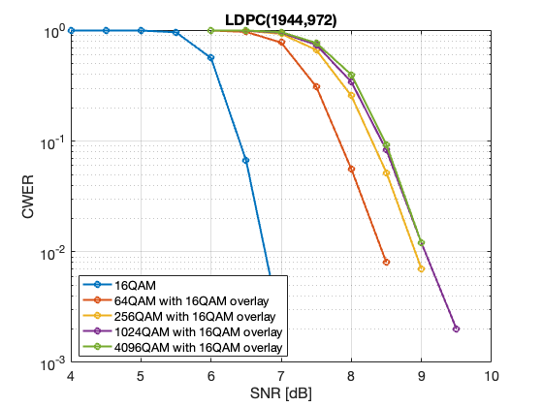
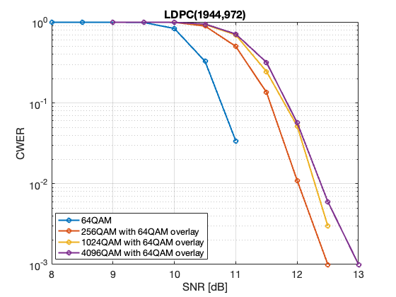
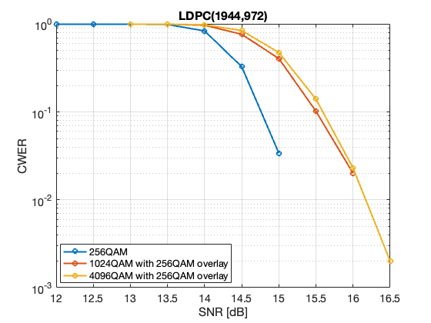
Simulation results – 16-QAM, 64-QAM, and 256-QAM
16-QAM
64-QAM
256-QAM
The same approach works also for larger modultions, although QPSK is believed to be the most interesting case

Slide 8
Conclusions
The multi-layer concept can be used also with legacy devices in a way that is transparent for the legacy devices
The most robust layer(s) can be decoded with a loss of around 3 dB compared to if a dedicated transmission to the legacy device would have been used
The idea works in principle for any modulation, but using QPSK for the legacy devices seems to be the most intereting

Slide 9
References
https://mentor.ieee.org/802.11/dcn/24/11-24-0435-00-00bn-ideas-related-to-achieving-ultra-high-reliability.pptx

