Slide 1
DPWiFi MIMO Polarization and Beamforming Update
Date: 2024-05-14
Authors:

Slide 2
Abstract
    DPWiFi Value Chain Stage 1 Update: Breakthrough Dynamic Polarization MIMO Multiplexing (“PMX”) and Beamforming (“BF”) technology

Slide 3
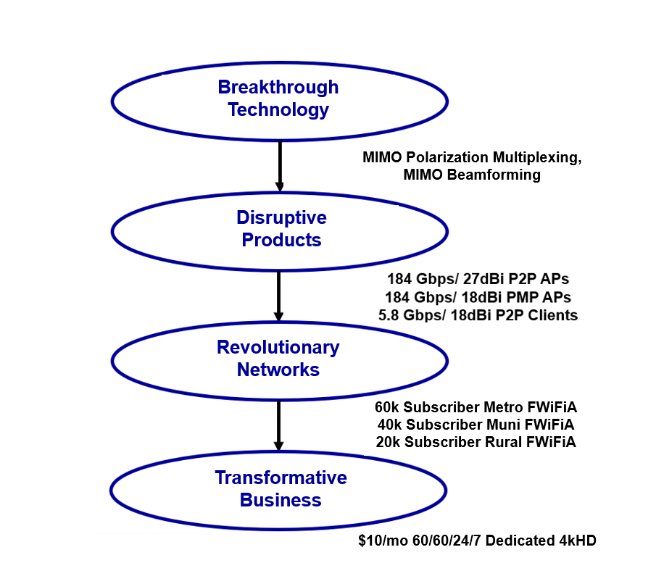



DPWiFi Value Chain

Slide 4
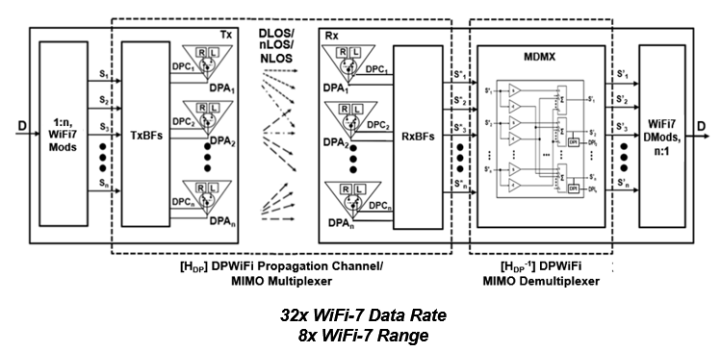
DPWiFi TRX Model
DPWiFi PMX: 32x EHT Data Rate
DPWiFi BF: 8x EHT Range (per STA)

Slide 5
WMAN Dynamic Polarization MIMO Multiplexing

Slide 6
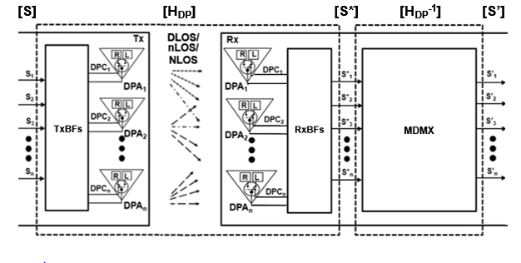
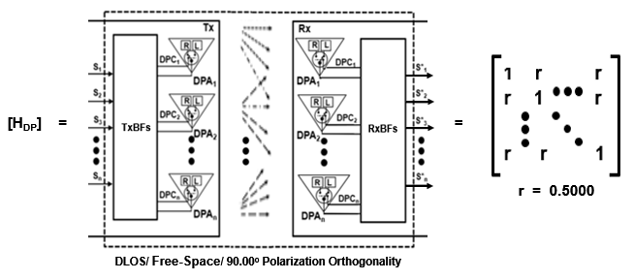

DPWiFi MIMO Multiplexing
    Given n WiFi-7 Streams (n-vectors) [S], [S*] and [S’], and
    The Canonical DPWiFi Propagation Channel (n x n matrix) [H_{DP}] below, and
    The Walsh-n Sequences (n-vectors) [TxDPC] and [RxDPC] below, then
    If [H_{DP}] is Non-Singular there exists an [H_{DP}⁻¹] such that [S’] = [S] x [H_{DP}] x [H_{DP}⁻¹]

Slide 7
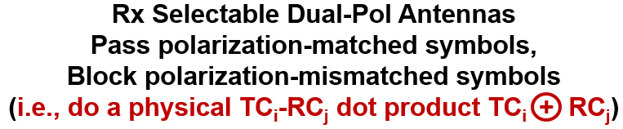

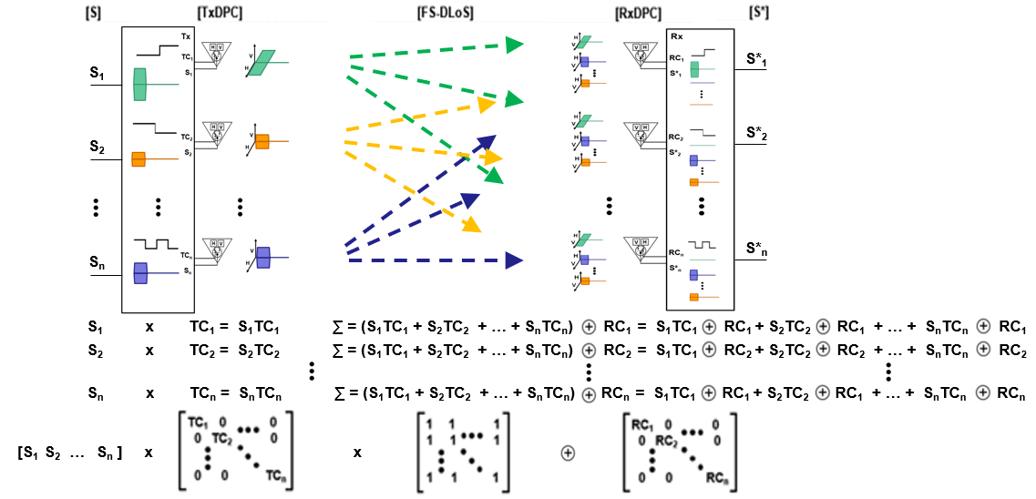



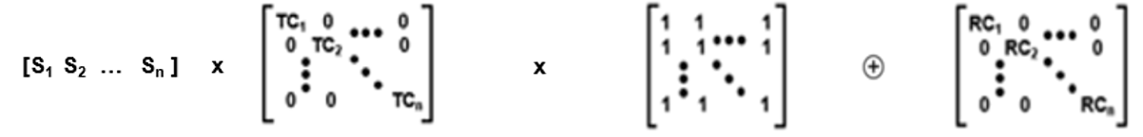
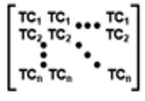
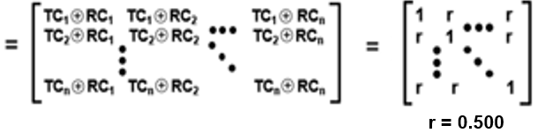
[H_{DP}] Analysis
    The Canonical [H_{DP}] is Non-Singular, Scalar and Uniform (r = 0.5000)

Slide 8
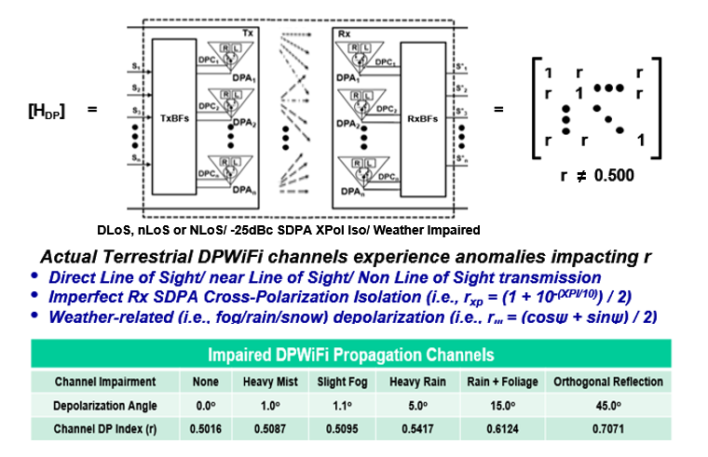
Real-World DPWiFi Propagation Channels
    A Real World [H_{DP}] is also Non-Singular, Scalar and Uniform, but with 0.501 < r < 0.750

Slide 9
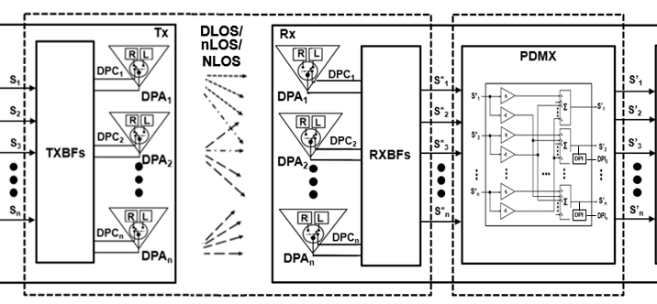

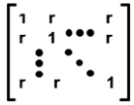
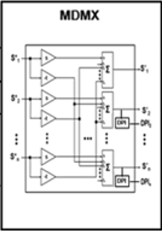
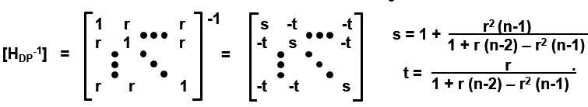
DPWiFi MIMO Demultiplexer
Provided
And given
[H_{DP}] = 0.501 < r < 0.750
Then
[H_{DP}] [H_{DP}⁻¹]
    Such that the Corresponding Real World [H_{DP}⁻¹] Becomes a Trivial Implementation

Slide 10
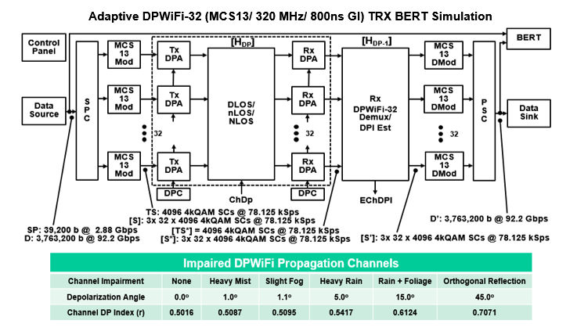
DPWiFi MATLAB Modeling
DPWiFi Math Posits 92 Gbps TRX in 320 MHz, at Least Under the Most Benign Conditions

Slide 11
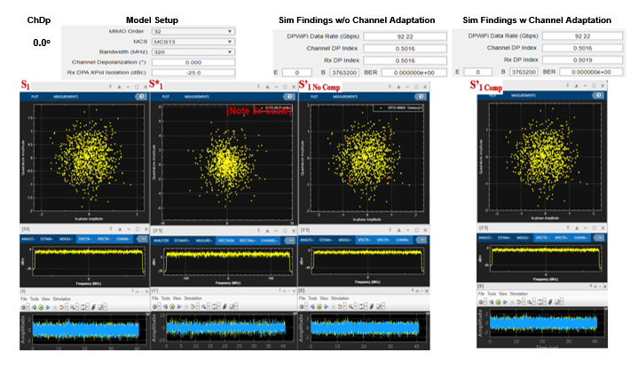
DPWiFi MATLAB Findings
DPWiFi Sims Concur, Validating 92 Gbps in 320 MHz under the Most Benign Conditions

Slide 12
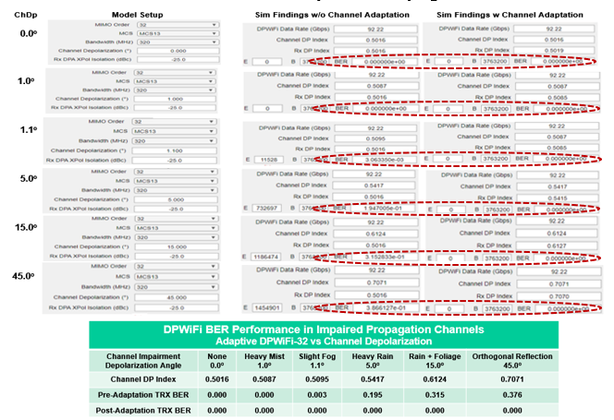
DPWiFi MATLAB Validation
And then Proceed to Validate 92 Gbps in 320 MHz under ANY Conditions

Slide 13
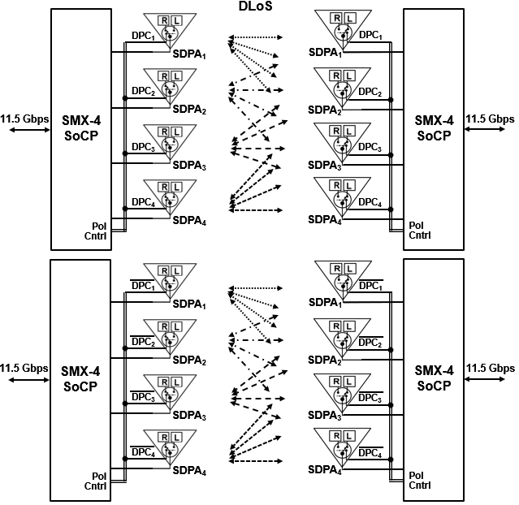
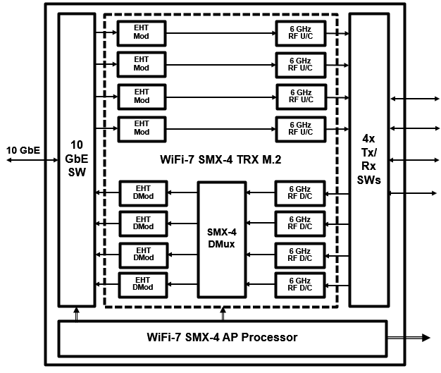


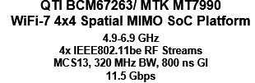

DPWiFi Hardware Validation
Proposed Quick-Turn DPWiFi-4 TRX Testbed
DPWiFi Hardware Validation Could be Completed Within Several Weeks

Slide 14
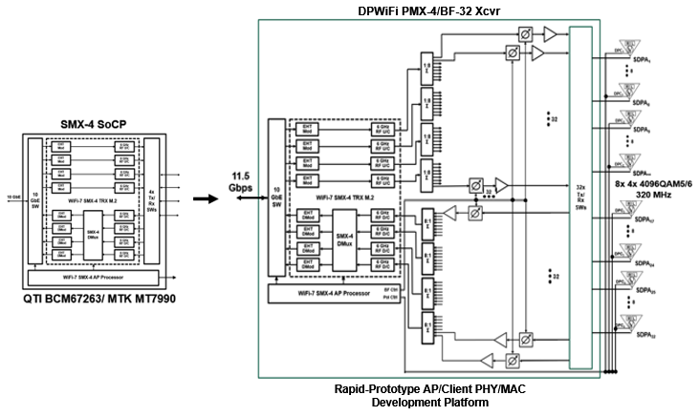
Early DPWiFi Product Development
Contemplated (WiFi-7 Kludge) DPWiFi PMX-4/ BF-32 PHY/MAC Engineering Platform
True TGbn DPWiFi AP/ Client Product Design Could Start Within Several Weeks

Slide 15
WMAN Dynamic Polarization MIMO Beamforming

Slide 16











DPWiFi DLoS/ nLoS/ NLoS Propagation
DPBS
NLoS
DLOS
nLoS
DPCs
DPWiFi APs and Clients Find a Way to Connect, One Way or Another

Slide 17
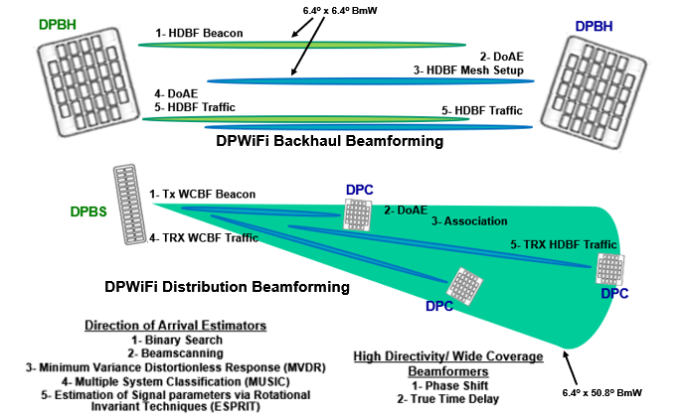
Basic DPWiFi Beamforming
Non-Coordinated Open Loop Direction of Arrival Estimation Rx Beamsteering sets Tx Beamsteering

Slide 18
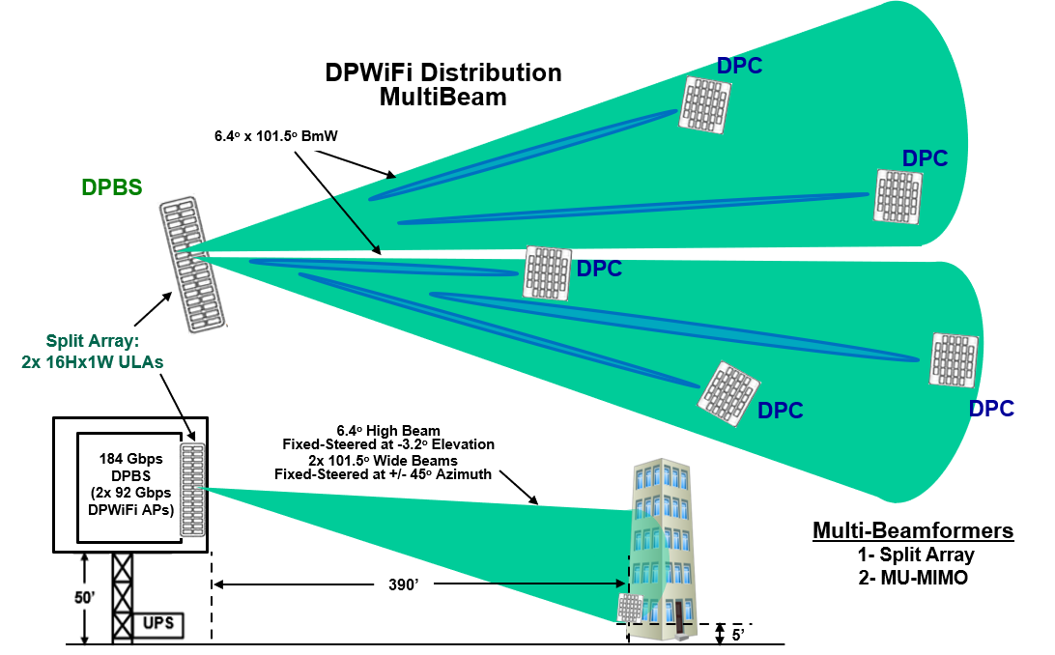
Advanced DPWiFi Beamforming
Full 180º DPBS Tx Multibeam Coverage Obviates Need for AP Scanning

Slide 19
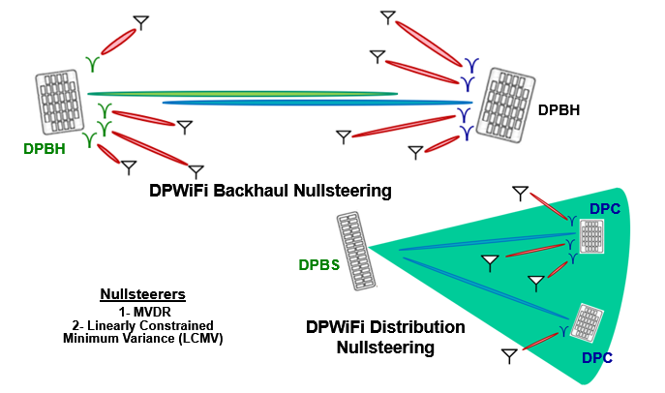
Advanced DPWiFi Beamforming
DPBH/ DPC Rx Interference Cancellation Enables Robust DPWiFi UNII Band Operation

Slide 20
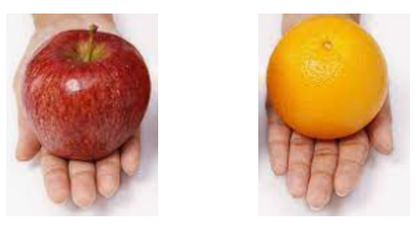
DPWiFi MIMO Summary
Spatial MIMO
MU-MIMO Beamforming
Polarization MIMO
DoAE Beamforming
TGbn DPWiFi Next Generation MIMO Represents World-Changing Wireless

Slide 21
References
1. 23/1464r1-WNGSC
Dynamic Polarization Spatial Multiplexing and Beamforming: Obliterating the MIMO Paradigm
Carlos A Rios (Terabit Wireless Internet), 9-Sep-2023
2. 23/1606r1-WNG SC
Dynamic Polarization Multiplexing and Beamforming WLANs
Carlos A Rios (Terabit Wireless Internet), 13-Sep-2023
3. 23/1756r3-TGbn
MIMO Dynamic Polarization and Beamforming: Proposed IEEE802.11bn PHY
Carlos A Rios (Terabit Wireless Internet), 16-Nov-2023
24/0041r12-TGbn
DPWiFi MATLAB Validation
Carlos A Rios (Terabit Wireless Internet), 02-Feb-2024
24/0440r6- TGbn
DPWiFi for IEEE802.11bn WMANs
Carlos A Rios (Terabit Wireless Internet), 02-Feb-2024

