Slide 1
DPWiFi MIMO Polarization and Beamforming Update
Date: 2024-05-14
Authors:

Slide 2
Abstract
    Detail regarding DPWiFi Value Chain Stage 1: Breakthrough Dynamic Polarization MIMO Multiplexing (“PMX”) and Beamforming (“BF”) technology

Slide 3
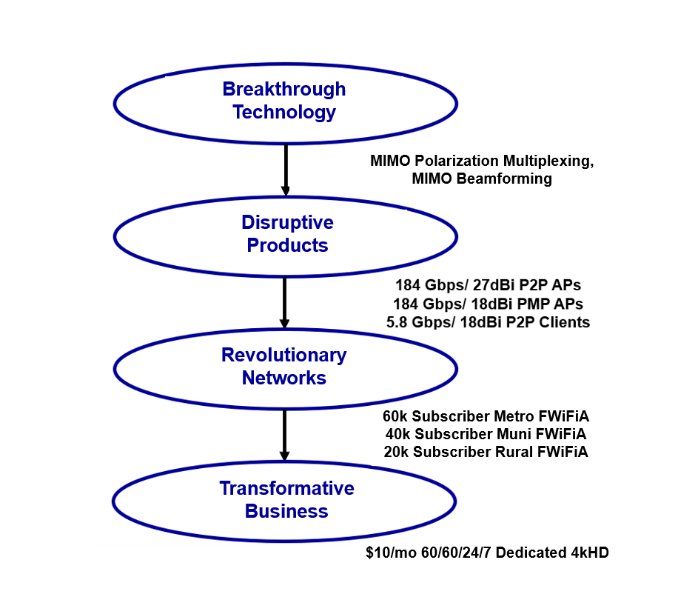


DPWiFi Value Chain

Slide 4
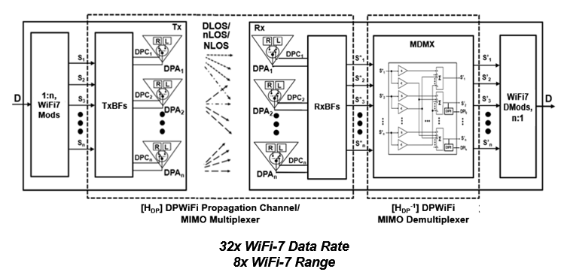
DPWiFi TRX Model
DPWiFi PMX: 32x EHT Data Rate
DPWiFi BF: 8x EHT Range (per STA)

Slide 5
WMAN Dynamic Polarization MIMO Multiplexing

Slide 6
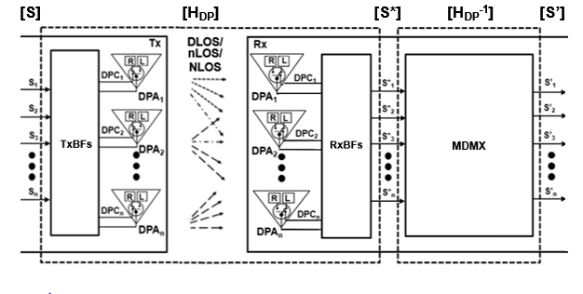
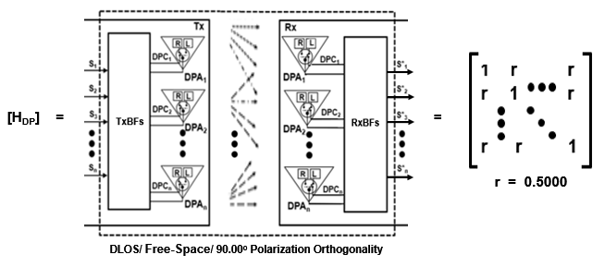

DPWiFi MIMO Multiplexing
    Given n WiFi-7 Streams (n-vectors) [S], [S*] and [S’], and
    The Canonical DPWiFi Propagation (n x n matrix) Channel [H_{DP}] below, and
    The Walsh-n Sequences (n-vectors) [TxDPC] and [RxDPC] below, then
    If [H_{DP}] is Non-Singular there exists an [H_{DP}⁻¹] such that [S’] = [S] x [H_{DP}] x [H_{DP}⁻¹]

Slide 7
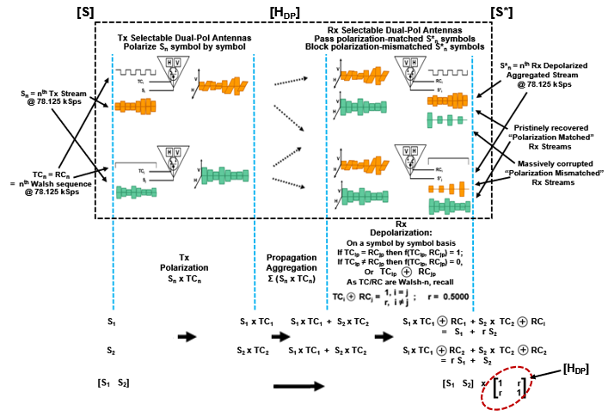
Heuristic 2-Stream [H_{DP}] Analysis
A physical
[TC]-[RC]
dot product
    Handwaving Indicates a Non-Singular and Uniform (r = 0.500) Canonical [H_{DP}]

Slide 8
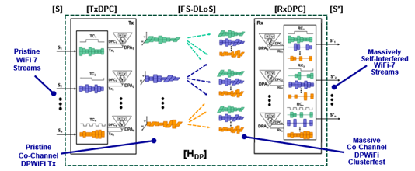
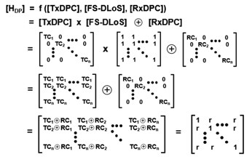
Rigorous n-Stream [H_{DP}] Analysis
r = 0.500
    Math Demonstrates a Non-Singular and Uniformly r = 0.500 Canonical [H_{DP}]

Slide 9
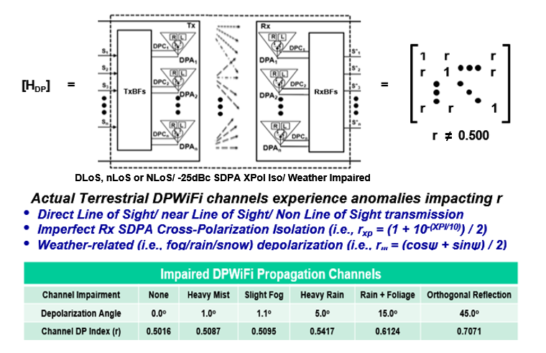
Real-World DPWiFi Propagation Channels
    A Real World [H_{DP}] is also Non-Singular and Uniform, but with 0.501 < r < 0.750

Slide 10
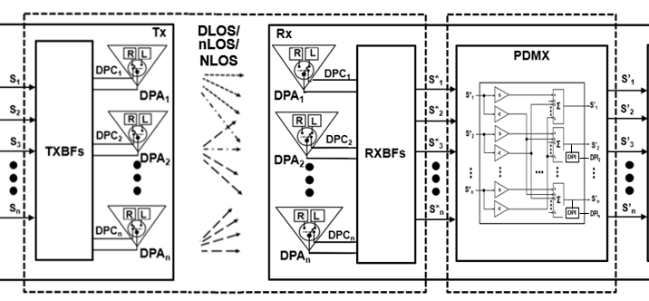


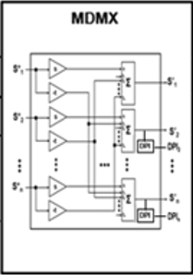
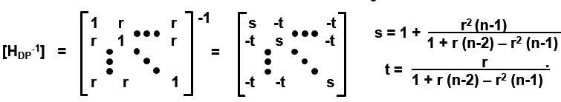
DPWiFi MIMO Demultiplexer
Provided
And given
[H_{DP}] = 0.501 < r < 0.750
Then
[H_{DP}] [H_{DP}⁻¹]
    Such that Implementing the Corresponding Real World [H_{DP}⁻¹] Becomes a Trivial Exercise

Slide 11
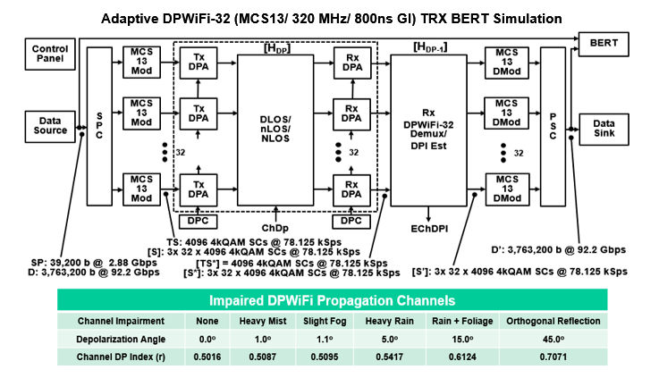
DPWiFi MATLAB Modeling
DPWiFi Math Posits 92 Gbps TRX in 320 MHz, at Least Under the Most Benign Conditions

Slide 12
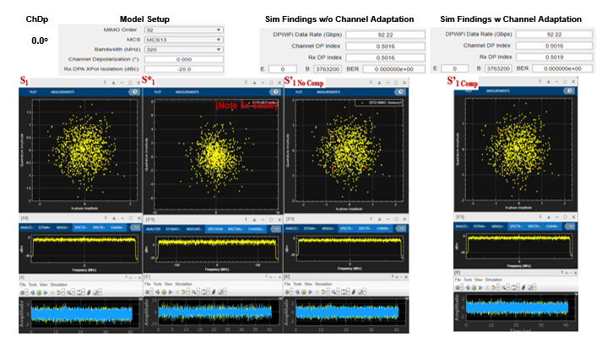
DPWiFi MATLAB Findings
DPWiFi Sims Concur, Validating 92 Gbps in 320 MHz under the Most Benign Conditions

Slide 13
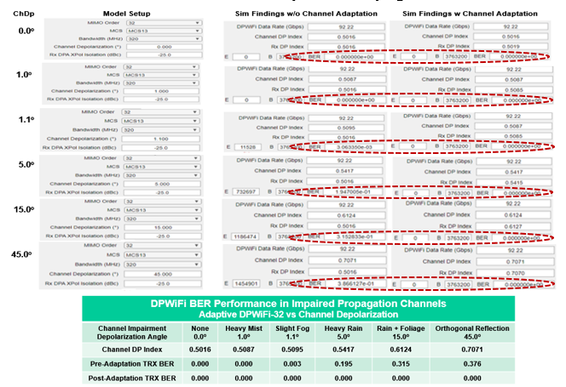
DPWiFi MATLAB Validation
And then Proceed to Validate 92 Gbps in 320 MHz under ANY Conditions

Slide 14
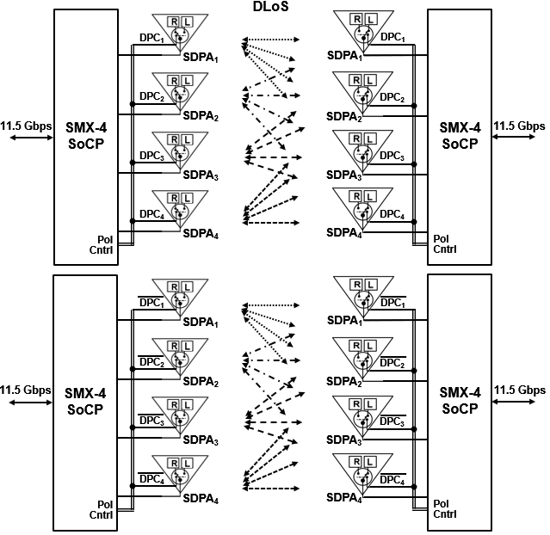
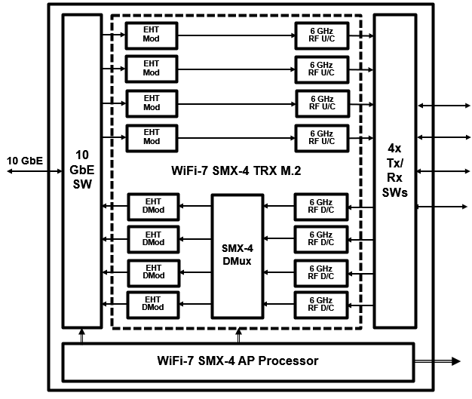


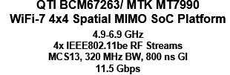

DPWiFi Hardware Validation
Proposed Quick-Turn DPWiFi-4 TRX Testbed
DPWiFi Hardware Validation Could be Completed Within Several Weeks

Slide 15
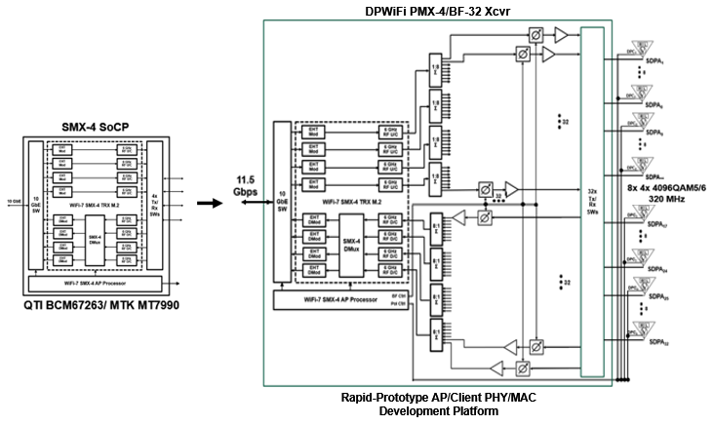
Early DPWiFi Product Development
Contemplated (WiFi-7 Kludge) DPWiFi PMX-4/ BF-32 PHY/MAC Engineering Platform
True TGbn DPWiFi AP/ Client Product Design Could Start Within Several Weeks

Slide 16
WMAN Dynamic Polarization MIMO Beamforming

Slide 17











DPWiFi DLoS/ nLoS/ NLoS Propagation
DPBS
NLoS
DLOS
nLoS
DPCs
DPWiFi APs and Clients Find a Way to Connect, One Way or Another

Slide 18
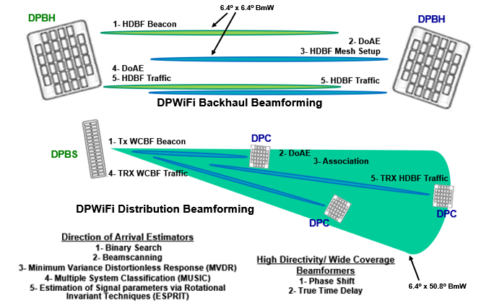
Basic DPWiFi Beamforming
Non-Coordinated Open Loop Direction of Arrival Estimation Rx Beamsteering sets Tx Beamsteering

Slide 19
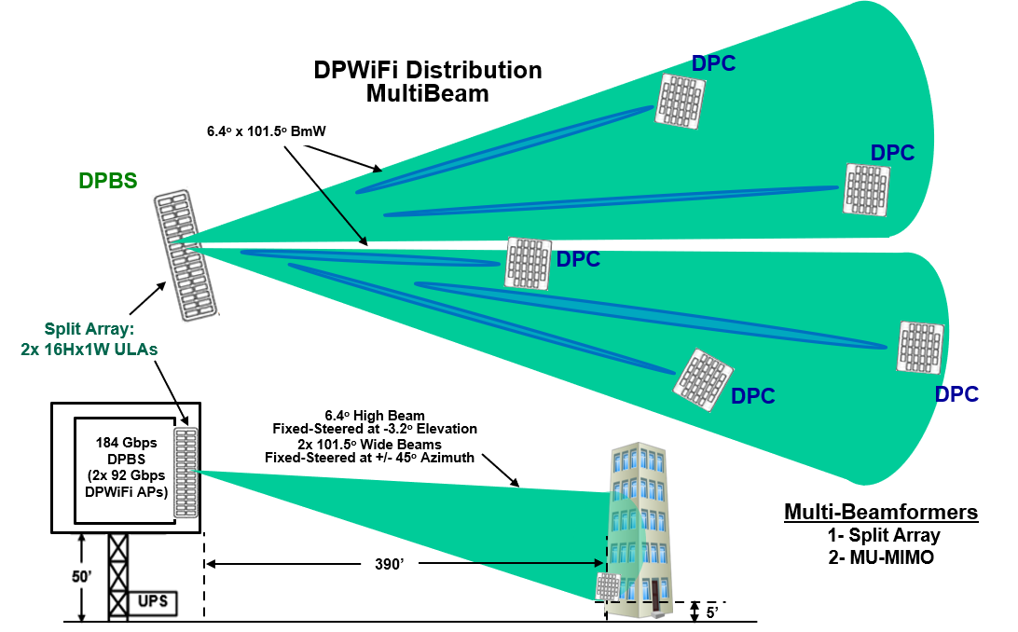
Advanced DPWiFi Beamforming
Full 180º DPBS Tx Multibeam Coverage Obviates Need for AP Scanning

Slide 20
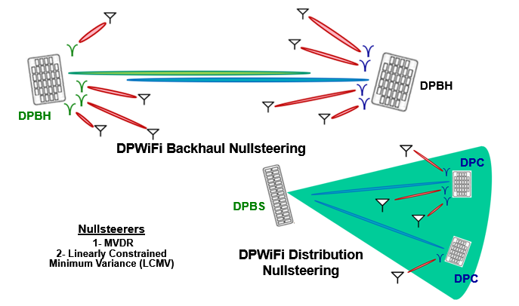
Advanced DPWiFi Beamforming
DPBH/ DPC Rx Interference Cancellation Enables Robust DPWiFi UNII Band Operation

Slide 21
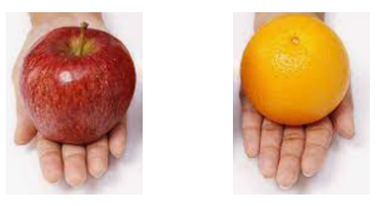
DPWiFi MIMO Summary
Spatial MIMO
MU-MIMO Beamforming
Polarization MIMO
DoAE Beamforming
TGbn DPWiFi Next Generation MIMO Represents World-Changing Wireless

Slide 22
References
1. 23/1464r1-WNGSC
Dynamic Polarization Spatial Multiplexing and Beamforming: Obliterating the MIMO Paradigm
Carlos A Rios (Terabit Wireless Internet), 9-Sep-2023
2. 23/1606r1-WNG SC
Dynamic Polarization Multiplexing and Beamforming WLANs
Carlos A Rios (Terabit Wireless Internet), 13-Sep-2023
3. 23/1756r3-TGbn
MIMO Dynamic Polarization and Beamforming: Proposed IEEE802.11bn PHY
Carlos A Rios (Terabit Wireless Internet), 16-Nov-2023
24/0041r12-TGbn
DPWiFi MATLAB Validation
Carlos A Rios (Terabit Wireless Internet), 02-Feb-2024
24/0440r6- TGbn
DPWiFi for IEEE802.11bn WMANs
Carlos A Rios (Terabit Wireless Internet), 02-Feb-2024

