Slide 1
DPWiFi MIMO Polarization and Beamforming Update
Date: 2024-05-13
Authors:

Slide 2
Abstract
Detail regarding DPWiFi Value Chain Stage 1: Dynamic Polarization MIMO Multiplexing and Beamforming technologies

Slide 3
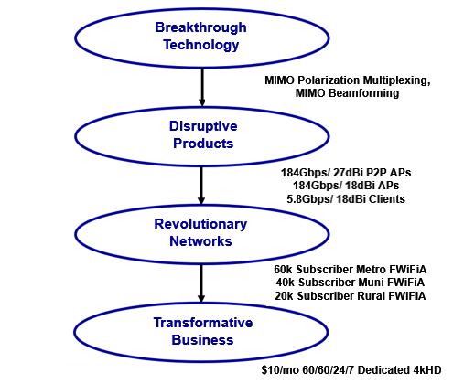
DPWiFi Value Chain
MIMO Polarization Multiplexing and Beamforming
$10/mo 60/60/24/7 Dedicated 4kHD
~2.5B DPWiFi Connections worldwide by 2030

Slide 4
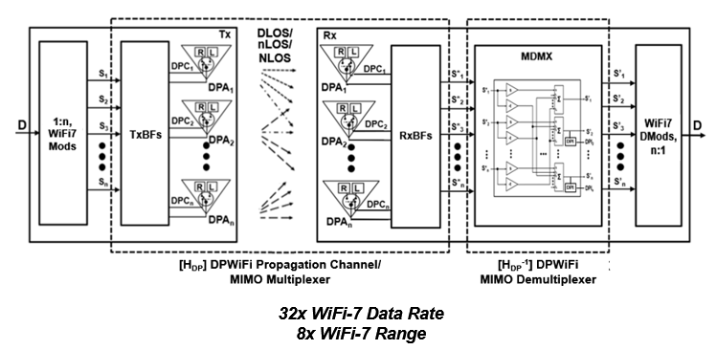
DPWiFi TRX Model

Slide 5
WMAN Dynamic Polarization MIMO Multiplexing

Slide 6
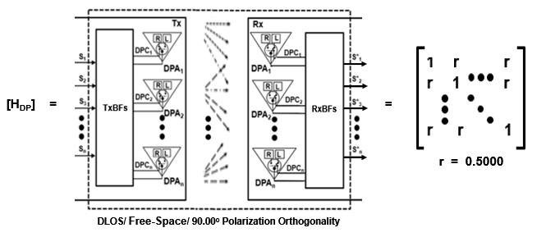
DPWiFi MIMO Multiplexing
Given n WiFi-7 Streams [S], and
The Canonical DPWiFi Propagation Channel [H_{DP}] below, and
The Walsh-n Sequences [TxDPC] and [RxDPC] below, then
If [H_{DP}] is Non-Singular there exists an [H_{DP}⁻¹] such that [S’] = [S] x [H_{DP}] x [H_{DP}⁻¹]

Slide 7
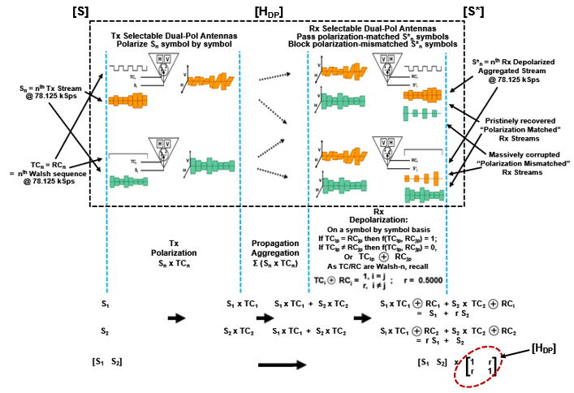
Heuristic 2-Stream [H_{DP}] Analysis
A physical
[TC]-[RC]
dot product
Handwaving Indicates a Non-Singular and Uniform (r = 0.5000) Canonical [H_{DP}]

Slide 8
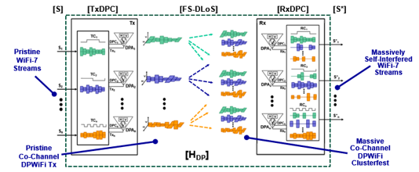
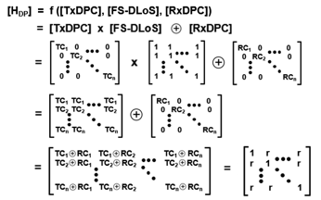
Rigorous n-Stream [H_{DP}] Analysis
r = 0.5000
Math Demonstrates a Non-Singular and Uniformly r = 0.500 Canonical [H_{DP}]

Slide 9
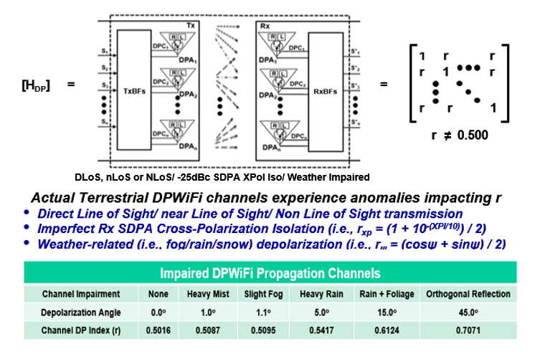
Real-World DPWiFi Propagation Channels
A Real World [H_{DP}] is also Non-Singular and Uniform, but with 0.501 < r < 0.750

Slide 10
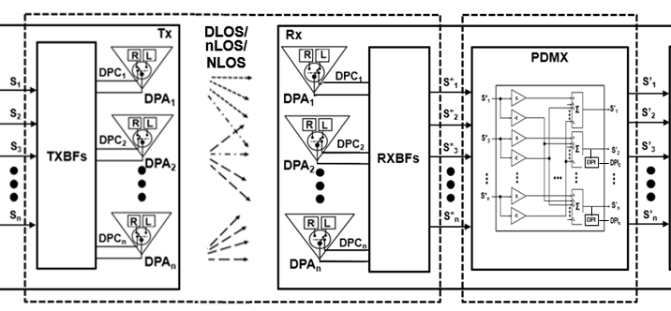
DPWiFi MIMO Demultiplexer
Provided
And given
[H_{DP}] = 0.500 < r < 0.750
Then
[H_{DP}] [H_{DP}⁻¹]
Such that Implementing the Corresponding Real World [H_{DP}⁻¹] is a Trivial Exercise

Slide 11
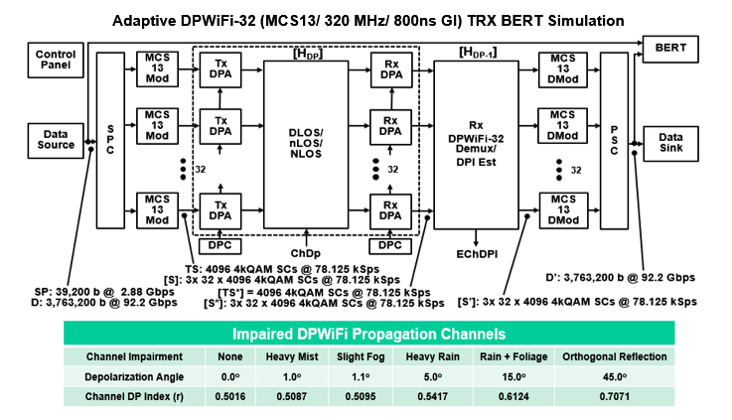
DPWiFi MATLAB Modeling
All that DPWiFi Math Says 92 Gbps in 320 MHz, at Least Under Benign Conditions

Slide 12
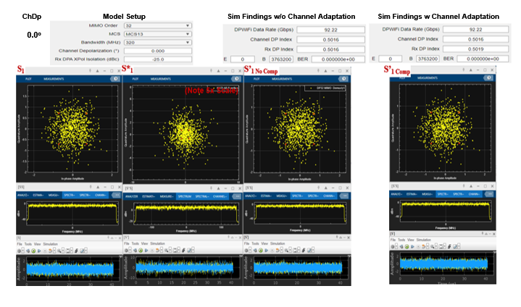
DPWiFi MATLAB Findings
The DPWiFi Sims Concur, Validating 92 Gbps in 320 MHz under the most Benign Conditions

Slide 13
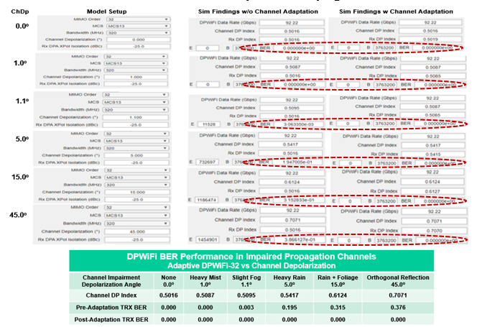
DPWiFi MATLAB Validation
And then they Proceed to Validate 92Gbps in 320 MHz under ANY Conditions

Slide 14
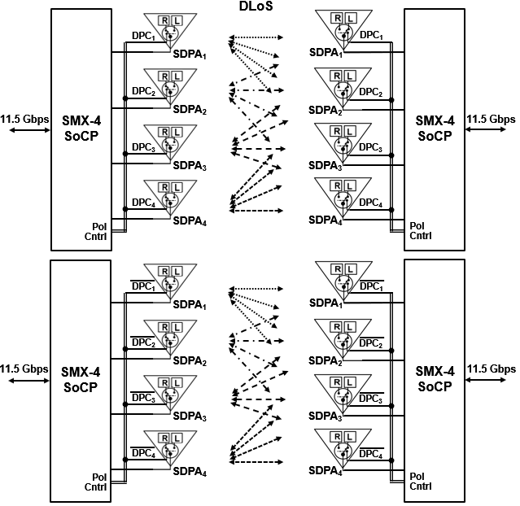
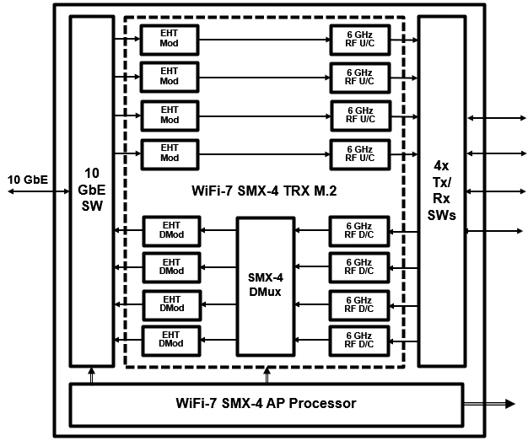
DPWiFi Hardware Validation
Proposed Quick-Turn DPWiFi-4 TRX Testbed
DPWiFi Hardware Validation Could be Completed Within Several Weeks

Slide 15
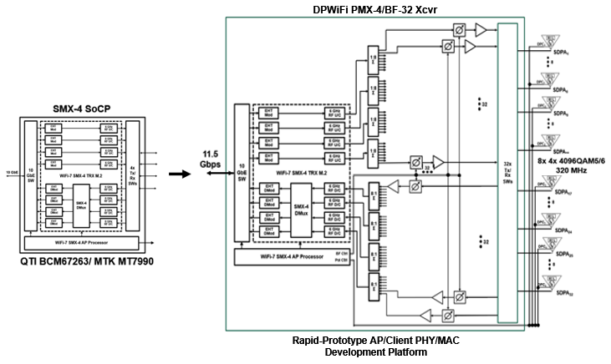
Early DPWiFi Product Development
Contemplated (WiFi-7 Kludge) DPWiFi PMX-4/ BF-32 PHY/MAC Engineering Platform
True TGbn DPWiFi AP/ Product Design Could also Start Within Several Weeks

Slide 16
WMAN Dynamic Polarization MIMO Beamforming

Slide 17
DPWiFi DLoS/ nLoS/ NLoS Propagation
DPBS
NLoS
DLOS
nLoS
DPCs
DPWiFi APs and Clients Find a Way to Connect, One Way or Another

Slide 18
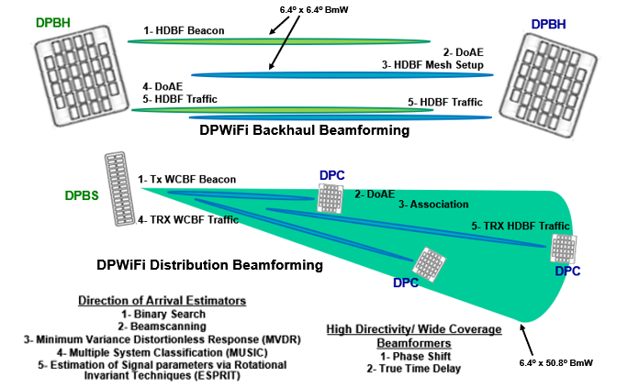
Basic DPWiFi Beamforming
Non-Coordinated Open Loop Direction of Arrival Estimation Rx Beamsteering sets Tx Beamsteering

Slide 19
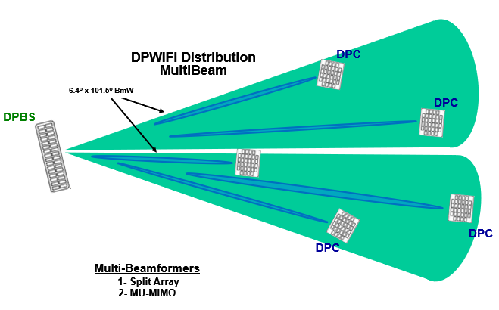
Advanced DPWiFi Beamforming
Full 180º DPBS Tx Multibeam Coverage Obviates Need for AP Scanning

Slide 20
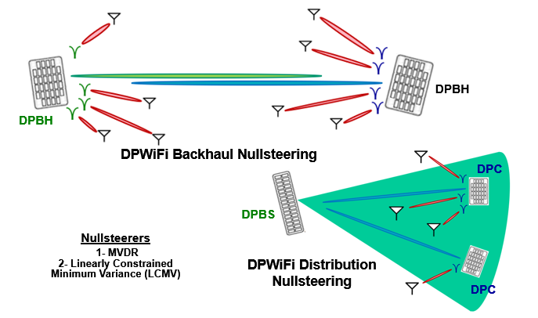
Advanced DPWiFi Beamforming
DPBH/ DPC Rx Interference Cancellation Enables Robust DPWiFi Operation in the UNII Bands

Slide 21
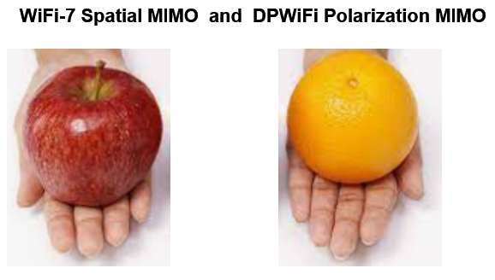
DPWiFi MIMO Summary

Slide 22
References
1. 23/1464r1-WNGSC Dynamic Polarization Spatial Multiplexing and Beamforming: Obliterating the MIMO Paradigm Carlos A Rios (Terabit Wireless Internet), 9-Sep-2023
2. 23/1606r1-WNG SC Dynamic Polarization Multiplexing and Beamforming WLANs Carlos A Rios (Terabit Wireless Internet), 13-Sep-2023
3. 23/1756r3-TGbn MIMO Dynamic Polarization and Beamforming: Proposed IEEE802.11bn PHY Carlos A Rios (Terabit Wireless Internet), 16-Nov-2023
24/0041r12-TGbn DPWiFi MATLAB Validation Carlos A Rios (Terabit Wireless Internet), 02-Feb-2024
24/0440r6- TGbn DPWiFi for IEEE802.11bn WMANs Carlos A Rios (Terabit Wireless Internet), 02-Feb-2024

