Slide 1
Multi-link In-device Coexistence Management
Date: 2024-05-08
Authors:

Slide 2
Abstract
In 11bn, in-device coexistence (IDC) indication based on response control frame(RCF) method was proposed [1]
RCF can be extended to indicate more information
  e.g., multi-link availability indication, delayed information
With the proposing method, IDC can be managed over multi-link

Slide 3
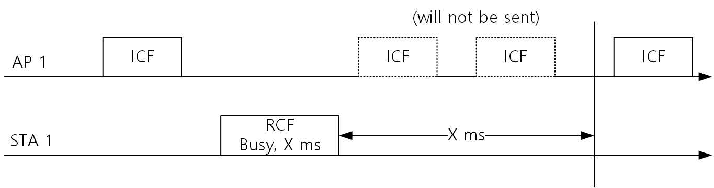
Background
In [1], RCF transmission method was discussed
When an AP transmit initial control frame (ICF) to a non-AP STA, the non-AP STA responses with an RCF frame
The RCF frame can indicate the non-AP STA’s unavailability
  ICF-RCF frame exchange can handle the IDC problem discussed in UHR SG and TGbn.
Example of RCF transmission [1]:

Slide 4
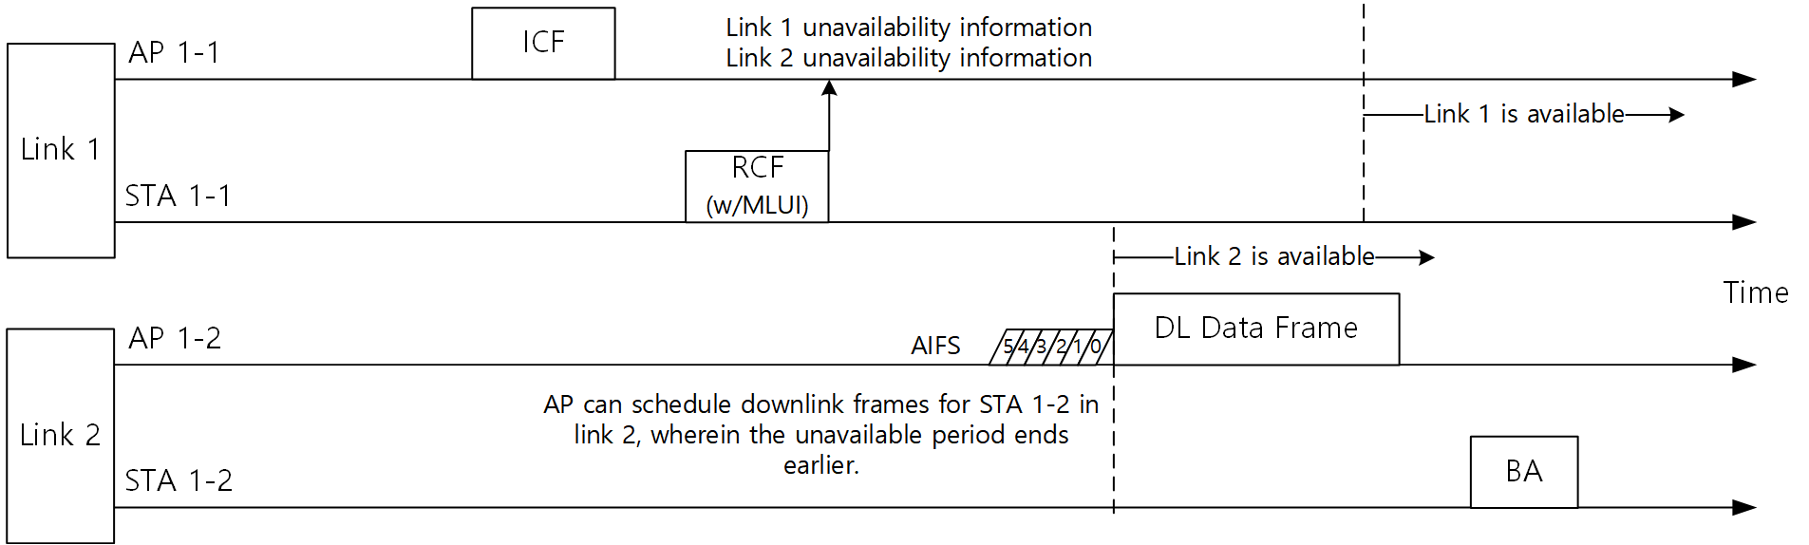
Extension for RCF frame
This submission proposes an extension for RCF
  Multi-link unavailability indication (MLUI)
When the RCF frame contains MLUI, the AP can schedule downlink frames regarding the indication.

Slide 5
Unsolicited RCF transmission
When the non-AP STA was able to receive the ICF but has been unable to transmit the RCF frame due to IDC, It can transmit ‘Unsolicited RCF’
  When the AP receives the unsolicited RCF, the channel coding algorithms of the AP will not drop the MCS of transmission for the non-AP MLD
Unsolicited RCF can be transmitted in multi-link.

Slide 6
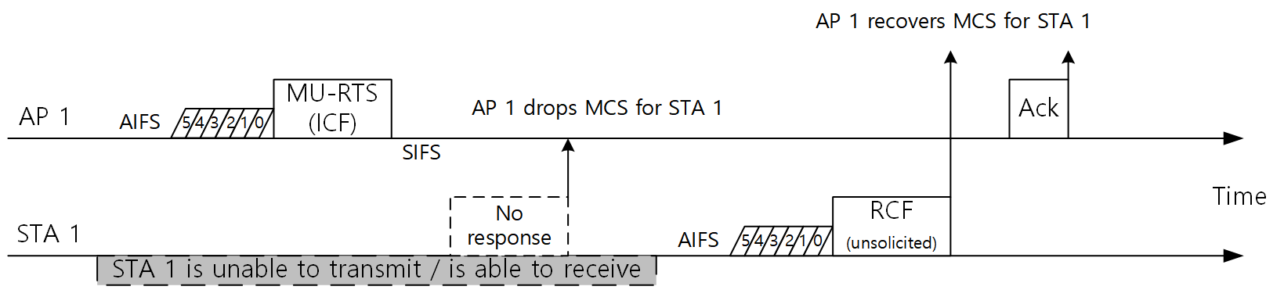
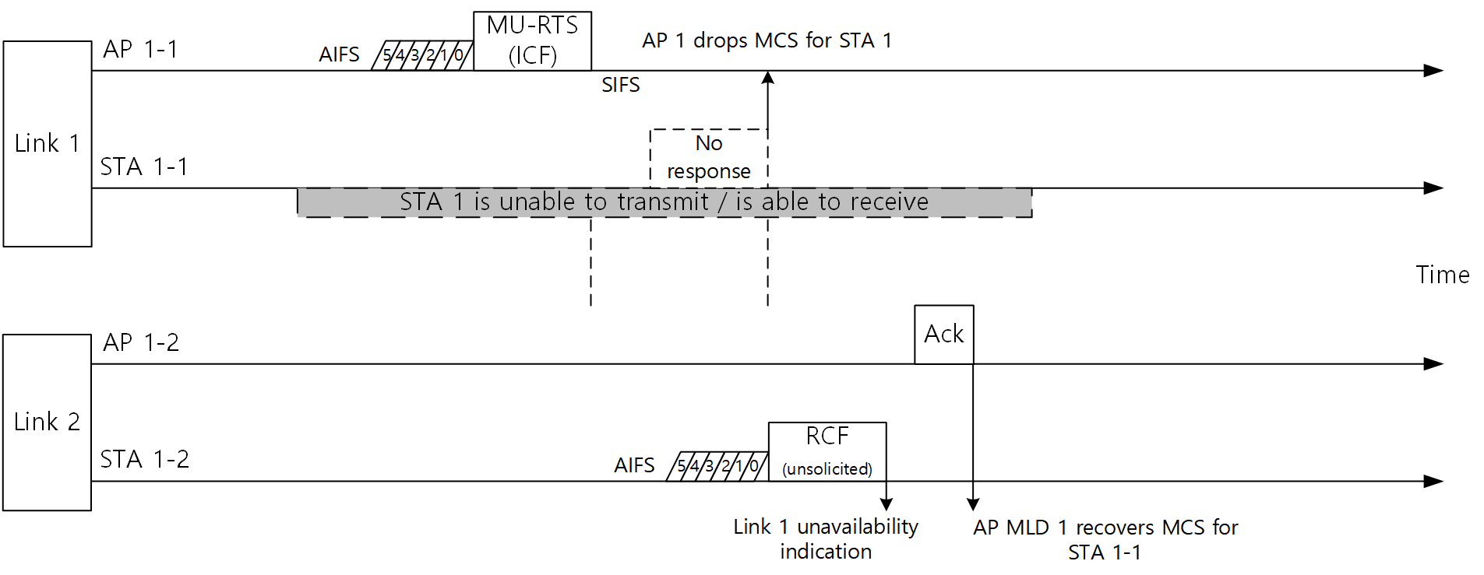
Unsolicited RCF transmission

Slide 7
Summary
This document proposed the extensions for the ICF – RCF transmission method
  RCF frames with Multi-link unavailability indication (MLUI)
  Unsolicited RCF transmission
With the proposed extensions, IDC problem in TGbn can be effectively handled

Slide 8
References
[1] Dibakar Das, ICF-RCF transmission rules (23/2055): https://mentor.ieee.org/802.11/dcn/23/11-23-2055-01-00bn-icf-rcf-transmission-rules.pptx

