Slide 1
Reachability of mmWave Link
Date: 2024-05-14
Authors:
Name | Affiliation | Address | Phone | Email
Insik Jung | LG Electronics | 19, Yangjae-daero 11gil, Seocho-gu, Seoul 137-130, Korea |  | insik0618.jung@lge.com
Eunsung Park |  |  |  | esung.park@lge.com
Insun Jang |  |  |  | insun.jang@lge.com
Dongju Cha |  |  |  | dongju.cha@lge.com
Jinsoo Choi |  |  |  | js.choi@lge.com
HanGyu Cho |  |  |  | hg.cho@lge.com
Sang Kim |  |  |  | sanggook.kim@lge.com

Slide 2
Introduction
IMMW pursues non-standalone operations and aims to minimize frame exchanges which are not data frames in mmWave band.
[1] propose not to transmit mmWave beacon or just transmit light version of a beacon
Aligned with the technical direction, we propose to estimate the mmwave link reachabilty in sub-7GHz link.
In this contribution, we consider the scenario where there is no mmWave beacon

Slide 3
Recap: Multi-link Reachability
In 11be, multi-link reachability problems have been handled.
[2] proposes a downlink reachability estimation method
[3] proposes a downlink and uplink reachability estimation method
Both contributions consider non-AP STA side reachability estimation because of some benefits (non-AP STA’s power saving, AP MLD selection diversity)
However, AP side reachability estimation could also be important in IMMW
Due to the non-standalone nature, power saving benefit would be weakened
We can prevent non-AP STA side reachability computation burden
We can save reporting overhead of reachability estimation result
In this contribution, we propose to conduct AP side reachability estimation
Notes:
AP쪽이 더 좋은 이유
-non-AP가 판단해도 signaling 똑같이 가야됨
-non-AP가 reachable하다는 피드백 해야함 → AP 스케줄링 목적으로
-non-standalone이라 이미 complex한데 STA 에게 연산 부담을 줄여줄 수 있음
STA estimation은 Tracking할 때 STA들이 각각 estimation 결과를 report 해줘야 함 → AP estimation할 경우에는 implicit하게 가능
mmWave는 환경에 따라 변화량이 크므로 tracking이 더 중요할 수 있음.

Slide 4
mmWave Reachability
System Model
AP
MLD
Non-AP MLD
Link 1 (L1) : sub-7GHz link
AP 1
STA 1
Link 2 (L2) : mmWave link
AP 2
STA 2
We want to estimate link 2’s reachability using frame exchanges in link 1

Slide 5
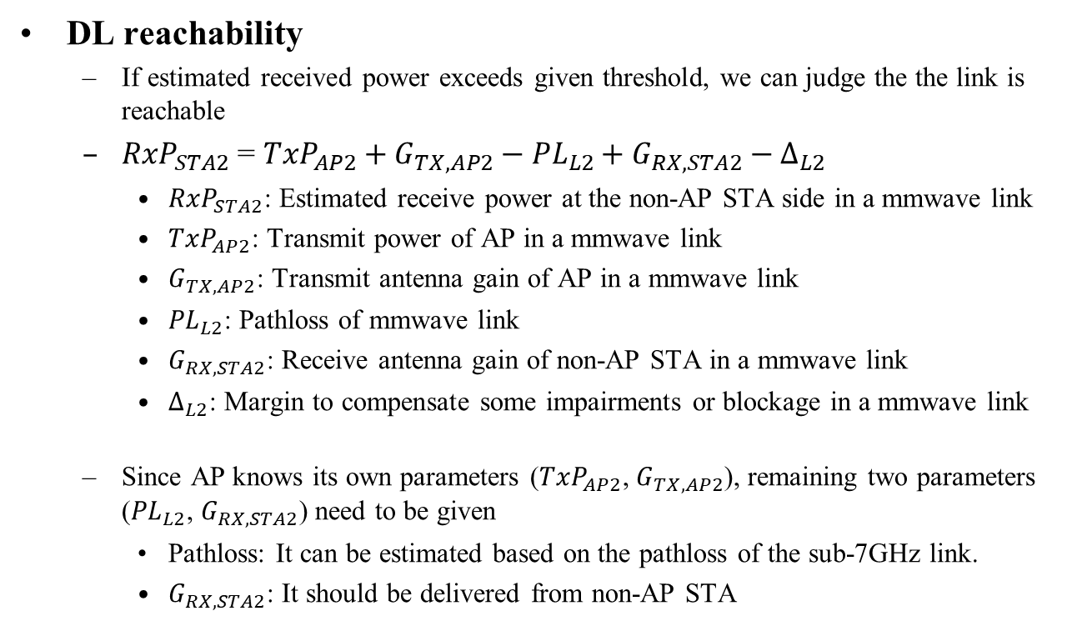
Reachability Estimation (1/4)
DL reachability
If estimated received power exceeds given threshold, we can judge the the link is reachable
${RxP}_{STA2}$ = ${TxP}_{AP2}+G_{TX,AP2}−{PL}_{L2}+G_{RX,STA2}−∆_{L2}$
${RxP}_{STA2}$: Estimated receive power at the non-AP STA side in a mmwave link
${TxP}_{AP2}$: Transmit power of AP in a mmwave link
$G_{TX,AP2}$: Transmit antenna gain of AP in a mmwave link
${PL}_{L2}$: Pathloss of mmwave link
$G_{RX,STA2}$: Receive antenna gain of non-AP STA in a mmwave link
$∆_{L2}$: Margin to compensate some impairments or blockage in a mmwave link
Since AP knows its own parameters (${TxP}_{AP2}$, $G_{TX,AP2}$), remaining two parameters (${PL}_{L2}$, $G_{RX,STA2}$) need to be given
Pathloss: It can be estimated based on the pathloss of the sub-7GHz link.
$G_{RX,STA2}$: It should be delivered from non-AP STA

Slide 6
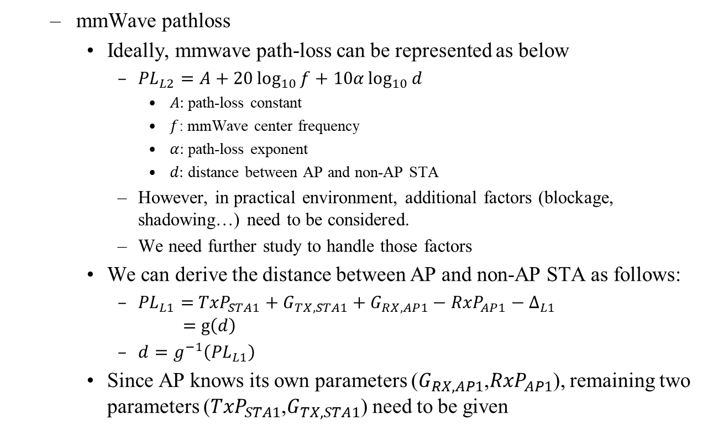
Reachability Estimation (2/4)
mmWave pathloss
Ideally, mmwave path-loss can be represented as below
${PL}_{L2}=A+20\log_{10}{f}+10α\log_{10}{d}$
$A:$path-loss constant
$f$: mmWave center frequency
$α:$ path-loss exponent
$d:$ distance between AP and non-AP STA
However, in practical environment, additional factors (blockage, shadowing…) need to be considered.
We need further study to handle those factors
We can derive the distance between AP and non-AP STA as follows:
${PL}_{L1}=$ ${TxP}_{STA1}+G_{TX,STA1}+G_{RX,AP1}−{RxP}_{AP1}−∆_{L1}$ $=$ $g\left(d\right)$
$d=g^{−1}\left({PL}_{L1}\right)$
Since AP knows its own parameters ($G_{RX,AP1}$,${RxP}_{AP1}$), remaining two parameters (${TxP}_{STA1}$,$G_{TX,STA1}$) need to be given

Slide 7
Reachability Estimation (3/4)
In summary, the parameters below should be delivered from non-AP STA for DL reachability estimation
$G_{RX,STA2}$: RX antenna gain at the non-AP STA side in mmwave link
${TxP}_{STA1}:$ Transmit power of the non-AP STA in sub-7GHz link
$G_{TX,STA1}$: TX antenna gain at the non-AP STA side in sub-7GHz link

Slide 8
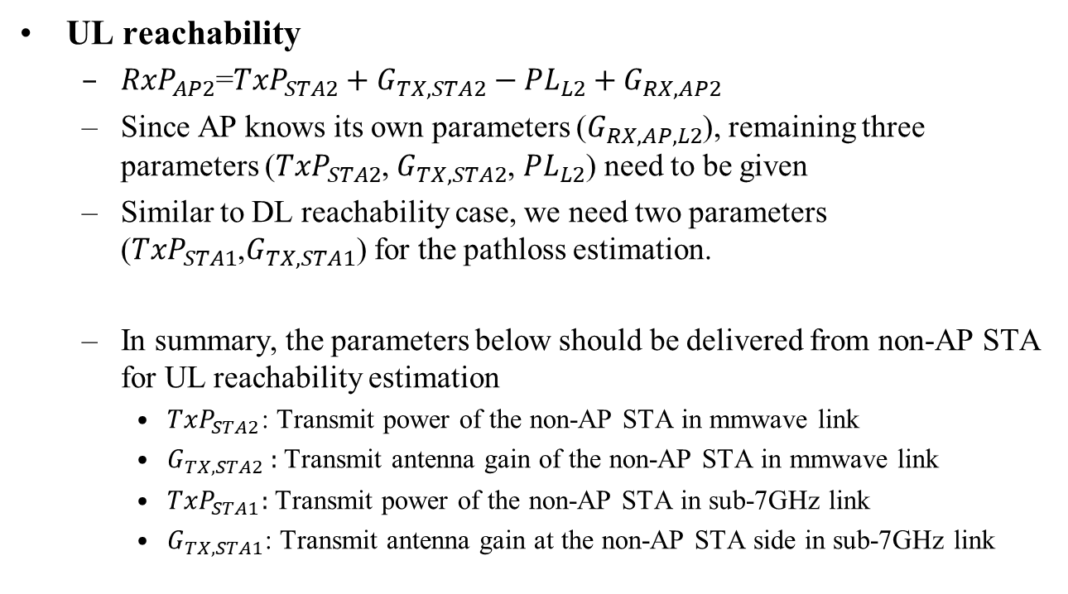
Reachability Estimation (4/4)
UL reachability
${RxP}_{AP2}$=${TxP}_{STA2}+G_{TX,STA2}−{PL}_{L2}+G_{RX,AP2}$
Since AP knows its own parameters ($G_{RX,AP,L2}$), remaining three parameters (${TxP}_{STA2}$, $G_{TX,STA2}$, ${PL}_{L2}$) need to be given
Similar to DL reachability case, we need two parameters (${TxP}_{STA1}$,$G_{TX,STA1}$) for the pathloss estimation.
In summary, the parameters below should be delivered from non-AP STA for UL reachability estimation
${TxP}_{STA2}$: Transmit power of the non-AP STA in mmwave link
$G_{TX,STA2}$ : Transmit antenna gain of the non-AP STA in mmwave link
${TxP}_{STA1}:$ Transmit power of the non-AP STA in sub-7GHz link
$G_{TX,STA1}$: Transmit antenna gain at the non-AP STA side in sub-7GHz link

Slide 9
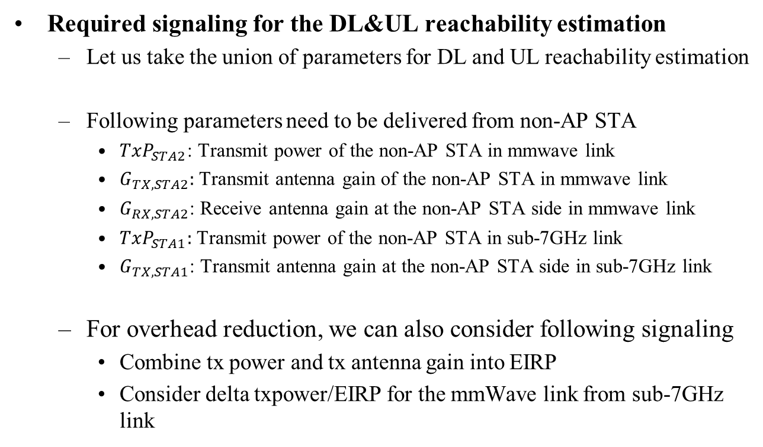
Required Signaling
Required signaling for the DL&UL reachability estimation
Let us take the union of parameters for DL and UL reachability estimation
Following parameters need to be delivered from non-AP STA
${TxP}_{STA2}$: Transmit power of the non-AP STA in mmwave link
$G_{TX,STA2}$: Transmit antenna gain of the non-AP STA in mmwave link
$G_{RX,STA2}$: Receive antenna gain at the non-AP STA side in mmwave link
${TxP}_{STA1}:$ Transmit power of the non-AP STA in sub-7GHz link
$G_{TX,STA1}$: Transmit antenna gain at the non-AP STA side in sub-7GHz link
For overhead reduction, we can also consider following signaling
Combine tx power and tx antenna gain into EIRP
Consider delta txpower/EIRP for the mmWave link from sub-7GHz link

Slide 10
Reachability Estimation in Multi-link Setup
mmWave reachability estimation would be natural to be conducted during multi-link setup procedure
Scanning
STA1
Scanning..
AP1
Multi-link probe request
STA1
Probing..
AP1
Multi-link probe response
STA1
Providing multi-link (L2) information
AP1
Association request
reachability estimation
STA1
Parameters listed in slide 9
AP1
Association response
STA1
Accept / Reject
AP1

Slide 11
Conclusion
We have proposed mmWave reachability estimation method without using mmWave link.
There are some challenges to estimate practical path-loss of the mmWave link. We need further study regarding that.
Especially, we focus on DL and UL reachability estimation method and its required signaling when AP estimates the mmWave reachability.

Slide 12
References
[1] 11-23-2052-00, mmWave operation without mmWave Beacon
[2] 11-20-0508-03, MLO: Reachability Problem
[3] 11-20-1892-02, Estimation of Link Reachability

