Slide 1
Discussion on Distribution Bandwidth of DRU
Date: 2024-05-08
Authors:
Name | Affiliations | Address | Phone | email
Mengshi Hu | Huawei |  |  | humengshi@huawei.com
Ross Jian Yu
Ming Gan

Slide 2
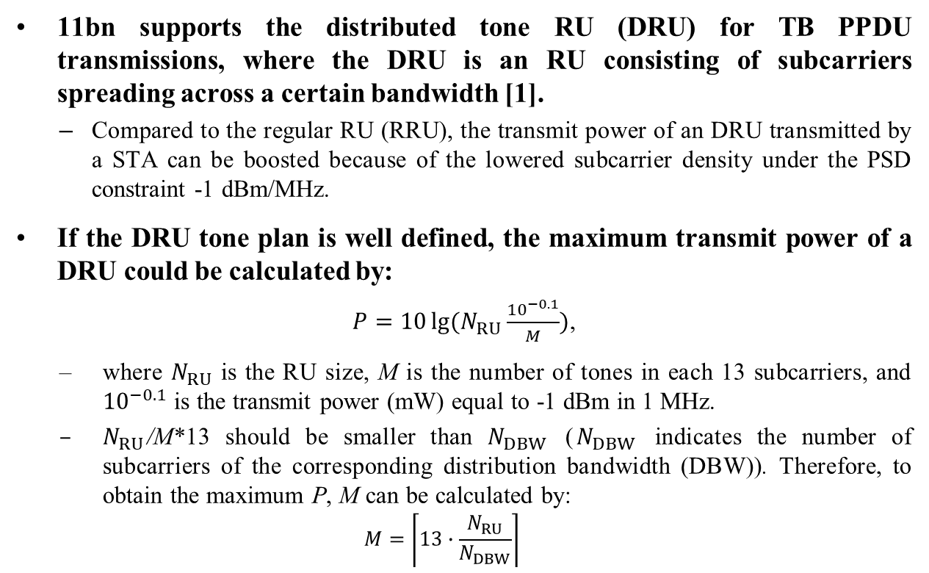
Background
11bn supports the distributed tone RU (DRU) for TB PPDU transmissions, where the DRU is an RU consisting of subcarriers spreading across a certain bandwidth [1].
  Compared to the regular RU (RRU), the transmit power of an DRU transmitted by a STA can be boosted because of the lowered subcarrier density under the PSD constraint -1 dBm/MHz.
  If the DRU tone plan is well defined, the maximum transmit power of a DRU could be calculated by:
  $P=10\lg{(N_{RU}\frac{{10}^{−0.1}}{M})}$,
  where $N_{RU}$ is the RU size, M is the number of tones in each 13 subcarriers, and ${10}^{−0.1}$ is the transmit power (mW) equal to -1 dBm in 1 MHz.
  $N_{RU}$/M*13 should be smaller than $N_{DBW}$ ($N_{DBW}$ indicates the number of subcarriers of the corresponding distribution bandwidth (DBW)). Therefore, to obtain the maximum P, M can be calculated by:
  $$M=\left\lceil 13∙\frac{N_{RU}}{N_{DBW}}\right\rceil$$

Slide 3

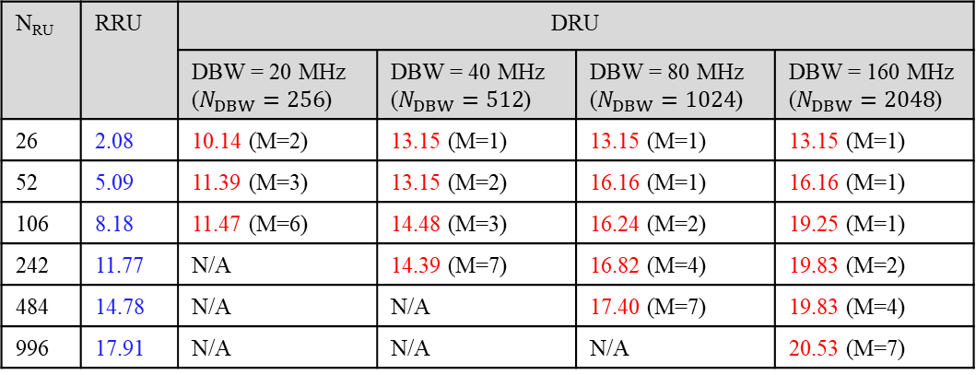
Maximum Power
The following table shows the maximum transmit power of a DRU:
  The maximum power of DRU is a function of the DRU size and its DBW [2]. The value can be calculated as P shown in the previous slide.
  The maximum power of RRU can be calculated by 10*lg($N_{RU}$*0.078125)-1 (dBm).
Table 1 Maximum Transmit Power of RU (dBm)
N_{RU} | RRU | DRU
 |  | DBW = 20 MHz ($N_{DBW}=256$) | DBW = 40 MHz ($N_{DBW}=512$) | DBW = 80 MHz ($N_{DBW}=1024$) | DBW = 160 MHz ($N_{DBW}=2048$)
26 | 2.08 | 10.14 (M=2) | 13.15 (M=1) | 13.15 (M=1) | 13.15 (M=1)
52 | 5.09 | 11.39 (M=3) | 13.15 (M=2) | 16.16 (M=1) | 16.16 (M=1)
106 | 8.18 | 11.47 (M=6) | 14.48 (M=3) | 16.24 (M=2) | 19.25 (M=1)
242 | 11.77 | N/A | 14.39 (M=7) | 16.82 (M=4) | 19.83 (M=2)
484 | 14.78 | N/A | N/A | 17.40 (M=7) | 19.83 (M=4)
996 | 17.91 | N/A | N/A | N/A | 20.53 (M=7)

Slide 4
Power Gain (1/2)
To clearly show the transmit power gain compared to the RRU case, a table is listed below.
  The values in the table show the power gains with different distribution bandwidths.
  The yellow blocks indicate that more gains are achieved by enlarging the distribution bandwidth.
Table 2 Power Gain Compared to RRU Case (dB)
N_{RU} | DRU
 | DBW = 20 MHz | DBW = 40 MHz | DBW = 80 MHz | DBW = 160 MHz
26 | 8.06 | 11.07 | 11.07 | 11.07
52 | 6.3 | 8.06 | 11.07 | 11.07
106 | 3.29 | 6.3 | 8.06 | 11.07
242 | N/A | 2.62 | 5.05 | 8.06
484 | N/A | N/A | 2.62 | 5.05
996 | N/A | N/A | N/A | 2.62

Slide 5
Power Gain (2/2)
From the previous slides, it is easy to note that:
  20 MHz DBW can enhance: 26-, 52-, and106-tone RUs.
  40 MHz DBW can further enhance: 26-, 52-, 106-, and 242-tone RUs.
  80 MHz DBW can further enhance: 52-, 106-, 242-, and 484-tone RUs.
  160 MHz DBW can further enhance: 106-, 242-, 484-, and 996-tone RUs.
  In other words, small and large distribution bandwidths are all important to the performance of DRUs.
  For small RUs, small DBW is enough to get the highest power boosting gain.
  For large RUs, larger distribution bandwidths are needed to support the power boosting (such as 996-tone RU) or further enhance the performance (such as 106-, 242-, and 484-tone RUs).
  Since large RUs (such as 242-, 484-, and 996-tone RUs) are the key point to increase the throughput and reduce the latency in UHR, a DBW of 160 MHz should be supported to well enhance the performance of large RUs.

Slide 6
Complexity
The suggested distribution bandwidths are 20, 40, 80, and 160 MHz.
Complexity at transmitter sides (Acceptable):
  Since the largest DRU size is 996 tones, the segment parser can be bypassed at the transmitter [3, 4].
Complexity at receiver sides (Acceptable):
  The receiver is an AP, which is more powerful.
  Similar to the existing RU or MRU crossing 80 MHz, it is not hard for an AP to combine the data of a DRU crossing 80 MHz.

Slide 7
Summary
Different distribution bandwidths are all important to DRU.
  Small DBW may be good enough for some small RUs.
  For large RUs, larger distribution bandwidths are needed to support the power boosting (such as 996-tone RU) or further enhance the performance (such as 106-, 242-, and 484-tone RUs).
  Suggest supporting the distribution bandwidth of 20, 40, 80, and 160 MHz.

Slide 8
References
[1] Alfred Asterjadhi, TGbn Motions List - Part 1, 802.11 DCN 2024/0171r6
[2] Sigurd Schelstraete, et al. Range Extension with dRU, 802.11 DCN 2024/0429r0
[3] Ross Jian Yu, et al. Distribution Bandwidth of DRU, 802.11 DCN 2023/2200r3
[4] Eunsung Park, et al. Hybrid PPDU and Distribution Bandwidth for DRU, 802.11 DCN 2023/0400r0

Slide 9
Straw Poll #1
Do you agree to include the following into the 11bn SFD?
  11bn defines distribution bandwidth of 20 MHz, 40 MHz, 80 MHz and 160 MHz.
    The distribution bandwidth is the bandwidth that a DRU spans over.
    The distribution bandwidth is smaller or equal to the PPDU bandwidth.
    Y
    N
    A

