Slide 1
DRU Tone Plan from the perspective of PAPR
Date: 2024-05
Authors:
Name | Affiliation | Address | Phone | Email
Chenchen Liu | Huawei Technologies Co., Ltd | Huawei Base, Bantian, Shenzhen |  | liuchenchen1@huawei.com
Jian Yu
Ming Gan

Slide 2
Introduction
The concept of Distributed tone Resource Unit (DRU) has been extensively discussed in contributions [1]-[10] .
Through these discussions, we have generally reached the following consensus:
  Achieve the optimal power boost gain
  Preserve hierarchical structure as RRU
  Better tone distribution pattern with either uniformly or near-uniformly distributed(for data tones)
  Easier for channel smoothing and simpler for scheduling/signaling
Besides the above consensus, having a lower PAPR is also an important factor to consider, especially in scenarios of large spreading BW

Slide 3
Factors Affecting the PAPR
Modulation Scheme: Higher-order modulation schemes typically results in higher PAPR.
Tone Plan: The way subcarriers are allocated can significantly impact the PAPR. Sparse or clustered allocation may lead to higher PAPR compared with evenly distributed allocation.
Number of Tones: Generally, increasing of the number of subcarriers can lead to a higher PAPR.
Coding and Signal Processing Techniques: Coding schemes designed to minimize peaks in the signal waveform can also be employed to reduce the PAPR.

Slide 4
DRU Effective Bandwidth
Definition of Effective Bandwidth:
  Effective bandwidth is defined as the spreading bandwidth divided by the greatest common divisor(GCD) of the spacing between all adjacent subcarriers
  This concept helps in understanding how the PAPR of DRU is influenced by the spreading bandwidth and tone plan
Impact on PAPR:
  A larger effective bandwidth generally leads to a higher PAPR
  An RRU has roughly the same PAPR as a DRU with equal effective bandwidth
Considerations for DRU Tone Plan Design:
  When designing the DRU, it’s crucial to aim for a smaller effective bandwidth for the purpose of more efficient power usage and better overall system performance

Slide 5
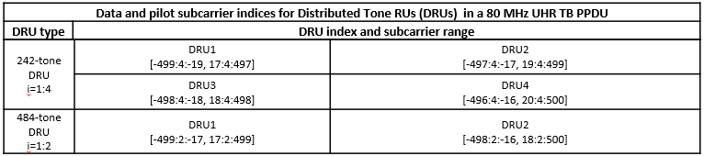
DRU Effective Bandwidth
A good DRU example for SBW=80MHz is given in [9], where
  For the 484-tone DRU, the adjacent subcarriers spaces are either 2 or 34 with GCD=2, resulting effective bandwidth 80MHz/2=40MHz and similar PAPR as 484-tone RRU
  For the 242-tone DRU, the adjacent subcarriers spaces are either 4 or 36 with GCD=4, resulting effective bandwidth 80MHz/4=20MHz and similar PAPR as 242-tone RRU
It is ideal to have GCD=8 for 106-tone DRU and GCD=16 for 52-tone DRU to achieve a comparable PAPR to an equal size RRU

Slide 6
PD false detection issues
The PD false detection issues is mention in [5]
  With a GCD of 16, the signal repeats every 0.8us.
  Some receiver may use the delay autocorrelation method[11] for packet detection as follows
To maintain the hierarchical structure while minimizing the effective bandwidth, it is recommended the GCD for both 106-tone and 52-tone DRU be set to 8 to prevent the PD false detection issues

Slide 7
Proposed DRU Tone Plan for 80MHz
Data and pilot subcarrier indices for Distributed Tone RUs (DRUs) in a 80 MHz UHR TB PPDU
DRU type | DRU index and subcarrier range
52-tone DRU i=1:16 | DRU1 [-471:16:-391, -367:16:-159, -135:16:-55, 41:16:121, 145:16:353, 377:16:457] | DRU2 [-463:16:-383, -359:16:-151, -127:16:-47, 49:16:129, 153:16:361, 385:16:465] | DRU3 [-467:16:-387, -363:16:-155, -131:16:-51, 45:16:125, 149:16:357, 381:16:461] | DRU4 [-459:16:-379, -355:16:-147, -123:16:-43, 53:16:133, 157:16:365, 389:16:469]
 | DRU5 [-465:16:-385, -361:16:-153, -129:16:-49, 47:16:127, 151:16:359, 383:16:463] | DRU6 [-457:16:-377, -353:16:-145, -121:16:-41, 55:16:135, 159:16:367, 391:16:471] | DRU7 [-469:16:-389, -365:16:-157, -133:16:-53, 43:16:123, 147:16:355, 379:16:459] | DRU8 [-461:16:-381, -357:16:-149, -125:16:-45, 51:16:131, 155:16:363, 387:16:467]
 | DRU9 [-470:16:-390, -366:16:-158, -134:16:-54, 42:16:122, 146:16:354, 378:16:458] | DRU10 [-462:16:-382, -358:16:-150, -126:16:-46, 50:16:130, 154:16:362, 386:16:466] | DRU11 [-466:16:-386, -362:16:-154, -130:16:-50, 46:16:126, 150:16:358, 382:16:462] | DRU12 [-458:16:-378, -354:16:-146, -122:16:-42, 54:16:134, 158:16:366, 390:16:470]
 | DRU13 [-464:16:-384, -360:16:-152, -128:16:-48, 48:16:128, 152:16:360, 384:16:464] | DRU14 [-456:16:-376, -352:16:-144, -120:16:-40, 56:16:136, 160:16:368, 392:16:472] | DRU15 [-468:16:-388, -364:16:-156, -132:16:-52, 44:16:124, 148:16:356, 380:16:460] | DRU16 [-460:16:-380, -356:16:-148, -124:16:-44, 52:16:132, 156:16:364, 388:16:468]
106-tone DRU i=1:8 | DRU1 [-471:8:-383, -367:8:-47, 41:8:361, 377:8:465] | DRU2 [-467:8:-379, -363:8:-43, 45:8:365, 381:8:469] | DRU3 [-465:8:-377, -361:8:-41, 47:8:367, 383:8:471] | DRU4 [-469:8:-381, -365:8:-45, 43:8:363, 379:8:467]
 | DRU5 [-470:8:-382, -366:8:-46, 42:8:362, 378:8:466] | DRU6 [-466:8:-378, -362:8:-42, 46:8:366, 382:8:470] | DRU7 [-464:8:-376, -360:8:-40, 48:8:368, 384:8:472] | DRU8 [-468:8:-380, -364:8:-44, 44:8:364, 380:8:468]
242-tone DRU i=1:4 | DRU1 [-499:4:-19, 17:4:497] |  | DRU2 [-497:4:-17, 19:4:499]
 | DRU3 [-498:4:-18, 18:4:498] |  | DRU4 [-496:4:-16, 20:4:500]
484-tone DRU i=1:2 | DRU1 [-499:2:-17, 17:2:499] |  | DRU2 [-498:2:-16, 18:2:500]

Slide 8
Proposed DRU Tone Plan for 160MHz
Data and pilot subcarrier indices for Distributed Tone RUs (DRUs) in a 160 MHz UHR TB PPDU
DRU type | DRU index and subcarrier range
106-tone DRU i=1:16 | DRU1 [-948:16:-884, -860:16:-668, -644:16:-404, -380:16:-188, -164:16:-84, 68:16:148, 172:16:364, 388:16:628, 652:16:844, 868:16:932] | DRU2 [-940:16:-876, -852:16:-660, -636:16:-396, -372:16:-180, -156:16:-76, 76:16:156, 180:16:372, 396:16:636, 660:16:852, 876:16:940] | DRU3 [-944:16:-880, -856:16:-664, -640:16:-400, -376:16:-184, -160:16:-80, 72:16:152, 176:16:368, 392:16:632, 656:16:848, 872:16:936] | DRU4 [-936:16:-872, -848:16:-656, -632:16:-392, -368:16:-176, -152:16:-72, 80:16:160, 184:16:376, 400:16:640, 664:16:856, 880:16:944]
 | DRU5 [-946:16:-882, -858:16:-666, -642:16:-402, -378:16:-186, -162:16:-82, 70:16:150, 174:16:366, 390:16:630, 654:16:846, 870:16:934] | DRU6 [-938:16:-874, -850:16:-658, -634:16:-394, -370:16:-178, -154:16:-74, 78:16:158, 182:16:374, 398:16:638, 662:16:854, 878:16:942] | DRU7 [-942:16:-878, -854:16:-662, -638:16:-398, -374:16:-182, -158:16:-78, 74:16:154, 178:16:370, 394:16:634, 658:16:850, 874:16:938] | DRU8 [-934:16:-870, -846:16:-654, -630:16:-390, -366:16:-174, -150:16:-70, 82:16:162, 186:16:378, 402:16:642, 666:16:858, 882:16:946]
 | DRU9 [-947:16:-883, -859:16:-667, -643:16:-403, -379:16:-187, -163:16:-83, 69:16:149, 173:16:365, 389:16:629, 653:16:845, 869:16:933] | DRU10 [-939:16:-875, -851:16:-659, -635:16:-395, -371:16:-179, -155:16:-75, 77:16:157, 181:16:373, 397:16:637, 661:16:853, 877:16:941] | DRU11 [-943:16:-879, -855:16:-663, -639:16:-399, -375:16:-183, -159:16:-79, 73:16:153, 177:16:369, 393:16:633, 657:16:849, 873:16:937] | DRU12 [-935:16:-871, -847:16:-655, -631:16:-391, -367:16:-175, -151:16:-71, 81:16:161, 185:16:377, 401:16:641, 665:16:857, 881:16:945]
 | DRU13 [-945:16:-881, -857:16:-665, -641:16:-401, -377:16:-185, -161:16:-81, 71:16:151, 175:16:367, 391:16:631, 655:16:847, 871:16:935] | DRU14 [-937:16:-873, -849:16:-657, -633:16:-393, -369:16:-177, -153:16:-73, 79:16:159, 183:16:375, 399:16:639, 663:16:855, 879:16:943] | DRU15 [-941:16:-877, -853:16:-661, -637:16:-397, -373:16:-181, -157:16:-77, 75:16:155, 179:16:371, 395:16:635, 659:16:851, 875:16:939] | DRU16 [-933:16:-869, -845:16:-653, -629:16:-389, -365:16:-173, -149:16:-69, 83:16:163, 187:16:379, 403:16:643, 667:16:859, 883:16:947]
242-tone DRU i=1:8 | DRU1 [-996:8:-36, 28:8:988] | DRU2 [-992:8:-32, 32:8:992] | DRU3 [-994:8:-34, 30:8:990] | DRU4 [-990:8:-30, 34:8:994]
 | DRU5 [-995:8:-35, 29:8:989] | DRU6 [-991:8:-31, 33:8:993] | DRU7 [-993:8:-33, 31:8:991] | DRU8 [-989:8:-29, 35:8:995]
484-tone DRU i=1:4 | DRU1 [-996:4:-32, 28:4:992] |  | DRU2 [-994:4:-30, 30:4:994]
 | DRU3 [-995:4:-31, 29:4:993] |  | DRU4 [-993:4:-29, 31:4:995]
996-tone DRU i=1:2 | DRU1 [-1010:2:-16, 14:2:1008] |  | DRU2 [-1009:2:-15, 15:2:1009]

Slide 9
Power boosting gain comparation
Optimal power boost gain can be obtained
RU Size | Max Tone Num. per MHz(13 tones)
 | Reference 80MHZ dRU Tone Plan[9] | Proposed 80MHZ dRU Tone Plan | Proposed 160MHZ dRU Tone Plan
RU52 | 1 | 1 | N
RU106 | 2 | 2 | 1
RU242 | 4 | 4 | 2
RU484 | 7 | 7 | 4
RU996 | N | N | 7

Slide 10
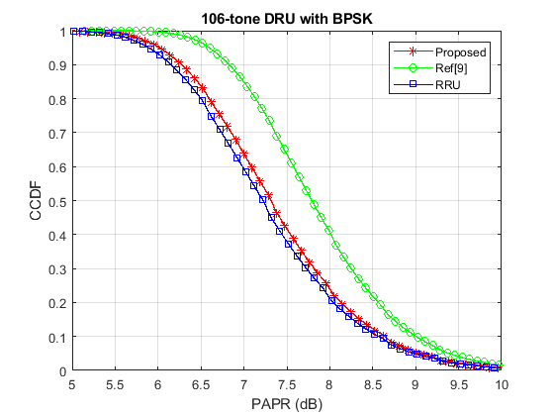
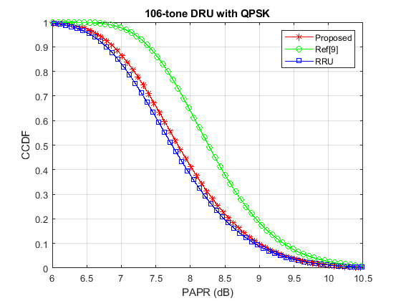
PAPR comparation
The PAPR comparation of the 106-tone DRU with BPSK and QPSK modulation (8x oversampling, 1M random data)

Slide 11
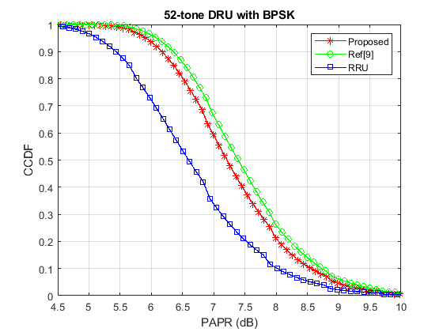
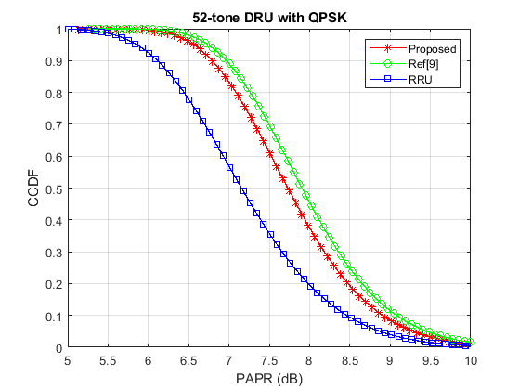
PAPR comparation
The PAPR comparation of the 52-tone DRU with BPSK and QPSK modulation (8x oversampling, 1M random data)

Slide 12
Smoothing complexity and performance
The space between adjacent subcarriers of 106-tone DRU
Single smoothing coefficient for every subcarriers
Better smoothing gain because of smaller space
0 | 1 | 2 | 3 | 4 | 5 | 6 | 7 | 8 | 9 | 10 | 11 | 12 | 13 | 14 | 15 | 16 | 17 | 18 | 19 | 20 | 21 | 22 | 23 | 24 | 25
Proposed | 8 | 8 | 8 | 8 | 8 | 8 | 8 | 8 | 8 | 8 | 8 | 16 | 8 | 8 | 8 | 8 | 8 | 8 | 8 | 8 | 8 | 8 | 8 | 8 | 8
Ref[9] | 12 | 8 | 8 | 8 | 12 | 8 | 8 | 8 | 12 | 8 | 8 | 8 | 12 | 8 | 8 | 8 | 12 | 8 | 8 | 8 | 12 | 8 | 8 | 8 | 12
26 | 27 | 28 | 29 | 30 | 31 | 32 | 33 | 34 | 35 | 36 | 37 | 38 | 39 | 40 | 41 | 42 | 43 | 44 | 45 | 46 | 47 | 48 | 49 | 50 | 51 | 52
8 | 8 | 8 | 8 | 8 | 8 | 8 | 8 | 8 | 8 | 8 | 8 | 8 | 8 | 8 | 8 | 8 | 8 | 8 | 8 | 8 | 8 | 8 | 8 | 8 | 8 | 8
8 | 8 | 8 | 12 | 8 | 8 | 8 | 12 | 8 | 8 | 8 | 12 | 8 | 8 | 8 | 12 | 8 | 8 | 8 | 12 | 8 | 8 | 8 | 12 | 8 | 8 | 8
53 | 54 | 55 | 56 | 57 | 58 | 59 | 60 | 61 | 62 | 63 | 64 | 65 | 66 | 67 | 68 | 69 | 70 | 71 | 72 | 73 | 74 | 75 | 76 | 77 | 78
88 | 8 | 8 | 8 | 8 | 8 | 8 | 8 | 8 | 8 | 8 | 8 | 8 | 8 | 8 | 8 | 8 | 8 | 8 | 8 | 8 | 8 | 8 | 8 | 8 | 8
44 | 8 | 8 | 8 | 12 | 8 | 8 | 8 | 12 | 8 | 8 | 8 | 12 | 8 | 8 | 8 | 12 | 8 | 8 | 8 | 12 | 8 | 8 | 8 | 12 | 8
79 | 80 | 81 | 82 | 83 | 84 | 85 | 86 | 87 | 88 | 89 | 90 | 91 | 92 | 93 | 94 | 95 | 96 | 97 | 98 | 99 | 100 | 101 | 102 | 103 | 104 | 105
8 | 8 | 8 | 8 | 8 | 8 | 8 | 8 | 8 | 8 | 8 | 8 | 8 | 8 | 8 | 16 | 8 | 8 | 8 | 8 | 8 | 8 | 8 | 8 | 8 | 8 | 8
8 | 8 | 12 | 8 | 8 | 8 | 12 | 8 | 8 | 8 | 12 | 8 | 8 | 8 | 12 | 8 | 8 | 8 | 12 | 8 | 8 | 8 | 12 | 8 | 8 | 8 | 12

Slide 13
Smoothing complexity and performance
The space between adjacent subcarriers of 52-tone DRU
Single smoothing coefficient for every subcarriers
Better smoothing gain because of smaller space
0 | 1 | 2 | 3 | 4 | 5 | 6 | 7 | 8 | 9 | 10 | 11 | 12
Proposed | 16 | 16 | 16 | 16 | 16 | 24 | 16 | 16 | 16 | 16 | 16 | 16
Ref[9] | 16 | 20 | 16 | 20 | 16 | 20 | 16 | 20 | 16 | 20 | 16 | 20
13 | 14 | 15 | 16 | 17 | 18 | 19 | 20 | 21 | 22 | 23 | 24 | 25
16 | 16 | 16 | 16 | 16 | 16 | 16 | 24 | 16 | 16 | 16 | 16 | 16
16 | 20 | 16 | 20 | 16 | 20 | 16 | 20 | 16 | 20 | 16 | 20 | 16
26 | 27 | 28 | 29 | 30 | 31 | 32 | 33 | 34 | 35 | 36 | 37 | 38
96 | 16 | 16 | 16 | 16 | 16 | 24 | 16 | 16 | 16 | 16 | 16 | 16
52 | 16 | 20 | 16 | 20 | 16 | 20 | 16 | 20 | 16 | 20 | 16 | 20
39 | 40 | 41 | 42 | 43 | 44 | 45 | 46 | 47 | 48 | 49 | 50 | 51
16 | 16 | 16 | 16 | 16 | 16 | 16 | 24 | 16 | 16 | 16 | 16 | 16
16 | 20 | 16 | 20 | 16 | 20 | 16 | 20 | 16 | 20 | 16 | 20 | 16

Slide 14
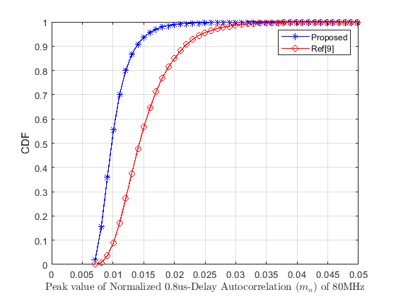
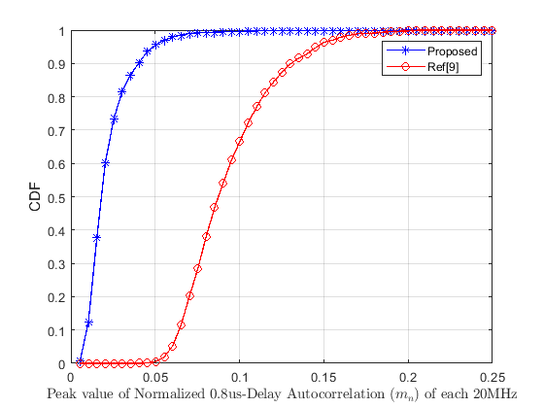
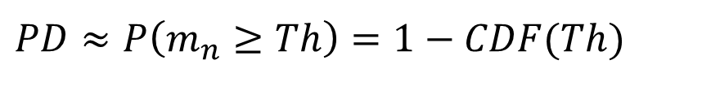
Delay autocorrelation Peak
CDF of delay autocorrelation peak value for 52-tone DRU of 80MHz (10k BPSK random data)
$PD≈P\left(m_{n}≥Th\right)=1−CDF(Th)$PD

Slide 15
Summary
In this contribution, some minor modification are applied to the existing 80MHz DRU tone plan and the 160M DRU tone plan is also proposed. The proposed tone plan have the following advantages:
  Optimal power boosting gain
  Hierarchical structure
  Lower PAPR
  Lower smoothing complexity
  Better smoothing gain

Slide 16
References
[1] 11-23-0037-00-0uhr-uhr-feature-to-overcome-psd-limitations-distributed-tone-resource-units
[2] 11-23-0281-00-0uhr-considerations-on-ru-mru-designs-for-uhr
[3] 11-23-1117-00-0uhr-dru-signaling-for-uhr
[4] 11-23-1448-00-0uhr-further-considerations-on-dru
[5] 11-23-2021-01-00bn-principle-and-methodology-for-dru-tone-plan-design
[6] 11-24-0014-00-00bn-further-thoughts-on-dru
[7] 11-24-0078-01-00bn-a-dru-design-approach-for-20-mhz
[8] 11-24-0402-01-00bn-20-mhz-tone-plan-and-pilot-design-for-dru
[9] 11-24-0468-01-00bn-dru-tone-plan-for-11bn
[10] 11-24-0476-01-00-tone-plan-design-principles-for-distributed-ru
[11] Terry, J., and J. Heiskala. OFDM Wireless LANs: A Theoretical and Practical Guide. Indianapolis, IN: Sams, 2002.

Slide 17
SP1
Do you support minimizing effective bandwidth without PD false detection should be an additional objective in the DRU tone plan design
  Existing objectives including optimal power boosting, hierarchical structure etc.
  Y/N/Abs

Slide 18
SP2
Do you agree to include the following text to the 11bn SFD?
  Data and pilot subcarrier indices for DRUs in an 80 MHz UHR PPDU are defined in following table:
Data and pilot subcarrier indices for Distributed Tone RUs (DRUs) in a 80 MHz UHR TB PPDU
DRU type | DRU index and subcarrier range
52-tone DRU i=1:16 | DRU1 [-471:16:-391, -367:16:-159, -135:16:-55, 41:16:121, 145:16:353, 377:16:457] | DRU2 [-463:16:-383, -359:16:-151, -127:16:-47, 49:16:129, 153:16:361, 385:16:465] | DRU3 [-467:16:-387, -363:16:-155, -131:16:-51, 45:16:125, 149:16:357, 381:16:461] | DRU4 [-459:16:-379, -355:16:-147, -123:16:-43, 53:16:133, 157:16:365, 389:16:469]
 | DRU5 [-465:16:-385, -361:16:-153, -129:16:-49, 47:16:127, 151:16:359, 383:16:463] | DRU6 [-457:16:-377, -353:16:-145, -121:16:-41, 55:16:135, 159:16:367, 391:16:471] | DRU7 [-469:16:-389, -365:16:-157, -133:16:-53, 43:16:123, 147:16:355, 379:16:459] | DRU8 [-461:16:-381, -357:16:-149, -125:16:-45, 51:16:131, 155:16:363, 387:16:467]
 | DRU9 [-470:16:-390, -366:16:-158, -134:16:-54, 42:16:122, 146:16:354, 378:16:458] | DRU10 [-462:16:-382, -358:16:-150, -126:16:-46, 50:16:130, 154:16:362, 386:16:466] | DRU11 [-466:16:-386, -362:16:-154, -130:16:-50, 46:16:126, 150:16:358, 382:16:462] | DRU12 [-458:16:-378, -354:16:-146, -122:16:-42, 54:16:134, 158:16:366, 390:16:470]
 | DRU13 [-464:16:-384, -360:16:-152, -128:16:-48, 48:16:128, 152:16:360, 384:16:464] | DRU14 [-456:16:-376, -352:16:-144, -120:16:-40, 56:16:136, 160:16:368, 392:16:472] | DRU15 [-468:16:-388, -364:16:-156, -132:16:-52, 44:16:124, 148:16:356, 380:16:460] | DRU16 [-460:16:-380, -356:16:-148, -124:16:-44, 52:16:132, 156:16:364, 388:16:468]
106-tone DRU i=1:8 | DRU1 [-471:8:-383, -367:8:-47, 41:8:361, 377:8:465] | DRU2 [-467:8:-379, -363:8:-43, 45:8:365, 381:8:469] | DRU3 [-465:8:-377, -361:8:-41, 47:8:367, 383:8:471] | DRU4 [-469:8:-381, -365:8:-45, 43:8:363, 379:8:467]
 | DRU5 [-470:8:-382, -366:8:-46, 42:8:362, 378:8:466] | DRU6 [-466:8:-378, -362:8:-42, 46:8:366, 382:8:470] | DRU7 [-464:8:-376, -360:8:-40, 48:8:368, 384:8:472] | DRU8 [-468:8:-380, -364:8:-44, 44:8:364, 380:8:468]
242-tone DRU i=1:4 | DRU1 [-499:4:-19, 17:4:497] |  | DRU2 [-497:4:-17, 19:4:499]
 | DRU3 [-498:4:-18, 18:4:498] |  | DRU4 [-496:4:-16, 20:4:500]
484-tone DRU i=1:2 | DRU1 [-499:2:-17, 17:2:499] |  | DRU2 [-498:2:-16, 18:2:500]

