Slide 1
Follow-up of Data Offload Using WLAN in Connected Vehicle Case
Date: 2024-05-14
Authors:
Jing Ma (Toyota)

Slide 2
Abstract
Data offload using WLAN in connected vehicle case is discussed in [1]
In this contribution, more details of the use case are discussed
In addition, the consideration of the gap between the current IEEE specifications and the requirements for data offload to WLAN in connected vehicle case is discussed

Slide 3
Recap
Automotive services (e.g. intelligent driving) needs big data capacity exchange between vehicle and the cloud.
Offloading data from cellular to WLAN may offer a faster and more cost-effective solution for connected vehicles.
Current solutions such as IEEE 802.11u do not fully support the connected vehicle’s data offloading case.
Fast association & authentication, seamless AP handover, optimized roaming algorithm, etc., are required for connected vehicle case.
Understanding these requirements and identifying the gaps in the current IEEE standards is important

Slide 4






Vehicle data collection using WLAN
Example use case: Data collection for High Definition (HD) map
  As vehicles drive through the interested area
  Vehicles transmit data about their local environment, dynamic objects, and so on when connected to WLAN
    Large data transfers are required to update HD map
    On-board sensor, camera, LIDAR contribute the necessary data
      Camera generates data (500~3500) Mbit/s/camera [2]
      RADAR generates data (0.1~15) Mbit/s/RADAR [2]
  A local server processes the collected data to update
  regional HD map.
  Other assumptions
    The interested area: 500m range in urban area
    Average vehicle velocity: 60km/h
Wi-Fi
Vehicular data (cameral, LIDAR, etc.) could be offloaded using WLAN

Slide 5
Vehicle Data distribution using WLAN
Example use case: Regional HD map distribution
  As vehicles drive through the interested area
  Vehicles download the relevant map data when connected to WLAN either on the vehicle request or server-pushed
    Static map and geospatial event (e.g. dynamic objects) information are included
    The total data volume could be large, e.g. updates for dynamic object may be 500kB [3]
  By receiving updated HD map, vehicles can maintain accurate map
  information, enabling advanced functions such as intelligent driving
Wi-Fi
Updated HD map could be distributed using WLAN

Slide 6
Possibility of using WLAN to offload vehicle data
Vehicles leverage WLAN for fast and cost-effective data offloading, both while parked (garages, parking lots, fuel/charging station) and on the move (drive-through)
However, data offloading while moving presents challenges:
  Doppler shift and fast varying channels can disrupt connections [4]
  Network discovery, link connection setup, and AP handovers become difficult at high speed
AP1
AP2
…
Ideal situation:
Steady WLAN connection
AP2
AP1
Failure in link setup
Wi-Fi
16m/s
Failure in AP handover
200m
Network discovery & selection
Link connection setup (association & authentication)
Drive-through scenario
IP connection setup (DHCP time)
TCP/UDP connectivity duration
Unable to complete

Slide 7
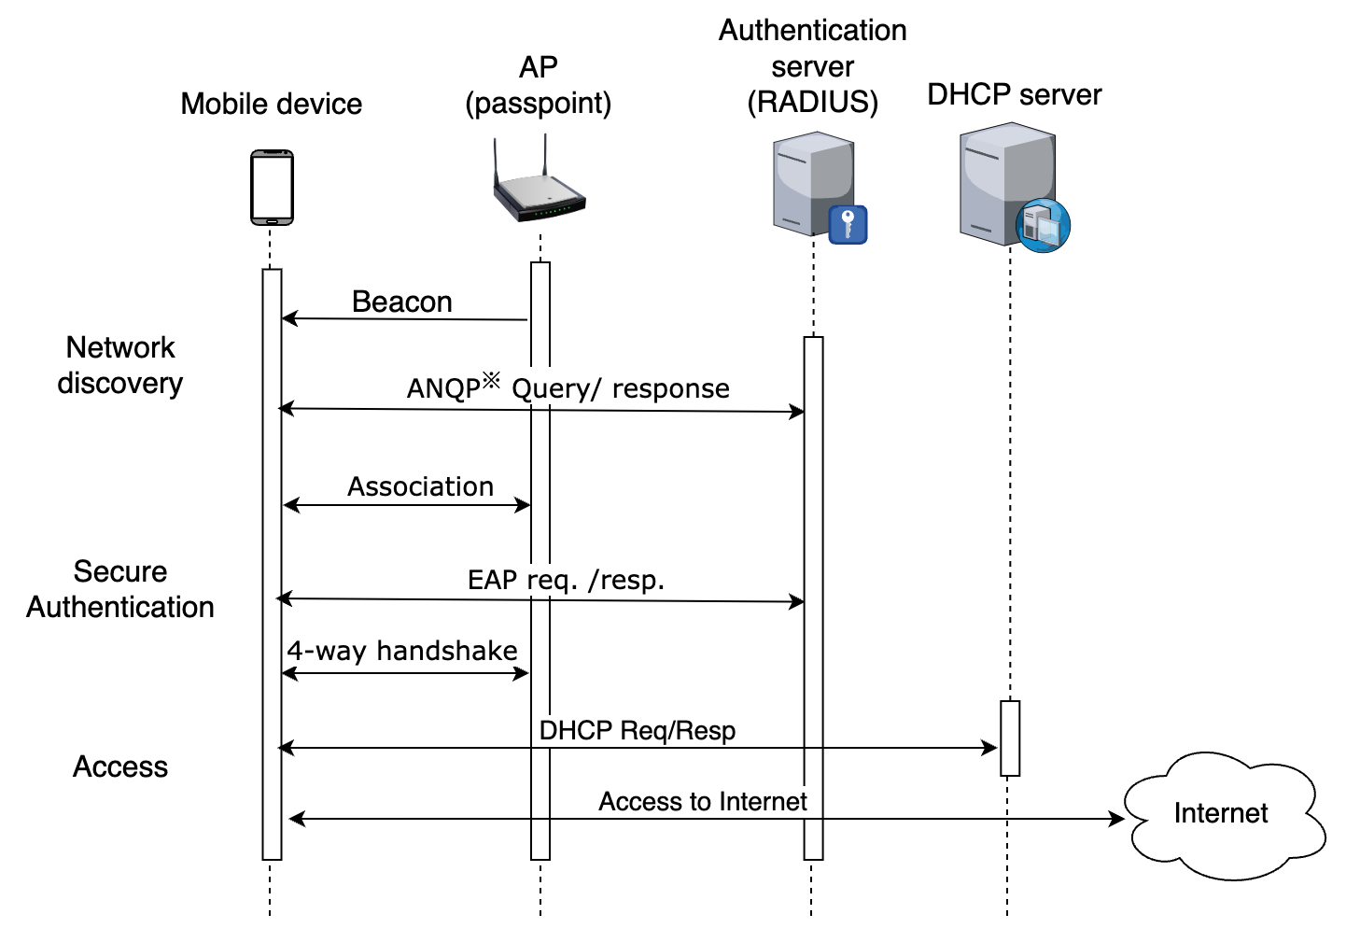
Current solutions & gaps
IEEE 802.11u-based solution makes connecting to WLAN easier and secure[5-6]
  Network discovery, automatic network selection, secure authentication & access
However, faster network discovery,
authentication and association are crucial
for seamless data offloading
  IEEE802.11ai may addresses this need
Jing Ma (Toyota)

Slide 8
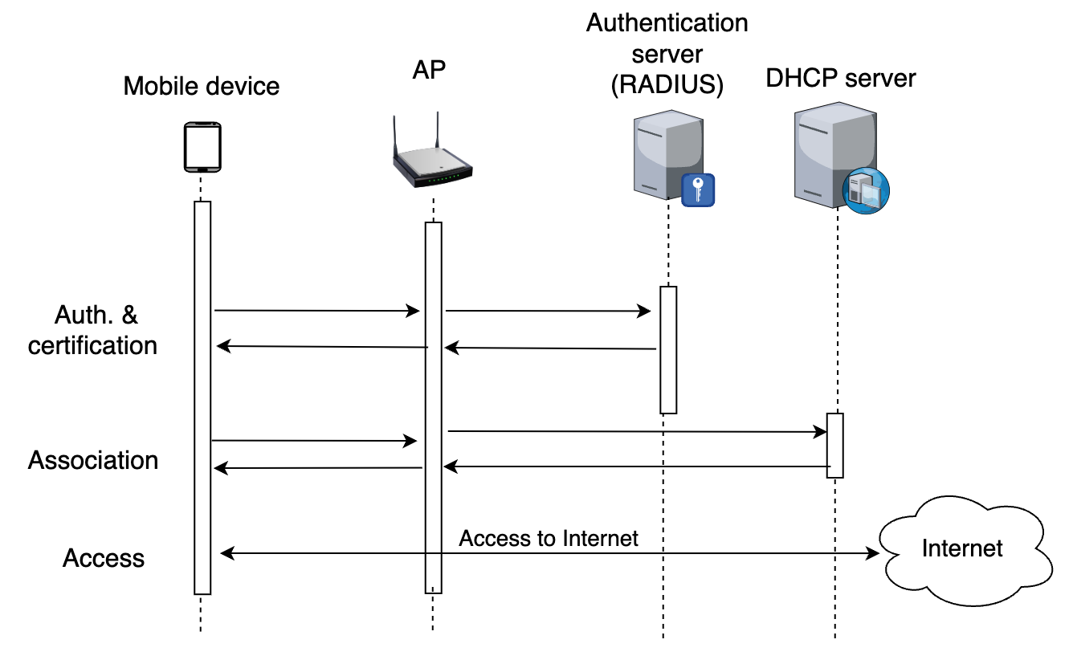
Current solutions & gaps (con’t)
IEEE802.11ai (Fast Initial Link Setup) enables fast establishment of a secure link connections through [7]:
  Enhanced channel scanning
  Simplified authentication procedure
However, re-transmissions of authentication
can still delay the link connection setup process [8]
Jing Ma (Toyota)

Slide 9
Current solutions & gaps (con’t)
IEEE 802.11r, IEEE802.11k aim to facilitate smooth handover between APs [9-10]
  IEEE 802.11r (Fast BSS Transition):
  Allows clients to connect to a new AP before disconnecting from the current one,
  minimizing downtime.
  IEEE 802.11k (Radio Resource Measurement):
  Enables APs to inform clients about nearby APs and suitable channels, promoting
  informed handover decisions.
However, achieving seamless handovers remains challenging at high mobility [11]
  Fine-grained RSSI measurements for handover decision are challenging at high speeds, for example fast channel varying can affect RSSI measurement
Jing Ma (Toyota)

Slide 10
Summary
Further discussion of data offload using WLAN for connected vehicles is provided.
Additionally, the consideration about the gap between the current IEEE specifications and the requirements for data offload using WLAN for connected vehicles is discussed.
It is also clear that our analysis is far from exhausting or complete. The current standards take a piecemeal approach. What is missing is a complete picture for the automotive industry to follow.
In order to fully understand the work required to support the automotive use case, we are proposing the formation of a TIG to raise interest and solicit input to further identify and analyze the gaps between IEEE specifications and the automobile industry's requirements.
We will continue to discuss the idea with members to build support for the proposal.

Slide 11
References
[1] 11-24/415r1 Data offload using WLAN in connected vehicle case, March, 2024
[2] WBA, Wi-Fi Opportunities for Connected vehicles, 2020.
[3] 5GAA, C-V2X Use cases and service level requirements, 2023
[4] 11-24/378r0, Wi-Fi for High Mobility Users, March, 2024
[5] WiFi Alliance, ”Passpoint Specification", 2022.
[6] IEEE 802.11u-2011
[7] IEEE802.11ai-2016
[8] F. Yang, etc., Revisiting WiFi offloading in the wild for V2I applications, Computer Networks, 2022
[9] IEEE802.11r-2008
[10] IEEE802.11k-2008
[11] Song, Z.,etc., Wi-Fi Goes to Town: Rapid Picocell Switching for Wireless Transit Networks, 2017

