Slide 1
Towards Reducing Handoff Times in Next Generation Wi-Fi Networks
Date: 2024-05-14
Authors:

Slide 2
Abstract
Importance of Handoff Process in WiFi Networks:
  Ensures continuity of service for wireless users.
  Crucial in environments with numerous access points (APs).
Challenges in Traditional WiFi Networks:
  Handoff process takes seconds, leading to potential information loss.
  Particularly problematic for delay-sensitive applications.
Proposed Solution: Reduced Detection and Discovery Time Approach:
  Based on Software Defined WiFi Networks (SD-WiFi).
  Utilizes SNMP manager and RSSI manager to report AP traffic conditions and RSSI values to SDN controller.
  Handoff decisions centralized at the controller end.
Implementation and Methodology:
  Extensive simulation runs conducted on Mininet-NS3-WiFi network simulator.
  Evaluation of proposed approach performance compared to standard handoff schemes.
Overall, proposed approach offers significant improvements in handoff efficiency and performance, making it a promising solution for WiFi networks.

Slide 3

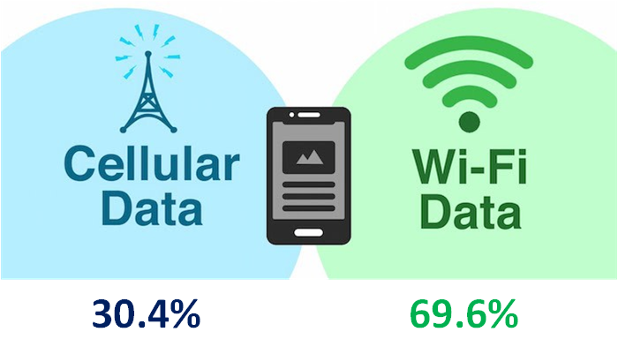


Introduction
70% of the smart phone data is originated from the WiFi networks
.

Slide 4
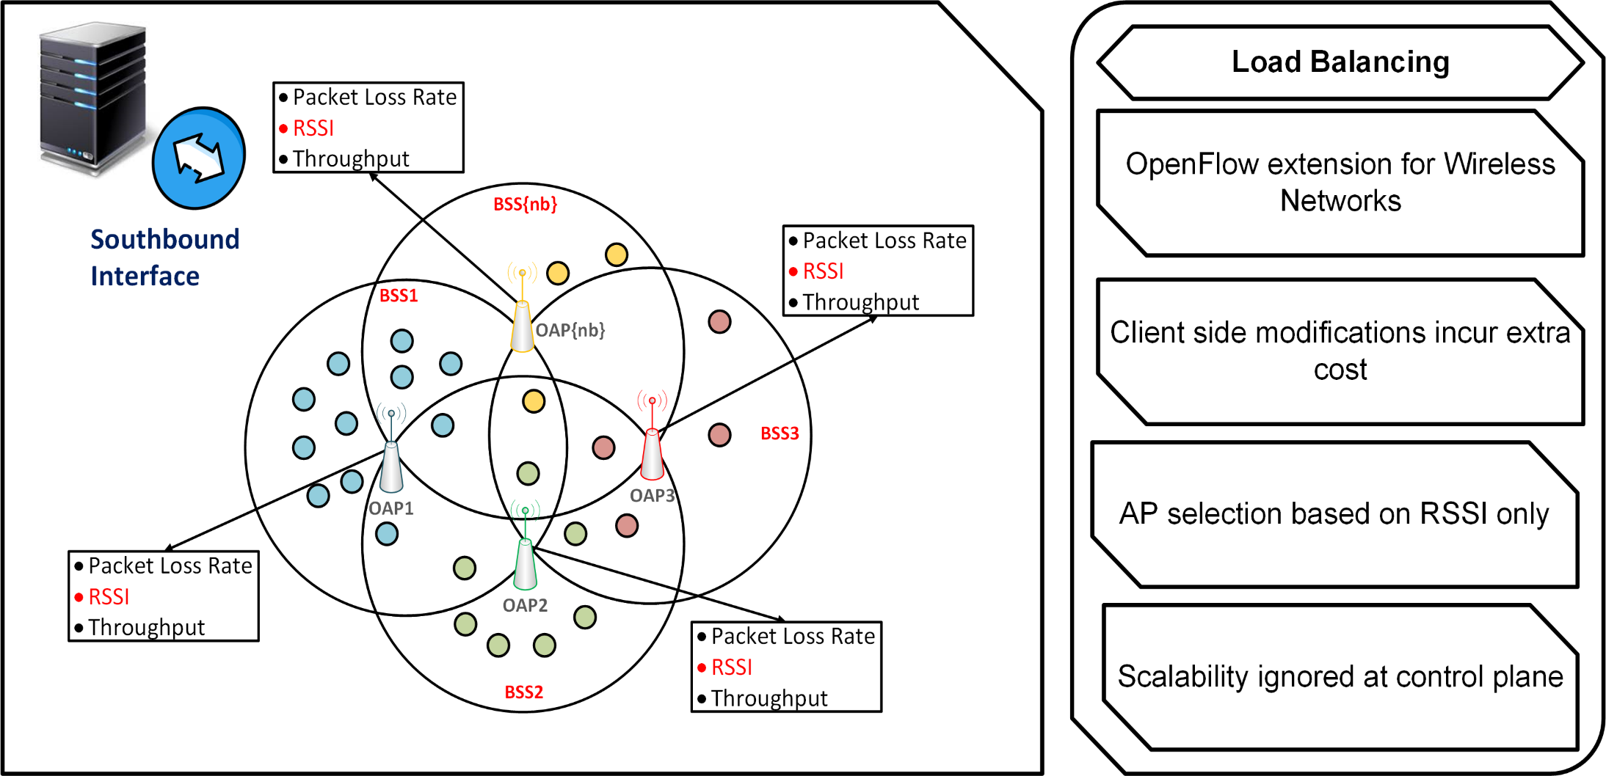
Gap Identification

Slide 5
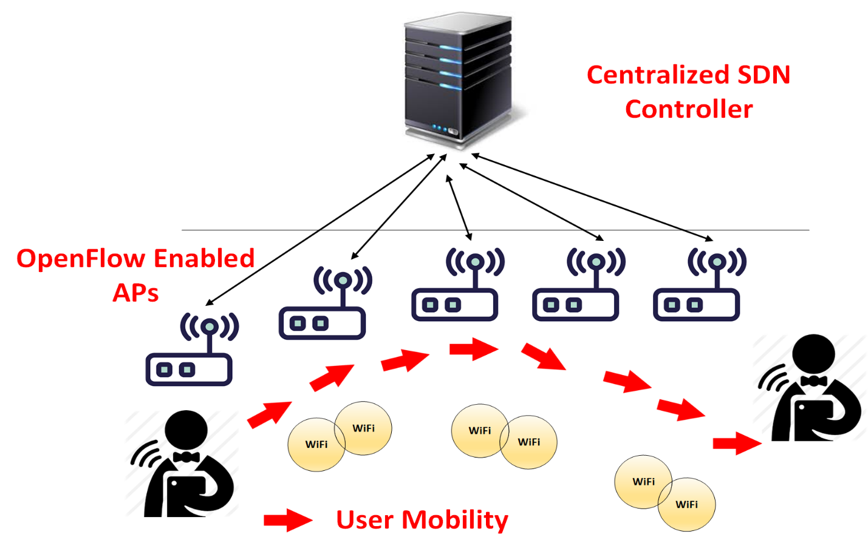
Project Objectives
Reducing handoff times in SD-Wi-Fi.

Slide 6
System Architecture

Slide 7
Experiment design
PARAMETERS | VALUE
Data Rate | 115.0 Mbit/s
Flow Size | 50 Bytes
Wireless Channel | 1, 3, 11
Ubuntu 18.04.3 LTS | Emulation
Iperf | Throughput Measurement
Mininet-NS3-WiFi/Testbed | Network Emulator/Software Defined Testbed

Slide 8
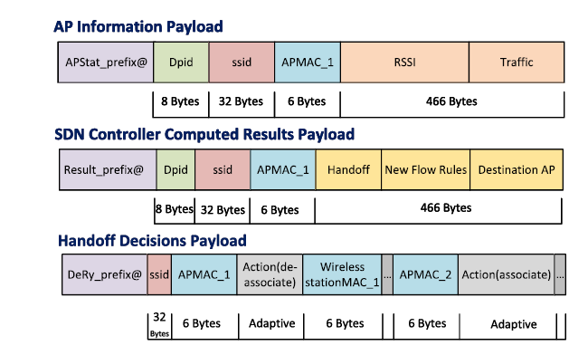
Experiment design (Cont.)
OpenFlow Message Extension
AP Status
Controller Computation
Controller Decision

Slide 9
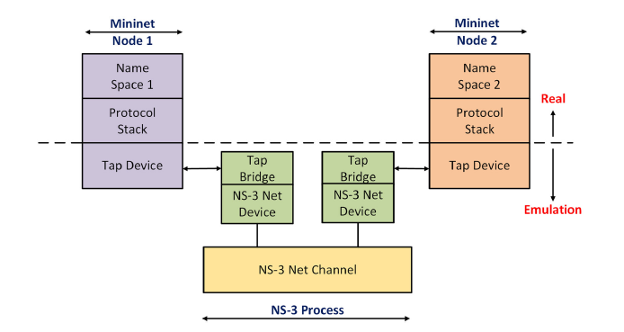
Implementation Design/Testbed Prototype
Mininet-NS3-WiFi Architecture
Programming Language

Slide 10

Impact in Quantifiable Terms
Network side modifications
AP association/re-association
Fairness of load
Service differentiation
Efficient queuing model

Slide 11
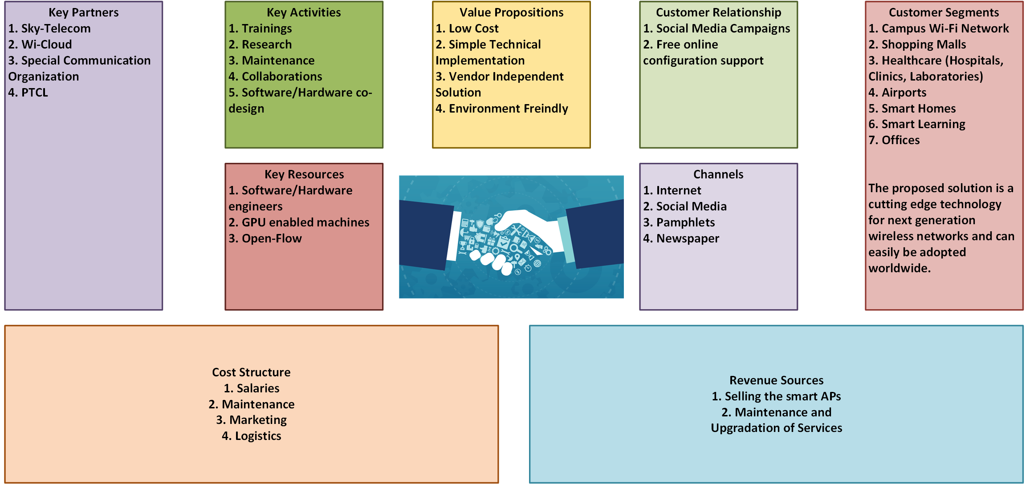
Business Model

Slide 12
Review of Literature
Optimized Technique in SD-WiFi Network
Related Work
Previous Technique (s)
Proposed Technique
Reducing Handoff Times
RSSI Based Schemes Traditional IEEE 802.11
RSSI Based selection Client makes the decision
SDN controller makes the association decision Association decision is made by the AP.

Slide 13
Key Expected Outcomes
Time versus Number of Connections

Slide 14
Link to Sustainable Development Goals (SDGs) | Digital Industry and Digital Life
Innovation Claimed | Ensure inclusive and equitable quality digital life pattern to all Wi-Fi users. Build resilient infrastructure, promote inclusive and sustainable industrialization and foster innovation as the telecom industry needs revolution in Pakistan. Ensure sustainable consumption and production patterns. Strengthen the means of implementation and revitalize the global partnership for sustainable development.

Slide 15
Requirements
# | Item | Justification
1 | Net Gear USB | Wireless Links
2 | Lice sensing | Software Define Hardware/Software Co-Design
3 | Flood Light (Controller) | SDN Controller
4 | Mini-net GRE Tunnel License | Emulation to Testbed design
5 | Multi-Port Wi-Fi Testers | Multi Channel Modeling
6 | Cisco Dual Switch Ports | Multi Channel Modeling
7 | Programmable Mobile Embedded Wi-Fi Units | Handoff testbed units

Slide 16

Thanks

