Slide 1
On the Pilot Tone Allocations in DRU
Date: 2024-05-06
Authors:

Slide 2
Abstract
In this contribution, we investigate how the pilot structure and pilot tone allocation may impact the performance of phase tracking. In essence, we compare the PER performance of clustered vs distributed pilot tones.

Slide 3
Background
It was agreed that [1]:
  11bn supports hierarchical pilot structure for DRU where pilot locations of a larger DRU is a subset of pilot locations of smaller component DRUs within the same PPDU BW
  The number of pilot tones for the same size DRU and RRU (regular RU) is the same
Design methods to guarantee sufficiently distributed pilot tones in all DRUs were proposed in [2]
High level criteria for the selection of pilot tones and a hierarchical pilot structure were proposed in [3]
Throughout this contribution, the DRU notation xDRUy for a DRU of x-tones distributed over a y MHz distribution bandwidth will be used [4]

Slide 4
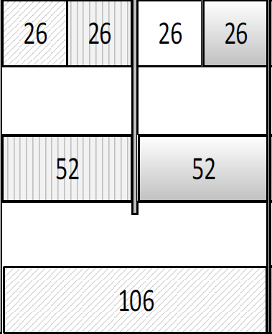
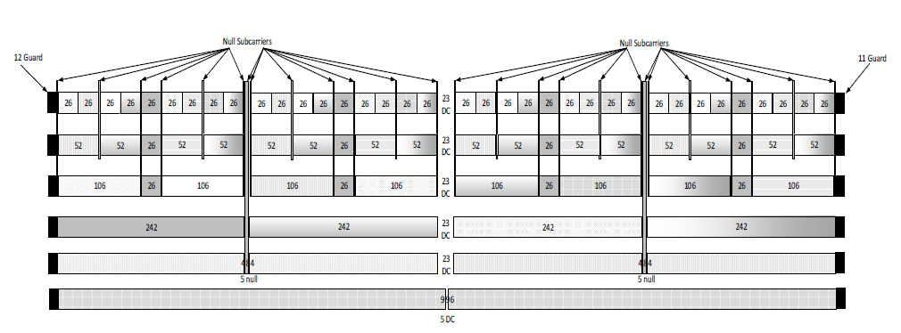
Structure of Pilot Tones in RRU
Recall that in Regular RU (RRU) the pilots are evenly distributed within the RRU bandwidth
Pilot tones

Slide 5
Structure of Pilot Tones in DRU
The selection of pilot structure in DRU may result in the pilots being clustered or distributed.
Clustered Pilots
Distributed Pilots
106DRU20
106DRU20

Slide 6
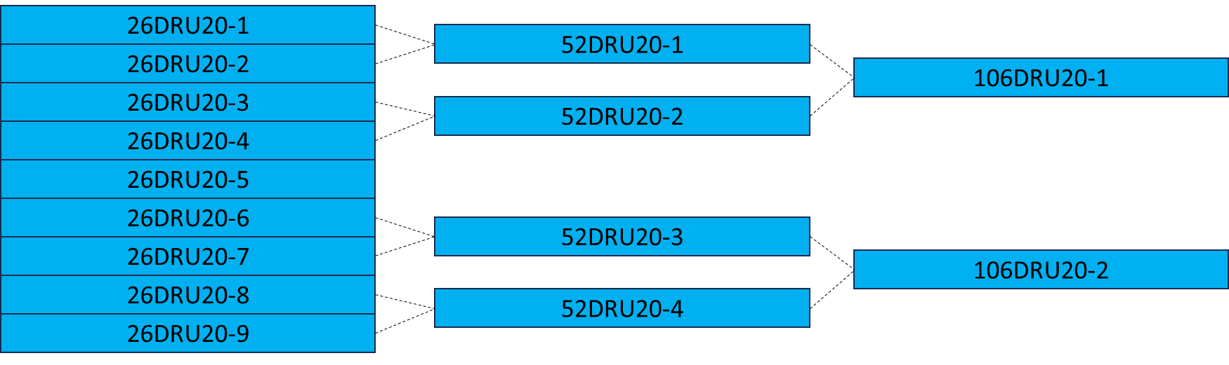
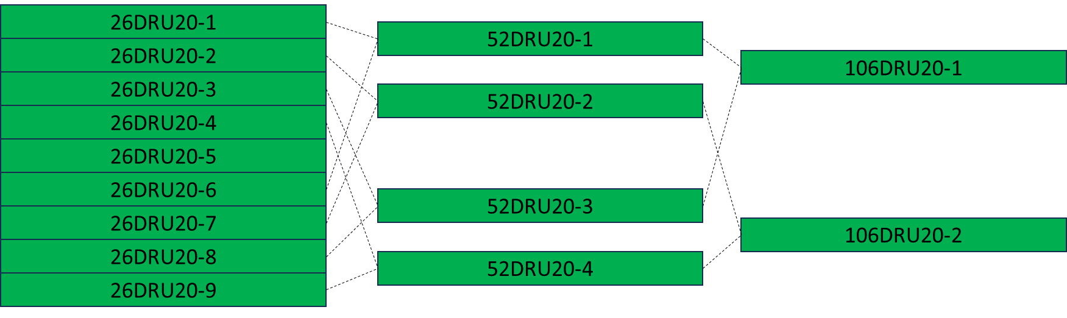
Hierarchical Structure of DRUs
Either Option 1 or Option 2 can be applied to form larger DRUs from smaller DRUs for any of the pilot designs in the next slides.
Option 1
Option 2

Slide 7
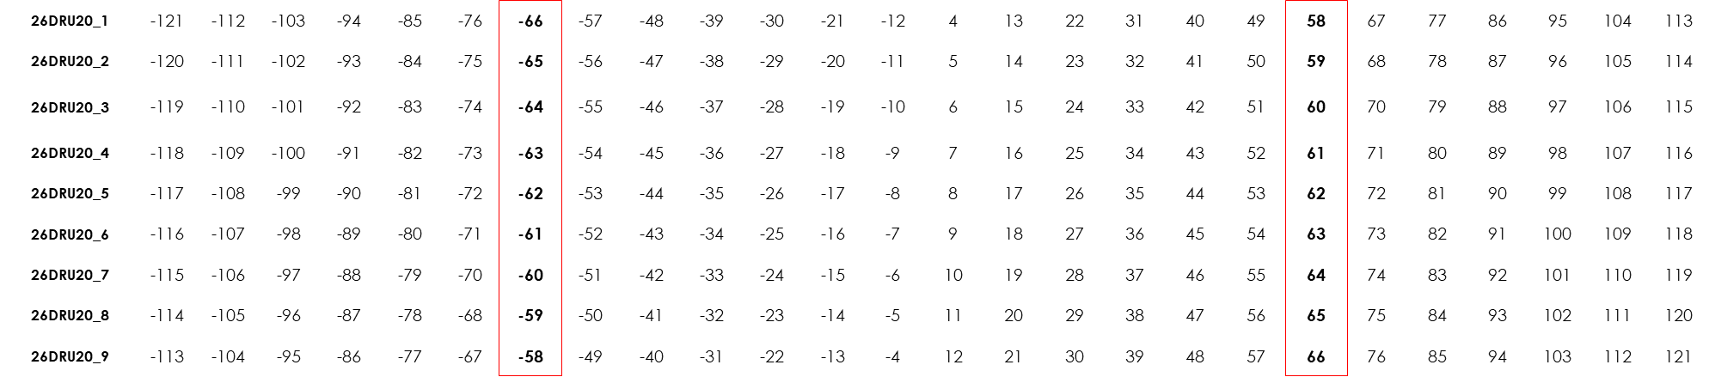
Clustered Pilot Structure
Distribution Bandwidth = 20 MHz
  By applying option 1 of the hierarchal structure in the previous slide, the larger DRUs (e.g., 52DRU20 or 106DRU20) will have its pilots clustered.
52DRU20_1

Slide 8
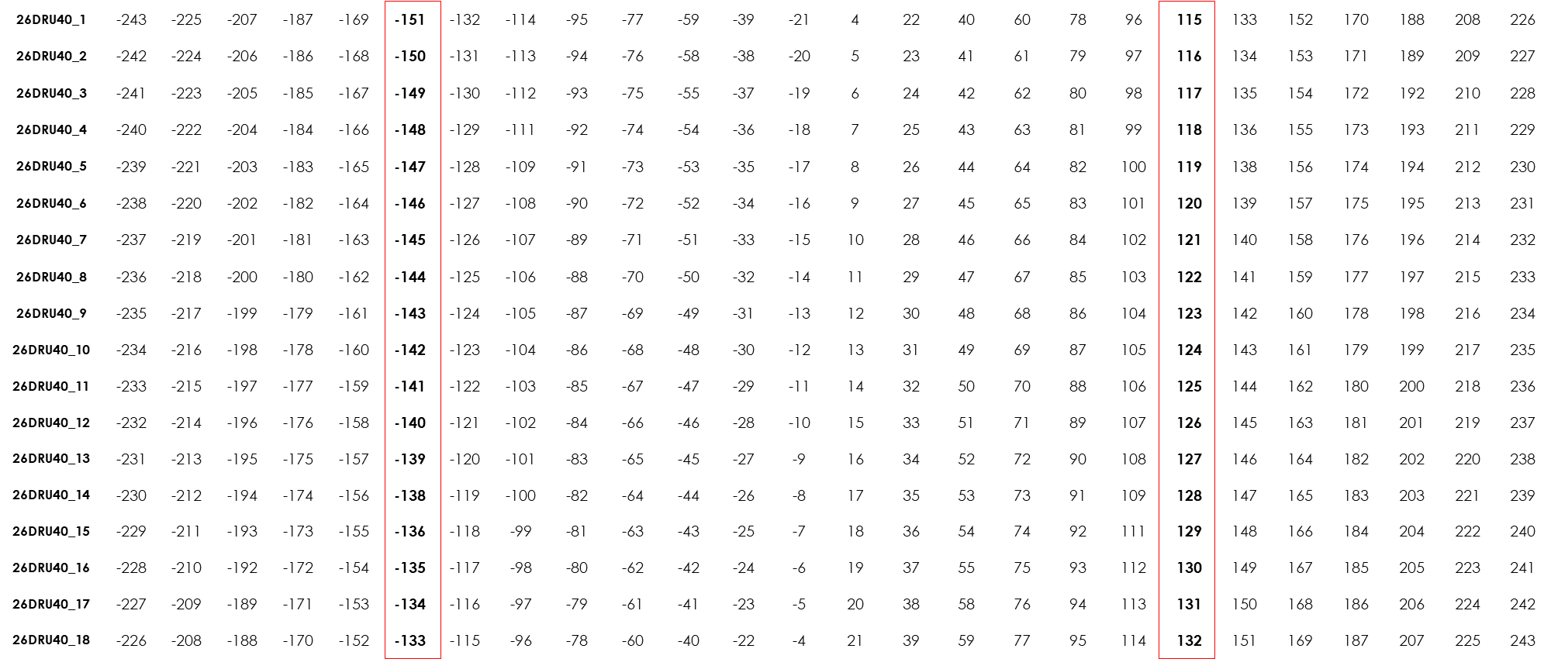
Clustered Pilot Structure
Distribution Bandwidth = 40 MHz
52DRU20_1

Slide 9
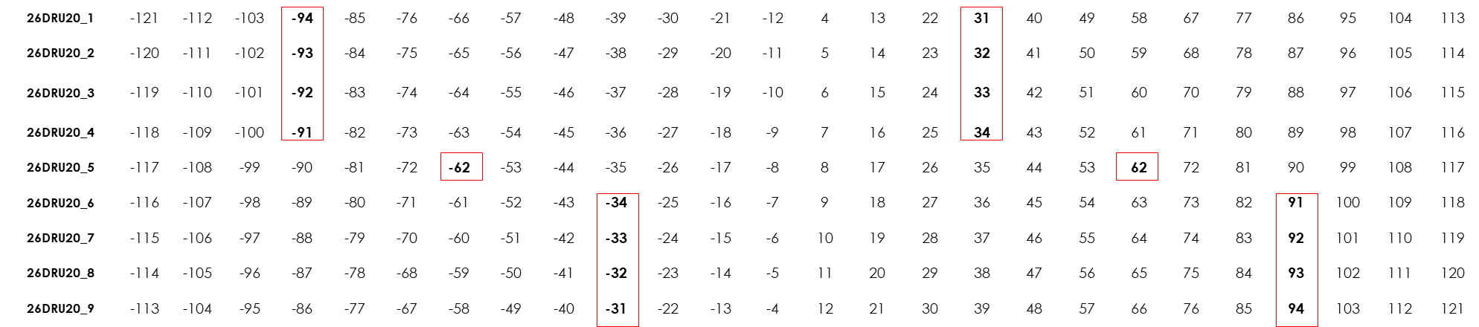
Distributed Pilot Structure
Design 1 (Distribution Bandwidth = 20 MHz) [2]
52DRU20_1

Slide 10
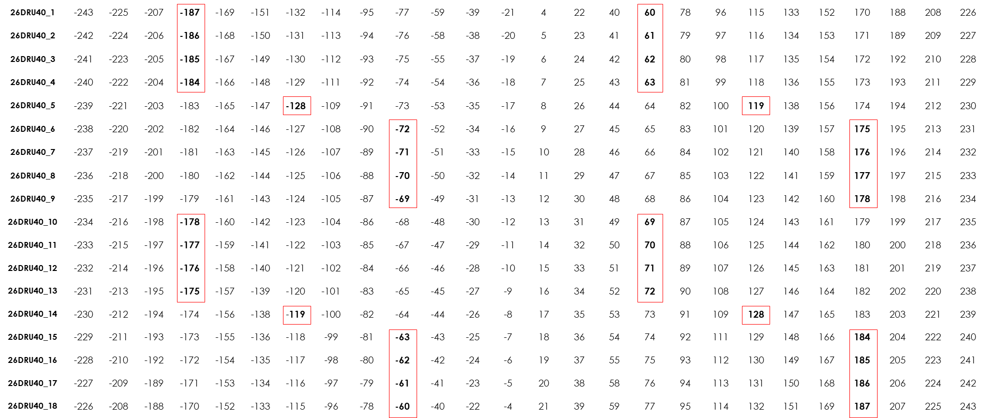
Distributed Pilot Structure
Design 1 (Distribution Bandwidth = 40 MHz)
52DRU20_1

Slide 11
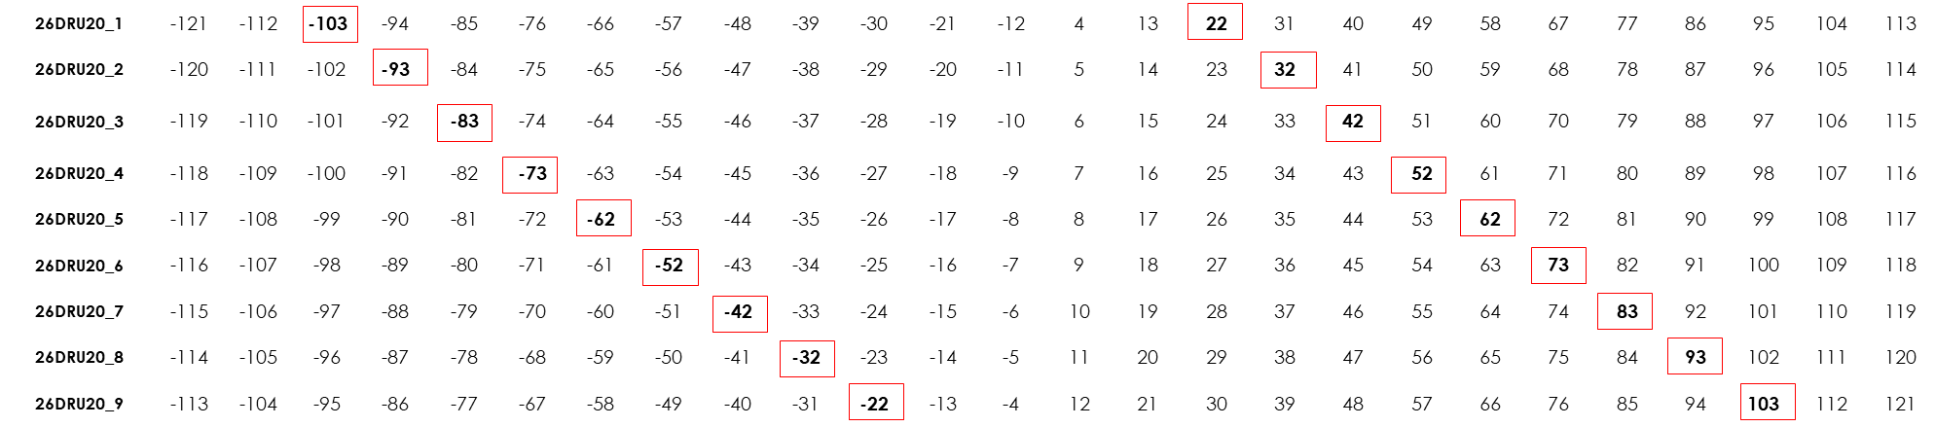
Distributed Pilot Structure
Design 2 ( Distribution Bandwidth = 20 MHz) [2]

Slide 12
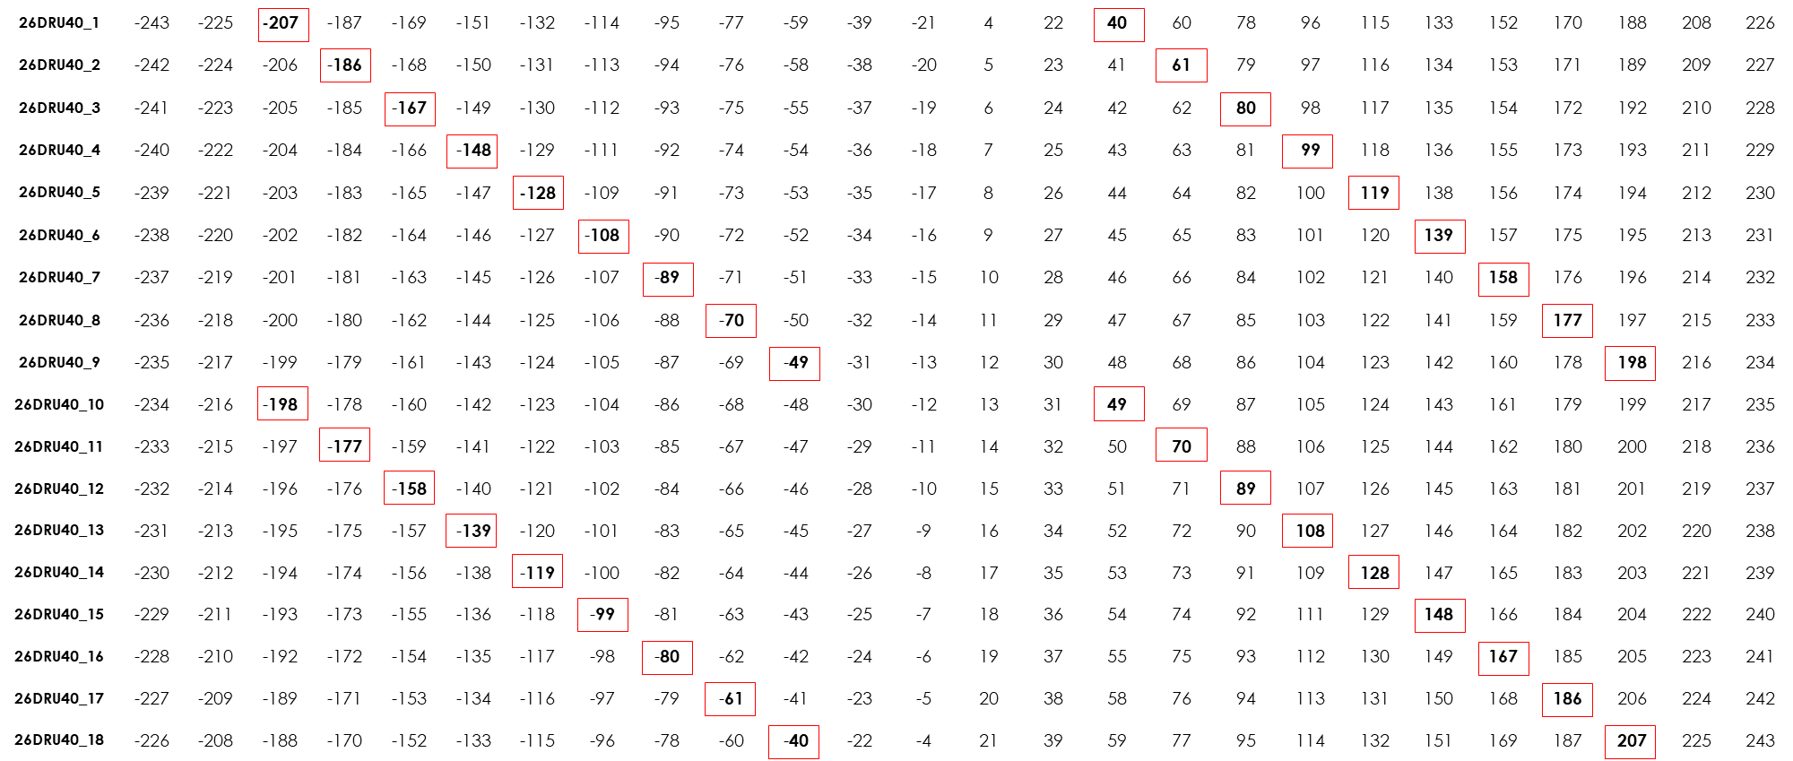
Distributed Pilot Structure
Design 2 ( Distribution Bandwidth = 40 MHz)

Slide 13
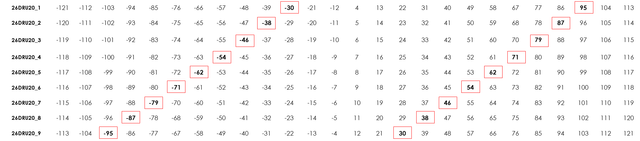
Distributed Pilot Structure
Design 3 ( Distribution Bandwidth = 20 MHz)

Slide 14
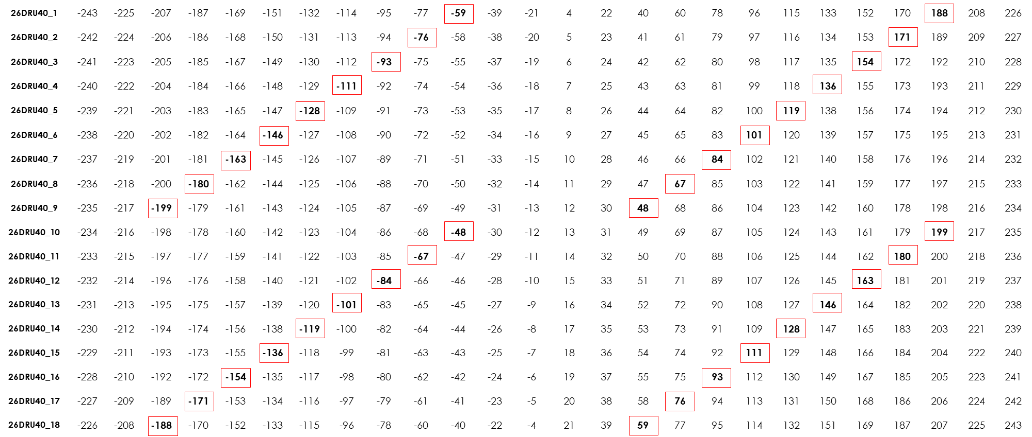
Distributed Pilot Structure
Design 3 ( Distribution Bandwidth = 40 MHz)

Slide 15
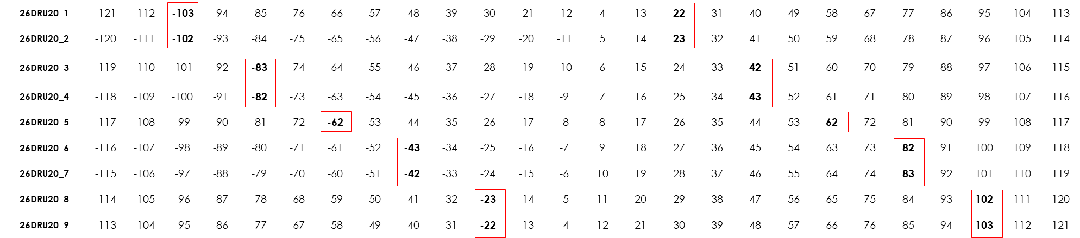
Distributed Pilot Structure
Design 4 (Distribution Bandwidth = 20 MHz)

Slide 16
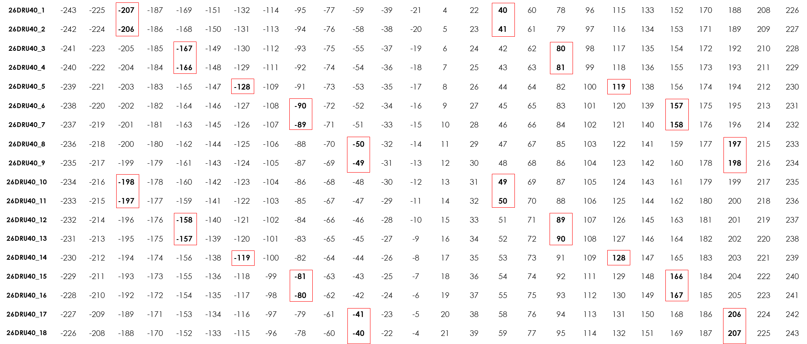
Distributed Pilot Structure
Design 4 (Distribution Bandwidth = 40 MHz)

Slide 17
Simulation Environment
Simulation Parameters
  Channel Bandwidth = 20 MHz / 40 MHz
  LDPC Coding, MCS = 0, 3, 7, 9
  SISO with Channel Model D
  SNR is defined as the average SNR per user.
  Packet Size = 100 bytes
  Pilot Positions:
  The average PER is considered
  Option 1 in slide 6 is applied for the clustered pilot design and option 2 is applied for the distributed pilot designs
Pilot Design | Clustered | Design 1 | Design 2 | Design 3 | Design 4
DRU Index
106DRU20_1 | -65, -64, 59, 60 | -94, -34, 31, 91 | -103, -52, 22, 73 | -87, -30, 38, 95 | -103, -23, 22, 102
106DRU20_2 | -60, -59, 64, 65 | -91, -31, 34, 94 | -73, -22, 52, 103 | -95, -38, 30, 87 | -102, -22, 23, 103
106DRU40_1 | -151, -144, 115, 122 | -187, -72, 60, 175 | -207, -108, 40, 139 | -180, -59, 67, 188 | -207, -50, 40, 197
106DRU40_2 | -150, -143, 116, 123 | -186, -71, 61, 176 | -186, -89, 61, 158 | -199, -76, 48, 171 | -206, -49, 41, 198
106DRU40_3 | -142, -134, 124, 131 | -185, -70, 62, 177 | -167, -70, 80, 177 | -171, -48, 76., 99 | -198, -41, 49, 206
106DRU40_4 | -141, -133, 125, 132 | -184, -69, 63,178 | -148, -49, 99, 198 | -188, -67, 59,180 | -197, -40, 50, 207

Slide 18
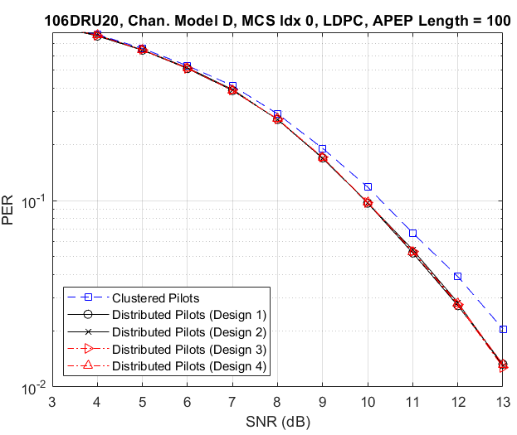
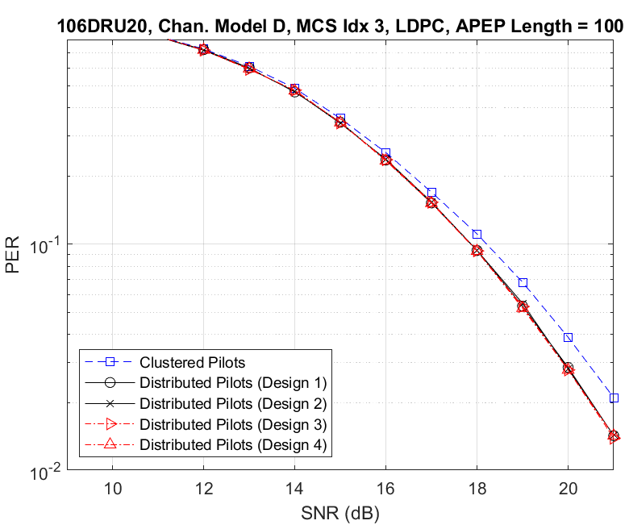
Distribution Bandwidth = 20 MHz
  All distributed pilot designs perform the same, slightly better than the clustered pilot design.
  The performance of the distributed pilot designs approaches that of the clustered pilot design as the MCS gets higher.

Slide 19
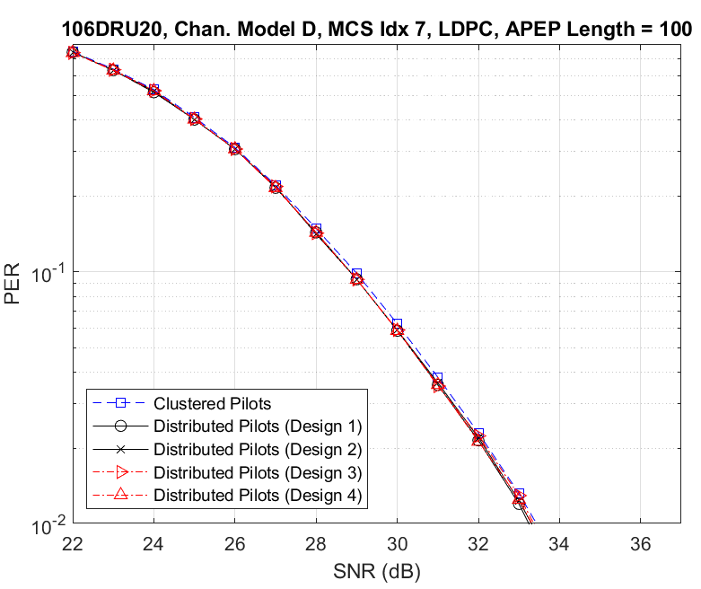
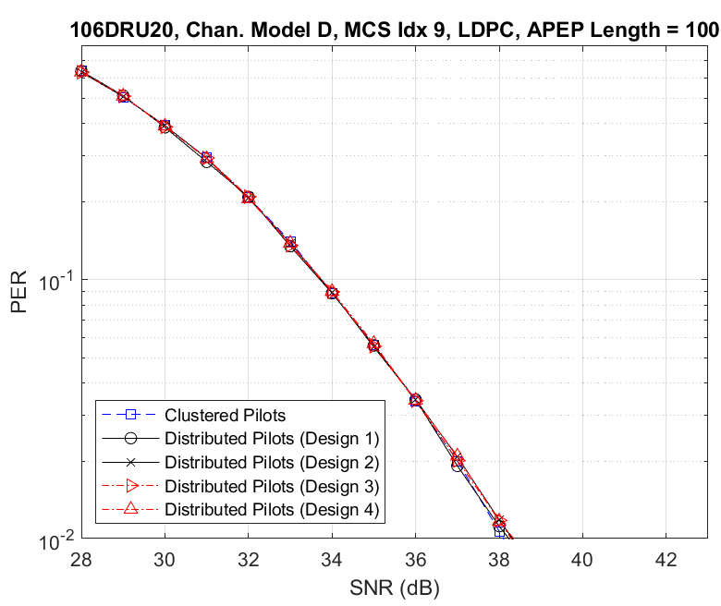
Distribution Bandwidth = 20 MHz
  The performance of the distributed pilot designs becomes similar to the clustered pilot design at higher MCSs.

Slide 20
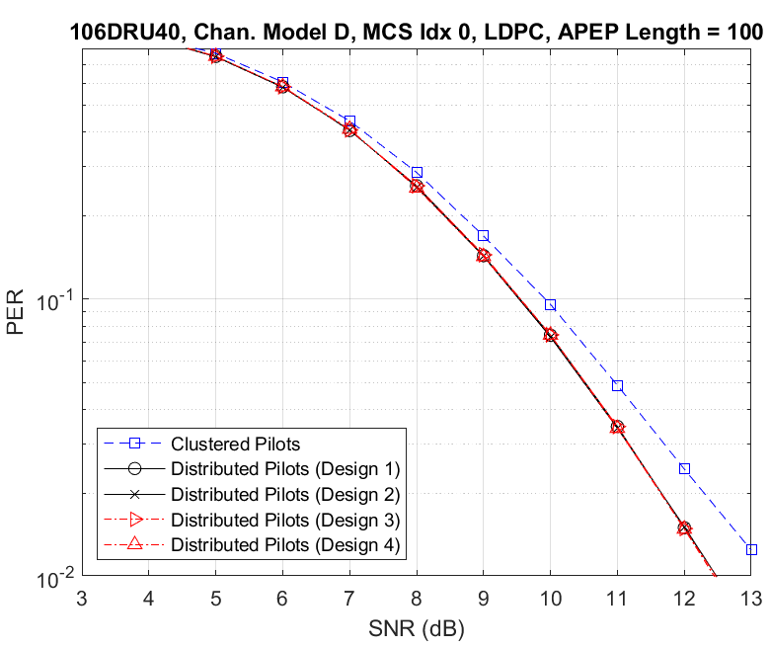
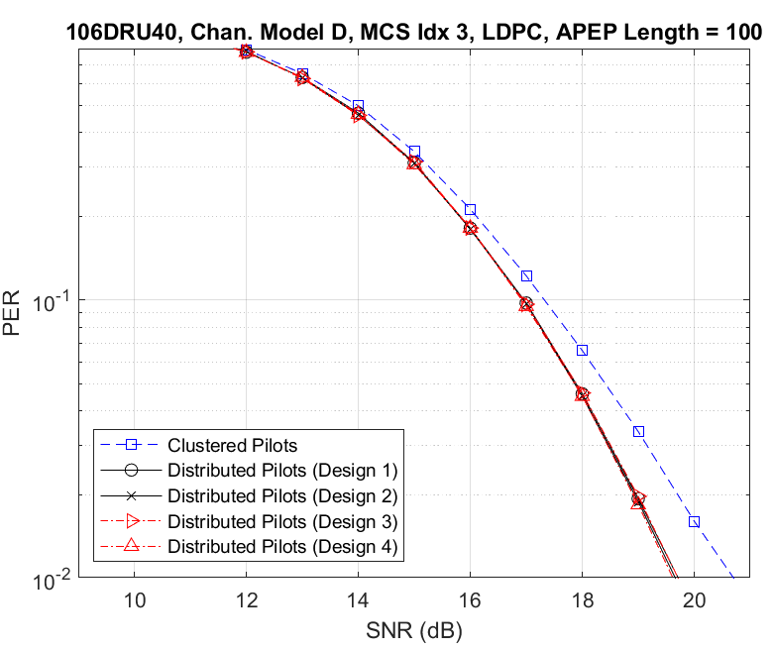
Distribution Bandwidth = 40 MHz
  Similar behavior for larger distribution bandwidths.

Slide 21
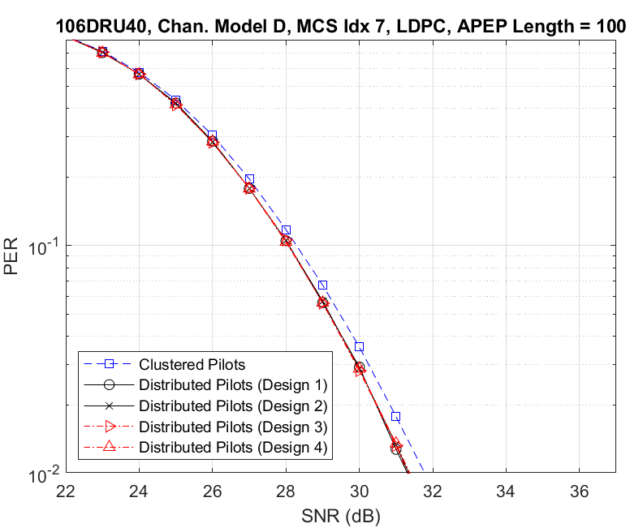
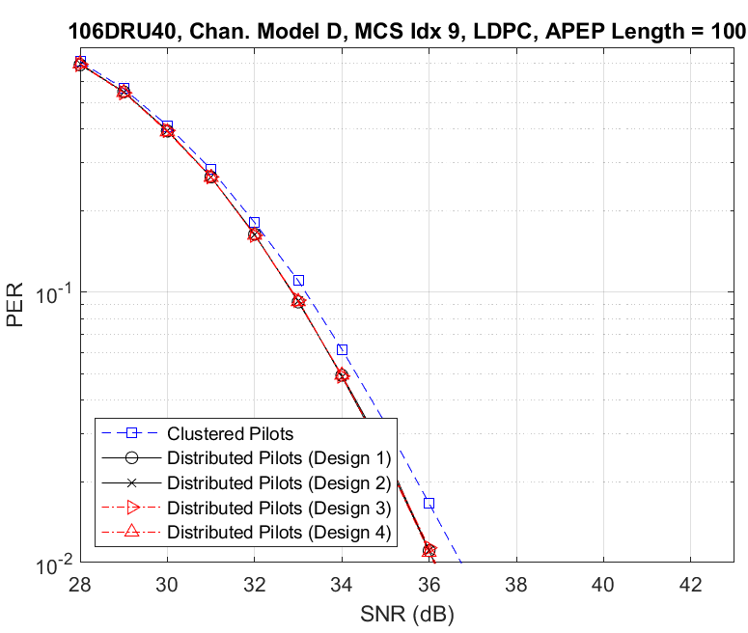
Distribution Bandwidth = 40 MHz
  …, with a slight difference between the performance of the distributed and clustered pilot designs at high MCS.

Slide 22
Conclusions
The PER performance of different designs for pilot structure is compared
All distributed pilot designs (regardless of the specifics of the design) perform the same
Distributed pilot designs perform slightly better than clustered pilot design.
  The performance is better for lower MCSs and larger distribution bandwidths
In terms of complexity, the discussed designs in this contribution are fairly similar.
A criteria to distinguish the best pilot design is required.
Other methods to combine smaller DRUs to form larger DRUs may be also recommended[4].

Slide 23
References
[1] 11-24/0209r1, Specification Framework for TGbn
[2] 11-24/0402r1, 20 MHz Tone Plan and Pilot Design for DRU
[3] 11-24/0501r2, Pilot design considerations for dRU
[4] 11-24/0520r1, Discussion on DRU

