Slide 1
STA-assisted Multi-AP Transmission Scheme Selection
Date: 2024-04-30
Authors:
Name | Affiliations | Address | Phone | email
Ke Zhong | Ruijie Networks Co., Ltd. |  |  | zhongke@ruijie.com.cn
Hui Che | Ruijie Networks Co., Ltd. |  |  | chehui@ruijie.com.cn
Hang Yang | Ruijie Networks Co., Ltd. |  |  | yanghang1@ruijie.com.cn
Longlong Hong | Ruijie Networks Co., Ltd. |  |  | honglonglong@ruijie.com.cn
Yuqian Tang | Ruijie Networks Co., Ltd. |  |  | tangyuqian@ruijie.com.cn

Slide 2
Abstract
Introduction
Transmission scheme selection issue in Multi-AP transmission
STA-assisted multi-AP transmission scheme selection
Conclusion

Slide 3
Introduction
In PAR of P802.11bn [1], the Ultra High Reliability (UHR) capability has been defined to improve Rate-vs-Range enhancement, reduce latency, and reduce power consumption for AP, compared to Extremely High Throughput (EHT) MAC/PHY operation.
Multi-AP operation (aka. Multi-AP coordination/transmission) has been proposed as one of the key candidate features to meet the requirement of UHR capability, balancing the quality of service for STAs at all the coverage areas of a system. Both the spectral efficiency and robustness can be improved with multi-AP operation. Especially in higher frequency bands, multi-AP operation is helpful and necessary in overcoming blocking effects, ensuring transmission/reception reliability and reducing latency.
Various multi-AP transmission schemes with different features have been proposed and investigated so far, including C-OFDMA, C-SR, C-BF, C-TDMA, R-TWT multi-AP coordination and JT, etc. However, current transmission scheme selection in multi-AP transmission is dominated by a sharing AP and optionally assisted by shared AP(s), without consideration of possibly assisted information from STA.
In this contribution, we propose a method of STA-assisted multi-AP transmission scheme selection.

Slide 4
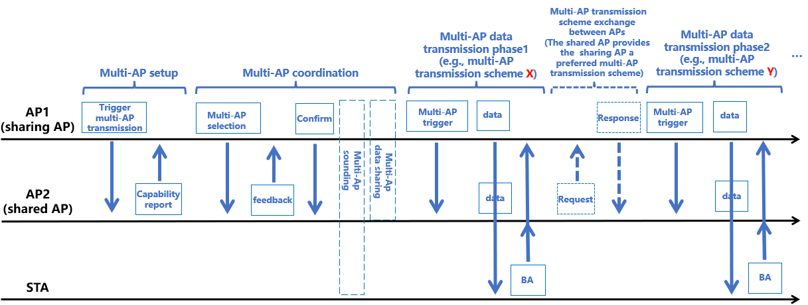
Transmission scheme selection issue in multi-AP transmission
Current transmission scheme selection in multi-AP transmission is dominated by a sharing AP and optionally assisted by shared AP(s) [2], as illustrated in the following figure:
Current transmission scheme selection in multi-AP transmission, where X=Y or X≠Y
Note: X, Y can be any one of C-OFDMA, C-SR, C-BF, C-TDMA, R-TWT multi-AP coordination and JT, or fallback to single AP transmission mode

Slide 5
Transmission scheme selection issue in multi-AP transmission
However, the current transmission scheme selection in multi-AP transmission only involves requirements/information/capability exchanges between the sharing AP and shared AP(s), the requirements/information/capability from STA is not accounted for. Given that STA has better and more-timely knowledge of signal/channel quality changes, we propose a method of STA-assisted multi-AP transmission scheme selection in this contribution.
With the assistance of STA feedbacks about a direct suggestion for multi-AP transmission scheme or measurements/requirements/status related to indirect suggestion for multi-AP transmission scheme, the proposed method could react to varying environments in a more timely manner and dynamically adjusting multi-AP transmission scheme according to their distinct features. For example,
  Joint transmission (JT) is adopted to achieve high throughput at the first place when STA is static and the channels between APs and the STA are good (e.g., no blockage and the received SNR is high). However, when the channel varies due to e.g., STA movement or background changes, where blockage occurs and the received SNR degrades, STA can timely report the following:
    Alterative 1: directly report a preferred multi-AP transmission scheme (e.g., C-TDMA in this case) to the sharing AP based on its own measurements/requirements/status.
    Alterative 2: report its own measurements/requirements/status to the sharing AP as assistant information, and then the sharing AP uses the reported assistant information to determine an updated multi-AP transmission scheme (e.g., C-TDMA in this case).
  Based on the timely reported information from STA, the sharing AP decides to change the multi-AP transmission scheme from JT to C-TDMA to improve reliability for the following multi-AP transmission phases.
As a result, the proposed method can improve robustness and adaptability of multi-AP transmission to varying environments in a more timely manner, compared to currently non-STA assisted multi-AP transmission scheme selection.

Slide 6
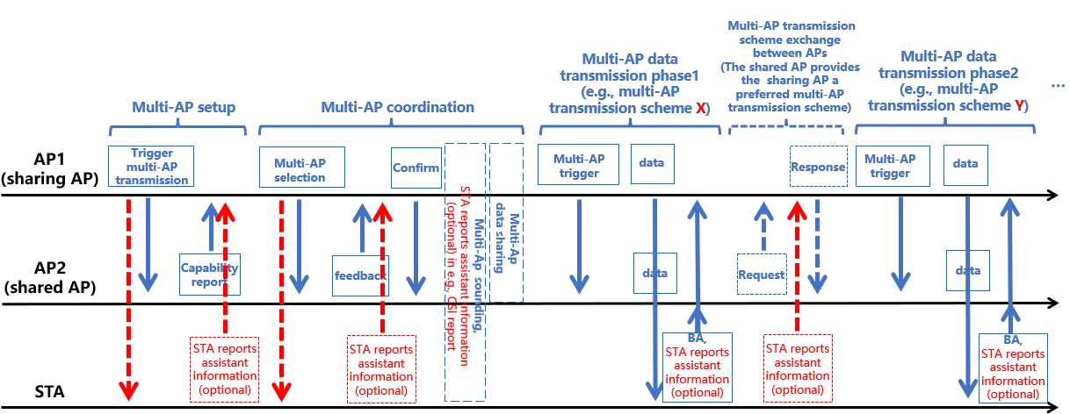
STA-assisted multi-AP transmission scheme selection
Besides shared AP(s), STA can also optionally provide the sharing AP a preferred multi-AP transmission scheme, either directly or indirectly, via reporting assistance information, as shown below:
STA (optionally) reports assistance information to the sharing AP to assist multi-AP transmission scheme selection, where X=Y or X≠Y
Note: X, Y can be any one of C-OFDMA, C-SR, C-BF, C-TDMA, R-TWT multi-AP coordination and JT, or fallback to single AP transmission mode

Slide 7
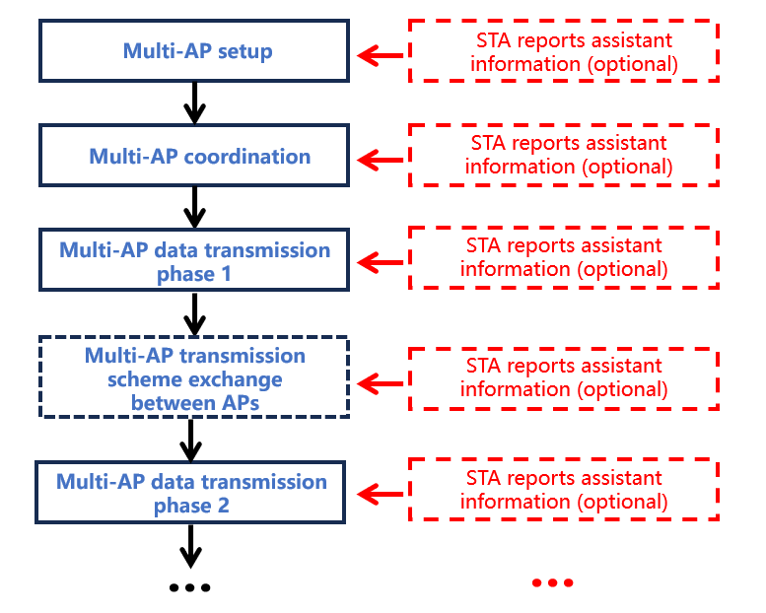
STA-assisted multi-AP transmission scheme selection
STA can optionally report assistance information to the sharing AP to assist multi-AP transmission scheme selection in at least one of the following multi-AP operation stage:
  Multi-AP setup stage: e.g., after receiving trigger frame for multi-AP transmission.
  Multi-AP coordination stage: e.g., after receiving trigger frame for multi-AP selection or in CSI report in multi-AP sounding.
  Multi-AP data transmission stage: e.g., in BA frame.
  Multi-AP transmission scheme exchange between APs stage (optional): e.g., besides shared AP(s), STA may also provide the sharing AP a preferred multi-AP transmission scheme.
The assistance information includes two possible alternatives:
  Alterative 1 (direct suggestion): a preferred multi-AP transmission scheme from STA side.
  Alternative 2 (indirect suggestion): measurements (via e.g., downlink pilot or training signals) and/or possible requirements/capability/other related information for DL/UL transmission to/from STA, to assist the sharing AP in multi-AP transmission scheme selection.
With the assistance information, the sharing AP can make a decision on multi-AP transmission scheme for the next possible multi-AP data transmission stages (if any), with the assistance of either shared AP(s) or STA(s), or both, depending on implementation or prioritization.

Slide 8
Conclusion
STA-assisted multi-AP transmission scheme selection:
  It is beneficial to introduce STA-assisted multi-AP transmission scheme selection in multi-AP transmission.
  With the assistance of STA feedbacks about a direct suggestion for a preferred multi-AP transmission scheme or measurements/requirements/status related to indirect suggestion for multi-AP transmission scheme, the proposed method could react to varying environments in a more timely manner and dynamically adjusting multi-AP transmission scheme according to features of different multi-AP transmission schemes.
  As a result, the proposed method can improve robustness and adaptability of multi-AP transmission to varying environments in a more timely manner, compared to currently non-STA assisted multi-AP transmission scheme selection.
Details of STA-assisted multi-AP transmission scheme selection need further study, including
  Necessary measurements, signalling/mechanism(s)
  Reporting configuration/content/format/procedure
  Multi-AP transmission scheme selection procedure based on information from shared AP(s) and STA(s)
  …

Slide 9
Straw Poll
April 2024
Do you agree that TGbn will introduce STA-assisted multi-AP transmission scheme selection?
  Yes:
  No:
  Abstain:
Ke Zhong, Ruijie Networks Co., Ltd

Slide 10
References
[1] IEEE 802.11-23/0480r3, UHR proposed PAR, Laurent Cariou (Intel)
[2] IEEE 802.11-24/0084r1, Consideration on Multi-AP Operation - Follow up, Jiayi Zhang et al. (Ofinno)

