Slide 1
On UEQM and UEQ-MCS
Date: 2024-06-04
Authors:
Name | Affiliations | Address | Phone | email
Ron Porat | Broadcom |  |  | ron.porat@broadcom.com
Qijia Liu | Broadcom

Slide 2
Introduction
UEQM and UEQ-MCS have been proposed to improve SU MIMO BF performance.
[1] compared their relative performance in a specific channel and a 4x4 configuration
We provide here new results comparing the performance of both schemes in various configurations and typical .11 channels
r1→ per feedback on r0 added adaptive Nss selection for 4x4 configurations, slide 13 onwards

Slide 3
Simulation Assumptions
SVD based Tx beamforming
MIMO Configs: 2x2, 4x2, 4x4
80MHz, DNLOS, BLOS, 500 channel realizations for each MIMO config
MCS0-13 on all streams (no new MCS)
Including RF impairments and realistic CHEST
Gain numbers based on RvR simulation, which uses genie rate selection per channel realization at each SNR point (note the SNR doesn’t include the impairments)
For UEQ MCS, total number of payload bytes is the same as EQM/UEQM. But the total payload bytes are allocated to each stream, proportional to per-stream rate
While UEQM is a direct enhancement of EQM (both using one LDPC), for UEQ-MCS we show two types of results:
UEQ-MCS with strictly one LDPC per spatial stream
UEQ-MCS including EQM with one LDPC for all streams

Slide 4
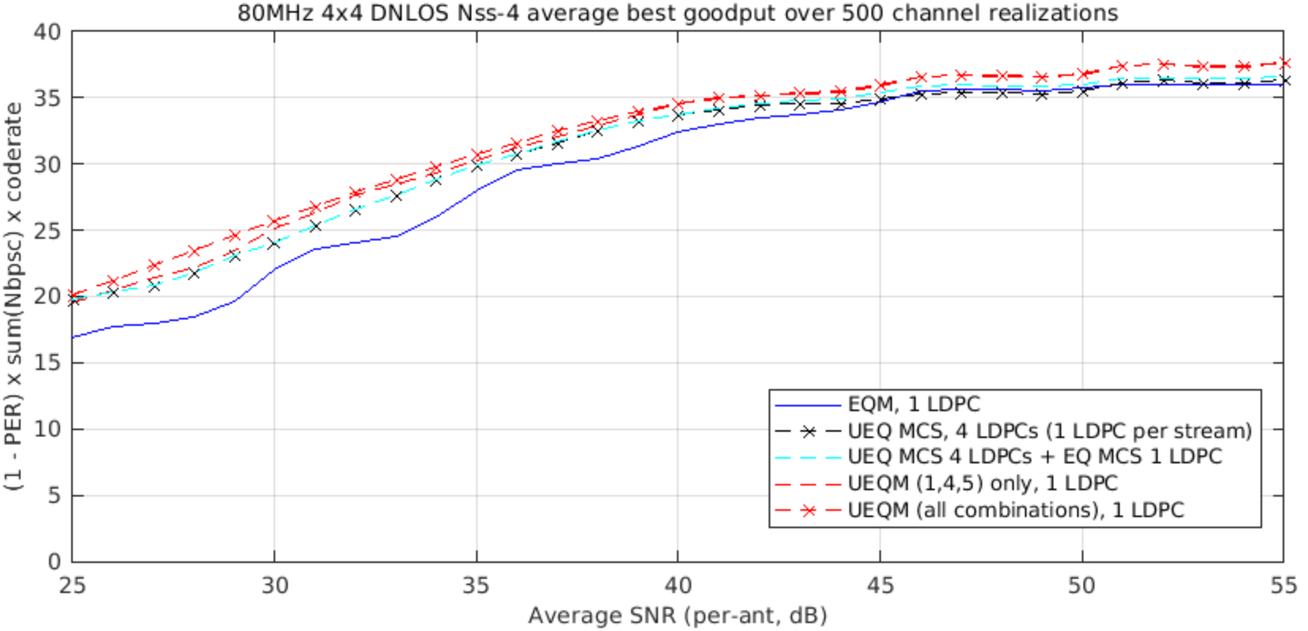
4x4 DNLOS
(*) the notation (1,4,5) is taken from [2]

Slide 5
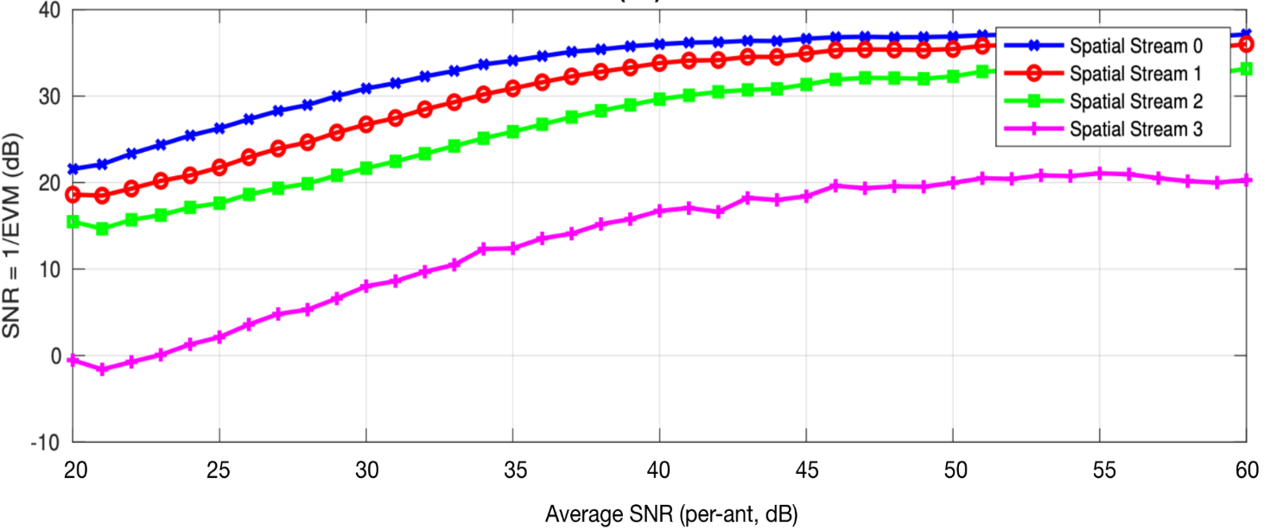
Observations
UEQM, whether all combinations or only the 3 proposed in [2] (shown below), exhibit higher Gput than UEQ-MCS. Why?
We think it’s because one LDPC protects the weakest 4th stream and enables it to use a higher QAM than would be possible if each stream had its own separate LDPC. In that sense the UEQM proposal in [2] provides full flexibility for the 4th stream {x,x-1,x-2} with equal QAM {x} for the stronger 3 streams which maximizes the performance at the high SNR.
 | Mod[stream] |  |  |  | # combinations
 | 0 | 1 | 2 | 3 | 1 | 2 | 3
0 | x | x | x | x | ✓ | ✓ | ✓
1 | x | x | x | x-1 |  |  | ✓
2 | x | x | x-1 | x-1
3 | x | x-1 | x-1 | x-1
4 | x | x | x | x-2 |  | ✓ | ✓
5 | x | x | x-1 | x-2 | ✓ | ✓ | ✓
6 | x | x-1 | x-1 | x-2
7 | x | x | x-2 | x-2
8 | x | x-1 | x-2 | x-2
9 | x | x-2 | x-2 | x-2

Slide 6
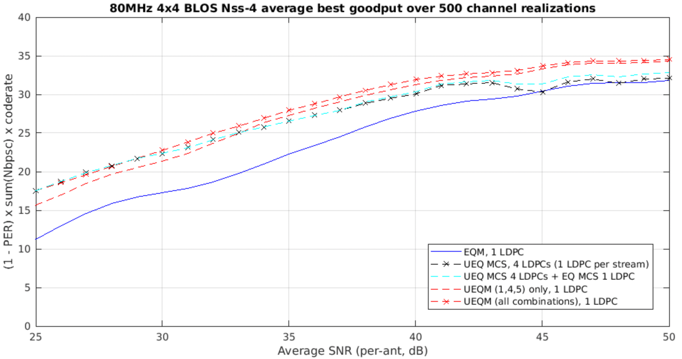
4x4 BLOS
Similar behavior as in DNLOS but bigger gap at high SNR

Slide 7
Example - MCS % Distributions for SNR=45dB
UEQM | 13 | 12 | 11 | 10 | 9 | 8 | 7 | 6
MCS[0] | 89 | 8.4 | 2.6
MCS[1] | 85 | 8.4 | 6.6
MCS[2] | 15.8 | 7.2 | 67.2 | 1.2 | 8.4 |  | 0.2
MCS[3] |  | 1 |  | 3.2 | 21 | 3 | 70.6 | 1
Spectral efficiency 33.65
UEQ MCS | 13 | 12 | 11 | 10 | 9 | 8 | 7 | 6 | 5 | 4
MCS[0] | 100
MCS[1] | 99.4 | 0.6
MCS[2] | 0.8 | 44 | 50 | 5 | 0.2
MCS[3] |  |  | 0.4 | 0.8 | 1 | 9.4 | 21 | 10.4 | 2.4 | 0.6
Spectral efficiency 30.94
For a lot of channels can’t support 4th spatial stream
UEQ MCS + EQM | 13 | 12 | 11 | 10 | 9 | 8 | 7 | 6 | 5 | 4
MCS[0] | 38.8 | 2 | 3.2 | 56
MCS[1] | 38.2 | 2.6 | 3.2 | 56
MCS[2] | 0.4 | 20.4 | 20.4 | 58.6 | 0.2
MCS[3] |  | 2 | 3.4 | 56 | 0.2 | 6.2 | 18.4 | 8 | 5.6 | 0.2
Spectral efficiency 31.59

Slide 8
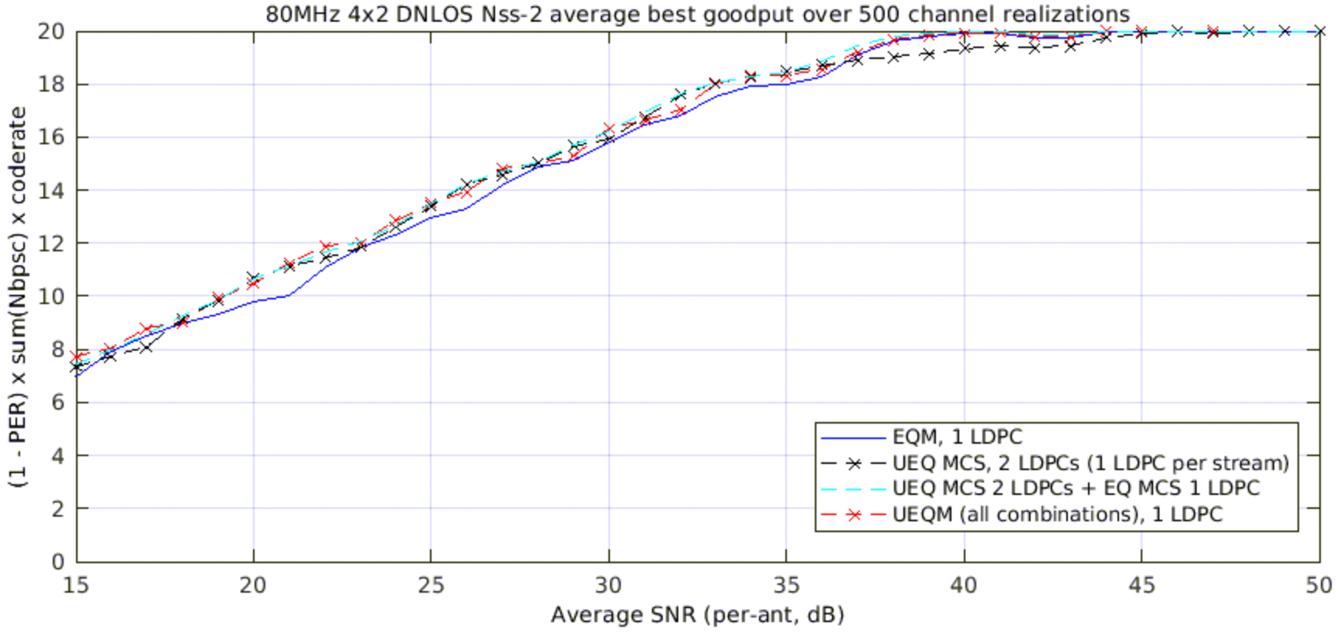
4x2 DNLOS
Observation - UEQ MCS has losses at around 40dB SNR compared with EQM and UEQM. Why?
UEQ MCS lands on MCS 13+12 there, while EQM can mostly go to MCS 13+13. This comes back to the fact that a single LDPC can help the weaker stream by combining it with the stronger stream

Slide 9
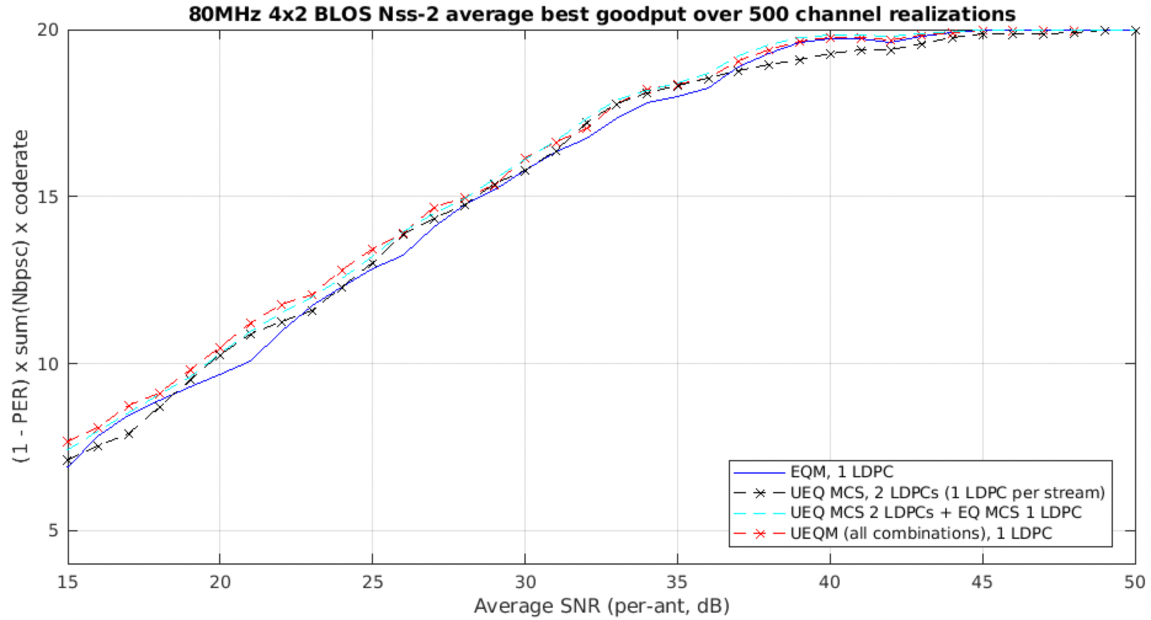
4x2 BLOS
Observation – same as in DNLOS

Slide 10
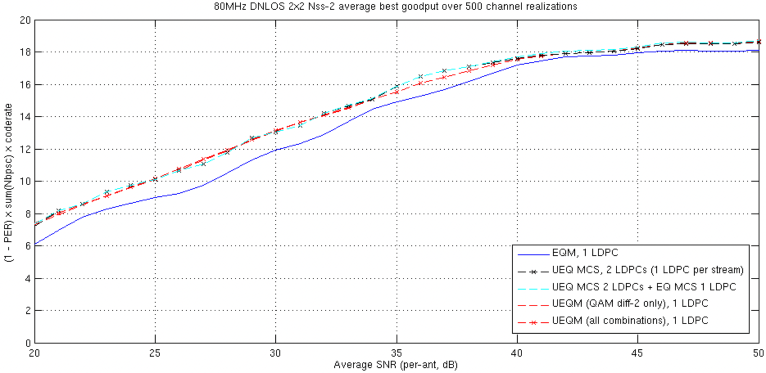
2x2 DNLOS
Observation - UEQ MCS are about the same

Slide 11
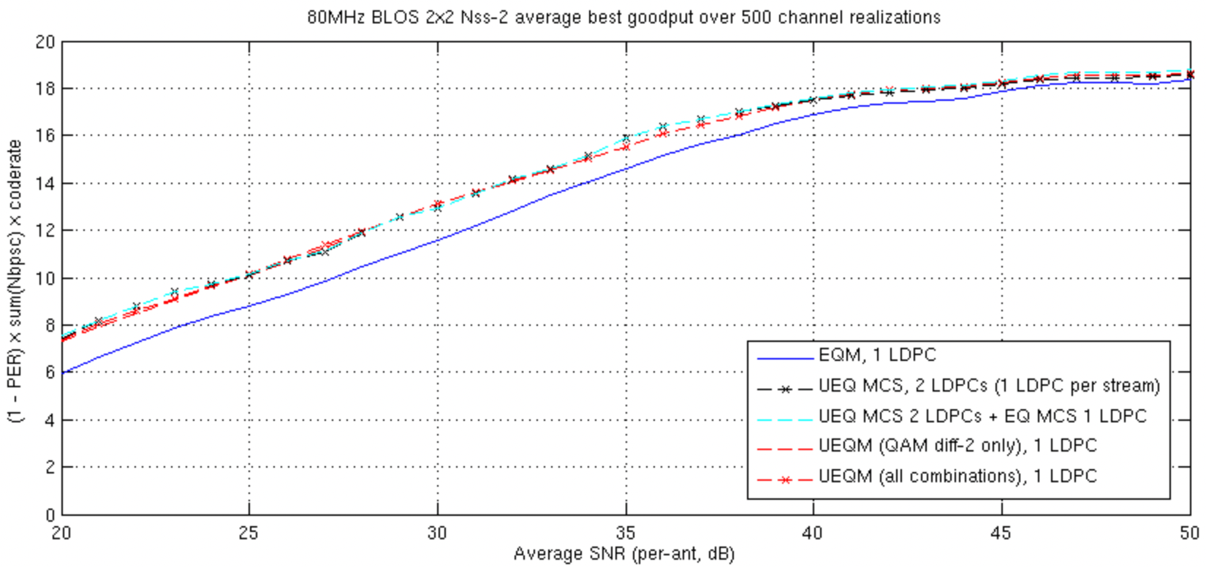
2x2 BLOS
Observation - UEQ MCS are about the same

Slide 12
Conclusions
UEQM is superior to UEQ-MCS with Nss>2 and with {Nss=2, 4x2} because one LDPC provides better protection over the strong and weak streams to enable pushing the QAM or code rate slightly higher than possible with UEQ-MCS
Not only UEQM is simpler to implement for STA because they have only one LDPC but even for AP to AP communications over with 4ss UEQM seems to provide gain over UEQ-MCS
UEQM works better with the existing EQM – easier to add and integrate
→ Recommend that 11bn adopts UEQM for MIMO+BF

Slide 13
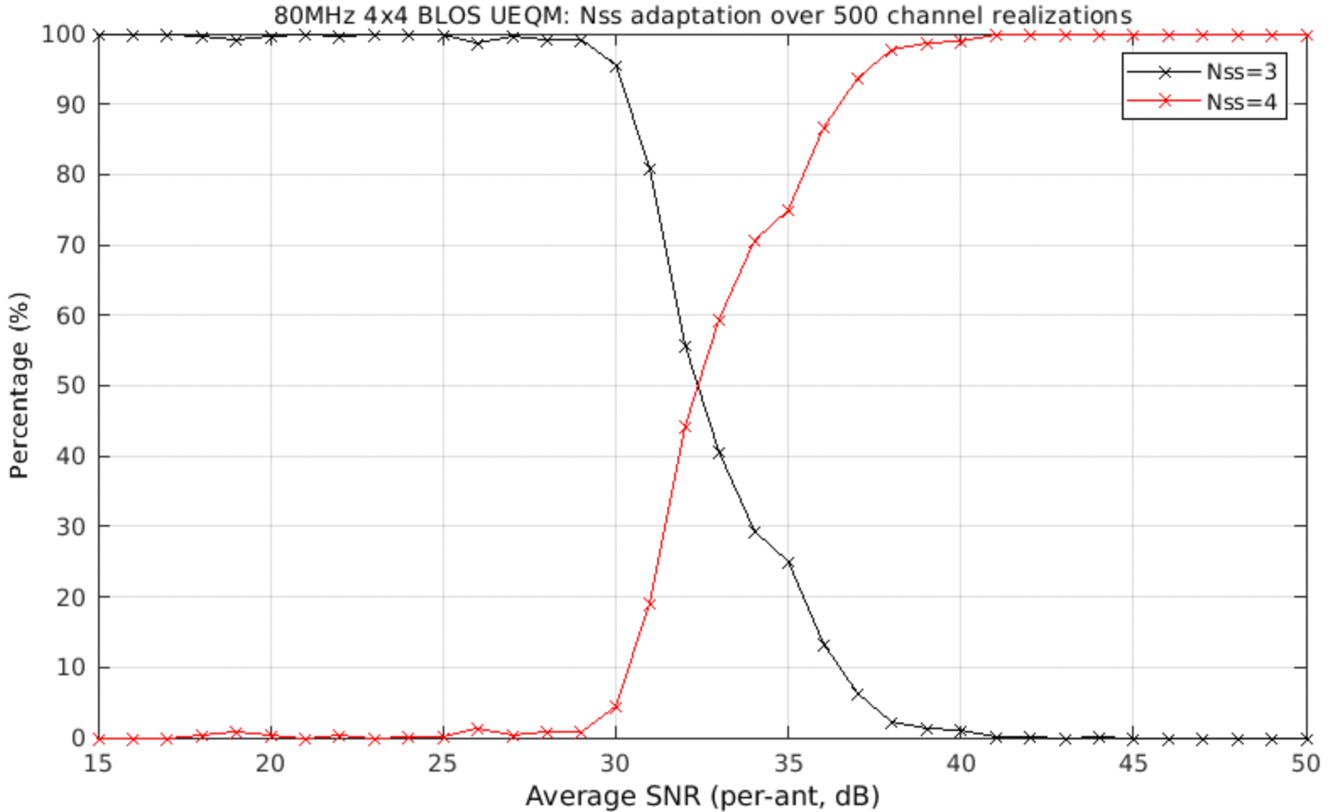
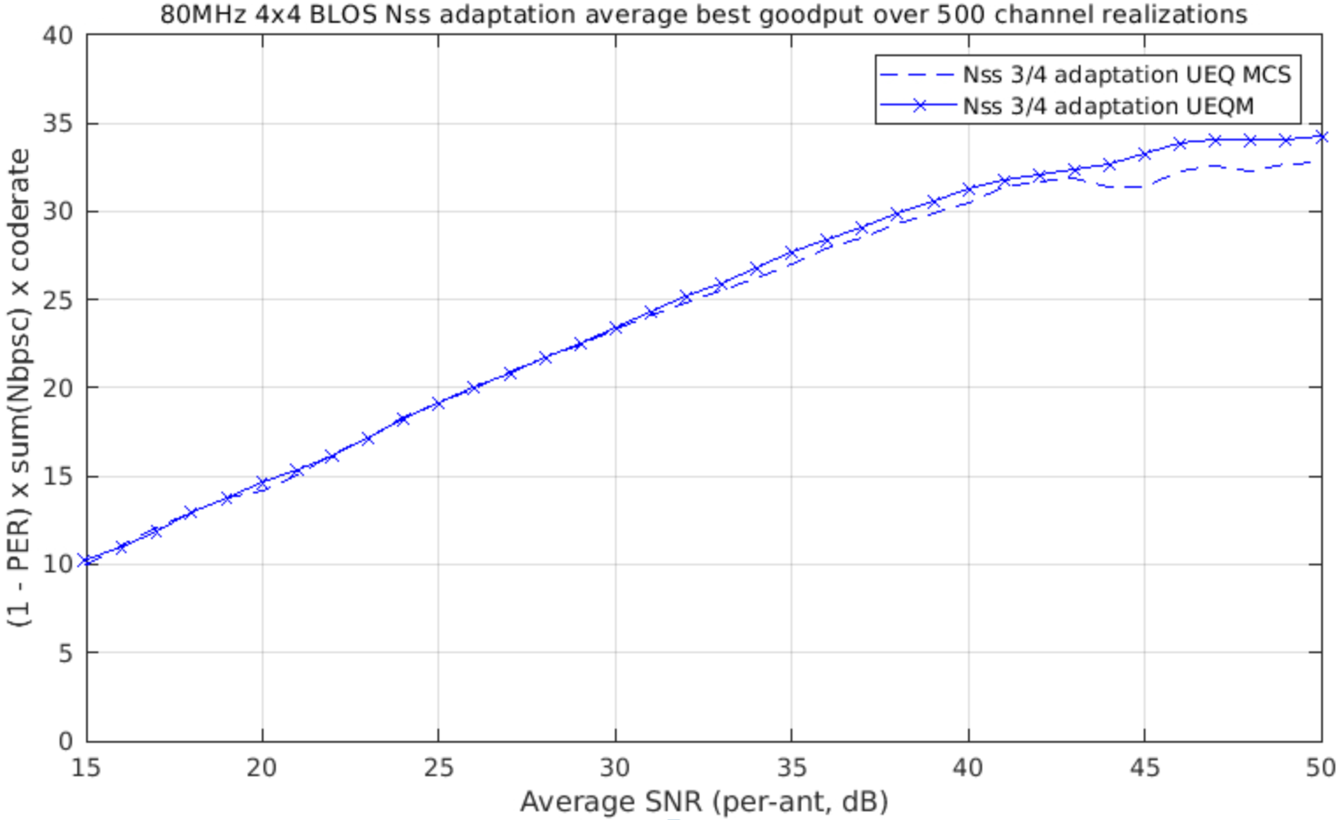
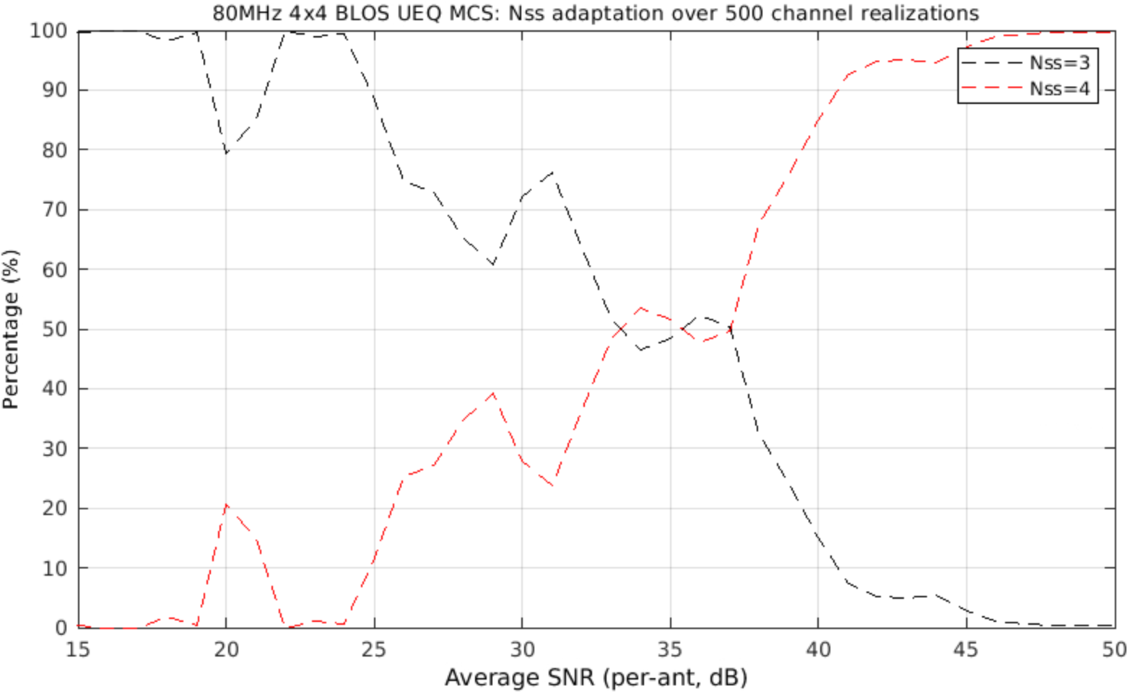
4x4 BLOS with Adaptive Nss
For each channel realization and SNR we chose the best rate between Nss=3 and Nss=4
For SNR>32dB UEQM shows higher Gput.
Plots on the right show UEQM choice of Nss depends on SNR in a nice linear fashion but not so much for UEQ-MCS

Slide 14
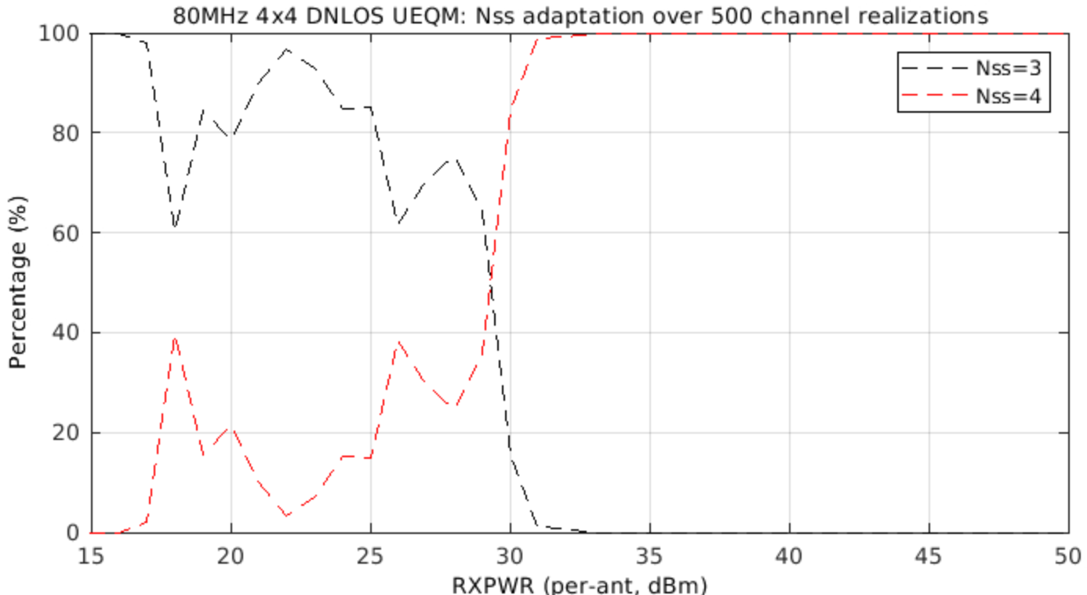
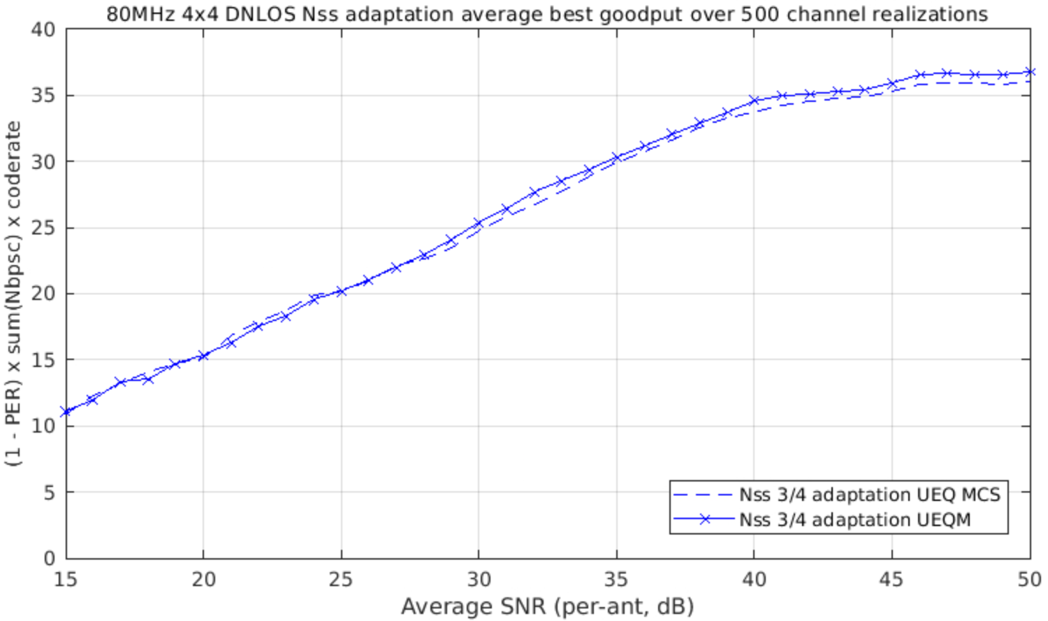
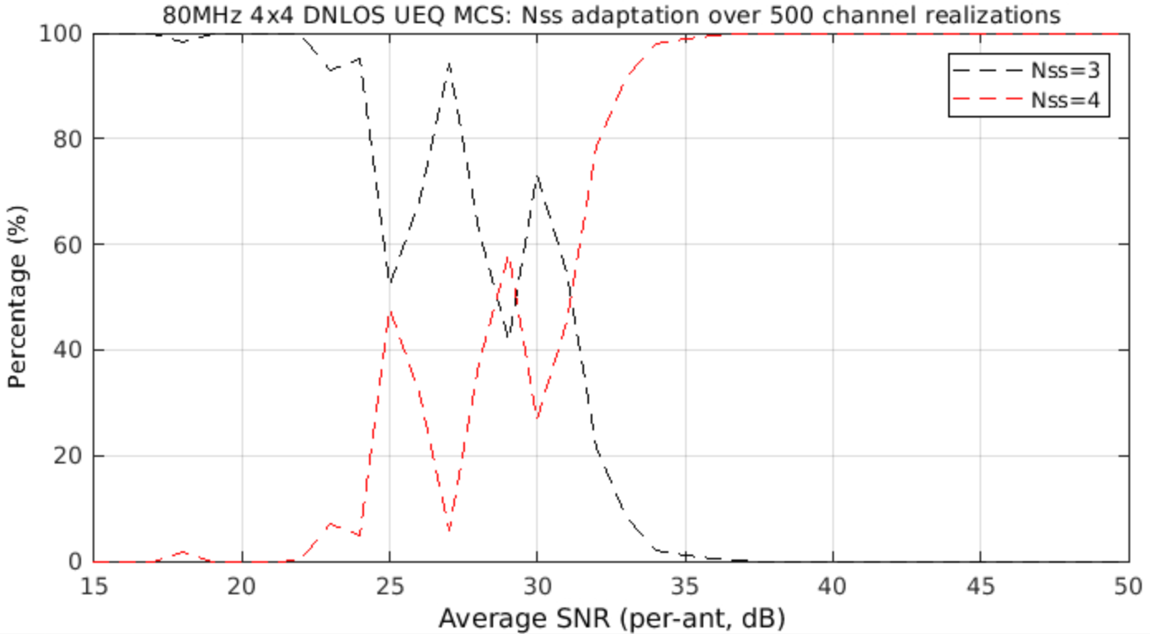
4x4 DNLOS with Adaptive Nss
Similar behavior as BLOS but with wider fluctuations in the percentage of Nss=4 for SNR<30dB
The reason is that the 4th stream SNR is much lower that for UEQ-MCS Nss=4 is quite similar to Nss=3 in many cases

Slide 15
Conclusions r1
In general no change to the previous conclusions even with adaptive Nss=3 and Nss=4 for 4x4 configurations – as soon as SNR enables higher percentage of Nss=4 cases UEQM exhibits higher Gput
We also simulated 2x2 and 4x2 configurations with adaptive Nss=1 and Nss=2 but saw no difference in performance, clearly in these cases Nss=1 is the same for UEQM and UEQ-MCS and results with Nss=2 are shown already in r0
Given that current implementations use one LDPC the logical enhancement for 11bn is to maintain a design with one LDPC and add unequal QAM

Slide 16
References
[1] 11-24-0433-00 Analysis on UEQM and UEQ MCS
[2] 11-24-0507-02 UEQM Further Details

Slide 17
SP #1 (from 24/117r1)
Do you agree to add to the 11bn SFD : 11bn supports unequal modulations (UEQM) with single encoder for all spatial streams and different modulation per spatial stream for beamforming with at least 2ss
This is used for single user MIMO beamforming transmission in full bandwidth or OFDMA

