Slide 1
1st Vice Chair Report - 2024 May - Interim - Warsaw
Date: 2024-05-17
Authors:
Notes:
R0 – initial posting
R1 Straw Poll Results added.

Slide 2
Abstract
Agenda Items for 1st Vice Chair –
Monday May 13:
M3.3 II Session Information
M3.4 II Meeting room locations
M3.5 II Meeting registration
M3.6 II Recording attendance
M3.7 II Local File Server Access
M3.8 II Breakfast, breaks, Social logistics
Friday May 17:
F3.1.2 DT WG Straw Poll
F3.1.3 DT Future venues Insight

Slide 3
Warsaw_May Interim_ Things to Know From MTG Events See Mentor: ec-24-0100-00-WCSG
https://mentor.ieee.org/802-ec/dcn/24/ec-24-0100-00-WCSG-warsaw-2024-may-802w-interim-things-to-know.pptx

Slide 4
IMPORTANT INFORMATION
IEEE 802 Wireless Interim Meeting
May 12 – 17, 2024
Warsaw Marriott. Hotel, POLAND

Slide 5
AUDIO VISUAL:
The Audio Visual is being supplied by the Hotel – Marriott Hotel.
There will be floating AV technicians between the rooms during the meetings.
For any issues, please see a contact Sara at the Registration Desk (sara@mtgevents.com.au)
AUDIO IN MEETING ROOM
If you are a local participant, PLEASE, select “Don’t connect to audio” when joining the WebEx session. Connecting to the audio, may cause an audio feedback loop that prevents the meeting from proceeding

Slide 6
COMBINED SCHEDULE
IN PERSON Room Assignments: Schedule QR codes posted outside each meeting room and on the back of your name badge.
REMOTE Participation: https://ieee802.org/802tele_calendar.html
ATTENDANCE TOOL (IMAT) : https://imat.ieee.org/

Slide 7
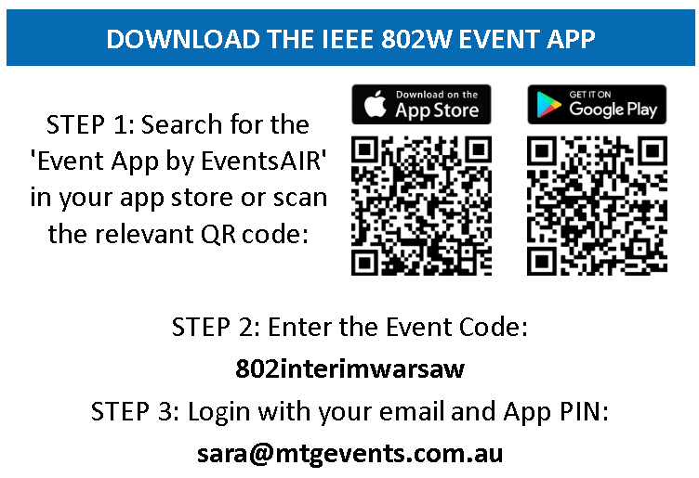
PROGRAM APP - The IEEE 802 Wireless Interim Meeting App information is available on the back of your name badge

Slide 8
NETWORK ACCESS INFORMATION:
Local Document Server for IEEE 802W Documents:
http://ieee802.linespeed.com/
The network provider for the IEEE 802 Wireless Interim is Linespeed Events. Linespeed are located in the Nysa Room (level 3) during the meeting.
Details on how to log into the network are printed on the back of your badge.

Slide 9
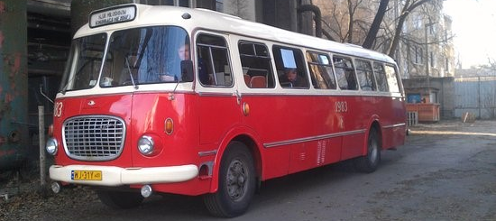
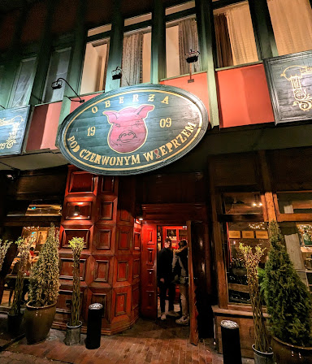
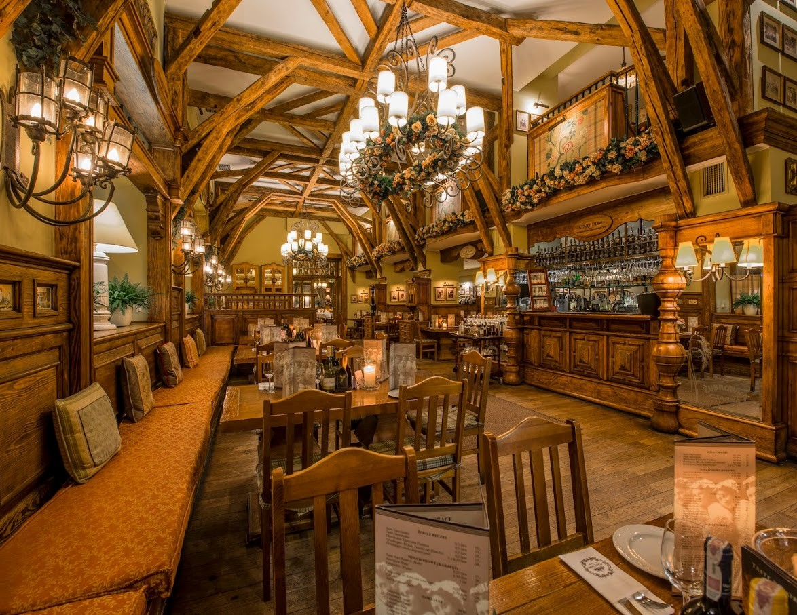
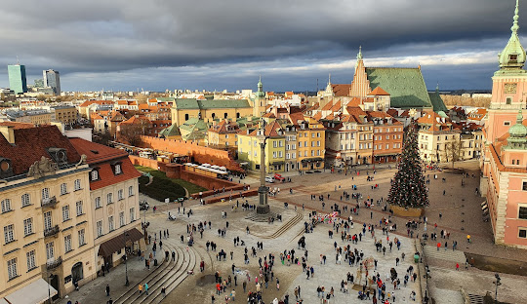
WEDNESDAY SOCIAL TOUR OF OLD TOWN + POLISH DINNER Wednesday May 15, 2024 Time: 6.00-6:30pm: 8 Buses will depart from Marriott Hotel Please meet from 6:00-6:30pm on the street level (Ground) of the Marriott Hotel to join one of the Cucumber Buses. Tour of Warsaw: Enjoy a short tour of Old Town in a historic communist era Cucumber Bus. Dinner: Due to increased numbers, we have 2 restaurants booked, both will serve Family Style Polish Food. Make sure you are on the same bus as those you would like to dine with. Return Coaches: Coaches will return from the restaurants to the Marriott from 9pm Please let the Registration Desk know if you CAN’T make the dinner to assist with restaurant numbers.

Slide 10
CATERING:
Breakfast: is included in your room rate if you booked at the Marriott.
Morning & Afternoon teas will be served from the foyer areas on both floors, Level 2 and 3
Lunch: will be held in the Terrace on Level 2

Slide 11
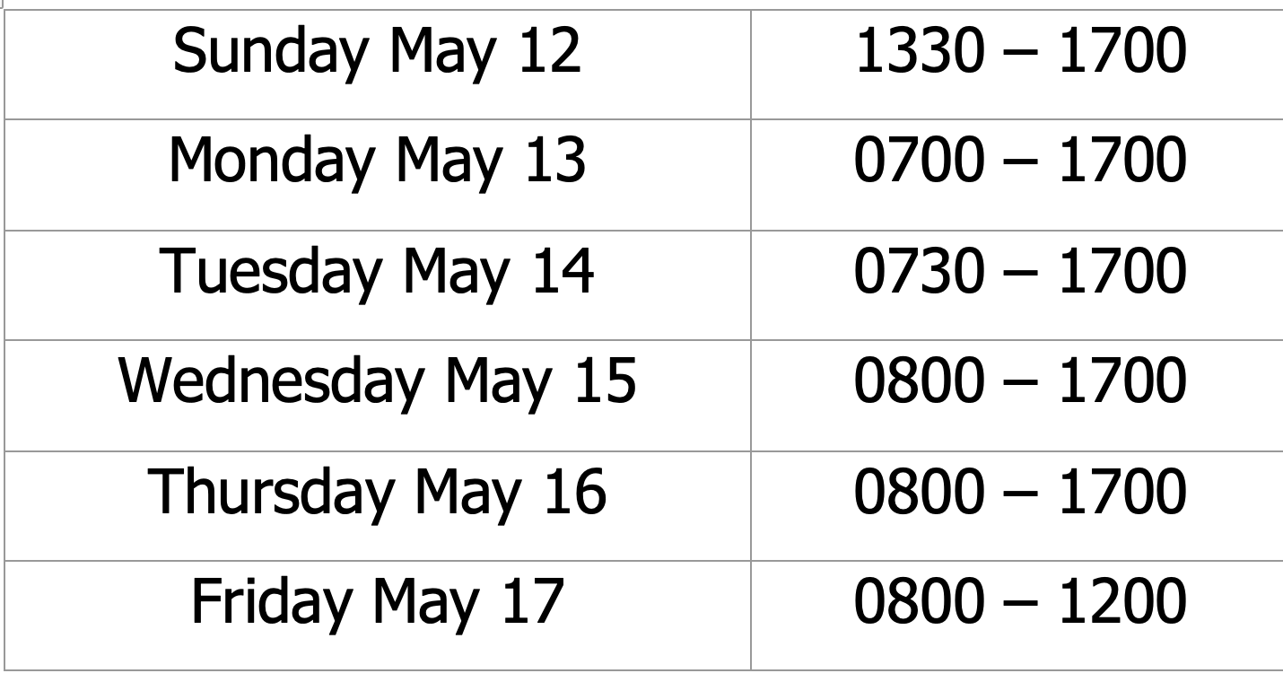
The REGISTRATION DESK will be located in the Hotel Foyer, on level 2, during the following times:

Slide 12
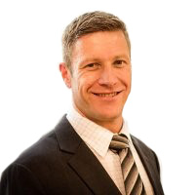
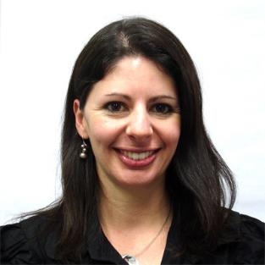
Any Questions Please see Daniel or Sara on the registration desk!
802wireless@mtgevents.com.au

Slide 13
M3.6 Recording attendance
It is a requirement that attendees record their participation at an 802.11 session and declare their affiliation. This record is usually made using the IMAT attendance system.
If you wish to participate without recording attendance, send an email per session to the WG 2nd vice chair declaring your participation and affiliation. You cannot gain or maintain 802.11 voting membership using this method.
You must record 75% attendance of required 802.11 slots in a session for that session to count towards gaining or maintaining 802.11 voting membership
You need a single IEEE-SA web account
The IEEE SA web account requires a working email address
do not remove your email address from the account
Use the email address associated with that web account when registering attendance
If you change email addresses, update the web account, don’t create a new web account, or your membership status may not be calculated properly
Record attendance using this URL: IMAT.IEEE.ORG/

Slide 14
Friday, May 17, 2024 802.11 WG Closing Plenary
Agenda Items:
3.1.2 DT Straw Poll regarding meetings
3.1.3 DT Future venues status and discussion

Slide 15
Straw Poll: Return to This Venue: (Warsaw Marriott Hotel)
1. How many people would like to come back to this venue?
Yes – 69
No – 0
2. Did you go to the social?
Yes –65
No – 4
3. If you attended the Social, did you like the social?
Yes – 56
No – 1
4. Did you like the Bus Tour portion? 37 yes
Notes:
Show of Hands of those in the room.

Slide 16
Future 802W Interim Venue Status
As of May 12, 2024
2024-09 (8-13) Hilton Waikoloa, Waikoloa, HI, USA
2025-01 (12-17) Kobe, Japan – TBC (Moved from May 2023) (Contract TBC)
2025-05 (11-16) Hilton Prague, Prague, Czech Republic (Contract TBC)
2025-09 (14-19) Hilton Waikoloa, Waikoloa, HI, USA
2026-01 (11-16) Victoria Conference Centre & Fairmont Empress, Victoria, Canada (Contract TBC)
2026-05 (10-15) –Hilton Antwerp Old Town, Antwerp, Belgium (Contract TBC)
2026-09 (13-18) Hilton Waikoloa, Waikoloa, HI, USA
2027-01 (10-15) Hyatt Regency Irvine, Irvine, CA, USA (Contract TBC)
2027-05 (9-14) Cordis Hotel, Auckland, New Zealand (Contract TBC)
2027-09 (12-17) Grand Hyatt Atlanta, Buckhead, GA, USA (Contract w/IEEE)
2028-01 (16-21) Hilton Panama, Panama City, Panama (Contract TBC)
Meeting Planner:
Dotted Venues: Face to Face Events
Starred Venues :MTG Events
Notes:
Future Wireless Interim Meetings: review and status May 12, 2024
In General, Each year one Session must be Non-NA/US
– Odd years Asia – Even Years Europe
2024 Sept 8-13 – Hilton Waikoloa Village – Contract (802WFIN-20/12r0)
2025 Jan 12-17 – Kobe, Japan – in negotiations
2025 May 11-16 – Hilton Prague, Prague, Czech Republic Contract TBC
2025 Sept 9-14 - Hilton Waikoloa Village, Waikoloa, HI – Contract (802WFIN-22-0007r0)
2026 Jan 11-16 – RFP – Victoria Conference Centre & Fairmont Empress, Victoria, Canada
2026 May 10-15–Hilton Antwerp Old Town, Antwerp, Belgium – Contract TBC
2026 Sept 13-18 Hilton Waikoloa Village, Waikoloa, HI – Contract (802WFIN-22-0008r0)
2027 Jan 10-15 – Hyatt Regency Irvine– Contract TBC
2027 May 9-14 – Auckland, New Zealand – Contract TBC
2027 Sept 12-17 – Grand Hyatt Atlanta, Buckhead, GA, USA – With IEEE Legal
2028 Jan 16-21 – Hilton Panama, Panama City, Panama – Contract TBC

Slide 17
Future 802 Plenary Venue Contract Status
2024 March 10-15 – Hyatt Regency Denver at Colorado Convention Center, Denver, CO, (March 2021)
2024 July 14-19 – Sheraton Le Centre Montreal, Montreal, Quebec, Canada (July 2020)
2024 November 10-15 –Hyatt Regency Vancouver, Vancouver, Canada (Nov 2021)
2025 March 9-14 –Hilton Atlanta, Atlanta, GA, United States (2 of 2 – March 2020).
2025 July 27-August 1 –Melia Castilla Madrid, Madrid, Spain (Changing Week to July 27)
2025 November 9-14 – Marriott Marquis Queen’s Park, Bangkok, Thailand
2026 March 8-13 - Hyatt Regency Vancouver, Vancouver, Canada (Change from Chicago)
2026 July 12-17 – Le Centre Sheraton Montreal, Montreal (July 2022 attrition offset)
2026 November 8-13 - Marriott Marquis Queen’s Park, Bangkok, Thailand
2027 March 14-19 – Hilton Atlanta, Atlanta, GA, United States ( offset potential shortfall 2023/2025)
2027 July 11-16 - Gothia Towers, Gothenburg, Sweden
2027 November 14-19 – Hawaiian Village, Oahu, Hawaii, United States
802 EC Approved – Contract is being Negotiated.
Contracts Executed
As of May 12, 2024
Notes:
2025 July - Site Visit planned for Melia Castilla Madrid (May 21-25) – Contract pending visit.
2025/2026 November – Terms and Conditions agreed to, need contract from Hotel
2026 March – Hyatt Regency Vancouver Contract - 802Fin-24/0005r0 – April 5, 2024
2027 March – Hilton Atlanta – need to get contract formalized
2027 July – Gothia Towers – Site Visit to be Scheduled

