Slide 1
Introduction to Passive sub-1GHz RFID systems
Date: 2024-05-14
Authors:

Slide 2
Introduction
This contribution gives a short introduction into passive UHF RFID systems and lists some key requirements for low-cost dual interface tags

Slide 3
Agenda
Dual system tags: use cases
UHF RFID system overview
  Major markets
  Passive RFID system
  EPC Gen 2 protocol
Low-cost dual system tag: key requirements

Slide 4
Dual system tags: use cases

Slide 5





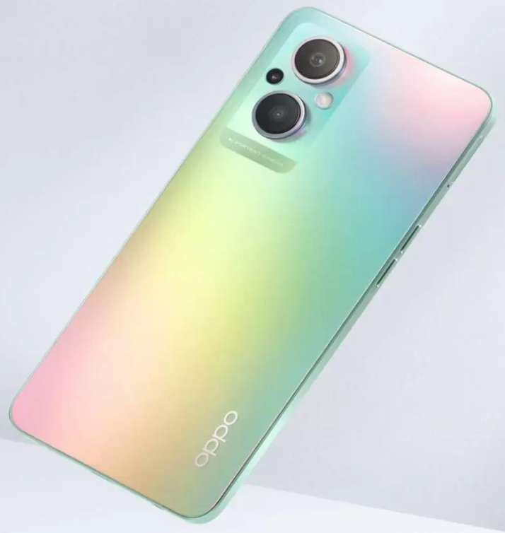




What if 10’s of billions of UHF tags can be read with a mobile device?
Consumer gets product related information
  - product properties, warranty, item history, promotion
Consumer self check-out with personal device
  - read tag and pay, no need to go cashier
Beyond sale
  - ease of product registration, recycle information
Connect the physical world with the virtual world
  Create digital twin, connect items to the cloud
Read range requirement: ~5cm

Slide 6







What if 10’s of billions of tags can be read with a mobile device and a Wi-Fi Router?
Smart Home
  Locate personal belongings
  Read expiration dates of food, trigger new order
Smart factory
  Production control, warehouse inventory,
  asset management, anti-counterfeiting, worker
  presence detection
Smart agriculture
  Supply chain and asset management
Combine the physical world with the virtual world
  connect items to the cloud
Read range requirement: several meters

Slide 7
UHF RFID system: overview

Slide 8

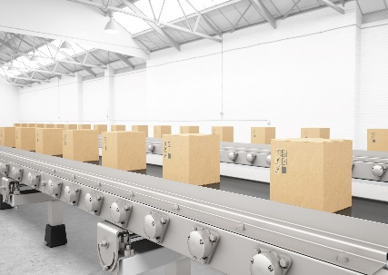



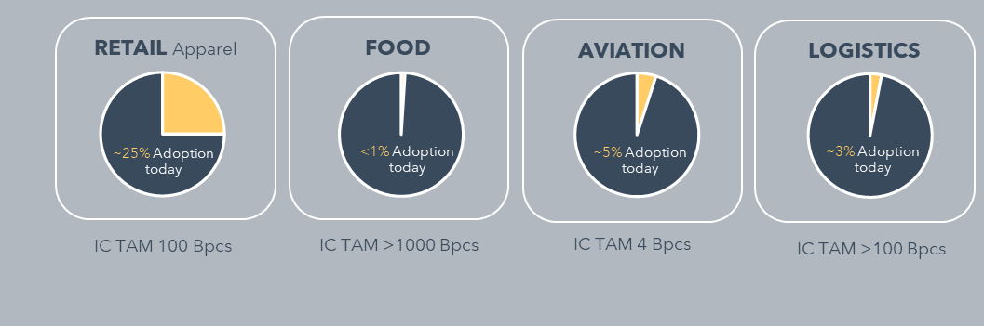


Major markets
RETAIL APPAREL
LOGISTICS
AVIATION
FOOD
INDUSTRY
VEHICLE IDENTIFICATION
  Source: RAIN RFID Market Research Report: www.rainrfid.org, VDC research

Slide 9
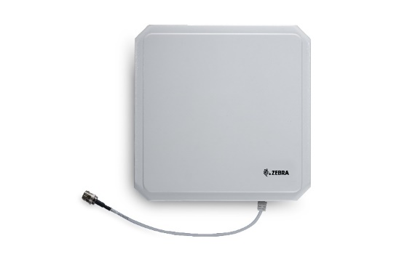

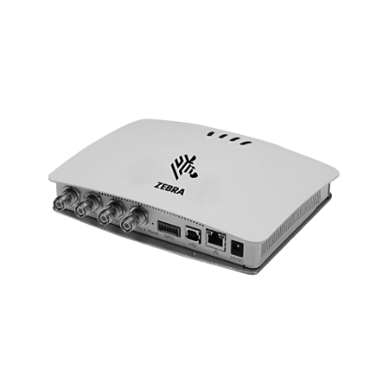
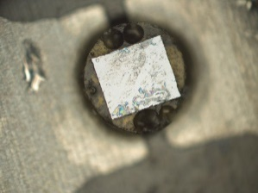
Passive UHF RFID (Radio Frequency Identification) system: overview
Modulated UHF carrier for power and data transmission
P
Reader
Passive Label
Reader
antenna
P
Tag, unmodulated
P
Tag, modulated
P
Delta, reflected
Reflected wave (backscatter) for data transmission
UCODE IC
RFID Reader
operating distance up to 15m

Slide 10
EPC Gen 2:
Protocol

Slide 11
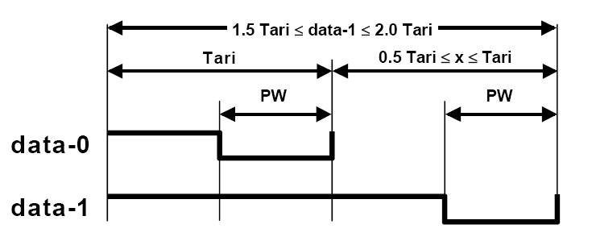
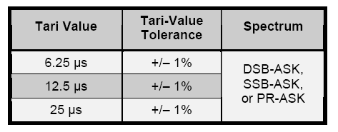
Reader to Tag Communication: OOK modulation using PIE Encoding
Tari = reference time interval (duration of a data-0)
transmitted CW
attenuated CW
Data rates according with local radio regulations.
6.25µs = 160kbps
12.5µs = 80kbps
25µs = 40kbps
The standard does not specify sensitivity levels: currently -24dBm (incl 2dB antenna gain) @ 900MHz can be achieved

Slide 12
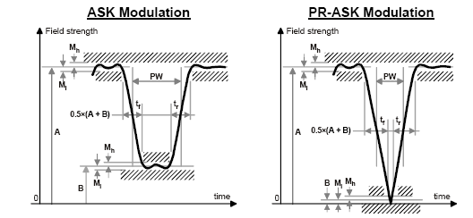
Pulse shape of OOK signal
RF envelope parameters
Tari | Parameter | Symbol | Minimum | Typical | Maximum | Units
6.25 µs to 25 µs | Modulation Index | (A-B)/(A+B) | 80 | 90 | 100 | %
 | RF Envelope Ripple | M_{h} = M_{l} | 0 |  | 0,05(A-B) | V/m or A/m
 | RF Envelope Rise Time | t_{r,10-90%} | 0 |  | 0,33Tari | µs
 | RF Envelope Fall Time | t_{f,10-90%} | 0 |  | 0,33Tari | µs
 | RF Pulsewidth | PW | MAX(0,265Tari, 2) |  | 0,525Tari | µs

Slide 13
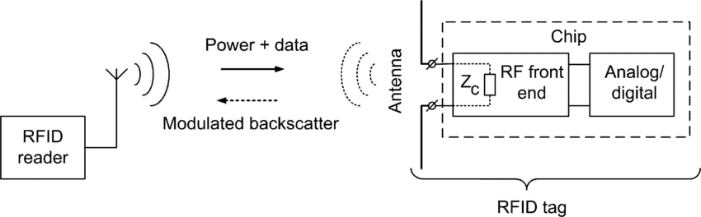
Tag to Reader Communication
Source:IEEE Xplore, Antenna design for UHF RFID tags: A review and a practical application
Modulation:
  backscatter modulation (change of antenna reflection coefficient)
Data Encoding:
  FM0 baseband
  Miller – encoded sub-carrier
The interrogator sets the choice of encoding and data rate by parameters in the Query command
The standard does not specify backscatter levels: currently -15dBm@ 900MHz and 0dBm input power are typical

Slide 14
Tag to Reader Communication: Data Rates
M: Number of sub-carrier cycles per symbol | Modulation type | Data rate (kbit/s)
1 | FM0 baseband | BLF
2 | Miller sub-carrier | BLF/2
4 | Miller sub-carrier | BLF/4
8 | Miller sub-carrier | BLF/8
BLF (bit link frequency): 40kHz – 640kHz
The Query command that initiates an inventory round specifies M

Slide 15

Key requirement in RFID applications: Identification rate
Besides the physical layer the anticollision (inventory) protocol is key to achieve a high identification rate
Who is there ?
Dark classroom:
A teacher wants to identify all pupils in the room
Pupils are moving in and out of the room randomly
Pupils cannot hear each other or talk to each other
Challenge: identify all pupils in the room at a certain time
  Source: Jeremy Bishop on Unsplash

Slide 16
Inventory process EPC Gen2 (1)

Slide 17
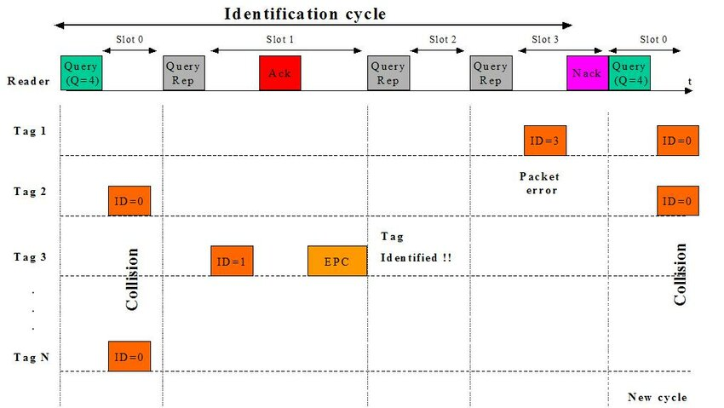
Inventory process EPC Gen2 (2)
Source: https://www.researchgate.net/publication/221311815

Slide 18
Inventory process EPC Gen2 (3)
C: adaptive slot parameter
Source: Parameters for EPC Global RFID Anti-Collision Q-Algorithm in Different Traffic Scenarios 2012 10th International Conference on Frontiers of Information Technology

Slide 19


A/B Symmetry replaces quiet state
Gen2 doesn’t put tags to sleep. It uses a “flag” instead
  Flag can be set to “A” or “B”
Count tags from A➔B➔A
  Step 1: Query(A)
    Only “A” tags respond
    “A” tags set their flag to “B” when they are counted
  Step 2: Query(B)
    Only “B” tags respond
    “B” tags set their flag to “A” when they are counted
  Go to step 1
A
B
B
A
After A➔B➔A, all tags have been counted and are in A

Slide 20
Multiple Reader -> Sessions
Solution: Tags have 4 flags rather than just 1
  One for each of 4 sessions
  A reader Queries tags in a single session
  Different readers can use different sessions
Example
  Shelf reader uses session #2; handheld reader uses session #1
Session 4
A
B
Session 3
A
B
B
Session 2
A
B
A
B
Session 1
A
B
A
A
B
B
A

Slide 21
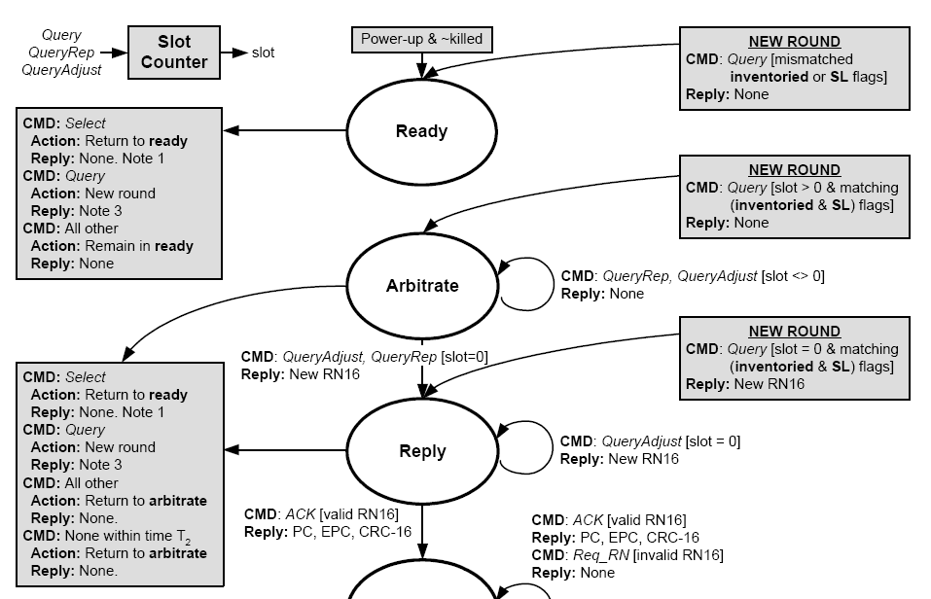
Tag state diagram (1)

Slide 22
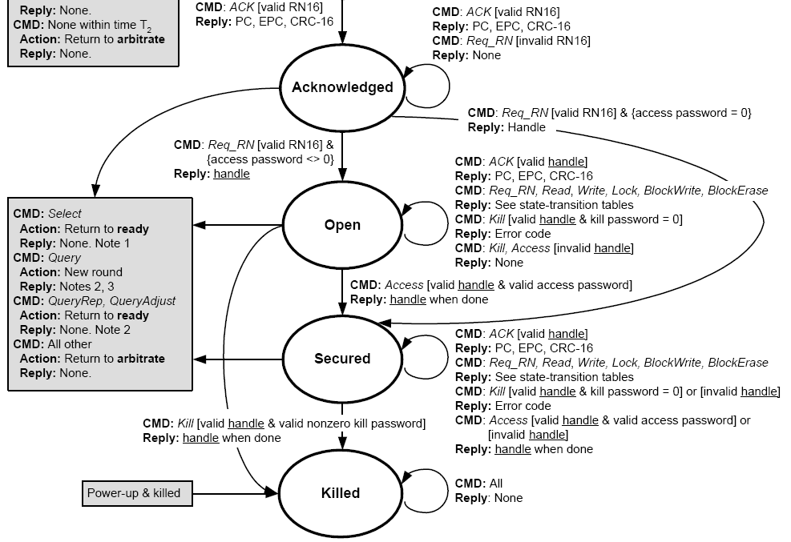
Tag state diagram (2)

Slide 23
EPC Gen2: Memory structure
Reserved
Memory
ACCESS and KILL Password
EPC Memory
EPC Electronic Product Code
TID
TID Tag Idenitfier (preprogrammed & locked)
User Memory
Manufacturing, quality and product related data storage
User related data storage
Code can be written by user
IC Manufacturer information, Unique serial number

Slide 24
EPC Gen2: Memory Organization
MSB
LSB
Tag Identification Memory contain the TID according EPCglobal [00_{h} – 1F_{h}], XTID header
and 48 bit unique Serial number [30_{h} – 5F_{h}]
TID SN
5
F
h
TID SN
TID SN
XTID
10
h
TID
[
15
:
0
]
1
F
h
00
h
TID
[
31
:
16
]
0
F
h
EPC Memory contain a StoredCRC [00_{h}-0F_{h}], a StoredPC [10_{h}-1F_{h}] and an EPC code beginning at address [20_{h}]
MSB
LSB
Bank
10
TID
Bank
01
EPC
EPC
9
F
h
:
Reserved Memory contain KILL and ACCESS passwords.
KILL password [00_{h}-1F_{h}]
ACCESS password [20_{h}-3F_{h}]
Bank
00
RESERVED
20
h
EPC
10
h
StoredPC
[
15
:
0
]
1
F
h
00
h
StoredCRC
[
15
:
0
]
0
F
h
MSB
LSB
30
h
ACCESS Pwd
[
15
:
0
]
3
F
h
20
h
ACCESS Pwd
[
31
:
16
]
2
F
h
10
h
KILL Pwd
[
15
:
0
]
1
F
h
00
h
KILL Pwd
[
31
:
16
]
0
F
h

Slide 25
Command List (without security, file management and privacy commands)
Command | Code | Length (bits) | Mandatory? | Protection
QueryRep | 00 | 4 | yes | Unique command length
ACK | 01 | 18 | yes | Unique command length
Query | 1000 | 22 | yes | Unique command length & a CRC-5
QueryAdjust | 1001 | 9 | yes | Unique command length
Select | 1010 | > 44 | yes | CRC-16
NAK | 11000000 | 8 | yes | Unique command length
Req_RN | 11000001 | 40 | yes | CRC-16
Read | 11000010 | > 57 | yes | CRC-16
Write | 11000011 | > 58 | yes | CRC-16
Kill | 11000100 | 59 | yes | CRC-16
Lock | 11000101 | 60 | yes | CRC-16
Access | 11000110 | 56 | no | CRC-16
BlockWrite | 11000111 | > 57 | no | CRC-16
BlockPermalock | 11001001 | > 66 | no | CRC-16
Reserved for custom commands | 11100000 00000000 … 11100000 11111111 | - | - | Manufacturer specified

Slide 26

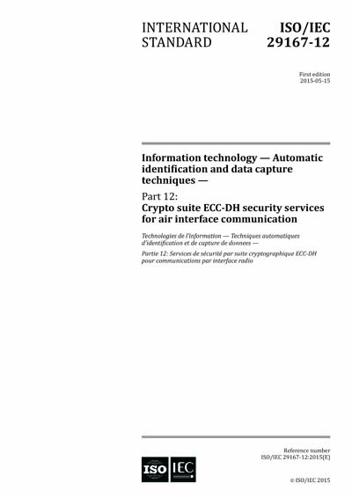
EPC Gen 2 security: crypto suites (examples)

Slide 27
Low-cost dual system tag: key requirements

Slide 28

Dual system Tag: block diagram

Slide 29
Low-cost dual system tag: key requirements
Passive operation mode
  Continuous carrier (also during tag response), broad input bandwidth (860MHz-928MHz)
  Backscatter return link
  Ultra low power design
  low clock frequency (<~2MHz)
  state machine instead of µC
Low complexity
  Simple demodulator (envelope detector): OOK
  On chip oscillator (accuracy ~10%)
  Re-use of basic protocol elements of RFID, e.g. inventory, security (e.g. AES)

