Slide 1
Buffer Status Report in Multi-AP – Follow Up
Date: 2024/04/17
Authors:
Name | Affiliations | Address | Phone | Email
Pei Zhou | TCL | Building G1, TCL International-E City, Shenzhen, Guangdong, China. |  | zhoupei36@gmail.com
Yuxin Lu | TCL
Zhanjing Bao

Slide 2
Introduction
  In [1], we described that the precondition to perform multi-AP coordination is to obtain resource needs from shared AP(s), for example,
    many contributions proposed to reuse the EHT TXS procedure to realize C-TDMA. In C-TDMA, the sharing AP needs to determine how much time allocate to shared AP(s).
    other multi-AP coordination schemes (C-SR, C-BF, etc.) may also need to know the resource needs of shared AP(s) in advance. Then, the sharing AP can prioritize inviting the shared AP(s) with low latency traffic to perform multi-AP transmission.
  In this contribution, we will discuss the following:
    the method to obtain resource needs of shared AP(s);
    the format details of carrying shared AP’s resource needs.
[1] 11-23-1844-00-00bn-bsr-in-multi-ap

Slide 3
Recap of [1]
  Identified issue:
    Currently, there is no BSR exchange procedure between APs (e.g., between sharing AP and shared AP).
  Proposal(s): C-BSR (Coordination BSR) in UHR multi-AP
  Shared AP can report its C-BSR to sharing AP by the following methods
    Unsolicited C-BSR
    Solicited C-BSR (by sharing AP’s BSRP Trigger frame)
  (Shared) AP’s C-BSR may include the following
    One or more associated non-AP STAs’ UL buffer status
    DL buffer status for one or more associated non-AP STAs
    Both of the above
  [1] only presented some general ideas without any details
[1] 11-23-1844-00-00bn-bsr-in-multi-ap

Slide 4
Methods of obtaining C-BSR (1/4)
Method 1: Unsolicited C-BSR
    Each (shared) AP sends its C-BSR without any solicitation (from sharing AP)
Option 1: Each AP sends C-BSR before sharing AP role is confirmed.
Each AP uses broadcast or groupcast frame to carry C-BSR.
Option 2: Shared AP sends C-BSR after sharing AP role is confirmed.
Each shared AP uses unicast frame to carry C-BSR.
Note: The procedure of how an AP is confirmed as sharing AP needs further study.
Notes:
A-MPDU

Slide 5
Methods of obtaining C-BSR (2/4)
Method 2-1: Solicited C-BSR
    An (sharing) AP solicits only one (shared) AP to report C-BSR.
    For example, AP 1 sends an unicast BSRP Trigger frame to AP 2.
    Key Point: The “RA field” of BSRP Trigger frame can be set to AP 2’s MAC Address.

Slide 6
Methods of obtaining C-BSR (3/4)
Method 2-2: Solicited C-BSR
    An (sharing) AP solicits two or more (shared) APs to report C-BSRs.
    Option 1: AP 1 (sharing AP) solicits other APs (shared APs) one by one. (same as Method 2-1)
    Key Point: The “RA field” of BSRP Trigger frame can be set to shared AP’s MAC Address.

Slide 7
Methods of obtaining C-BSR (4/4)
Method 2-2: Solicited C-BSR
    An (sharing) AP solicits two or more (shared) APs to report C-BSRs.
    Option 2: AP 1 (sharing AP) solicits other APs (shared APs) at once.
    Key Points:
  The “RA field” of BSRP Trigger frame should be set to broadcast address;
  Then, sharing AP uses AID12 subfield of User Info field to indicate the shared APs that need to report C-BSR;
    Each AP is assigned an “APID” (e.g., just like AID of non-AP STA) when forming an multi-AP group (or assigned by sharing AP when initiating multi-AP coordination negotiation)
    Note: So far, no consensus, and further study is needed.
    Use one reserved bit in Common Info field of BSRP Trigger frame to indicate “AID12 subfield” of User Info field is redefined as “APID subfield”.

Slide 8
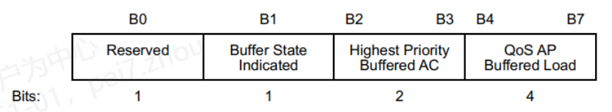
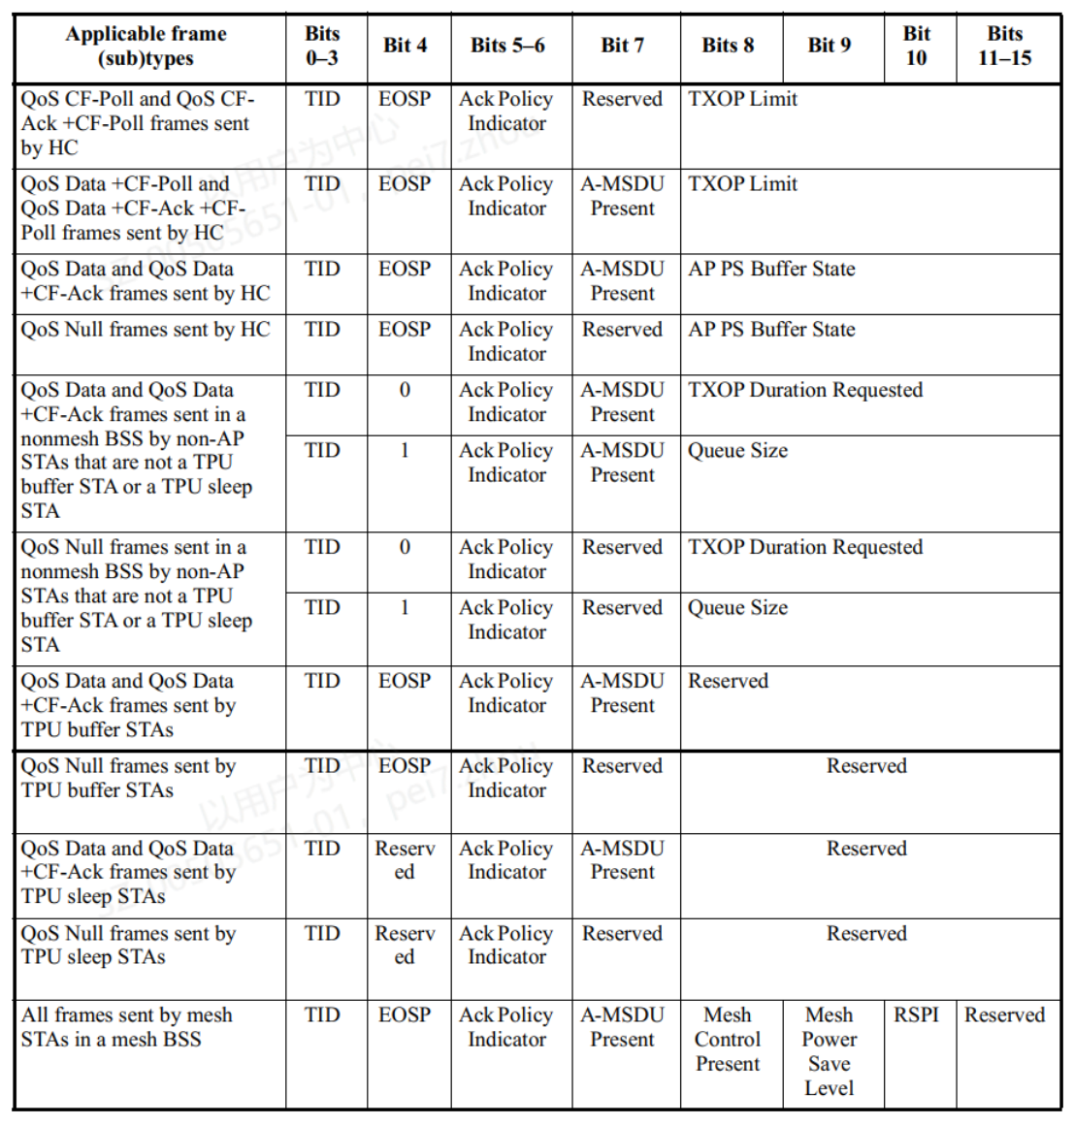
Formats of C-BSR (1/2)
Based on QoS Control field [2]
C-BSR Indicator
AP PS Buffer State subfield format
  An example:
    The reserved B0 of AP PS Buffer State subfield is defined as the indicator of C-BSR;
      If C-BSR Indicator subfield = 1, then AP PS Buffer State subfield indicates the buffer state at the AP for multiple (or all) associated STAs;
    QoS AP Buffered Load may indicate the following 3 options
      AP’s DL buffered load for multiple (or all) associated STAs
      Multiple (or all) associated STAs’ UL buffered load for AP
      The sum of the above two

Slide 9
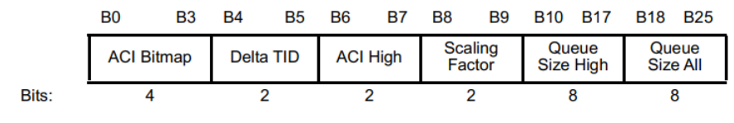
Formats of C-BSR (2/2)
Based on BSR Control field [2]
    When a frame contains BSR Control field is transmitted from an AP (e.g., shared AP) to another AP (e.g., sharing AP), the receiver (e.g., sharing AP) assumes:
      the Queue Size High subfield indicates the sum amount of buffered traffic, in units of Scaling Factor octets, for the AC identified by the ACI High subfield that is buffered by the AP identified by the transmitter address of the frame containing the BSR Control subfield for multiple (or all) associated STAs.
      the Queue Size All subfield indicates the sum amount of buffered traffic, in units of Scaling Factor octets, for all the ACs identified by the ACI Bitmap subfield that is buffered by the AP identified by the transmitter address of the frame containing the BSR Control subfield for multiple (or all) associated STAs.
    Similar to the previous slide, the Queue Size High subfield and the Queue Size All subfield may indicate the following 3 options
  AP’s DL buffered traffic for multiple (or all) associated STAs
  Multiple (or all) associated STAs’ UL buffered traffic for AP
  The sum of the above two
BSR Control field format

Slide 10
Summary
We proposed the following methods to share C-BSR between APs
  Unsolicited C-BSR
  Solicited C-BSR
We proposed the following potential formats of C-BSR
  Revised QoS Control field
  Revised BSR Control field
We proposed the following potential contents that need to be included into the C-BSR
  Multiple (or all) associated non-AP STAs’ UL buffer status
  DL buffer status for multiple (or all) associated non-AP STAs
  Both of the above

Slide 11
Q&A of [1]
  Q1: Requesting resources is more efficient/relevant than exact buffer.
  A: Requesting resources may have two drawbacks,
    if the total amount of resources requested by shared APs exceeds what sharing AP can provide, sharing AP doesn’t know how to execute the resource allocation;
    An arbitrary shared AP may request more resources than needed, which will cause fairness issue to other shared APs.
  In addition to buffer size, C-BSR also contains “priority information” (i.e., TID / Highest Priority Buffered AC / ACI / ACI High, etc.) of the buffered traffic, which benefits the multi-AP coordination. For example, the sharing AP can prioritize inviting the shared AP(s) with high priority traffic to perform multi-AP transmission. However, only “Requesting resources” could not achieve this effect.
  Q2: How does AP-1 (sharing AP) create a resource allocation for AP-2 (shared AP) based on queue size info at AP-2 (shared AP), if it doesn’t know MCS, NSS to be used by AP-2 (shared AP)?
  A: One possible solution is to define a multi-AP coordination negotiation procedure/phase (So far, no consensus, and further study is needed). In this phase, shared AP reports some of its capability information or operation parameters (e.g., MCS and NSS) to sharing AP. Then, sharing AP could determine the multi-AP coordination mode and related parameters (including resource allocation) for shared AP. Thus, sharing AP could estimate the resource allocation for shared AP.

Slide 12
Straw Poll 1
Do you agree to add the following text to the TGbn SFD:
TGbn shall define the Coordinated Buffer Status Report (C-BSR) for UHR APs.
Note 1: C-BSR is used to indicate the information on the pending traffic by an AP to its neighboring AP(s). The details of the information are TBD.
Note 2: It's TBD whether the UHR AP is an AP set (including MBSSID set or/and co-hosted BSSID set) or an individual AP.
Y/N/A

Slide 13
Straw Poll 2
Do you agree to add the following text to the TGbn SFD:
One UHR AP may use one or more of the following methods to obtain the C-BSR of the other UHR APs:
    Unsolicited C-BSR
    Solicited C-BSR
Note 1: detailed signaling and formats are TBD.
Note 2: Individual or group addressed frame is TBD.
Y/N/A

Slide 14
Straw Poll 3
Do you agree to add the following text to the TGbn SFD:
The C-BSR of a UHR AP may contain the aggregation of the following traffic information for the corresponding BSS:
    Multiple associated non-AP STAs’ buffer status for the UHR AP
    Buffer status at the UHR AP for multiple associated non-AP STAs
Note: detailed frame format is TBD.
Y/N/A

Slide 15
References
[1] 11-23-1844-00-00bn-bsr-in-multi-ap
[2] Draft P802.11REVme_D5.0

