Slide 1
802.11 Working Group Opening Report
May 2024
Authors:
Date: 2024-05-15

Slide 2
Introduction
This presentation, together with the reports cited herein, forms the opening report of the IEEE 802.11 Working Group for May 2024
“Mx.y.z” terminology indicates that the item was on the tentative agenda for the Monday 802.11 plenary, and was agenda item x.y.z.

Slide 3
M1.3 Meeting Decorum
%
Please observe proper decorum in meetings; No Photography or recording
Press (i.e., anyone reporting publicly on this meeting) are to announce their presence (Jan 2019 IEEE-SA Standards Board Ops Manual 5.3.3.2)
Laptop speakers, cell phone / tablet ringers off
Mute when not speaking (teleconference)
Use “no audio” in Webex when joining mixed mode meeting in person
Use chat window to enter the queue (teleconference)
Wear badges at all times in meeting areas (face to face meetings)
  Help the hotel security staff improve the general security of the meeting rooms

Slide 4
M2.2.1 Summary of Liaisons
Liaisons received since March 2024:
From ITU-T Study Group 15 re: a planned fibre to the room workshop in 2024 July (11-24/0745r0):
The 4th joint workshop on fibre-to-the-room will be held from 8 am until noon Montreal time (2 pm – 6 pm Geneva time) Wednesday July 10 during the ITU-T SG15 meeting. Both in-person and virtual participation will be supported.
Liaisons website, see https://grouper.ieee.org/groups/802/11/Liaisons/Liaisons-and-External-Communications.html

Slide 5
M2.3 Recent and anticipated 802 EC actions
March 2024
P802.11bf (Sensing) PAR Modification
P802.11bp (Ambient Power) PAR and CSD
July 2024
P802.11bf (Sensing) PAR Extension
P802.11bq (IMMW) PAR

Slide 6
M2.3 IEEE-SA Standards Board (SASB)
March 19-21, 2024 –NesCom/SASB
P802.11bf (Sensing) PAR Modification
P802.11bp (Ambient Power) PAR and CSD

Slide 7
M3.1 802.11 Working Group Session Documents
WG Session Reports
WG Agenda | https://mentor.ieee.org/802.11/dcn/24/11-24-0704
Opening report | https://mentor.ieee.org/802.11/dcn/24/11-24-0707
Snapshot slides | https://mentor.ieee.org/802.11/dcn/24/11-24-0709
1st vice chair | https://mentor.ieee.org/802.11/dcn/24/11-24-0727
2nd vice chair | https://mentor.ieee.org/802.11/dcn/24/11-24-0712
Treasurer | https://mentor.ieee.org/802-ec/dcn/24/ec-24-0007
Chair's Supplementary Material | https://mentor.ieee.org/802.11/dcn/24/11-24-0708
Motions | https://mentor.ieee.org/802.11/dcn/24/11-24-0713
Session report | https://mentor.ieee.org/802.11/dcn/24/11-24-0710
Previous Session Minutes | https://mentor.ieee.org/802.11/dcn/24/11-24-0448

Slide 8
M3.2 Joint meetings and Reciprocal Credit
Reciprocal credit is provided to 802.11 voters for attendance at: 802.18 (.11 credit for .18 attendance and .18 credit for the .11 attendance during the 2 .18 timeslots), 802.19, 802.24, 802.1, and the 802 JTC1 SC.
For the May 2024 session, reciprocal credit is given for other WG/TAG meetings which occur during the WG11 session, Monday May 13, 2024 10:30 am Warsaw time to Friday, May 17, 2024 noon Warsaw time.
The May 2024 in-person and electronic meeting DOES count towards voting credit. NOTE: 12 meeting slots required for 75%.

Slide 9
M3.2 802.18 details
Agenda: See https://mentor.ieee.org/802.18/documents
Meeting times: Tuesday 2024-05-14 AM2 and Thursday 2024-05-16 AM1, see https://www.ieee802.org/18/ and https://ieee802.org/802tele_calendar.html
Discussion items of interest to 802.11 WG include
  Invited presentation on spectrum management and regulation in Poland
  Recent Americas, European ETSI, CEPT and Asia Pacific activities status and discussion
  IEEE 802 ITU-R WP5A contributions

Slide 10
M3.2 802.19 details
See https://www.ieee802.org/19/
802.19 documents: https://mentor.ieee.org/802.19/documents

Slide 11
M4.1.1/W2.6 IEEE 802.11 Groups
Type | Group | WG & Infrastructure
WG | WG11 | The IEEE 802.11 Working Group
SC | ARC | Architecture
SC | COEX | Coexistence
SC | PAR | PAR review
802 SC | JTC1 | ISO/IEC JTC1/SC6
Type | Group | Amendments/Revision
TG | BE | Extremely High Throughput
TG | BF | WLAN Sensing
TG | BH | Randomized MAC Addresses (RCM)
TG | BI | Enhanced Data Privacy Protection (EDP)
TG | BK | 320 MHz Positioning
TG | BN | Ultra High Reliability
TG | BP | Ambient Power
TG | ME | Revision (REVme)
Type | Group | New Work
SC | WNG | Wireless Next Generation
SC | AIML | AI/ML in 802.11
SG | IMMW | Integrated Millimeter Wave
AHG | ITU | ITU Liaison

Slide 12
M3.2 Other 802 WG meetings
IEEE 802 website: https://www.ieee802.org/
  Includes links to all WG webpages
Consolidated calendar: https://ieee802.org/802tele_calendar.html
Documents: 802.11, 15, 18, 19, 24: https://mentor.ieee.org/802/bp/StartPage

Slide 13
M4.1.2 /W2.6 PAR Expiration/Renewal Schedule
Project | PAR Expiration Date
BB | 31-DEC 2024
BC | 31-DEC 2024
BE | 31-DEC 2025
BF | 31-DEC 2024
BH | 31-DEC 2025
BI | 31-DEC 2025
BK | 31-DEC 2026
BN | 31 DEC 2027
REVme | 31 DEC 2025
P802.11-2020 Cor 2 | 31 DEC 2027
PAR Extension Request – consider in May 2024
http://www.ieee802.org/11/PARs/index.html

Slide 14
M4.1.3 /W2.6 802.11 WG Appointed positions
WG Secretary – Stephen McCann (temporary)
Treasurer – Jon Rosdahl
ANA Authority – Robert Stacey
WG Technical Editor – Emily Qi

Slide 15
M4.1.3 /W2.6 Officers
Cat | Group | Chair | Vice Chair | Technical Editor | Secretary
WG |  | Robert STACEY | Jon ROSDAHL, Stephen MCCANN | Emily QI | Stephen MCCANN
SC | ARC | Mark HAMILTON | Joseph LEVY |  | Joseph LEVY
SC | Coex | Marc EMMELMANN | Richard KENNEDY, Manish KUMAR |  | Guido HIERTZ
SC | PAR | Jon ROSDAHL | Michael MONTEMURRO |  | Michael MONTEMURRO
SC | WNG | Jim LANSFORD | Lei WANG |  | Lei WANG
SC | AIML | Xiaofei WANG | Ming GAN, Gaurang NAIK |  | Liangxiao XIN
TG | ME | Michael MONTEMURRO | Mark HAMILTON, Mark RISON | Emily QI, Edward AU | Jon ROSDAHL
TG | BC | Marc EMMELMANN | Hitoshi MORIOKA, Stephen MCCANN | Carol ANSLEY | Xiaofei WANG
TG | BE | Alfred ASTERJADHI | Laurent CARIOU, Matthew FISCHER | Edward AU | Jason Yuchen GUO
TG | BF | Tony Xiao HAN | Sang KIM, Assaf KASHER | Claudio DA SILVA | Leif WILHELMSSON
TG | BH | Mark HAMILTON | Peter YEE, Stephen ORR | Carol ANSLEY | Peter YEE
TG | BI | Carol ANSLEY | Stephen MCCANN, Jerome HENRY | Po-Kai HUANG | Stephane BARON
TG | BK | Jonathan SEGEV | Assaf KASHER | Roy WANT | Dibakar DAS
TG | BN | Alfred ASTERJADHI
TG | BP | Bo SUN
SG | IMMW | Laurent CARIOU |  |  | Volker JUNGNICKEL
AHG | ITU | Hassan YAGHOOBI |  |  | Richard KENNEDY
New since last session

Slide 16
M4.1.4 /W2.6 IEEE 802.11 Revisions
802.11
-2020
802.11
-2016
802.11
-2012
802.11
-2007
802.11
-2003
11aq
Pre Association
Discovery
11aa
Video Transport
11k
RRM
11s
Mesh
11e
QoS
MAC
11u
WIEN
11v
Network
Management
11h
DFS & TPC
IEEE
Std
802.11
-1997
11ak
General Link
11ae
QoS Mgt Frames
11z
TDLS
11i
Security
11d
Intl roaming
11ai
Fast Initial Link
Setup
11w
Management
Frame
Security
11r
Fast Roam
11f
Inter AP
11n
High
Throughput
(>100 Mbps)
11ah
Sub 1 GHz
11af
TV Whitespace
11j
JP bands
11a
54 Mbps
5GHz
PHY & MAC
11aj
China millimeter
wave
11ac -VHT
>1 Gbps @ 5GHz
11p
WAVE
11y
Contention
Based
Protocol
11g
54 Mbps
2.4GHz
11b
11 Mbps
2.4GHz
11ad - VHT
>1 Gbps @ 60GHz
Notes:
doc.: IEEE 802.11-11/0483r0
May 2011
Bruce Kraemer (Marvell)
Page 16

Slide 17
M4.1.4 /W2.6 IEEE 802.11 Standards Pipeline
MAC
802.11
COR 1
802.11
-2020
802.11bc
BCS + COR2
802.11az
NGP
802.11bi
EDP
802.11bk
320MHz Pos
802.11
REVme
ITU Liaison
(ITU) AHG
WNG
802.11ba
WUR
IMMW SG
802.11bn
UHR
802.11be
EHT
802.11bb
LC
802.11bp
AMP
802.11ax
HEW
802.11bh
RCM
802.11ay
NG60
802.11bf
SENS
Liaison
MAC & PHY
802.11bd
NGV
Liaison Topics
Discussion Topics
TIG/Study
groups
TG without
Approved draft
WG
Letter Ballot
SA
Ballot
Published
Amendment
Published
Standard
Notes:
doc.: IEEE 802.11-11/0483r0
May 2011
Bruce Kraemer (Marvell)
Page 17

Slide 18
M4.1.5 /W2.6 Summary of ballots and comment collections
Type | Label | Group | Opened (mm-dd) | Dur (d) | # Comments | Ballot Group | Approve | Disapprove | Abstain | Return % | Approve % | Result
T | 3nd Recirc | TGbh | 03-21 | 15 | 19 | 527 | 356 | 2 | 52 | 78 | 99 | Pass
T | 3nd Recirc | TGbf | 04-10 | 16 | 13 | 491 | 354 | 13 | 38 | 82 | 96 | Pass
T | 1st Recirc | TGbk | 04-10 | 16 | 134 | 559 | 321 | 10 | 53 | 69 | 97 | Pass
T | 1st SA | TGbh | 04-09 | 30 | 209 | 153 | 120 | 12 | 6 | 90 | 91 | Pass

Slide 19
M4.1.6 /W2.6 Current Membership Status
Data as of 2024-05-12
Status | Number
Aspirant | 103
Potential Voter | 35
Voter | 572
Ex Officio Voter | 9
Definitions:
  Aspirant: a member who has attended 1 qualifying meeting
  Potential Voter: a member who has attended 2 qualifying meetings and will become a voter at the start of the next plenary they attend
  Ex Officio Voter: a voter who has voting rights by virtue of their membership of the 802 EC and has requested to be recorded as an ex officio voter in 802.11

Slide 21
Updated following March session but before 11bh and 11bf ballot series update

Slide 22
Attendees by affiliation
(attended at least one meeting March to May)

Slide 23
Attendance by subgroup (March to May)

Slide 24
M6.4 Announcements: 2024 May Designation of Individual experts
Individual experts who attend electronically for a specific purpose/presentation can be designated as such by the WG Chair and receive a registration fee waiver and limited attendance rights.
See section 5 in https://mentor.ieee.org/802-ec/dcn/17/ec-17-0090-25-0PNP-ieee-802-lmsc-operations-manual.pdf ,
  The Working Group Chair may designate specific individual experts who are allowed to participate in Working Group discussions via electronic means during an in-person meeting for the benefit of the group. These individuals are not considered to be attending the meeting and so they are not required to pay meeting fees and they do not get participation credit. The participation of these individuals should be limited to specific technical topics. Such participation shall be documented in the minutes of the Working Group meeting.
The individuals listed below are hereby designated as specific individual experts on their respective topics and subject to the restrictions and benefits described in the 802 OM.
  Engr. Dr. Sohaib Manzoor, Mirpur University of Science and Technology, Pakistan, sohaib.ee@must.edu.pk
  WNG – 1 timeslot
For WNG, attendance for each is limited to the WNG timeslot in which the respective presentation is scheduled.

Slide 25
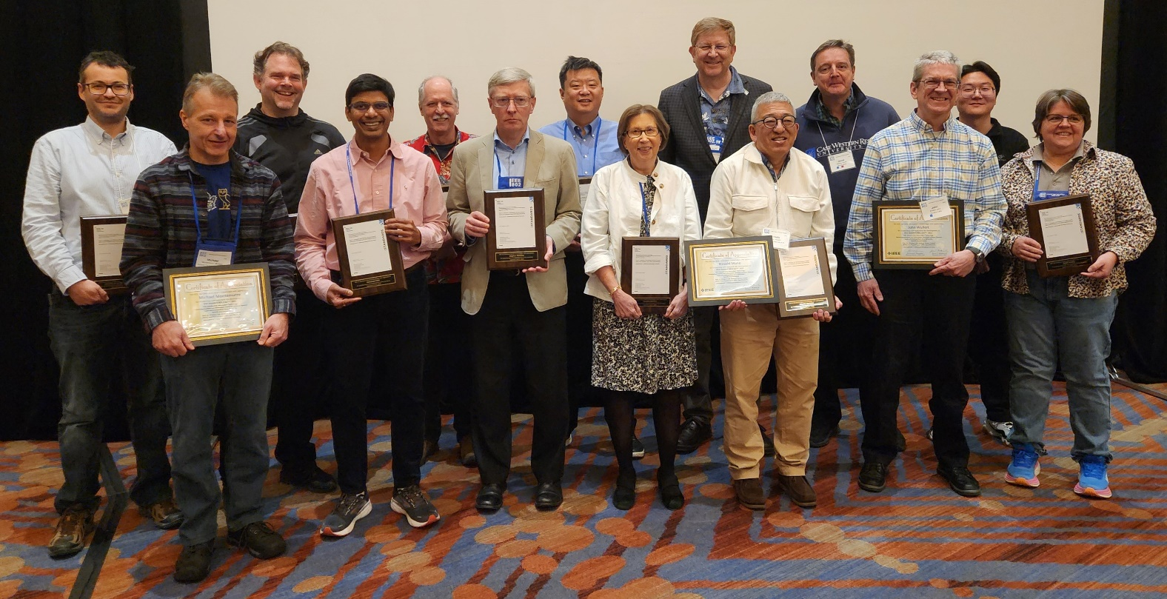
M6.4 Announcements
The TGbc award photographs are on our web page:
See 802.11 → WG Info → Photographs → TGbc Awards

Slide 26
M6.4 Announcements
I have made some updates to the website. Much of it is editorial:
Improving layout on mobile devices
Improving consistency page-to-page
Updates to:
Main page
How to participate (significant changes)
Officers
Members (now has a sortable table)
Officer’s honor roll

Slide 27
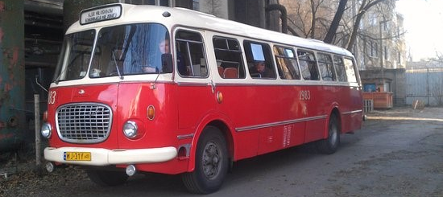
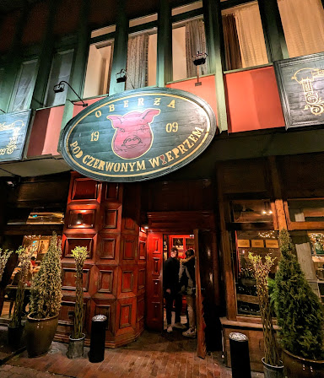
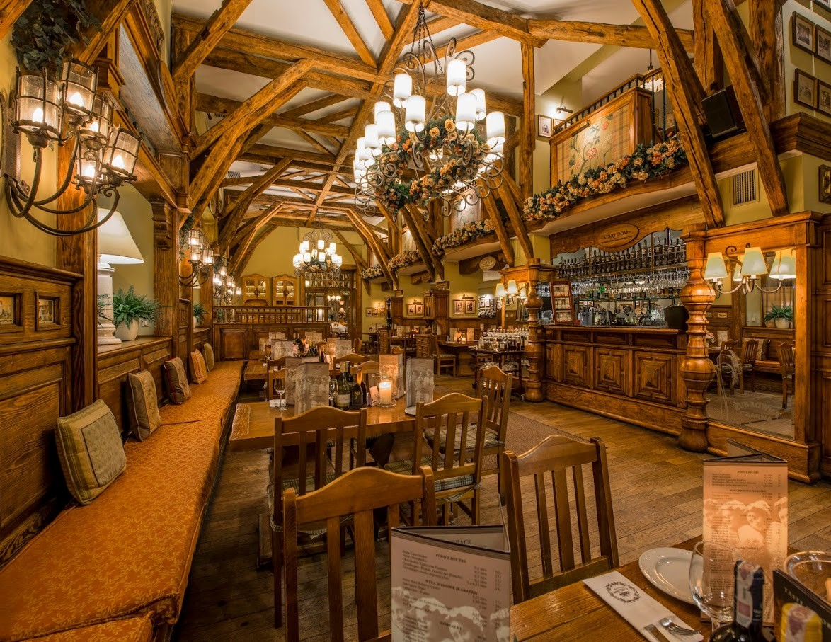
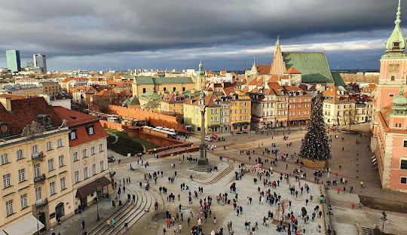
WEDNESDAY SOCIAL
TOUR OF OLD TOWN + POLISH DINNER
Wednesday May 15, 2024
Time:
6.00-6:30pm: 8 Buses will depart from Marriott Hotel
Please meet from 6:00-6:30pm on the street level (Ground) of the Marriott Hotel to join one of the Cucumber Buses.
Tour of Warsaw:
Enjoy a short tour of Old Town in a historic communist era Cucumber Bus.
Dinner:
Due to increased numbers, we have 2 restaurants booked, both will serve Family Style Polish Food. Make sure you are on the same bus as those you would like to dine with.
Return Coaches:
Coaches will return from the restaurants to the Marriott from 9pm
Please let the Registration Desk know if you CAN’T make the dinner to assist with restaurant numbers.

Slide 28
Additional Reference material

Slide 29
Comment Resolution Resources
Comment resolution resources
  See https://mentor.ieee.org/802.11/dcn/13/11-13-0230-05-0000-comment-resolution-tutorial.ppt
  See https://mentor.ieee.org/802.11/dcn/11/11-11-1625-02-0000-comment-resolution-guide.doc
There are many examples of good practice for documentation of comment analysis and resolution; ensures there is a record of comment consideration and agreed resolution
  https://mentor.ieee.org/802.11/dcn/18/11-18-0237-00-000m-cid-177.docx
  https://mentor.ieee.org/802.11/dcn/18/11-18-0930-00-000m-cid-1007.docx
  https://mentor.ieee.org/802.11/dcn/18/11-18-0669-04-000m-revmd-mac-comments-assigned-to-hamilton.docx
  https://mentor.ieee.org/802.11/dcn/18/11-18-1410-00-00ax-lb233-cr-spatial-reuse.docx

Slide 30
Motion and other templates
WG11 templates
  Motions: see https://mentor.ieee.org/802.11/dcn/22/11-22-1967-01-0000-working-group-motions-templates.pptx
  Liaison: see https://grouper.ieee.org/groups/802/11/Rules/2018-03 Liaison submission template.docx
802 LMSC templates
  Motions: https://mentor.ieee.org/802-ec/dcn/16/ec-16-0170-04-00EC-802-ec-motion-template.pptx
  CSD: https://mentor.ieee.org/802-ec/dcn/18/ec-18-0064-01-0PNP-csd-template-in-doc-format.doc
  Liaison: https://mentor.ieee.org/802-ec/dcn/17/ec-17-0012-01-00EC-802-liaison-template.docx

