Slide 1
Thoughts on functionality and security architecture for UHR seamless roaming
Date: 2024-05-10
Authors:
Name | Affiliations | Address | Phone | Email
Thomas Derham | Broadcom |  |  | thomas.derham@broadcom.com
Nehru Bhandaru
Manoj R Kamath
Sindhu Verma
Shubhodeep Adhikari
Matthew Fischer
Brian Petry

Slide 2
Introduction
There has been agreement (e.g. [1], [2]) on some basic requirements for UHR seamless roaming, whereby:
  the non-AP MLD remains in State 4 throughout a successful roam from one AP MLD to another AP MLD
  the non-AP MLD has only a single point of connection to the DS at a given time
    except when the non-AP MLD receives buffered DL frames with Serving AP MLD after switching its point of connection to the Target AP MLD
    forwarding of buffered data packets over the DS between Serving AP MLD and Target AP MLD is also possible
  during roaming procedure, (some of) the context related to a non-AP MLD is exchanged between AP MLDs such that the data exchange context is preserved
In this submission, we discuss and propose:
  High-level requirements for UHR seamless roaming
  A description of new capabilities to achieve these requirements
  Security framework requirements
    with a caution against some alternative proposals to share PTK(SA) across multiple AP MLDs
  A high-level design for these new capabilities as an extension of FT protocol

Slide 3
High-level requirements
Generic roam sequence implied by so-far agreed requirements
initial auth/assoc to AP MLD1
roam to AP MLD2
AP MLD2
s1
s4
non-AP MLD
s1
s4
s4limited
s1/s2
AP MLD1
State 4 (s4) data path with AP MLD1
State 4 (s4) data path with AP MLD2
Limited DL data path for “buffered data delivery” from AP MLD1
Non-AP MLD is always in State 4 with one AP MLD in the network
  Additionally, for a short period after roam to Target AP MLD2, a limited data path for “buffered data delivery” might continue to exist with Serving AP MLD1 to allow remaining DL data to be flushed
Roam signaling exchange(s) trigger (*):
  (0) initiation of roaming procedures
  (1) capability exchange (per-link and per-MLD) and security setup
  (2) context exchange to AP MLD2
  (3) establishment of OTA data path (State 4) with AP MLD2
  (4) DS mapping update (to forward DL traffic to AP MLD2)
* This list does not imply the ordering of triggers or the number of signaling messages

Slide 4
High-level requirements
Problem statements and solution requirements
Problem (1): Roams may not be triggered when needed, especially in mobility, resulting in “emergency scans” when current link fails, causing outage/disruption to data flows
  Client devices cannot continuously scan for off-channel transition candidates due to (a) power consumption limitations and (b) impact on existing link (depending on implementation)
  Networks cannot continuously monitor for client devices from other off-channel APs
    Client devices rarely transmit off-channel, especially if using passive scan
  Hence, measurement data needed by roaming/steering algorithms may be unavailable or unreliable
    Incomplete and/or stale bidirectional RSSI measurements
    Incomplete, unreliable and/or unprotected link/AP scoring metrics (e.g. channel utilization, WAN capacity/latency)
  In addition, roaming/steering algorithms tend to be conservative in triggering roams in order to:
    avoid link disruption due to (frequent) roam events
    avoid ping-pong / thrashing roams, particularly if both network-side and client-side roaming/steering algos are active
    avoid higher-layer disruption (e.g. IP change), bill shock, etc, if algorithm triggers network switch (e.g. to cellular)
Collection_trigger
Active measurement/metric collection (*)
Transition candidates assessment
No_action
Passive measurement/metric collection (**)
Roam_trigger[AP_MLD_Addr]
  Solution requirements:
    More efficient, protected, exchange of measurements/metrics – minimize signaling and off-channel operations
    Exchange information on scope and nature of client-side and network-side algos
    Support exchange of metrics to intelligently determine collection_trigger events (e.g. network topology)
(*) e.g. active scan, off-channel passive scan, send measurement request to peer
(**) e.g. current link metrics (PER, MCS, ...), on-channel passive scan, receive unsolicited measurement report from peer

Slide 5
High-level requirements
Problem statements and solution requirements (2)
Problem (2): Once a roam is triggered, roam procedures themselves cause outage/disruption
to data flows
  Data exchange suspended during (off-channel) authentication/reassociation exchanges with target AP
    except, potentially, for clients capable of simultaneous Tx/Rx on both channels
  Data exchange with Target AP may be suspended, inefficient or insufficiently prioritized until MAC states are re-established (e.g. BA agreement, MSCS/SCS rules)
  Data packet loss and/or duplication (e.g. DL packets buffered at Serving AP may be lost, dirty scoreboard on roam)
    alternatively, implementations might defer roam until buffers are empty and scoreboard is clean, which can lead to similar “emergency roam” scenario as on previous slide
  Roam failures or delays (e.g. association comeback procedures) occur with non-negligible probability
    e.g. security (SA Query / PMF) related [can also be due to insufficient link quality or excessive roams - see previous slide]
  Solution requirements:
    Allow all roam setup exchanges with target AP (e.g. reassoc req/resp) to be tunneled over DS via Serving AP
      For scenarios where roam is triggered while link quality with Serving AP is still good
    Enable roam setup to occur with a minimal number of exchanges
      For scenarios where roam exchanges are directly with Target AP due to poor link quality with Serving AP
    Enable context transfer over DS to target AP, to avoid post-roam exchanges for MAC state re-establishment
    Provide mechanisms for retrieval of buffered data at Serving AP, and optimization of delivery order requirements, depending on higher-layer requirements of flows in a given TID
    Ensure roaming security framework is robust to avoid security-related roam failures / delays

Slide 6
Description of new capabilities
Roam triggering
UHR AP MLD and non-AP MLD exchange transition candidate information within roam setup request/response frames (e.g. Reassoc Req/Resp) to assist future roaming/steering
  Enables both peers to obtain initial information for subsequent roams, without need for additional management frame exchanges (e.g. Neighbor Report Req/Resp, BTM Query/Req, Beacon Req/Resp)
  In setup request frame, Non-AP MLD includes Neighbor Report elements for links of other AP MLDs (in same ESS) that were strong/viable transition candidates but not selected
    Define RCPI element as a new subelement for Neighbor Report, so non-AP MLD indicates the beacon RCPI
    Consider also including Actual Measurement Start Time when RCPI measurement was made (similar to Beacon Report)
  In setup response frame, Target AP MLD includes Neighbor Report elements for each link of the AP MLDs (in same ESS) that are its topological neighbors
    RCPI subelement indicates, if available, a measured RCPI for some frame the non-AP MLD transmitted on that channel
    NR elements should include subelements with metrics for transition candidate scoring (e.g. BSS Load subelement)
Existing management frame exchanges (with above extensions) can be used to provide updated information post-association, e.g.
  (AP MLD querying non-AP MLD): Beacon Report Request/Response
    Non-AP MLD should respond at least when off-channel scan is not required (e.g. Table mode, or current channels only)
    APs of a managed network should avoid requesting all beacon contents since that information is already known
  (non-AP MLD querying AP MLD): BTM Query/Request
    Consider a new mode with deterministic behavior – e.g. if a request (from AP MLD) specifies a Target AP MLD and indicates (with quantitative evidence) that the network has verified the Target AP is able to at least match the current traffic/QoS of the non-AP MLD, the non-AP MLD must attempt to roam to Target AP unless specified conditions are met

Slide 7
Description of new capabilities
Roam triggering (2)
UHR AP MLD and non-AP MLD exchange information about network topology and activity of roaming/steering algorithms within roam setup request/response frames
  In response frame, AP MLD also indicates basic network topology and recommended transition RSSI (if known) for each setup link
    e.g. by including ESS Report element (with new extensions?) in each per-STA profile
  In request frame, non-AP MLD indicates scope/nature of its roaming algorithm
    e.g. none (on link failure only) vs proactive, typical off-channel scan cadence, etc
  In response frame, AP MLD indicates scope/nature of its steering algorithm
    e.g. none, colocated APs only vs ESS-wide steering, unassociated STA scan capability by other (co-channel and/or off-channel) APs in network, etc
    extensions to transition candidate preference information in NR of BTM Request could also be considered to indicate the basis of a steering recommendation (e.g. specific measurements, historical venue-specific learning, etc)
UHR non-AP MLD can probe a transition candidate AP MLD via Serving AP MLD
  Tunneled probe request/response, potentially targeting multiple candidates AP MLDs, either as standalone exchange (e.g. based on FST Action using OCT) or bundled with other discovery exchanges
    Note: In general, non-AP MLD needs full contents of Probe Response (or Beacon(s)) of candidate target AP MLDs to make roam decision (*); i.e. Neighbor Report alone is not sufficient
    Note: Implementations might still prefer to go off-channel to obtain RSSI for link quality scoring, however topology information (see above) could be sufficient
(*) e.g. BSS Load, WAN metrics, BSS Membership Selectors, VSIEs, ...

Slide 8
Description of new capabilities
Roam signaling
All roam signaling should be protected
  If unprotected roam signaling is allowed, attacker could inject, modify or replay roam signaling to cause reset of MAC states, teardown of security associations, unauthorized context transfers in the network, etc
    Baseline PMF handling of unprotected (re)assoc (i.e. reject + SA Query) is cumbersome, contributes to roam delay/failure
  Encrypted signaling can also protect against privacy/tracking
For roam signaling that is sent directly to the target AP MLD, new protection is needed
  Sharing the main PTK (used with CCM/GCM cipher) across roams should be avoided – see later slides
  Therefore, define a dedicated UHR Roaming Key (ROAM-EncKey, which is solely used to protect roaming exchanges sent between a non-AP MLD and any (target) AP MLD in the ESS when no pairwise PTKSA exists
    Extract ROAM-EncKey from existing master keys (e.g. PMK, R0-Key-Data) during initial association to the ESS
    ROAM-EncKey is distributed over the DS to other target AP MLDs in network (e.g. along with PMK)
    ROAM-EncKey is always used with AES-SIV (RFC 5297) – synthetically derived nonce (misuse resistant)
      Note: AES-SIV is already used in baseline, e.g. to encrypt parts of FILS Reassoc frames
    Replay protection can be provided by including both MLD addresses and a PN based on a timestamp in the AAD
      Timestamp is defined and used in a similar way to the Known STA Identification timestamp in baseline (REVme 11.13), e.g.
      1) non-AP MLD obtains target AP MLD’s TSF by scanning or (with some additional error) by tunneled probe / NR via Serving AP
      2) when non-AP MLD sends roam request, it sets Timestamp in AAD to the estimated TSF of target AP MLD at that time
      3) target AP MLD verifies the ML addresses, and that timestamp is within TBD ms of its own TSF (for the specified link), and that if any other message has been received from non-AP MLD within that TBD period, this message’s timestamp is strictly greater
        TBD margin accounts for possible clock drift since the TSF was obtained from scan or tunneled probe / NR
        Note: Obtaining TSF in protected manner via Serving AP provides further protection against jam-and-replay attacks
      Unique timestamp in AAD also provides privacy/tracking protection if the same payload is sent in multiple messages

Slide 9
Description of new capabilities
Roam signaling (2)
For roam signaling that is sent via Serving AP MLD, existing PMF protection can be used
  Serving AP forwards encapsulated signaling to/from target AP MLD over DS using (e.g.) RRB
  PMF provides integrity/replay protection - messages from non-AP MLD are validated by Serving AP
New PTK is efficiently derived during roam procedure out of critical path
  Embed A/S-Nonce or A/S-EphemeralPub, and PTK-confirming MICs, in roam signaling that will occur anyway
    Note these messages might be exchanged directly with target AP MLD, or tunneled via Serving AP MLD
    PTK derived as either:
      (regular AKM style, using A/S-Nonce): PTK = KDF-Hash(PMK, SNonce || ANonce || MLD_addresses ... ), or
      (PASN AKM style, using A/S-EphemeralPub): PTK = KDF-Hash(PMK, MLD_addresses || DHss)
        where DHss is Diffie-Hellman shared secret (provides Perfect Forward Secrecy – PTK is protected even if PMK is compromised)
  Example sequences:
3-message
4-message
non-AP MLD
target AP MLD
non-AP MLD
target AP MLD
Initiate_Context_Transfer, LinkSetupReq, S-Nonce/EphPub
Initiate_Context_Transfer, S-Nonce/EphPub
Confirm_Context_Transfer, LinkSetupResp, A-Nonce/EphPub,
MIC(key=PTK-KCK, MLD_addresses || Msg2)
Confirm_Context_Transfer, A-Nonce/EphPub
Reassoc_Req, DS_Update_Req,
MIC(key=PTK-KCK, MLD_addresses || Hash(Msg1) || Msg3)
DS_Update_Req,
MIC(key=PTK-KCK, MLD_addresses || Hash(Msg1) || Msg3)
Reassoc_Resp,
MIC(key=PTK-KCK, MLD_addresses || Hash(Msg2) || Msg4)

Slide 10
Description of new capabilities
Delivery of buffered DL data at (previously) Serving AP after roam
Post-roam retrieval of already-buffered DL data from (previously) Serving AP MLD to non-AP MLD has been proposed to enable zero-packet loss on roam, with relatively simple network implementation
Design should include:
  Signaling within roam exchanges to indicate buffer state at Serving AP MLD (i.e. whether buffered data exists)
  Signaling of remaining buffer state during data delivery (e.g. so non-AP MLD knows when it has received all data)
  Definition of which class 3 frames that can be transmitted in this state: DL Data (unicast only?), BA, mgmt?
  Security design – assume buffered data is sent using existing PTK and PN space with Serving AP MLD
  Consider frame exchanges to assist concurrent operation by multi-radio non-AP MLDs
    Note: The affiliated APs of Serving and Target are not part of the same AP MLD; therefore MLO features (e.g. STR, eMLSR,
    cross-link PM) cannot be used per-se across the two links
  Ability for non-AP MLD to choose whether to retrieve any or all of the buffered data for a given TID
    Buffered data retrieval implies some disruption to data path with Target AP MLD, especially when on different channels
    For some flows. zero-packet loss (especially where in-order delivery is enforced) might be undesirable, e.g. “stale” packets
    More generally, allow per-TID negotiation of out-of-order delivery (minimize latency if higher layers can support) – see Annex
    AP MLD should not attempt to send buffered data if the non-AP MLD indicates it will not collect it
An alternative is for the already-buffered DL data to be transferred over DS to the target AP MLD, for delivery to the non-AP MLD
  Probably deployment would be limited to certain managed network architectures
  It can generally be achieved as vendor implementation (see Annex slide); minimal formal support in the standard may be convenient
    Assume transfer of data between AP MLDs (over the DS) in the form of MSDUs

Slide 11
Description of new capabilities
Control plane context exchange
It should be possible to negotiate what context is transferred on a roam (level of granularity TBD)
Block ACK
  Experimental results (see later slides) indicate that ADDBA exchanges take a few ms to begin, and then take a few more ms to complete, and this is the dominant cause of outage in an optimized design
    Data transfer does not start (or is inefficient) until ADDBA exchanges complete
  Most gains can be achieved with simple exchange of semi-static parameters only (see next slides)
SCS
  Disruption to QoS-sensitive flows might occur if there is a delay in re-establishing SCS state after roam
  SCS parameters are generally semi-static so can be transferred over the DS with minimal downside
    e.g. any changes to SCS agreements after a context exchange has been initiated would be lost
MSCS
  Similar considerations to SCS, but should allow current derived MSCS rules (IP tuple->UP) at Serving AP MLD to be transferred to Target AP MLD, in addition to the (semi-static) contents of MSCS Descriptor
Note: If other TID assignment policies exist (e.g. based on DPI), they should also be transferred to target AP MLD in a proprietary manner
- If TID assignment of packets is different on Serving and Target AP MLDs, any attempts to preserve the TID’s state (e.g. BA agreement) would be futile
Other MAC states (e.g. TWT)
  Maybe nice-to-have in theory, but complex to transfer synchronized timing state, and may need renegotiation
    e.g. conflict with existing TWT agreement at Target AP MLD
    Generally less impactful on link performance even if state is not transferred and need to be reestablished

Slide 12
Description of new capabilities
Control plane context exchange (2)
Block ACK agreement parameters
  A ‘simple’ form of Block ACK agreement context exchange involves simply exchanging the existence of, and semi-static parameters of, the Block ACK agreements for each TID
    i.e. fields in ADDBA’s Block Ack Parameter Set field (TID, Block Ack Policy, Buffer Size, etc), BA Timeout
    Various low-complexity design options exist for this context exchange, e.g.
      lightweight context exchange over DS, OR
      lightweight context transfer from non-AP STA (e.g. embedded within protected roam setup exchanges), OR
      implicit setup with default (mandatory-support) parameters – can be “upgraded” later [no explicit transfer needed]
    In this design, dynamic parameters (e.g. WinStartR/B, WinEndR/B, scoreboard) would be reset
      The next slides show impact of this on retransmission, duplicate detection, and in-order delivery (when enabled) functions
        assuming “buffered data delivery” path described on earlier slide
  A slight variant of the above involves additionally transferring WinStartB (*) for each uplink TID in real-time (e.g. in roam signaling)
    This has the same properties as above, but allows non-AP MLD implementations to continue to use already-allocated SN values for MSDUs in transmit queue
  The most ‘advanced’ form of Block ACK agreement context exchange involves also transferring the current scoreboard, and all WinStart/End values, maintained at AP MLD for each TID
    Described further in Annex; generally does not appear to provide sufficient gains to justify complexity
(*) Note: WinStartB of UL TID is the SN of the first MSDU not yet successfully received (and so not yet passed up to DS)

Slide 13
Description of new capabilities
Control plane context exchange (3)
DOWNLINK TID example
server: packets: 1, 2, 3, 4, 5, 6, 7, 8
packets: 1, 2, 3, 4
switch
packets: 5, 6, 7, 8
Packet index | SN | Status
4 | 104 | ✅
3 | 103 | ❌
2 | 102 | ❌
1 | 101 | ✅
Packet index | SN | Status
8 | 3 | ✅
7 | 2 | ✅
6 | 1 | ✅
5 | 0 | ✅
AP MLD1
DS
AP MLD2
Packet index | SN | Status
4 | 104 | ✅
3 | 103 | ✅
 | 102 | ❌
1 | 101 | ✅
non-AP MLD
Packet index | SN | Status
8 | 3 | ✅
7 | 2 | ✅
6 | 1 | ✅
5 | 0 | ✅
Retransmissions
  Retransmission of DL packets from Serving AP MLD1 (i.e. packet index 2) is handled by “buffered data delivery” path
Duplicate detection
  There is no issue with duplicate transmission of the same DL packets by AP MLD1 and AP MLD2, since DS forwards a given packet to one AP MLD or the other; therefore, duplicate detection (e.g. packet 3) can be handled for each AP MLD separately
In-order delivery (when enabled)
  Packets sent by DS to AP MLD1 are presumed older than packets sent by DS to AP MLD2; therefore non-AP MLD can ensure in-order delivery by delivering all packets from AP MLD1 (1 thru 4) to higher layers [unless those packets reach retry/lifetime limits, or non-AP MLD “gives up” on the packets] prior to delivering any packets from AP MLD2
Note: “Packet index” is simply an index that indicates the order of the packets sent by higher layers (it does not refer to PN)

Slide 14
Description of new capabilities
Control plane context exchange (4)
server
UPLINK TID example
Packet index | SN | Status
4 | 104 | ✅
3 | 103 | ✅
2 | 102 | ❌
1 | 101 | ✅
switch
Packet index | SN | Status
8 | 3 | ✅
7 | 2 | ✅
6 | 1 | ✅
5 | 0 | ✅
AP MLD1
DS
AP MLD2
Packet index | SN | Status
4 | 104 | ✅
3 | 103 | ❌
2 | 102 | ❌
1 | 101 | ✅
non-AP MLD
Packet index | SN | Status
8 | 3 | ✅
7 | 2 | ✅
6 | 1 | ✅
5 | 0 | ✅
Retransmissions
  If a UL packet is not Ack’d by AP MLD1 (e.g. packet 2), the non-AP MLD re-sends it “fresh” to AP MLD2
Duplicate detection
  There is a small risk of undetected duplicates, e.g. non-AP MLD might re-send packet 3 to AP MLD2 because the Ack from AP MLD1 was not received; resulting in both AP MLDs forwarding the packet to the DS (although STAs could do the same today)
In-order delivery (when enabled)
  Option 1: Regular behavior by AP MLD1 (i.e. packets 3-4 will not be forwarded to DS because packet 2 is pending retransmission). Non-AP MLD freshly re-sends all packets that are ahead of any un-Ack’d packets to AP MLD2 (i.e. packets 2-4)
  Option 2: AP MLD1 releases packets ahead of any un-Ack’d packets (i.e. packets 3-4) once roam completes, then signals (over DS) to AP MLD2 that it can release newly received packets to the DS; non-AP MLD drops earlier un-Ack’d packets (packet 2)

Slide 15
Security considerations
Concerns with other proposals of sharing PTK across network
Some other submissions have proposed sharing the PTK across AP MLDs in the network
  Even though, as shown on previous (and later) slides, efficient derivation of a new/unique PTK on each roam is possible without compromising roam performance
  Note that PTK compromise allows the attacker to passively decrypt, or actively inject or modify packets
    e.g. see Appendix A “Importance of Uniqueness Requirement on IVs” of NIST SP 80038D [5]
  Other potential issues with flawed PTK management include replay detection failure
  There is an expectation that new versions of technologies improve security, and certainly avoid regressions
  Several concerns with PTK sharing are highlighted in these slides:
(A) Regression in key hygiene / key separation
  In all RSN security mechanisms in baseline, there is a clear key hierarchy, and a PTK is a pairwise secret
    Between a given AP and non-AP MLD
    If a PTK is compromised, there is no impact on security of the connection between the non-AP MLD and any other AP MLD
      Note: PTKs are designed as short-term pairwise secrets because they directly encrypt traffic sent over the air, and therefore are particularly vulnerable to attack
    PTK sharing is not comparable to PMK Caching - since PMK is a key-generating key, not an encryption key
      also note in 802.11, PMK caching is defined for use with the same AP MLD (so-called OKC is proprietary and has known interop issues)
  On the contrary, in other proposals in which it is suggested the same PTK is used as a non-AP MLD roams across many AP MLDs in the network, knowledge of the PTK is shared by many parties
    In a “push” model, N + 1 entities know the PTK, where N is # AP MLDs in the “seamless roaming” domain
    In a “pull” model, M +1 entities know the PTK, where M is # AP MLDs that non-AP MLD connects to during PTK lifetime
  This increases the attack surface and risk of PTK compromise due to implementation vulnerability
    Vulnerabilities might be related to over the air transmissions, or related to the transport and/or sync between the AP MLDs

Slide 16
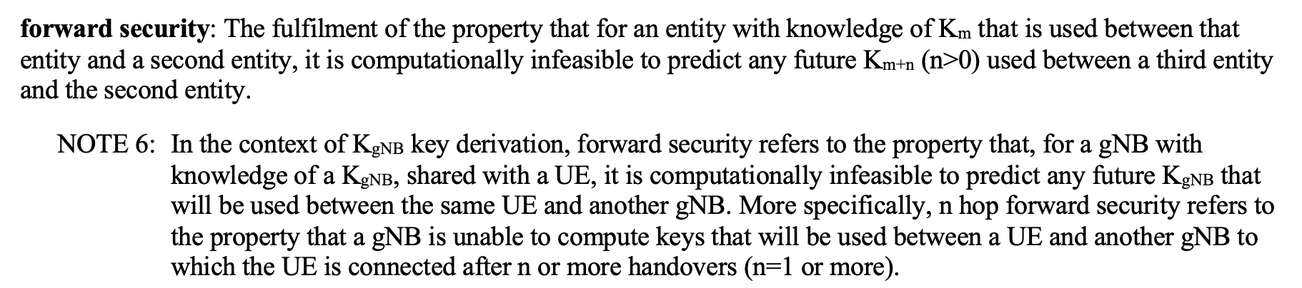
Security considerations
Concerns with other proposals of sharing PTK across network (2)
(B) Regression in competitive positioning with respect to alternative technologies
  3GPP defines concept of “forward security” for roaming (aka handover) in 5G RAN (see [6] and Annex slide)
  Data plane encryption key K_{UPenc} (equivalent to TK component of PTK) is derived by KDF from base-station specific key K_{gNB} (roughly equiv. PMK-R1)
    K_{UPenc} is a pairwise secret between ME (equiv. non-AP MLD) and gNB (equiv. AP MLD)
    K_{gNB} is a pairwise secret between ME and AMF (within core network; for initial connection) or source gNB (for handover)
  For “vertical” handover, new K_{gNB} is derived (via intermediate key NH) from root key K_{AMF} (equiv. PMK-R0)
    K_{AMF} is a pairwise secret between ME and (source) AMF
    NH is a secret of three parties – ME, AMF and source gNB
    Provides “forward security” for K_{gNB} – i.e. if a K_{gNB} is compromised, all other past and future K_{gNB} are still secure
  For “horizontal” handover, new K_{gNB} is derived by KDF from previous K_{gNB}
    Does not provide full “forward security” for K_{gNB}, although an older K_{gNB} can’t be derived from a compromised newer K_{gNB}
  In both handover cases, K_{gNB} (and, therefore, the encryption key K_{UPenc}) is unique after each handover
    “PTK sharing” (i.e. sharing of K_{UPenc}) is never used, so no issues with nonce reuse across multiple handovers
    “PMK sharing” (i.e. sharing of K_{gNB}) across base stations is never used either
  3GPP handover security properties have been the subject of significant academic research studies, e.g. see [7]
    Expect UHR seamless roaming to be of similar interest; researchers will stress-test implementations for vulnerabilities

Slide 17
Security considerations
Concerns with other proposals of sharing PTK across network (3)
(C) Risk of nonce reuse from flawed PN context exchange or management across AP MLDs
  In order to use the same PTK across all AP MLDs, the PTKSA would need to be included in the context exchange
  It is essential that the IV/nonce (i.e., for GCMP, A2 || PN) is never reused with the same PTK
    Note: A2 is the TA (or the MLD address for unicast frames between MLDs)
    This means a given MLD must never reuse a PN with the same PTK
    Note: Nonce reuse with GCMP can allow attacker to decrypt, replay and bidirectionally forge packets
  In the uplink, it can be assumed the non-AP MLD implementation avoids PN reuse for the entire PTK lifetime
    Although uplink PN might still need to be proactively synced across AP MLDs to avoid replay detection issues
      e.g. replay of an earlier roam request message that was sent to the same Target AP MLD
  However, in the downlink, when the PN is (re)set with the same A2 multiple times (e.g. on roam back to same AP, or if A2 is the “SMD MLD” address), PN reuse must be strictly avoided. This implies one of the following:
    the AP needs to maintain state of previously used PN ranges with a given PTK, even after non-AP MLD roams away, or
    the PN needs to be synced/transferred across AP MLDs as part of context exchange, e.g.
      “last PN” is transferred, and first PN used by next AP MLD is equal to {last PN + N}, or
      part of PN space is assigned to a “roam counter”, which is transferred and incremented on each roam
  Any of these approaches are particularly fragile to imperfect implementations (see examples on next slides)
    especially (but not only) in heterogeneous and/or multi-vendor network deployments
    potential issues - synchronization race conditions, improper coordination, loss/reset of state due to power outage/crash
    compare to baseline (per-UHR) case where a single entity is responsible for avoiding PN reuse and handling rekeying
  Note a requirement to attempt PTK rekeying some time (shortly) after the roam does not mitigate the issue
    since nonce reuse can occur before the rekeying is complete and/or attacker can try to cause the rekeying or roam to fail, resulting in continued use of the same PTK and/or roam back to the original AP before rekeying is successful

Slide 18
Security considerations
Concerns with other proposals of sharing PTK across network (4)
  Some examples of potential nonce reuse fragility are shown on the next slides
    Note: These are a limited set of examples. A design that addresses these particular cases is not necessarily robust against other similar-but-different scenarios or attacks
  For the purpose of these examples, some assumptions are made on signaling/design using a shared PTK:
    Non-AP MLD can initiate roam by signaling to either
    (a) Serving AP MLD or (b) Target AP MLD
    In case (a), Context Exchange (CX) is included with tunneled add link request to Target AP MLD, and acknowledged by target AP MLD in the response
    In case (b), a context exchange request is included with tunneled delete link request to Target AP MLD, and CX is included with tunneled delete link response
Roam Request/Response (e.g. UHR Add Link Reconfig)
Roam Request/Response tunneled over DS between AP MLDs
Context Exchange (CX) [includes PN for shared PTK]
Downlink data path
Uplink data path
X
Downlink PN = X
LLC XID update to DS (updates L2 switch port mapping)
Each CX exchange is referenced to a (unique/random) RoamID in tunneled Request and Response over the DS
If CX is not completed and PTK is unknown by Target AP MLD, Add Link Resp. status = fail
On each roam, downlink PN in CX is equal to last used PN + N (where value N might be large)
Note: These assumptions are based on a design that tries to mitigate/avoid basic nonce reuse issues
AP MLD2
Assumed AP MLD1➔AP MLD2 Roam signaling for shared PTK
TUN{AddLinkReq(MLD2)}
CX(PN)
RoamID
TUN{AddLinkResp(MLD2, SUCCESS)} RoamID
AddLinkReq(MLD2)
DelLinkReq(MLD1)
AddLinkResp(MLD2, SUCCESS)
DelLinkResp(MLD1, SUCCESS)
non-AP MLD
AddLinkReq(MLD2)
DelLinkReq(MLD1)
AddLinkResp(MLD2, SUCCESS)
DelLinkResp(MLD1, SUCCESS)
TUN{DelLinkReq(MLD1)}
CXReq
RoamID
TUN{DelLinkResp(MLD1, SUCCESS)}
CX(PN)
RoamID
AP MLD1
(a) via Serving AP
(b) via Target AP

Slide 19
Security considerations
Concerns with other proposals of sharing PTK across network (5)
  Nonce reuse fragility: Example (1)
    “CX failure”
    Non-AP MLD communicates with AP MLD1 for a while, reaching PN=500000
    Non-AP MLD initiates roam by signaling to Target AP MLD (AP MLD2)
    AP MLD2 requests CX from Serving AP MLD1, however due to backhaul issue, no response is received from AP MLD1
    Since AP MLD2 has previously received the (shared) PTK but has not yet used it, it accepts the roam request in order to not leave the STA without connectivity and resets the PN [note: there is no nonce reuse issue at this point, since the TAs of AP MLD1 and MLD2 are different]
    After a short time, the non-AP MLD initiates roam back to AP MLD1, by signaling via Serving AP (AP MLD2)
    The CX procedure proceeds normally, and the last PN used by AP MLD2 (100) is used as the basis for the transferred PN (100+N)
    AP MLD1 now sends packets starting from PN=100+N, resulting in nonce reuse if 100+N<500000
AddLinkResp(MLD2, SUCCESS)
TUN{DelLinkReq(MLD1)}
CXReq
RoamID=1
AddLinkReq(MLD1)
DelLinkReq(MLD2)
AddLinkReq(MLD2)
DelLinkReq(MLD1)
AddLinkResp(MLD1, SUCCESS)
DelLinkResp(MLD2, SUCCESS)
Switch (on DS)
AP MLD2
0
100
non-AP MLD
AP MLD1
100+N
0
500000
TUN{DelLinkResp(MLD1, SUCCESS)}
CX(PN=50000+N)
RoamID=1
TUN{AddLinkReq(MLD1)}
CX(PN=100+N)
RoamID=2
TUN{AddLinkResp(MLD1, SUCCESS)}
RoamID=2

Slide 20
Security considerations
Concerns with other proposals of sharing PTK across network (6)
  Nonce reuse fragility: Example (2)
    “Incomplete roam state”
    Non-AP MLD communicates with AP MLD1 for a while
    Non-AP MLD initiates roam by signaling to Target AP MLD (AP MLD2)
    AP MLD2 requests CX from Serving AP MLD1, which responds successfully
    However, the response message from Target AP (MLD2) is not received by non-AP MLD since it has temporarily moved out of coverage
    Non-AP MLD now moves back into coverage of AP MLD1 and tries to communicate with it; however since the CX transfer already occurred with AP MLD2, AP MLD1 is no longer exchanging (class 3) frames with the non-AP MLD. When non-AP MLD detects this, it attempts to roam back to non-AP MLD1 by sending message to AP MLD1
    Since AP MLD2 did not receive Ack from non-AP MLD, it dropped the CX it previously received. So when AP MLD1 requests the CX, it respond with an arbitrary PN value (e.g. 0, 0+N, etc)
    AP MLD1 now sends packets starting from the arbitrary PN value, resulting in nonce reuse if it is less than 500000
AddLinkResp(MLD2, SUCCESS)
AddLinkReq(MLD2)
DelLinkReq(MLD1)
TUN{DelLinkReq(MLD1)}
CXReq
RoamID=1
AddLinkReq(MLD1)
DelLinkReq(MLD2)
AddLinkResp(MLD1, SUCCESS)
DelLinkResp(MLD2, SUCCESS)
Switch (on DS)
AP MLD2
non-AP MLD
AP MLD1
100+N
0
500000
TUN{DelLinkResp(MLD1, SUCCESS)}
CX(PN=50000+N)
RoamID=1
TUN{DelLinkReq(MLD2)}
CXReq
RoamID=2
TUN{DelLinkResp(MLD1, SUCCESS)}
CX(PN=0+N)
RoamID=2

Slide 21
Security considerations
Concerns with other proposals of sharing PTK across network (7)
  Nonce reuse fragility: Example (3)
    “Delayed / out-of-order CX”
    Non-AP MLD initiates roam by signaling to Target AP MLD (AP MLD2)
    AP MLD2 requests CX from Serving AP MLD1
    However, the CX response is delayed on the DS, so AP MLD2 does not respond to non-AP MLD (or sends Failure response)
    In the meantime, while processing the DelLinkReq, AP MLD1 sent a few more packets to non-AP STA that were already queued for delivery
    Non-AP MLD tries the roam again
    This time, AP MLD2 requests and receives CX from AP MLD1 (with slightly increased PN), sends Success response to non-AP MLD, roam completes, and sends DL frames using new PN
    Shortly after, the original delayed CX response is received by AP MLD2
    AP MLD2 incorrectly accepts and updates the current PN with the PN in the delayed CX, since it did not internally invalidate the original RoamID in time. This causes subsequent packets to be sent using nonce that was used a few packets earlier (PN=105+N, ...)
AddLinkReq(MLD2)
DelLinkReq(MLD1)
TUN{DelLinkReq(MLD1)}
CXReq
RoamID=1
TUN{DelLinkReq(MLD1)}
CXReq
RoamID=2
AddLinkResp(MLD2, SUCCESS)
DelLinkResp(MLD1, SUCCESS)
Switch (on DS)
AP MLD2
105+N
100+N
non-AP MLD
AP MLD1
0
100
105
TUN{DelLinkResp(MLD1, SUCCESS)}
CX(PN=100+N)
RoamID=1
TUN{DelLinkResp(MLD1, SUCCESS)}
CX(PN=105+N)
RoamID=2

Slide 22
Security considerations
Concerns with other proposals of sharing PTK across network (8)
  Nonce reuse fragility: Example (4)
    “Ping-pong roam race condition”
    Non-AP MLD roams from AP MLD2 to AP MLD1
    Some time later, non-AP MLD initiates roam to AP MLD2 by signaling to Serving AP MLD (AP MLD1)
    Before Serving AP MLD1 has processed the request, the non-AP MLD changes its mind due to RSSI change and sends request to the Serving AP MLD to return back to AP MLD1
    The first request causes AP MLD1 to send CX to AP MLD2, while the second request causes AP MLD2 to request CX from AP MLD1. These two messages are received by AP MLD2 about the same time. AP MLD2 sends CX back to AP MLD1 containing the same PN as when the prior roam happened (i.e. without having yet updated its internal PN based on the incoming CX).
    AP MLD1 receives the CX, sends success response back to non-AP MLD, and updates its PN based on the CX.
    When AP MLD1 continues sending packets to non-AP MLD, it reuses nonce values that it used when the non-AP MLD first roamed to it.
TUN{AddLinkReq(MLD2)}
CX(PN=100+2N)
RoamID=1
TUN{DelLinkReq(MLD2)}
CXReq
RoamID=2
TUN{DelLinkResp(MLD2, SUCCESS)}
CX(PN=50+N)
RoamID=2
Switch (on DS)
AP MLD2
50
0
non-AP MLD
AP MLD1
50+N
100+N
50+N
AddLinkReq(MLD2)
DelLinkReq(MLD1)
AddLinkReq(MLD1)
DelLinkReq(MLD2)
AddLinkResp(MLD1, SUCCESS)
DelLinkResp(MLD2, SUCCESS)

Slide 23
Security considerations
Concerns with other proposals of sharing PTK across network (9)
  Nonce reuse fragility: Example (5)
    “Distributed responsibility for rekeying”
    Non-AP MLD has been connected to AP MLDs in the network for some significant period of time, and the PN has reached some large value L
    The AP MLDs in the network are configured with a consistent threshold for PN exhaustion warning (dot11PNWarningThreshold), which triggers them to initiate a PTK rekey
    Non-AP MLD initiates roam from AP MLD1 to AP MLD2 just before the warning threshold PN value is reached
    The PN value exactly equal to the warning threshold is used by AP MLD1 to deliver already-buffered packets. Since AP MLD1 has already sent CX to AP MLD2, it assumes AP MLD2 will handle rekeying.
    However, the first PN value used by AP MLD2 (incremented by N) is already greater than the threshold and does not trigger AP MLD2 to rekey either
    As a result, the APs continue to increment the PN until it wraps around, resulting in nonce reuse when non-AP MLD roams back to the same AP MLD it used on first connection
AddLinkReq(MLD1)
AddLinkResp(MLD2, SUCCESS)
Switch (on DS)
PN=dot11PNWarningThreshold
AP MLD2
L+50
L+90
L+150
L
non-AP MLD
AP MLD1
L+50+N
0
TUN{AddLinkReq(MLD2)}
CX(PN=100+2N)
RoamID=1
TUN{AddLinkResp(MLD2, SUCCESS)}
RoamID=1
PN>dot11PNWarningThreshold

Slide 24
Security considerations
Concerns with other proposals of sharing PTK across network (10)
  (D) Sharing PTKs does not meaningfully simplify implementations
    STA-side complexity
      On STA side, the main scenario for consideration is if, after a roam, the non-AP MLD is concurrently connected to both (previously) Serving AP MLD and Target AP MLD, while retrieving buffered DL data from the Serving AP MLD (e.g. per slides 3 and 10). Considering two different STA-side implementation options:
      (1) STA implementation always processes all buffered DL data from Serving AP MLD before processing any DL data from Target AP MLD
        e.g. STA stays in PS with Target AP MLD during this period to avoid receiving any DL data from Target AP MLD
        Note - this implies in-order delivery for DL data over the roam, since data received from Serving AP MLD is assumed to be older than any data received from Target AP MLD; i.e. DL data from Target AP MLD is delayed until all buffered data from Serving AP MLD has been processed
        In this case, irrespective of whether shared-PTK or unique-PTK is used, STA only needs a single set of reordering buffers and replay counters. In unique-PTK case, STA would (re)set buffers/counters and activate new PTK once it completes processing of buffered DL data from the Serving AP MLD
        If STA using unique-PTKs wishes to send uplink data (to Target AP MLD) during the period it is retrieving buffered DL data from Serving AP MLD, then for a short period it would have the old PTK installed for DL data, and the new PTK installed for UL data
      (2) STA implementation is able to process DL data from Target AP MLD before it has completed receiving/processing all buffered DL data from Serving AP MLD
        Note – this is a requirement for a STA that wishes to support out-of-order delivery of DL data over the roam (where negotiated), in order to minimize latency for packets that are sent from Target AP MLD shortly after the roam
        In this case, irrespective of whether shared-PTK or unique-PTK is used, STA needs separate sets of reordering buffers and replay counters for each AP MLD
        STA using unique-PTKs would have the old PTK installed for buffered DL data from Serving AP MLD, and the new PTK installed for new DL data from Target AP MLD and UL data

Slide 25
Security considerations
Concerns with other proposals of sharing PTK across network (11)
    AP-side complexity
      AP-side complexity is likely to be increased in a shared PTK design, in order to exchange PTKSA (and PNs, etc), and harden implementations against potential new security vulnerabilities
      Note – if unique (non-shared) PTKs are used, various designs for PMK derivation and distribution across AP MLDs in the network can be considered in principle, with various possible security vs network implementation trade-offs
        e.g. unique PMKs derived from master key (e.g. FT key hierarchy), or unique PMKs derived “horizontally” from previous PMK (e.g. Hash(Prev_PMK || Addresses || Counter)), or shared PMKs, etc
          note - if some kind of PMK sharing is considered, PTK derivation with PFS (exchanging ephemeral public keys instead of nonces) is particularly important

Slide 26
Proposed extensions to FT protocol
Background - baseline FT (11r) protocol
initial auth/assoc to AP MLD1
roam to AP MLD2
AP MLD2
s1
s4
non-AP MLD
s1
s2
s3
s4
s2
AP MLD1
FT Initial
MD Assoc
FT reassoc
(AP MLD2 opens 802.1X port)
State 4 (s4) data path with AP MLD1
SAE/EAP/OWE(*) auth
4-way
FT Auth (OTA or OTDS)
State 4 (s4) data path with AP MLD2
It is proposed that the security framework and new capabilities for roam signaling, as described in earlier slides, are designed as enhancements to FT protocol
Baseline FT (11r) protocol already meets some of the requirements for seamless roaming
  Non-AP MLD always has exactly one full “state 4 connection” to the DS
    Note: State 4 with AP MLD1 remains until Reassoc Resp received from AP MLD2 (see 12.3.5.4; Annex)
  New PTK derivation (with AP MLD2) occurs while still associated to Serving AP MLD1
    Note: New PTK is derived from AP MLD2’s PMK-R1. and SNonce/ANonce exchanged in FT Auth frames
    Note: Reassoc Req/Resp just contain MIC (CMAC/HMAC using PTK-KCK) to confirm the PTK liveliness
      AP MLD2’s PMK-R1 is derived by AP MLD1 (R0KH **) from the PMK-R0, and securely transported over the DS to AP MLD2
      MIC protection means roam failure scenarios caused by PMF protection mechanisms (SA Query) are avoided
(*) FILS auth in FT Initial MD Assoc is also supported (no 4-way needed)
(**) R0KH is part of Authenticator, performed by AP’s SME (see 3.1, 4.10.1)

Slide 27
Proposed extensions to FT protocol
Background – baseline FT (11r) protocol (2)
Higher-layer procedures that could delay connectivity after roam are skipped
  e.g. skip DHCP and ARP to gateway’s IP; since AP MLDs in FT Mobility Domain are known to be on same DS
New PTK key derivation is not in critical path, does not contribute to connectivity outage
  Particularly for OTDS case, since FT authentication frames are sent via Serving AP MLD1 without need to go off-channel (when AP MLD1 and AP MLD2 are non-co-channel)
  New PTK is derived prior to non-AP MLD changing its point of connection to DS
Choice of OTA and OTDS mechanisms allows optimization for the roam scenario
  e.g. OTDS is generally preferred when link quality with Serving AP MLD1 is still good, but OTA might be preferred if the link quality with Serving AP MLD1 is already poor (or non-existent) when roam is triggered
FT defines a clear security key hierarchy with well-bounded roles for each key holder, e.g.
  the PMK-R0 is a pairwise secret between one AP MLD (the R0KH) and the non-AP MLD
  each PMK-R1 is a secret of only 3 entities: the R0KH, the corresponding AP MLD (R1KH), and non-AP MLD
    closer to zero-trust methodology, i.e. a malicious AP cannot derive PTK of another AP’s link just by obtaining SNonce/ANonce
  each PTK is a pairwise secret between the corresponding AP MLD and non-AP MLD
Flexible and scalable options for implementing security key distribution across APs
  “push” model – R0KH proactively generates PMK-R1s for all APs in Mobility Domain and pushes to the APs
  “pull” model – R0KH generates PMK-R1 for a given AP either proactively or on-demand, and provides it to a given AP on request (e.g. when STA initiates roam to Target AP)
  even in large Mobility Domains (N x AP MLDs) where PMK-R1s are proactively generated (e.g. in central controller), computational complexity (N x KDFs *) and storage requirements are low
(*) In an experiment using open-source AP daemon hostapd, derivation of PMK-R1s (wpa_derive_pmk_r1()) for 1000 APs took only 7 ms

Slide 28
Proposed extensions to FT protocol
Performance of existing baseline FT implementations
Experimental setup
(as an example of behavior)
  packet capture (on switch)
switch
DS
AP1
AP2
sniffer
(TSF timestamped)
STA
APs
  Both APs operate on same channel, advertise same FT MD
  Based on commodity Wi-Fi chipset modules, open-source host daemon (*)
  TxBF and MU disabled
STA
  (STA-A): Commercial smartphone
  (STA-B): Reference Wi-Fi module with minor experimental driver optimizations
  Static IP assignment
Data traffic
  Bidirectional iperf isochronous flows between STA and bridge on DS (small packets every 1ms)
  Target AP sends LLC XID packet to DS with SA=STA_MAC, to update DS mapping when FT Reassoc Resp is Ack’d
    i.e. DL frames will be forwarded to AP2 even before STA sends its first data packet to AP2 in uplink
Security / Roaming
  FT-SAE OTDS; BTM-triggered (also, for STA-B, Supplicant-triggered)
(*) Trunk hostapd as of April 2024, https://w1.fi/cgit/hostap/log/

Slide 29
Proposed extensions to FT protocol
Performance of existing baseline FT implementations (2)
STA-A (commercial smartphone)
BTM-triggered
36 ms
3 ms
4 ms
47 ms
5 ms
AP2
12 ms
DL
ADDBA
Probes
7 ms
UL
STA
UL
2 ms
AP1
DL
5 ms
BTM
Req/Resp
FT Action
(Auth Req/Resp)
FT Reassoc Req/Resp
Note: Data paths are only shown if the Tx frames captured by sniffer are ACK’d by receiver and appear in Rx interface capture

Slide 30
Proposed extensions to FT protocol
Performance of existing baseline FT implementations (3)
STA-B (reference Wi-Fi module with minor experimental driver optimizations)
BTM-triggered
1 ms
16 ms
4 ms
19 ms
7 ms
AP2
10 ms
DL
ADDBA
Probes
11 ms
UL
STA
UL
AP1
DL
2 ms
BTM
Req/Resp
FT Action
(Auth Req/Resp)
FT Reassoc Req/Resp
Experimental optimizations:
  Delay suspending of uplink data FIFO until the short period during FT Reassociation state changes
  Delay canceling packet filter for Serving AP’s BSSID until FT Reassociation
Note: Data paths are only shown if the Tx frames captured by sniffer are ACK’d by receiver and appear in Rx interface capture

Slide 31
Proposed extensions to FT protocol
Performance of existing baseline FT implementations (4)
STA-B (reference Wi-Fi module with minor experimental driver optimizations)
Supplicant-triggered
4 ms
15 ms
6 ms
AP2
6 ms
DL
ADDBA
Probes
(off-channel probes – 100+ ms)
7 ms
UL
STA
UL
AP1
DL
1 ms
FT Action
(Auth Req/Resp)
FT Reassoc Req/Resp
Note: In this supplicant-triggered case, Target AP’s channel is not specified in roam trigger; STA does full scan prior to roam decision
Note: Data paths are only shown if the Tx frames captured by sniffer are ACK’d by receiver and appear in Rx interface capture

Slide 32
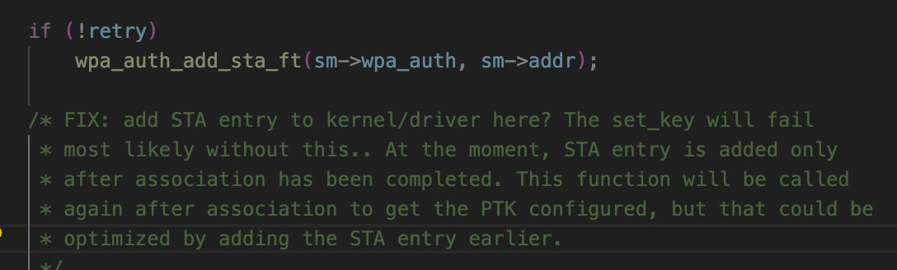
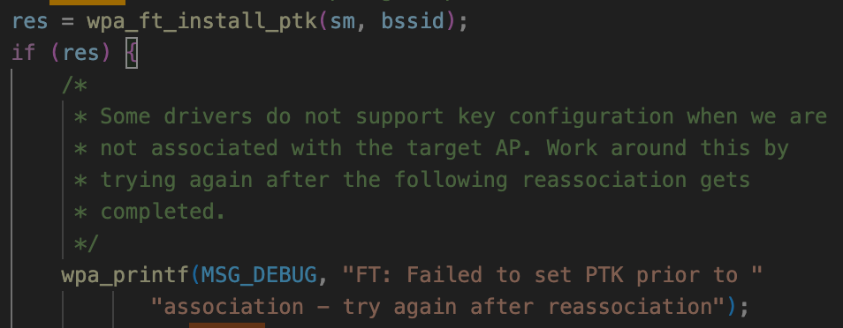
Proposed extensions to FT protocol
Performance of existing baseline FT implementations (5)
Observations from experimental results with existing commercial implementations:
  Connectivity outage during roam broadly consistent with previous results in literature, e.g. 40-70 ms (e.g. [3])
  The time for STA (host) to make roam decision based on BTM Request is significant, but not in the critical path
  Uplink traffic stops several 10s of ms before FT Reassoc exchange
    This is because typical STA drivers/supplicants suspend data path with Serving AP (e.g. suspend Tx FIFO, clear A2 Rx filter, block 1X controlled port, and/or delete PTK), during process of authenticating/reassociating with the Target AP
      This is not required by the standard – see Annex excerpts
  As expected, Serving AP maintains PTK (and active interface) until (after) the roam is complete
  Traffic with target AP does not begin until ADDBA exchanges are complete, however ADDBA signaling overhead per-se does not dominate the delay (from Reassoc Resp until first data frames)
    Note – the time taken for host to install key in driver/hardware can be significant. Some host implementations attempt to install the key as soon as FT Authentication is complete (i.e. prior to reassociation), but this is not supported by many existing drivers (e.g. see open-source examples below of host FT key installation functions)
With minor STA-side optimizations, outage is reduced to ~12 ms (half of which is due to ADDBA setup) and can be optimized further
With optimized implementations, the perception of FT as “non-seamless” (e.g. [4]) would not exist
hostapd
wpa_supplicant

Slide 33
Proposed extensions to FT protocol
New roam signaling capabilities as extensions to FT protocol
The new roam signaling capabilities described on earlier slides can be implemented as relatively simple extensions to FT protocol as follows:
(1) Extend FT OTDS to allow Probe Request/Response and FT Reassociation Request/Response frames to also be sent over-the-DS to the Target AP MLD
  Since both FT Auth and Reassoc frames are encapsulated in FT Action frames, fingerprinting privacy is ensured
  Allow OTDS Reassoc Response to also be duplicated OTA by target AP MLD
    to avoid stranding non-AP MLD if link with Serving AP MLD fails during the exchange (i.e. non-AP MLD moves to Target AP MLD’s channel)
  Consider allowing deferral of DS data path mapping, and deferral of terminating assoc state with Serving AP MLD, until a direct OTA exchange with target AP MLD is complete
    to avoid stranding non-AP MLD if link quality with Target AP MLD has not yet been confirmed and is too weak
  Note: Can reuse existing RRB transport used for FT Authentication frames in baseline FT OTDS
Baseline FT OTDS
UHR FT Auth+Reassoc OTDS
AP MLD2
s4
s4
non-AP MLD
s2
s2
AP MLD1
FT Auth
FT Auth
FT Reassoc
(tunneled) probe
FT Reassoc

Slide 34
Proposed extensions to FT protocol
New roam signaling capabilities as extensions to FT protocol (2)
(2) Use ROAM-EncKey (see earlier) to encrypt over-the-air FT Authentication and Reassociation frames
  Note: As mentioned earlier, we cannot assume an OTDS mechanism can always be used
    e.g. if link quality to Serving AP is already poor/nil when roam trigger occurs (see diagram in Annex), or if non-AP MLD is anyway going off-channel to obtain RSSI
  Note: For privacy protection of the Initial MD association, mechanisms being defined in 11bi might be used
(3) Bundle signaling to trigger context exchange and DS mapping update in FT Auth / Reassoc frames
  by inclusion of additional elements in Auth/Reassoc frames, e.g.
    Msg 1: FTAuthReq(S-Nonce/EphPub) || SemiStatic_Context_Exchange_Trigger
    Msg 2: FTAuthResp(A-Nonce/EphPub) || SemiStatic_Context_Exchange_Conf
    Msg 3: FTReassocReq(MIC) || DS_Mapping_Update_Trigger
    Msg 4: FTReassocResp(MIC)
  if needed, minimum number of messages can be reduced to 3 by bundling FT Auth and Reassoc contents
    e.g. (1) FTAuthReq(S-Nonce/EphPub) || FTReassocReq ; (2) FTAuthResp(A-Nonce/EphPub, MIC) || FTReassocResp; (3) FTConf(MIC)
  note, even in a “shared PTK” design, multiple messages are required during roam procedure to trigger context exchange, exchange link/MLD-specific capabilities, DS mapping update, deliver group keys, etc
(4) To ensure implementations maintain an active dath path throughout the roam procedure
  UHR non-AP MLD is required to maintain the existing PTKSA with Serving AP MLD until (at least) the time that reassociation with target AP MLD completes
    Non-AP MLD should also maintain active data flow (Tx FIFO, packet filters, 1X port) with Serving AP MLD during this time
    If “buffered data delivery” is used, PTKSA with Serving AP MLD would be maintained until this is complete
  Implementations should install PTK in driver ready for use as soon as it is derived (after FT Auth)
  After roam, data path should be unblocked even if other exchanges (e.g. sounding) are still pending completion

Slide 35
Proposed extensions to FT protocol
Seamless integration with existing FT networks
Network deployments with mixed-technology APs (UHR and non-UHR) are likely to exist
  Since FT is already widely deployed, it is expected it will continue to be used – both for legacy (non-UHR) STAs / non-AP MLDs, and also for UHR non-AP MLDs when connecting to non-UHR APs in the network
  In an FT-based seamless roaming design, UHR enhancements (e.g. tunneled OTDS, context exchange triggers) can be used seamlessly together with legacy FT operations in the same MD
    i.e. the new features are used between UHR devices, while baseline FT is used with a non-UHR device – both cases can use the same FT key hierarchy and have commonality in signaling and behavior
Compare this to a “shared PTK” design that uses a separate (non-FT) key hierarchy and AKM – separate full authentication procedures for UHR and FT would be required
    Implies roam performance degradation when the second key hierarchy is established, e.g. see figure below
    Also requires STA to maintain both key hierarchies
UHR key distribution (UHR domain)
Initial connection at (1)
- “Shared PTK” initial assoc
Roam 1➔2
- FT Initial Mobility Domain assoc
Roam 2➔3
- FT protocol roam
Roam 3➔4
- “Shared PTK” roam
Roam 4➔1
- “Shared PTK” roam
context exchange
UHR AP MLD1
UHR AP MLD2
Initial connection
1
4
non-AP MLD
2
3
non-UHR AP MLD3
non-UHR AP4
Roam 1➔ 2 is a “slow” procedure including 4-way handshake
FT key (PMK-R1) distribution (FT domain)

Slide 36
Proposed extensions to FT protocol
.... but you said (FT) “reassociation”!
In other submissions, various rationales have been discussed for “avoiding reassociation” due to non-seamless reassociation behavior observed in baseline implementations
  However, all those issues are addressed by the FT enhancements proposed in the previous slides
  i.e. enhanced FT reassociation with context transfer has the same seamless performance as other proposals
Support for context transfer can be added to baseline reassociation procedures with simple changes
  i.e. in 11.3.5.4, the list of “states, agreements, and allocations [that] shall be deleted or reset to initial values” would be modified such that parameters exchanged in the context exchange would instead be maintained
On the other hand, adding support for roaming between AP MLDs to other mechanisms such as ML Reconfiguration would involve duplication of standards and implementation effort
  ML Reconfiguration is currently only defined for adding/removing links to the same AP MLD, not for adding/removing links with a different AP MLD with separate MAC SAP, MLD MAC state management, etc, hence various reassociation concepts would need to be ported to this mechanism, e.g.
    rules for managing 802.1X controlled port (or, if port is centralized, its interface with each AP MLD’s MAC SAP)
    association state management, and corresponding Tx/Rx rules at each AP MLD for each class of frames
    roam failure handling, e.g. rules for roam rejection based on MLD-level capabilities and policies
  Some proposals have asserted the need to define new concepts such as “SMD association” and “SMD MLDs”
    such complexity would not be necessary if existing association concepts are used, with the addition of context transfer
  In addition, fundamental MLO concepts that currently apply when a new link is added (e.g. STR/eMLSR, TID-to-link mapping) would not apply across the links of the Serving and Target AP MLDs
  To avoid confusion, it is better to not override ML Reconfiguration, and instead enhance existing reassoc rules

Slide 37
Summary of proposed features
Roam triggering
  Mutual exchange of initial candidates for future roams using Neighbor Reports within Reassociation / Roam Request and Response
  Define RCPI and measurement timestamp subelements in Neighbor Reports
  Include link scoring metrics (e.g. BSS Load) in Neighbor Reports in BTM Request
  Define “deterministic” roam behavior by non-AP MLD in response to a BTM Request that includes quantitative evidence that the specified Target AP MLD can meet current traffic/QoS requirements
  Mutual exchange of network topology information, and the scope of roaming/steering algorithms, within Reassociation / Roam Request and Response
  Tunneled probing of candidate AP MLD(s) via Serving AP MLD
Security
  Maintain use of unique PTKs for each AP MLD; embed PTK derivation handshake within roam messages
    Propose using FT key hierarchy and exchanges with extensions (e.g. to trigger context transfer, DS mapping update)
  AES-SIV based encryption, using separate network-wide key derived on initial connection, for roam signaling sent directly to a Target AP MLD
Context transfer
  “Simple” transfer of BA and MSCS/SCS context
  Per-TID negotiation of in- vs out-of-order delivery to higher layers of data from each AP MLD
  Support retrieving buffered DL packets at Serving AP either directly by non-AP MLD or by simple MSDU transfer to target over the DS

Slide 38
Annex: Considerations on data transfer over the DS
A potential alternative approach to data plane “buffered data delivery” from Serving AP MLD is for the already-buffered DL data to be transferred from Serving AP MLD to Target AP MLD over the DS, and then transmitted by Target AP MLD after the roam
This is already (theoretically) a network implementation option today, i.e.
  Serving AP MLD gathers MSDUs from its Tx buffers, send over some secure data tunnel on DS between AP MLDs (or via controller), and Target AP MLD transmits
Optimizations could be possible to ensure in-order DL delivery (e.g. additional BA context transfer)
Unlikely for mass-market adoption, but could be attractive in certain deployments e.g. enterprise
  Higher AP MLD implementation complexity: Implementation involves multiple data queues at different levels of the stack (e.g. within OS kernel, driver, hardware, etc). Extracting buffered data from those queues in order to transfer it to another AP MLD is non-trivial
  Implies secure data paths need to be established pairwise between every AP MLD in the network, or data is sent via a central controller with additional backhaul and processing overhead
  Likely inappropriate for networks with non-ideal backhaul (e.g wireless backhaul with non-negligible latency)
Data transfer should be in the form of MSDUs - not (encrypted) MPDUs
  Most buffered data is within larger OS kernel queues
  Most AP MLD implementations perform MPDU encryption in hardware immediately prior to transmission
    Note: While certain network architectures currently use centralized encryption engines, these are not in the majority and on-chip encryption is expected to become even more dominant as data rates continue to increase
Should remain an implementation option; only minimal formal support is needed in the standard

Slide 39
Annex: Considerations on full BA agreement context transfer
  The most ‘advanced’ form of Block ACK agreement context exchange involves also transferring the current scoreboard, and all WinStart/End values, maintained at AP MLD for each TID
    The description below is with respect to the figures in earlier slides on Block ACK context transfer
    This could help avoid the small possibility of UL duplicates
    However, it would not help with either of the following issues:
      end-to-end out-of-order DL delivery if the switching of DS data interface from AP MLD1 to AP MLD2 is “glitchy”
        i.e. if some packets the DS forwards to AP MLD2 are older than some packets the DS forwards to AP MLD1
        since SN assignment would generally be performed at each AP MLD based on order of arrival of MSDUs at that AP MLD, the order of packets in terms of SN might not be the same as the original order of packets from the source
      inefficiencies in ensuring UL in-order delivery to the DS (see previous slide)
        e.g. even if non-AP MLD retransmits packet 2 to AP MLD2 using the original SN (102) and the full BA context is shared, it would require real-time coordination between the two AP MLDs to ensure AP MLD2 forwards packet 2 to the DS prior to AP MLD1 forwarding packets 3-4 to the DS
          in cases where the scoreboard has multiple holes, the two APs would need to coordinate to round-robin forward MSDUs to the DS in SN order, which would be extremely inefficient
        ... and even if this could be done, it would not necessarily ensure end-to-end in-order UL delivery since the DS paths from AP MLD1 and AP MLD2 to the gateway may have different delays
        Note: The in-order delivery requirement per TID applies at the 802.11 layer (not explicitly to the gateway)
    In addition, full BA context exchange implies need to suspend the uplink data path while it is transferred
      The goal should be to avoid significant data outage during roam, even if the probability of UL packet duplication of out-of-order delivery to the gateway is slightly increased

Slide 40
Annex: Considerations on utility of retrieving buffered DL data from (previously) Serving AP
In non-real-time use cases (e.g. downloads, buffered audio/video), the buffered data might often be usable by the application, but it might be more efficient for the packets to be dropped and higher-layer retransmissions (e.g. TCP, QUIC) be invoked
  Particularly where retrieval of the packets involves off-channel operations that disrupt new link
  However there may be exceptions - e.g. on end-to-end links with high bandwidth-delay product, or highly constrained northbound links, the impact of TCP congestion window collapse due to dropped packets could be significant
In real-time use cases (e.g. conversational or XR audio/video), the buffered data might often be “stale” due to newer data already being transferred with the target AP MLD
  For example, if a new VoIP packet has already been received from the Target AP MLD, then in principle buffered data that contains previous VoIP packets is useless since the codec would have already reconstructed the missing packets
  In addition, under the current in-order delivery requirements, the new VoIP packet would not be delivered to the higher layers until the older packets are retrieved, effectively further increasing the number of missing (or late) packets at the codec
  However some important exceptions may exist - e.g. if the buffered data contains a video I-frame, it may be needed to render subsequent P-frames
  For such cases where the higher layers can support it, it should be possible for the non-AP MLD to opt-in to out-of-order delivery of the corresponding TID, so that retrieval of the (potentially useful) buffered data does not delay delivery of the most recently received data in the same TID
    If multiple flows involving multiple higher layer entities share the same TID, and some of the higher layers cannot support out-of-order delivery, then in-order delivery should be used for that TID

Slide 41
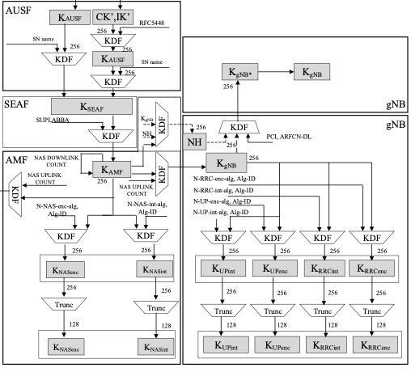
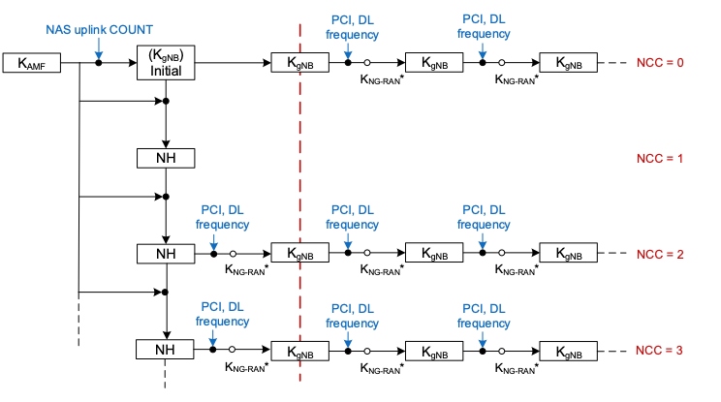
Annex: 3GPP 5G handover key handling
horizontal handover
vertical handover
(from [6])

Slide 42
Annex: Challenges with roaming triggers
AP1 [p]
6 GHz
AP2 [t]
6 GHz
STA
STA
2.4GHz
2.4GHz
2.4GHz
AP3
6 GHz
A STA in mobility can rapidly move out of coverage of Serving AP (depending which bands it has active links with)
Since it cannot always be guaranteed a clear roam target can be determined while the link quality with Serving AP remains good, there is a need to support both OTDS and OTA roaming mechanisms

Slide 43
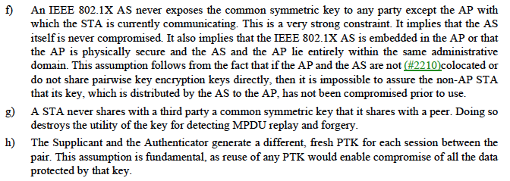
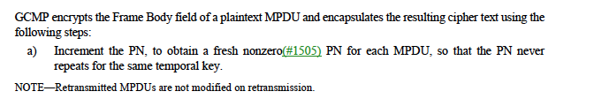
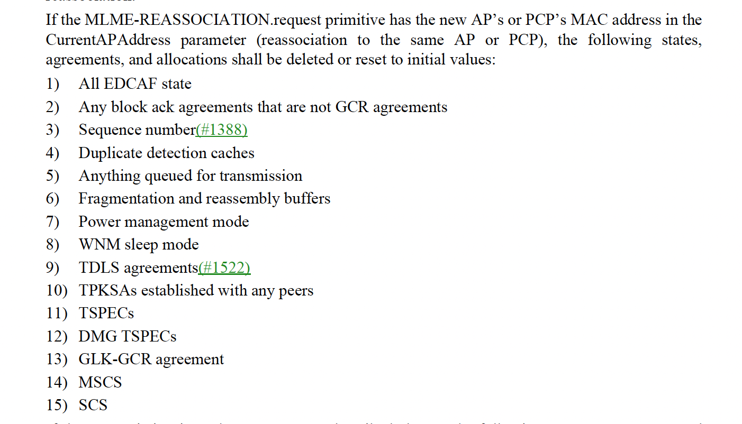
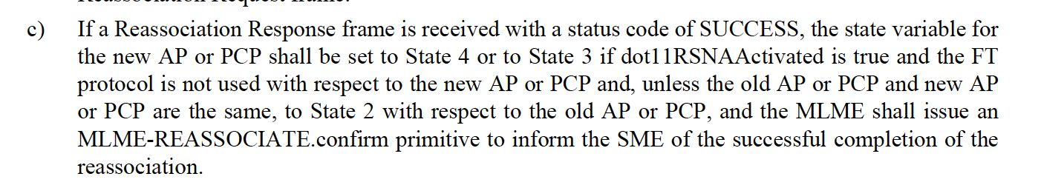
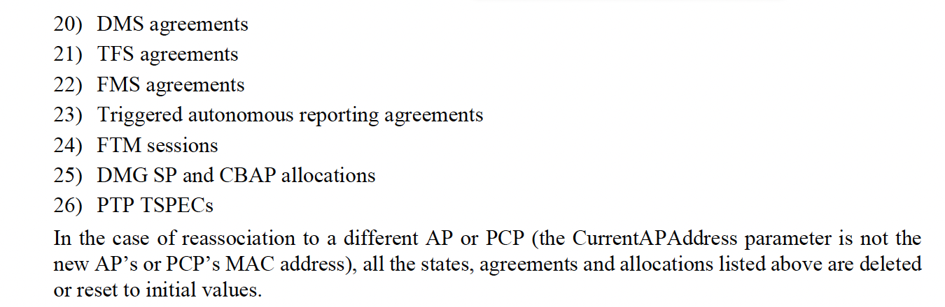
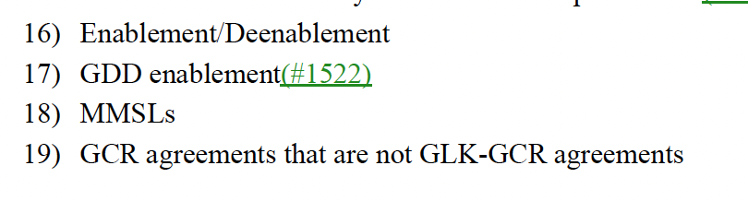
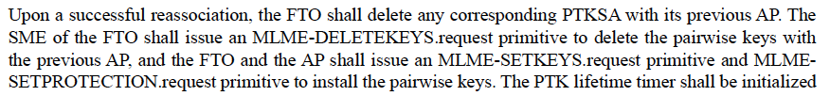
Annex: Relevant excerpts from REVme D5.0
(12.2.5)
(12.5.4.3.1)
(11.3.5.4)
(12.3.5.4)
(13.7.1)

Slide 44
References
[1] IEEE 802.11-23/1884r2 Seamless Roaming SPs, D. Ho et al, Jan 2024
[2] IEEE 802.11-24/0209r4 Specification Framework for TGbn
[3] Performance Study of Fast BSS Transition using IEEE 802.11r, S. Bangolae et al, 2006
[4] IEEE 802.11-23/1908r2 Seamless Roaming Procedure, Y. Yoon et al, Nov 2023
[5] NIST SP 800-38D “Recommendation for Block Cipher Modes of Operation: GCM and GMAC”
[6] 3GPP TS 33.501 V18.4.0
[7] https://people.inf.ethz.ch/rsasse/pub/5G-handover-WISEC21.pdf

