Slide 1
Thoughts on functionality and security architecture for UHR seamless roaming
Date: 2024-05-10
Authors:
Name | Affiliations | Address | Phone | Email
Thomas Derham | Broadcom |  |  | thomas.derham@broadcom.com
Nehru Bhandaru
Manoj R Kamath
Sindhu Verma
Shubhodeep Adhikari
Matthew Fischer
Brian Petry

Slide 2
Introduction
There seems to be general agreement (e.g. [1], [2]) on some technical requirements for UHR seamless roaming, whereby:
  the non-AP MLD remains in state 4 [with respect to some AP MLD in the network] throughout a successful roam from one AP MLD to another AP MLD
  the non-AP MLD has only a single point of connection to the DS at a given time
    with possible [TBD] exception for the non-AP MLD to exchange buffered DL frames with serving AP MLD after switching its point of connection to the target AP MLD
  during roaming procedure, the context related to a non-AP MLD is exchanged between AP MLDs such that the data exchange context is preserved
    a request/response frame exchange is defined for the non-AP MLD to initiate roaming procedure, and the context exchange to be triggered and completed
In this submission, we discuss and propose:
  A security architecture based on FT to achieve these objectives
    and caution against other proposals that involve sharing the PTK(SA) across multiple AP MLDs
  Roaming procedures based on extensions of FT OTA and OTDS mechanisms
  Contents of the context exchange and their impact on data continuity in key use cases

Slide 3
Proposed security architecture
Generic representation of roaming requirements
initial auth/assoc to AP MLD1
roam to AP MLD2
(and context exchange over DS)
AP MLD2
s1
s4
non-AP MLD
s1
s4
s4limited
s1/s2
AP MLD1
State 4 (s4) data path with AP MLD1
[TBD] Limited DL data path for “buffered data delivery” from AP MLD1
State 4 (s4) data path with AP MLD2
Non-AP MLD always has exactly one full “state 4” connection to the DS
  [TBD] Additionally, for a short period after roam to target AP MLD2, a limited data path for “buffered data delivery” continues to exist with serving AP MLD1 to allow remaining DL data to be flushed
Signaling exchange(s) trigger:
  (1) context exchange, (2) data path establishment with target AP MLD2

Slide 4
Proposed security architecture
Background - baseline FT (11r) protocol
initial auth/assoc to AP MLD1
roam to AP MLD2
AP MLD2
s1
s4
non-AP MLD
s1
s2
s3
s4
s2
AP MLD1
FT Initial
MD Assoc
FT reassoc
(AP MLD2 opens 802.1X port)
State 4 (s4) data path with AP MLD1
SAE/EAP/OWE(*) auth
4-way
FT Auth (OTA or OTDS)
State 4 (s4) data path with AP MLD2
Characteristics of baseline FT (11r) protocol
  Non-AP MLD always has exactly one full “state 4 connection” to the DS
    Note: State 4 with AP MLD1 remains until Reassoc Resp received from AP MLD2 (see 12.3.5.4; Annex)
  New PTK derivation (with AP MLD2) occurs while still associated to serving AP MLD1
    Note: New PTK is derived from AP MLD2’s PMK-R1. and SNonce/ANonce exchanged in FT Auth frames
    Note: Reassoc Req/Resp just contain MIC (CMAC/HMAC using PTK-KCK) to confirm the PTK liveliness
      AP MLD2’s PMK-R1 is derived by AP MLD1 (R0KH **) from the PMK-R0, and securely transported over the DS to AP MLD2
  AP implementations update DS’s data path mapping when FT Reassoc Resp is Ack’d
    e.g. AP MLD2 sends LLC XID (and possibly gARP) packet to DS with SA=non-AP MLD address
      updates port-MAC / IP-MAC tables on switch(es) / router(s) on DS immediately after roam, so DL frames are forwarded to AP MLD2 even before the non-AP MLD sends its first data packet to AP MLD2 in uplink
(*) FILS auth in FT Initial MD Assoc is also supported (no 4-way needed)
(**) R0KH is part of Authenticator, performed by AP’s SME (see 3.1, 4.10.1)

Slide 5
Proposed security architecture
Background – benefits of baseline FT (11r) protocol
Higher-layer procedures that could delay connectivity after roam are skipped
  e.g. skip DHCP and ARP to gateway’s IP; since AP MLDs in FT Mobility Domain are known to be on same DS
New PTK key derivation is not in critical path, does not contribute to connectivity outage
  Particularly for OTDS case, since FT authentication frames are sent via serving AP MLD1 without need to go off-channel (when AP MLD1 and AP MLD2 are non-co-channel)
  New PTK is derived prior to non-AP MLD changing its point of connection to DS
Choice of OTA and OTDS mechanisms allows optimization for the roam scenario
  e.g. OTDS is generally preferred when link quality with serving AP MLD1 is still good, but OTA might be preferred if the link quality with serving AP MLD1 is already poor (or non-existent) at the time roam is triggered
FT defines a clear security key hierarchy with well-bounded roles for each key holder, e.g.
  the PMK-R0 is a pairwise secret between one AP MLD (the R0KH) and the non-AP MLD
  each PMK-R1 is a secret of only 3 entities: the R0KH, the corresponding AP MLD (R1KH), and non-AP MLD
  each PTK is a pairwise secret between the corresponding AP MLD and non-AP MLD
Flexible and scalable options for implementing security key distribution across APs
  “push” model – R0KH proactively generates PMK-R1s for all APs in Mobility Domain and pushes to the APs
  “pull” model – R0KH generates PMK-R1 for a given AP either proactively or on-demand, and provides it to a given AP on request (e.g. when STA initiates roam to target AP)
  even in large Mobility Domains (N x AP MLDs) where PMK-R1s are proactively generated (e.g. in central controller), computational complexity (N x KDFs *) and storage requirements are low
(*) In an experiment using open-source AP daemon hostapd, derivation of PMK-R1s (wpa_derive_pmk_r1()) for 1000 APs took only 7 ms

Slide 6
Proposed security architecture
Performance of existing baseline FT (11r) implementations
Experimental setup
(as an example of behavior)
  packet capture (on switch)
switch
DS
AP1
AP2
sniffer
(TSF timestamped)
STA
APs
  Both APs operate on same channel, advertise same FT MD
  Based on commodity Wi-Fi chipset modules, open-source host daemon (*)
  TxBF and MU disabled
STA
  (STA-A): Commercial smartphone
  (STA-B): Reference Wi-Fi module with minor experimental driver optimizations
  Static IP assignment
Data traffic
  Bidirectional iperf isochronous flows between STA and bridge on DS (small packets every 1ms)
Security / Roaming
  FT-SAE OTDS; BTM-triggered (also, for STA-B, Supplicant-triggered)
(*) Trunk hostapd as of April 2024, https://w1.fi/cgit/hostap/log/

Slide 7
Proposed security architecture
Performance of existing baseline FT (11r) implementations
STA-A (commercial smartphone)
BTM-triggered
36 ms
3 ms
4 ms
47 ms
5 ms
AP2
12 ms
DL
ADDBA
Probes
7 ms
UL
STA
UL
2 ms
AP1
DL
5 ms
BTM
Req/Resp
FT Action
(Auth Req/Resp)
FT Reassoc Req/Resp
Note: Data paths are only shown if the Tx frames captured by sniffer are ACK’d by receiver and appear in Rx interface capture

Slide 8
Proposed security architecture
Performance of existing baseline FT (11r) implementations
STA-B (reference Wi-Fi module with minor experimental driver optimizations)
BTM-triggered
1 ms
16 ms
4 ms
19 ms
7 ms
AP2
10 ms
DL
ADDBA
Probes
11 ms
UL
STA
UL
AP1
DL
2 ms
BTM
Req/Resp
FT Action
(Auth Req/Resp)
FT Reassoc Req/Resp
Experimental optimizations:
  Delay suspending of uplink data FIFO until the short period during FT Reassociation state changes
  Delay canceling packet filter for serving AP’s BSSID until FT Reassociation
Note: Data paths are only shown if the Tx frames captured by sniffer are ACK’d by receiver and appear in Rx interface capture

Slide 9
Proposed security architecture
Performance of existing baseline FT (11r) implementations
STA-B (reference Wi-Fi module with minor experimental driver optimizations)
Supplicant-triggered
4 ms
15 ms
6 ms
AP2
6 ms
DL
ADDBA
Probes
(off-channel probes – 100+ ms)
7 ms
UL
STA
UL
AP1
DL
1 ms
FT Action
(Auth Req/Resp)
FT Reassoc Req/Resp
Note: In this supplicant-triggered case, target BSSID’s channel is not specified in roam trigger; STA does full scan prior to roam decision
Note: Data paths are only shown if the Tx frames captured by sniffer are ACK’d by receiver and appear in Rx interface capture

Slide 10
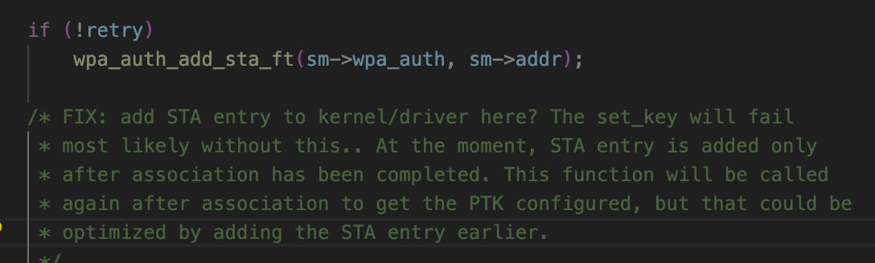
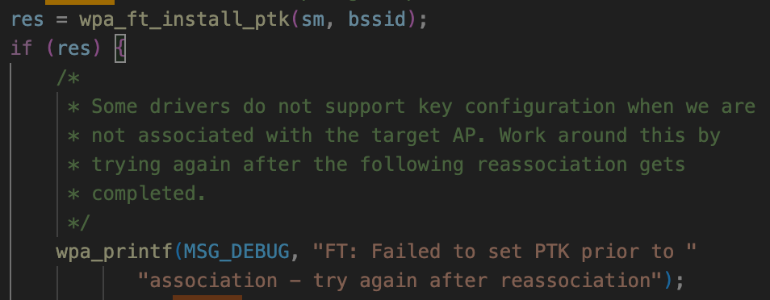
Proposed security architecture
Performance of existing baseline FT (11r) implementations
Observations from experimental results with existing commercial implementations:
  Connectivity outage during roam broadly consistent with previous results in literature, e.g. 40-70 ms (e.g. [3])
  The time for STA (host) to make roam decision based on BTM Request is significant, but not in the critical path
  Uplink traffic stops several 10s of ms before FT Reassoc exchange
    This is because typical STA drivers/supplicants suspend data path with serving AP (e.g. suspend Tx FIFO, clear A2 Rx filter, block 1X controlled port, and/or delete PTK), during process of authenticating/reassociating with the target AP
      This is not required by the standard – see Annex excerpts
  As expected, serving AP maintains PTK (and active interface) until (after) the roam is complete
  Traffic with target AP does not begin until ADDBA exchanges are complete, however ADDBA signaling overhead per-se does not dominate the delay (from Reassoc Resp until first data frames)
    Note – the time taken for host to install key in driver/hardware can be significant. Some host implementations attempt to install the key as soon as FT Authentication is complete (i.e. prior to reassociation), but this is not supported by many existing drivers (e.g. see open-source examples below of host FT key installation functions)
With minor STA-side optimizations, outage is reduced to ~12 ms (half of which is due to ADDBA setup) and can be optimized further
With optimized implementations, the perception of FT as “non-seamless” (e.g. [4]) would not exist
hostapd
wpa_supplicant

Slide 11
Proposed security architecture
Proposed enhancements to FT protocol for UHR
(1) To allow all roam exchanges to occur without the non-AP MLD necessarily going off-channel (when serving and target AP MLDs have links on different channels)
  Extend FT OTDS to allow FT Reassociation Request/Response frames to also be sent over-the-DS to the target AP MLD
    Since both Auth and Reassoc frames would be encapsulated in FT Action frames, complete fingerprinting privacy is provided
    Allow OTDS Reassoc Response to also be duplicated OTA by target AP MLD
      to avoid stranding non-AP MLD if link with serving AP MLD fails during the exchange (i.e. non-AP MLD moves to target AP MLD’s channel)
    Consider allowing deferral of DS data path mapping, and loss of assoc to serving AP MLD, until a direct OTA exchange with target AP MLD is complete
      to avoid stranding non-AP MLD if link quality with target AP MLD has not yet been confirmed and is too weak
  Consider extending FT OTDS to (optionally) allow (ML) Probe Request/Response exchange with target AP MLD to be encapsulated in FT Action frames (possibly in separate frames, or bundled with FT Authentication request/response).
    Note: In general, non-AP MLD needs contents of Probe Response (or Beacon(s)) of candidate target AP MLDs to make roam decision (*)
    Note: Implementations might still prefer to go off-channel to obtain RSSI for link quality scoring (using on-channel active/passive scan)
  Note: Can reuse existing RRB transport used for FT Authentication frames in baseline FT OTDS
Baseline FT OTDS
UHR FT Auth+Reassoc OTDS
AP MLD2
s4
s4
non-AP MLD
s2
s2
AP MLD1
FT Auth
FT Reassoc
FT Auth
FT Reassoc
(tunneled) probe
(*) e.g. BSS Load, WAN metrics, BSS Membership Selectors, VSIEs, ...

Slide 12
Proposed security architecture
Proposed enhancements to FT protocol for UHR [2]
(2) To ensure implementations maintain an active dath path throughout the roam procedure
  UHR non-AP MLD is required to maintain the existing PTKSA with serving AP MLD until (at least) the time that reassociation with target AP MLD completes
    UHR non-AP MLD should also maintain active data flow (Tx FIFO, packet filters, 1X port, etc) with serving AP MLD during this time
    If “buffered data delivery” data path is defined, PTKSA with serving AP MLD would be maintained until this is complete (see later slides)
  UHR AP MLD and non-AP MLD implementations should install PTK in driver ready for use as soon as it is derived (after FT Auth)
  After roam, data path should be unblocked even if exchanges to improve performance (e.g. sounding) are still pending completion
(3) To provide fingerprinting privacy with OTA (or baseline-style OTDS) FT
  Define a dedicated FT Privacy Key (e.g. PTK-FTPRIV), which is solely used to protect unicast pre-association management frames sent by the non-AP MLD to AP MLDs in the MD (such as OTA FT Auth/Reassoc)
    e.g. extracted from R0-Key-Data (along with PMK-R0), or extracted from PTK, during FT Initial MD association
    FT Privacy Key is always used with AES-SIV and is shared across mobility domain (e.g. can be distributed by R0KH along with PMK-R1s)
    Note: AES-SIV (RFC 5297) is nonce-misuse resistant (it is already used in 802.11 to encrypt parts of FILS Reassociation frames)
    Non-AP MLD incorporates a fresh nonce in the AAD for each exchange using the key to avoid tracking if the data payload happens to be the same
  Note: As mentioned earlier, we cannot assume the OTDS mechanism on previous slide can always be used
    e.g. if link quality to serving AP is already poor/nil when roam trigger occurs (see diagram in Annex), or if non-AP MLD is anyway going off-channel to obtain RSSI
  Note: For privacy protection of the Initial MD association, mechanisms being defined in 11bi might be used
(4) To avoid increasing the number of frame exchanges during a roam
  Define extensions to existing FT Authentication frames (OTDS and OTA) that can initiate a Context Exchange (see later slides)
  Note: Protection of these frames (as discussed above) also prevents DoS attacks on Context Exchange
(5) To further reduce the number of frame exchanges for a roam
  Consider schemes to bundle FT Auth Req/Resp and Reassoc Req/Resp (with MICs), e.g. into 3 frames similarly to PASN

Slide 13
Proposed security architecture
Concerns with other proposals of sharing PTK across network
A number of other submissions have proposed sharing the PTK across AP MLDs in the network
  Several concerns with that approach are highlighted in these slides:
(A) Regression in key hygiene / key separation
  In FT (and, indeed, all RSN mechanisms in baseline), there is a clear key hierarchy, and a PTK is a pairwise secret (between a given AP MLD and non-AP MLD)
    If a PTK is compromised, there is no impact on security of the connection between the non-AP MLD and any other AP MLD
    Note: PTKs are designed as short-term pairwise secrets because they directly encrypt traffic sent over the air, and therefore are particularly vulnerable to attack
    PTK sharing is not comparable to PMK Caching - since PMK is a key-generating key, not an encryption key
      also note in 802.11, PMK caching is only defined for use with the same AP MLD (so-called OKC is proprietary)
    Note: A PMK-R1 (which, if somehow compromised, could also compromise PTK if nonces / addresses are captured) is known by only three parties (target AP MLD, non-AP MLD, and R0KH), and transport over DS is assume secure
  On the contrary, in other proposals in which it is suggested the same PTK is used as a non-AP MLD roams across many AP MLDs in the network, knowledge of the PTK (and PMK) is shared by many parties
    In a “push” model, N + 1 entities know the PTK, where N is # AP MLDs in the “seamless roaming” domain
    In a “pull” model, M +1 entities know the PTK, where M is # AP MLDs that non-AP MLD connects to during PTK lifetime
  This increases the attack surface and risk, for PTK to be compromised by some implementation vulnerability
    Such vulnerabilities might be related to over the air transmissions between the non-AP MLD and any AP MLD, or might be related to the transport and/or synchronization between all the AP MLDs with which the PTK is shared
    Important aspects of this attack surface are not mitigated by more frequent rekeying outside of roam procedures
  Note: PTK compromise allows the attacker to passively decrypt, or actively inject or modify packets
    e.g. see Appendix A “Importance of Uniqueness Requirement on IVs” of NIST SP 80038D [5]

Slide 14
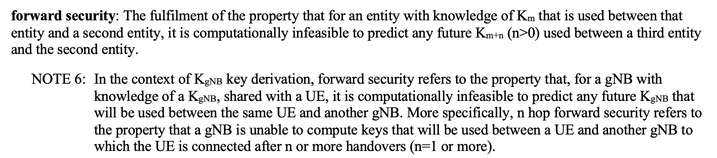
Proposed security architecture
Concerns with other proposals of sharing PTK across network [2]
(B) Regression in competitive positioning with respect to alternative technologies
  3GPP defines concept of “forward security” for roaming (aka handover) in 5G RAN (see [6] and Annex slide)
  Data plane encryption key K_{UPenc} (equivalent to TK component of PTK) is derived by KDF from base-station specific key K_{gNB} (roughly equiv. PMK-R1)
    K_{UPenc} is a pairwise secret between ME (equiv. non-AP MLD) and gNB (equiv. AP MLD)
    K_{gNB} is a pairwise secret between ME and AMF (within core network; for initial connection) or source gNB (for handover)
  For “vertical” handover, new K_{gNB} is derived (via intermediate key NH) from root key K_{AMF} (equiv. PMK-R0)
    K_{AMF} is a pairwise secret between ME and (source) AMF
    NH is a secret of three parties – ME, AMF and source gNB
    Provides “forward security” for K_{gNB} – i.e. if a K_{gNB} is compromised, all other past and future K_{gNB} are still secure
  For “horizontal” handover, new K_{gNB} is derived by KDF from previous K_{gNB}
    Does not provide full “forward security” for K_{gNB}, although an older K_{gNB} can’t be derived from a compromised newer K_{gNB}
  In both handover cases, K_{gNB} (and, therefore, the encryption key K_{UPenc}) is unique after each handover
    “PTK sharing” (i.e. sharing of K_{UPenc}) is never used, so no issues with nonce reuse across multiple handovers
    “PMK sharing” (i.e. sharing of K_{gNB}) across base stations is never used either
  Handover security properties have been the subject of significant academic research studies, e.g. see [7]

Slide 15
Proposed security architecture
Concerns with other proposals of sharing PTK across network [3]
(C) Complexity and slow roams with existing FT deployments in mixed-technology networks
  Network deployments with mixed-technology APs (UHR and non-UHR) are likely to exist
  Since FT is already widely deployed, it is expected it will continue to be used – both for legacy (non-UHR) STAs / non-AP MLDs, and also for UHR non-AP MLDs when connecting to non-UHR APs in the network
  In an FT-based seamless roaming design, the UHR FT enhancements (e.g. tunneled OTDS, context exchange triggers) can be used seamlessly together with legacy FT operations in the same MD
  However, in a “shared PTK” design – assuming it uses a separate (non-FT) key hierarchy and AKM – separate full authentication procedures for UHR and FT would be required
    Implies roam performance degradation when the second key hierarchy is established, e.g. see figure below
    Also requires STA to maintain both key hierarchies
UHR key distribution (UHR domain)
Initial connection at (1)
- “Shared PTK” initial assoc
Roam 1➔2
- FT Initial Mobility Domain assoc
Roam 2➔3
- FT protocol roam
Roam 3➔4
- “Shared PTK” roam
Roam 4➔1
- “Shared PTK” roam
context exchange
UHR AP MLD1
UHR AP MLD2
Initial connection
1
4
non-AP MLD
2
3
non-UHR AP MLD3
non-UHR AP4
Roam 1➔ 2 is a “slow” procedure including 4-way handshake
FT key (PMK-R1) distribution (FT domain)

Slide 16
Proposed security architecture
Concerns with other proposals of sharing PTK across network [4]
(D) Risk of nonce reuse from flawed PN context exchange or management across AP MLDs
  In order to use the same PTK across all AP MLDs, the PTKSA needs to be included in the context exchange
  It is essential that the IV/nonce (i.e., for GCMP, A2 || PN) is never reused with the same PTK
    Note: A2 is the TA (or the MLD address for unicast frames between MLDs)
    This means a given MLD must never reuse a PN with the same PTK
    Note: Nonce reuse with GCMP can allow attacker to decrypt, replay and bidirectionally forge packets
  In the uplink, it can be assumed the non-AP MLD implementation avoids PN reuse for the entire PTK lifetime
  However, in the downlink, when a roam occurs back to the same AP MLD as used previously, PN reuse in downlink must be strictly avoided since A2 will return to the same value as before. This implies one of the following:
    the AP needs to maintain state of previously used PN ranges with a given PTK, even after non-AP MLD roams away, or
    the PN needs to be synced/transferred across AP MLDs as part of context exchange, e.g.
      “last PN” is transferred, and first PN used by next AP MLD is equal to {last PN + N}, or
      part of PN space is assigned to a “roam counter”, which is transferred and incremented on each roam
  Any of these approaches are particularly fragile to imperfect implementations, e.g.
    e.g. synchronization race conditions, improper coordination, loss/reset of state due to power outage/crash
    compare to baseline (per-UHR) case where a single entity is responsible for avoiding PN reuse and handling rekeying
    some examples are shown on next slides
It can be expected security researchers will stress test 11bn implementations to try to find vulnerabilities
  In general, there is an expectation that new versions of technologies improve security, and certainly avoid regressions in security properties

Slide 17
Proposed security architecture
Concerns with other proposals of sharing PTK across network [5]
  Some examples of potential nonce reuse fragility are shown on the next slides
    Note: These are a limited set of examples. A design that addresses these particular cases is not necessarily robust against other similar-but-different scenarios or attacks
  For the purpose of these examples, some assumptions are made on signaling/design using a shared PTK:
    Non-AP MLD can initiate roam by signaling to either
    (a) Serving AP MLD or (b) Target AP MLD
    In case (a), Context Exchange (CX) is included with tunneled add link request to target AP MLD, and acknowledged by target AP MLD in the response
    In case (b), a context exchange request is included with tunneled delete link request to target AP MLD, and CX is included with tunneled delete link response
Roam Request/Response (e.g. UHR Add Link Reconfig)
Roam Request/Response tunneled over DS between AP MLDs
Context Exchange (CX) [includes PN for shared PTK]
Downlink data path
Uplink data path
X
Downlink PN = X
LLC XID to DS (update switch port mapping for non-AP MLD)
Each CX exchange is referenced to a (unique/random) RoamID in tunneled Request and Response over the DS
If CX is not completed, Add Link Resp. status = failure
On each roam, downlink PN in CX is equal to last used PN + N (where value N might be large)
Note: These assumptions are based on a design that tries to mitigate/avoid basic nonce reuse issues
AP MLD2
Assumed AP MLD1➔AP MLD2 Roam signaling for shared PTK
TUN{AddLinkReq(MLD2)}
CX(PN)
RoamID
TUN{AddLinkResp(MLD2, SUCCESS)} RoamID
AddLinkReq(MLD2)
DelLinkReq(MLD1)
AddLinkResp(MLD2, SUCCESS)
DelLinkResp(MLD1, SUCCESS)
non-AP MLD
AddLinkReq(MLD2)
DelLinkReq(MLD1)
AddLinkResp(MLD2, SUCCESS)
DelLinkResp(MLD1, SUCCESS)
TUN{DelLinkReq(MLD1)}
CXReq
RoamID
TUN{DelLinkResp(MLD1, SUCCESS)}
CX(PN)
RoamID
AP MLD1
(a) via Serving AP
(b) via Target AP

Slide 18
Proposed security architecture
Concerns with other proposals of sharing PTK across network [6]
  Nonce reuse fragility: Example (1)
    “Delayed / out-of-order CX”
    Non-AP MLD initiates roam by signaling to Target AP MLD (AP MLD2)
    AP MLD2 requests CX from serving AP MLD1
    However, the CX response is delayed on the DS, so AP MLD2 does not respond to non-AP MLD (or sends Failure response)
    In the meantime, while processing the DelLinkReq, AP MLD1 sent a few more packets to non-AP STA that were already queued for delivery
    Non-AP MLD tries the roam again
    This time, AP MLD2 requests and receives CX from AP MLD1 (with slightly increased PN), sends Success response to non-AP MLD, roam completes, and sends DL frames using new PN
    Shortly after, the original delayed CX response is received by AP MLD2
    AP MLD2 incorrectly accepts and updates the current PN with the PN in the delayed CX, since it did not internally invalidate the original RoamID in time. This causes subsequent packets to be sent using nonce that was used a few packets earlier (PN=105+N, ...)
AddLinkReq(MLD2)
DelLinkReq(MLD1)
TUN{DelLinkReq(MLD1)}
CXReq
RoamID=1
TUN{DelLinkReq(MLD1)}
CXReq
RoamID=2
AddLinkResp(MLD2, SUCCESS)
DelLinkResp(MLD1, SUCCESS)
Switch (on DS)
AP MLD2
105+N
100+N
non-AP MLD
AP MLD1
0
100
105
TUN{DelLinkResp(MLD1, SUCCESS)}
CX(PN=100+N)
RoamID=1
TUN{DelLinkResp(MLD1, SUCCESS)}
CX(PN=105+N)
RoamID=2

Slide 19
Proposed security architecture
Concerns with other proposals of sharing PTK across network [7]
  Nonce reuse fragility: Example (2)
    “Ping-pong roam race condition”
    Non-AP MLD roams from AP MLD2 to AP MLD1
    Some time later, non-AP MLD initiates roam to AP MLD2 by signaling to Serving AP MLD (AP MLD1)
    Before Serving AP MLD1 has processed the request, the non-AP MLD changes its mind due to RSSI change and sends request to the Serving AP MLD to return back to AP MLD1
    The first request causes AP MLD1 to send CX to AP MLD2, while the second request causes AP MLD2 to request CX from AP MLD1. These two messages are received by AP MLD2 about the same time. AP MLD2 sends CX back to AP MLD1 containing the same PN as when the prior roam happened (i.e. without having yet updated its internal PN based on the incoming CX).
    AP MLD1 receives the CX, sends success response back to non-AP MLD, and updates its PN based on the CX.
    When AP MLD1 continues sending packets to non-AP MLD, it reuses nonce values that it used when the non-AP MLD first roamed to it.
TUN{AddLinkReq(MLD2)}
CX(PN=100+2N)
RoamID=1
TUN{DelLinkReq(MLD2)}
CXReq
RoamID=2
TUN{DelLinkResp(MLD2, SUCCESS)}
CX(PN=50+N)
RoamID=2
Switch (on DS)
AP MLD2
50
0
non-AP MLD
AP MLD1
50+N
100+N
50+N
AddLinkReq(MLD2)
DelLinkReq(MLD1)
AddLinkReq(MLD1)
DelLinkReq(MLD2)
AddLinkResp(MLD1, SUCCESS)
DelLinkResp(MLD2, SUCCESS)

Slide 20
Proposed security architecture
Concerns with other proposals of sharing PTK across network [8]
  Nonce reuse fragility: Example (3)
    “Distributed responsibility for rekeying”
    Non-AP MLD has been connected to AP MLDs in the network for some significant period of time, and the PN has reached some large value L
    The AP MLDs in the network are configured with a consistent threshold for PN exhaustion warning (dot11PNWarningThreshold), which triggers them to initiate a PTK rekey
    Non-AP MLD initiates roam from AP MLD1 to AP MLD2 just before the warning threshold PN value is reached
    The PN value exactly equal to the warning threshold is used by AP MLD1 to deliver already-buffered packets. Since AP MLD1 has already sent CX to AP MLD2, it assumes AP MLD2 will handle rekeying.
    However, the first PN value used by AP MLD2 (incremented by N) is already greater than the threshold and does not trigger AP MLD2 to rekey either
    As a result, the APs continue to increment the PN until it wraps around, resulting in nonce reuse when non-AP MLD roams back to the same AP MLD it used on first connection
AddLinkReq(MLD1)
AddLinkResp(MLD2, SUCCESS)
Switch (on DS)
PN=dot11PNWarningThreshold
AP MLD2
L+50
L+90
L+150
L
non-AP MLD
AP MLD1
L+50+N
0
TUN{AddLinkReq(MLD2)}
CX(PN=100+2N)
RoamID=1
TUN{AddLinkResp(MLD2)}
RoamID=1
PN>dot11PNWarningThreshold

Slide 21
Roaming procedures and context exchange
.... but you said (FT) “reassociation”!
In other submissions, various rationales have been discussed for “avoiding reassociation”:
  (1) connectivity outage due to delays in security key derivation
  (2) connectivity outage due to delays from internal implementation procedures to establish association
  (3) connectivity disruption (e.g. QoS impact) due to overhead/delays in re-establishing pairwise state (e.g. BA agreements, SCS, ...) and/or handling buffered data at serving AP MLD
As discussed in earlier slides, FT reassociation protocol provides continuity in state 4 association
  with optimized implementation, (1) and (2) above occur in parallel with existing connection to the serving AP
  however, there is potential benefit in a “context exchange” to avoid disruption due to (3) above
FT reassociation is compatible with context exchange by simple changes to reassociation rules
  i.e. in 11.3.5.4, the list of “states, agreements, and allocations [that] shall be deleted or reset to initial values” would be modified such that parameters exchanged in the context exchange would instead be maintained
Note: Our understanding is that, in other submissions that have proposed use of ML Reconfiguration mechanisms, it is not intended that links of serving and target are considered part of the same MLD (e.g. see [8])
  For example, fundamental MLO concepts (e.g. STR/eMLSR, TID-to-link mapping, common MAC-SAP) do not apply across links of the serving and target AP MLDs, so usage of “add/delete link” concepts would need clear definition to avoid confusion
  This is a good assumption since the non-colocated APs in most deployments are lightly-coupled over an imperfect backhaul (unlike affiliated STAs/APs of an MLD which have tight coupling in hardware/driver)
Note: Since Link Reconfiguration Request/Response frames for Add Link contain a Per STA Profile consisting of all elements/fields that would be in a Reassociation Request/Response frame, it is essentially equivalent to FT Reassociation frames with the proposed UHR enhancements

Slide 22
Roaming procedures and context exchange
Data plane – “buffered data delivery”
Post-roam retrieval of already-buffered DL data from serving AP MLD to non-AP MLD has been proposed as a way to achieve zero-packet loss on roam
  Simpler network implementation - does not involve transferring already-buffered data between AP MLDs over DS
In general, this retrieval can have a deleterious impact on already-established link with target AP MLD
  non-AP MLD may need to suspend ongoing DL/UL data exchanges with target AP MLD in order to retrieve DL data from (previously) serving AP MLD
  in some use cases, “old” packets may no longer be useful to the higher layers (see later slide)
  therefore, the net benefit of zero-packet loss is use case specific, so the non-AP MLD must have the option to obtain, or not obtain, any buffered data for a given TID/AC
    If the non-AP MLD does not want the buffered data, the serving AP MLD should not try to send it
Design should include:
  Signaling within roam exchanges to indicate buffer state at serving AP MLD (i.e. if buffered data exists)
  Signaling of remaining buffer state during data delivery (e.g. so non-AP MLD knows when it has received all data)
  Consider frame exchanges to assist concurrent operation by multi-radio non-AP MLDs
    Note: The affiliated APs of source and target are not part of the same MLD; therefore MLO features (e.g. STR, eMLSR,
    cross-link PM) cannot be used per-se across the two links
  Definition of class 3 frames that can be transmitted in this state: DL Data (unicast only?), BA, mgmt?
  Security (e.g. PN) management (see earlier slides)
    Note: In FT-based design, buffered data would be sent using serving AP MLD’s PTK and PN space.
    Note: In “Shared PTK design”, buffered data would be sent by serving AP MLD using a separate PN counter from the data sent by target AP MLD. Therefore, in either case, separate replay detection counters will be needed for the two connections

Slide 23
Roaming procedures and context exchange
Control plane context exchange
Block ACK agreements
  Experimental results (see earlier slides) indicate that ADDBA exchanges take a few ms to start, and then take a few more ms to complete, and this is the dominant cause of outage in an optimized (FT-based) design
    Data transfer does not start (or is inefficient) until ADDBA exchanges complete
  A ‘simple’ form of Block ACK agreement context exchange involves simply exchanging the existence of, and semi-static parameters of, the Block ACK agreements for each TID
    i.e. fields in ADDBA’s Block Ack Parameter Set field (TID, Block Ack Policy, Buffer Size, etc), BA Timeout
    Various low-complexity design options exist for this context exchange, e.g.
      lightweight context exchange over DS, OR
      lightweight context transfer from non-AP STA (e.g. within protected FT Auth or Reassoc Req/Resp frames), OR
      implicit setup with default (mandatory-support) parameters – can be “upgraded” later [no explicit transfer needed]
    In this simplest design, dynamic parameters (e.g. WinStartR/B, WinEndR/B, scoreboard) would be reset
      The next slides show impact of this on retransmission, duplicate detection, and in-order delivery functions
        assuming “buffered data delivery” path described on previous slide
      Note: The in-order delivery requirement per TID applies at the 802.11 layer; especially in uplink, it is practically impossible to guarantee in-order delivery across the DS or end-to-end (see later slide)
    Note: This is essentially the same as establishing new BA agreement with target AP MLD, however it avoids explicit signaling and the internal setup procedures on target AP MLD can be in initiated in advance

Slide 24
Roaming procedures and context exchange
Control plane context exchange [2]
DOWNLINK TID example
server: packets: 1, 2, 3, 4, 5, 6, 7, 8
packets: 1, 2, 3, 4
switch
packets: 5, 6, 7, 8
Packet index | SN | Status
4 | 104 | ✅
3 | 103 | ❌
2 | 102 | ❌
1 | 101 | ✅
Packet index | SN | Status
8 | 3 | ✅
7 | 2 | ✅
6 | 1 | ✅
5 | 0 | ✅
AP MLD1
DS
AP MLD2
Packet index | SN | Status
4 | 104 | ✅
3 | 103 | ✅
 | 102 | ❌
1 | 101 | ✅
non-AP MLD
Packet index | SN | Status
8 | 3 | ✅
7 | 2 | ✅
6 | 1 | ✅
5 | 0 | ✅
Retransmissions
  Retransmission of DL packets from serving AP MLD1 (i.e. packet index 2) is handled by “buffered data delivery” path
Duplicate detection
  There is no issue with duplicate transmission of the same DL packets by AP MLD1 and AP MLD2, since DS forwards a given packet to one AP MLD or the other; therefore, duplicate detection (e.g. packet 3) can be handled for each AP MLD separately
In-order delivery
  Packets sent by DS to AP MLD1 are all older than packets sent by DS to AP MLD2; therefore non-AP MLD can ensure in-order delivery by delivering all packets from AP MLD1 (1 thru 4) to higher layers [unless those packets reach retry/lifetime limits, or non-AP MLD “gives up” on the packets] prior to delivering any packets from AP MLD2
Note: “Packet index” is simply an index that indicates the order of the packets sent by higher layers (it does not refer to PN)

Slide 25
Roaming procedures and context exchange
Control plane context exchange [3]
server
UPLINK TID example
Packet index | SN | Status
4 | 104 | ✅
3 | 103 | ✅
2 | 102 | ❌
1 | 101 | ✅
switch
Packet index | SN | Status
8 | 3 | ✅
7 | 2 | ✅
6 | 1 | ✅
5 | 0 | ✅
AP MLD1
DS
AP MLD2
Packet index | SN | Status
4 | 104 | ✅
3 | 103 | ❌
2 | 102 | ❌
1 | 101 | ✅
non-AP MLD
Packet index | SN | Status
8 | 3 | ✅
7 | 2 | ✅
6 | 1 | ✅
5 | 0 | ✅
Retransmissions
  If a UL packet is not Ack’d by AP MLD1 (e.g. packet 2), the non-AP MLD re-sends it “fresh” (new SN/PN) to AP MLD2
Duplicate detection
  There is a small risk of undetected duplicates, e.g. non-AP MLD might re-send packet 3 to AP MLD2 because the Ack from AP MLD1 was not received; resulting in both AP MLDs forwarding the packet to the DS (although STAs could do the same today)
In-order delivery
  Option 1: Regular behavior by AP MLD1 (i.e. packets 3-4 will not be forwarded to DS because packet 2 is pending retransmission). Non-AP MLD freshly re-sends all packets that are ahead of any un-Ack’d packets to AP MLD2 (i.e. packets 2-4)
  Option 2: AP MLD1 releases packets ahead of any un-Ack’d packets (i.e. packets 3-4) once roam completes, then signals (over DS) to AP MLD2 that it can release newly received packets to the DS; non-AP MLD drops earlier un-Ack’d packets (packet 2)

Slide 26
Roaming procedures and context exchange
Control plane context exchange [4]
  A slightly more advanced form of Block ACK agreement context exchange additionally involves transferring WinStartB for each uplink TID in real-time (e.g. when FT Reassoc Req received)
    This has the same properties as on previous slide, but allows non-AP MLD implementations to continue to use already-allocated SN values for MSDUs in transmit queue
  The most ‘advanced’ form of Block ACK agreement context exchange involves also transferring the current scoreboard, and all WinStart/End values, maintained at AP MLD for each TID
    This could help avoid the small possibility of UL duplicates
    However, it would not help with either of the following issues:
      end-to-end out-of-order DL delivery if the switching of DS data interface from AP MLD1 to AP MLD2 is “glitchy”
        i.e. if some packets the DS forwards to AP MLD2 are older than some packets the DS forwards to AP MLD1
        since SN assignment at each AP MLD is based on order of arrival of MSDUs at that AP MLD, the order of packets in terms of SN might not be the same as the original order of packets from the source
      inefficiencies in ensuring UL in-order delivery to the DS (see previous slide)
        e.g. even if non-AP MLD retransmits packet 2 to AP MLD2 using the original SN (102) and the full BA context is shared, it would require real-time coordination between the two AP MLDs to ensure AP MLD2 forwards packet 2 to the DS prior to AP MLD1 forwarding packets 3-4 to the DS
          in cases where the scoreboard has multiple holes, the two APs would need to coordinate to round-robin forward MSDUs to the DS in SN order, which would be extremely inefficient
        ... and even if this could be done, it would not necessarily ensure end-to-end in-order UL delivery since the DS paths from AP MLD1 and AP MLD2 to the gateway may have different delays
    In addition, full BA context exchange implies need to suspend the uplink data path while it is transferred
      The goal should be to avoid significant data outage during roam, even if the probability of UL packet duplication of out-of-order delivery to the gateway is slightly increased
Note: WinStartB of UL TID is the SN of the first MSDU not yet successfully received (and so not yet passed up to DS)

Slide 27
Roaming procedures and context exchange
Control plane context exchange [5]
SCS
  Although current use of SCS is still limited, it can be assumed it will be one of the key techniques used with UHR to negotiate QoS treatment; hence disruption to QoS-sensitive flows might occur if there is a delay in re-establishing SCS state after roam
  SCS parameters are semi-static so can be transferred OTDS with minimal downside
    e.g. any changes to SCS agreements after a context exchange has been initiated would be lost
MSCS
  Similar considerations to SCS
  Should allow current derived MSCS rules (IP tuple->UP) at serving AP MLD to be transferred to target AP MLD, in addition to the (semi-static) contents of MSCS Descriptor
Other TID assignment policies (e.g. based on DPI – might be transferred in proprietary manner)
  It should be noted that if (for whatever reason) TID assignment of packets is different on serving and target AP MLDs, then any attempts to preserve the TID’s state (e.g. Block Ack agreement) would be futile
TWT
  Maybe nice-to-have in theory, but complex to transfer synchronized timing state, and may need renegotiation (e.g. conflict with existing TWT agreement at target AP MLD)
  Less impactful on link performance even if TWT agreements are not transferred and need to be reestablished

Slide 28
Roaming procedures and context exchange
Data plane – data transfer across DS
A potential alternative approach to data plane “buffered data delivery” from serving AP MLD is for the already-buffered DL data to be transferred from serving AP MLD to target AP MLD over the DS, and then transmitted by target AP MLD after the roam
This is already (theoretically) a network implementation option today, i.e.
  serving AP MLD gathers MSDUs from its Tx buffers, send over some secure data tunnel on DS between AP MLDs (or via controller), and target AP MLD transmits
Some optimizations could be possible to ensure in-order DL delivery
  i.e. by also transferring (more of) the Block Ack context
Unlikely for mass-market adoption, but could be attractive in certain deployments e.g. enterprise
  Higher AP MLD implementation complexity: Implementation involves multiple data queues at different levels of the stack (e.g. within OS kernel, driver, hardware, etc). Extracting buffered data from those queues in order to transfer it to another AP MLD is non-trivial
  Implies secure data paths need to be established pairwise between every AP MLD in the network, or data is sent via a central controller with additional backhaul and processing overhead
Note: Any data transfer is likely to be of MSDUs (or possibly plaintext MPDUs), not encrypted MPDUs
  Most buffered data is within larger OS kernel queues
  Most AP MLD implementations perform MPDU encryption in hardware immediately prior to transmission
    Note: While certain network architectures currently use centralized encryption engines, these are not in the majority and on-chip encryption is expected to become even more dominant as data rates continue to increase
Should remain an implementation option without requiring significant formal support in the standard

Slide 29
Roaming procedures and context exchange
Data plane – general considerations
Considerations on the utility of DL data that is buffered at serving AP MLD
  In non-real-time use cases (e.g. downloads, buffered audio/video), the buffered data might often be usable by the application, but it might be more efficient for the packets to be dropped and higher-layer retransmissions (e.g. TCP, QUIC) be invoked
    However there may be exceptions - e.g. on end-to-end links with high bandwidth-delay product, or highly constrained northbound links, the impact of TCP congestion window collapse due to dropped packets could be significant
  In real-time use cases (e.g. conversational or XR audio/video), the buffered data might be “stale” due to newer data already being transferred with the target AP MLD
    For example, if an application is already about to render a new video frame based on new data, the previous frame corresponding to the buffered data has already been skipped so the data is now useless
    However there may be exceptions - e.g. if the buffered data contains a video I-frame, it may be needed to render subsequent P-frames
  The net gains of supporting retrieval of already-buffered data should be assessed
In-order delivery requirements across a roam need to be carefully considered
  At least for some applications, it would be undesirable and counter-productive to delay delivery of new packets from target AP MLD until the transfer of buffered data is complete
  Out-of-order delivery to higher layers might be necessary for the application to determine whether or not it is beneficial to actually receive the older buffered data

Slide 30
Summary
All requirements for seamless roaming can be achieved using FT protocol as the base framework, without compromising performance, by defining straightforward protocol/behavioral extensions
  alternative approaches based on PTK sharing across AP MLDs represent a significant security risk
There are several benefits to reusing FT protocol
  Avoid regression in security characteristics and concerns on new attack vectors
  Extensible existing signaling (e.g. to trigger context exchange)
  No need to define new concepts such as “SMD association”, “non-collocated” or “virtual” AP MLDs, add/delete link pertaining to a different AP MLD, or make changes to addressing
  Seamless integration of UHR roaming into existing mixed-technology FT networks
Considerations regarding context exchange (in control and data planes) have been described
  Overall, there are clear benefits for transfer of certain control-plane states (e.g. SCS, static BA parameters)
  The pros/cons of serving buffered data delivery (zero packet loss) are highly use case specific
    A relatively simple design can be envisaged, although further studies are needed to orientate design details
  Whenever there is a trade-off between outage / latency and packet loss / out-of-order delivery, non-AP MLD should be able to specify the context exchange behavior based on application requirements on per-TID basis
Overall roaming design should also aim to enhance:
  Timeliness of triggering a roam prior to link with serving AP MLD becoming bad
    AP MLD or non-AP MLD initiated, AP MLD’s always-on monitoring should assist power-constrained non-AP MLD
  Delay between roam trigger and roam completion
    Including scan time, particularly if non-AP MLD needs to interrupt link with serving AP MLD to do off-channel scan

Slide 31
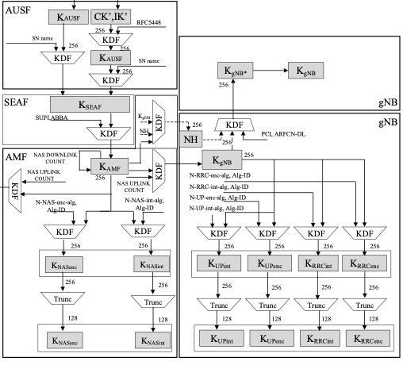
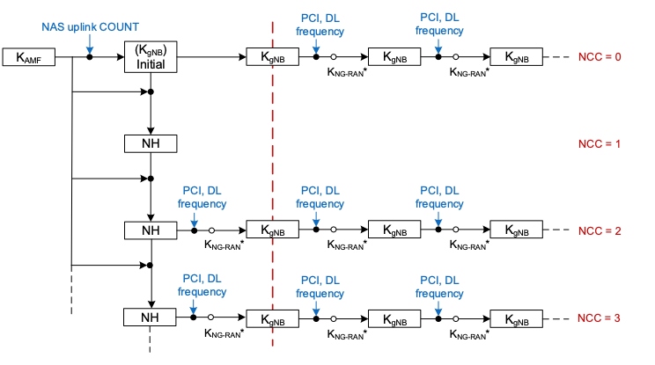
Annex: 3GPP 5G handover key handling
horizontal handover
vertical handover
(from [6])

Slide 32
Annex: Roaming trigger challenge
AP1 [p]
6 GHz
AP2 [t]
6 GHz
STA
STA
2.4GHz
2.4GHz
2.4GHz
AP3
6 GHz
A STA in mobility can rapidly move out of coverage of serving AP (depending which bands it has active links with)
Since it cannot always be guaranteed a clear roam target can be determined while the link quality with serving AP remains good, there is a need to support both OTDS and OTA mechanisms

Slide 33
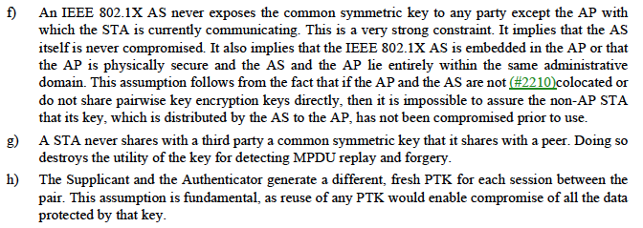
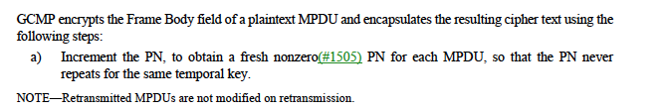
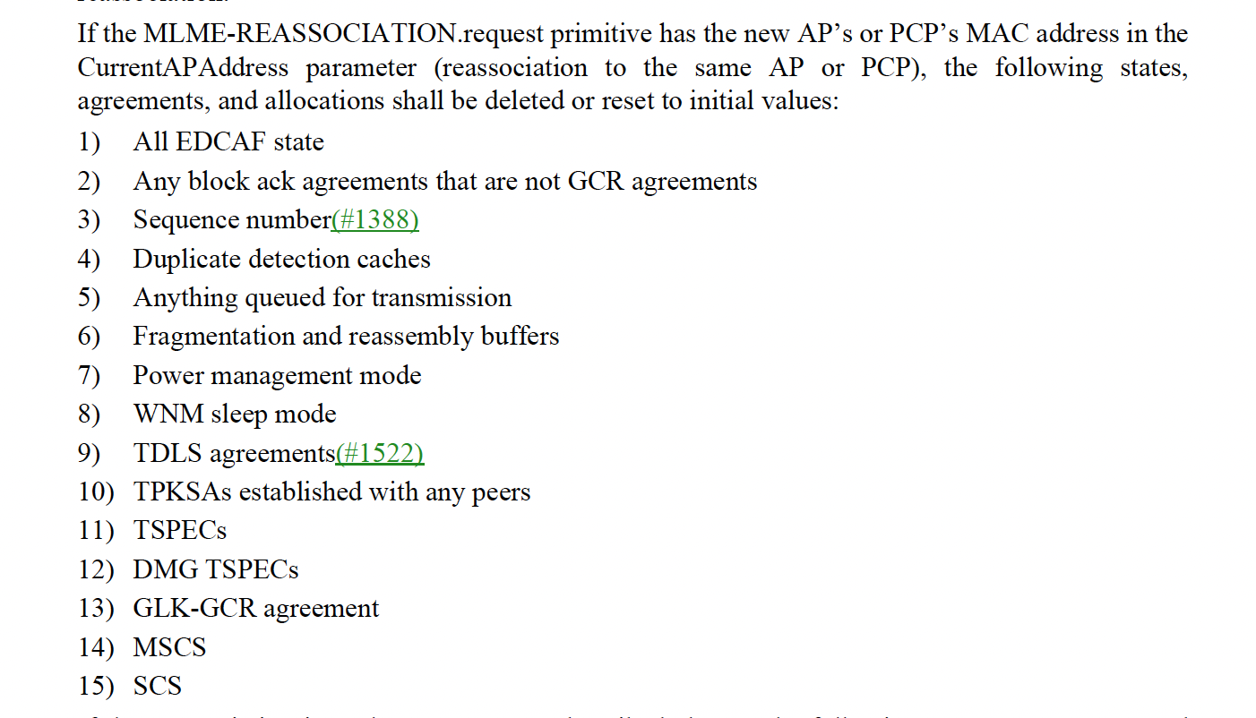
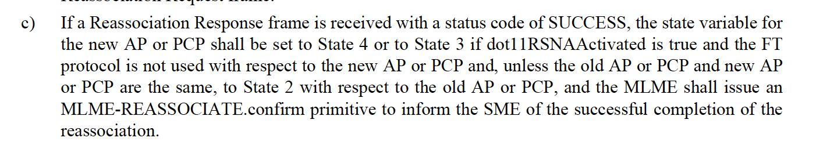
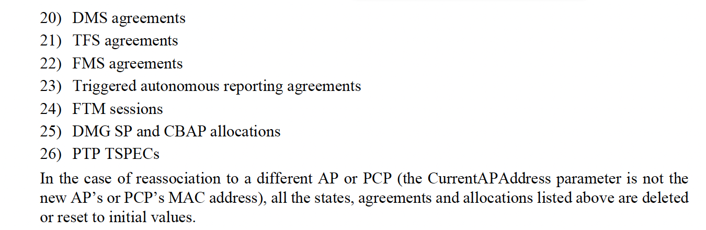
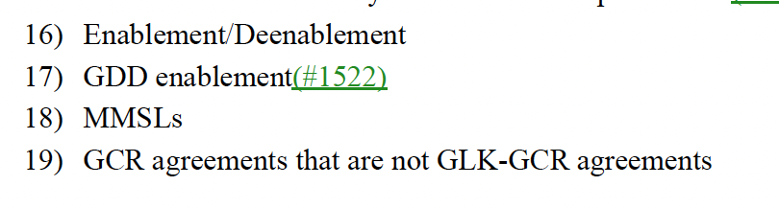
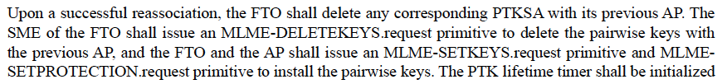
Annex: Relevant excerpts from REVme D5.0
(12.2.5)
(12.5.4.3.1)
(11.3.5.4)
(12.3.5.4)
(13.7.1)

Slide 34
References
[1] IEEE 802.11-23/1884r2 Seamless Roaming SPs, D. Ho et al, Jan 2024
[2] IEEE 802.11-23/2157r2 Seamless Roaming within a Mobility Domain, B. Gupta et al, Nov 2023
[3] Performance Study of Fast BSS Transition using IEEE 802.11r, S. Bangolae et al, 2006
[4] IEEE 802.11-23/1908r2 Seamless Roaming Procedure, Y. Yoon et al, Nov 2023
[5] NIST SP 800-38D “Recommendation for Block Cipher Modes of Operation: GCM and GMAC”
[6] 3GPP TS 33.501 V18.4.0
[7] https://people.inf.ethz.ch/rsasse/pub/5G-handover-WISEC21.pdf
[8] IEEE 802.11-24/396r0 Seamless Roaming within a Mobility Domain – Follow Up, B. Gupta et al, Feb 2024

