Slide 1
Different view problems of NPCA
Date: 2024-06-27
Authors:

Slide 2
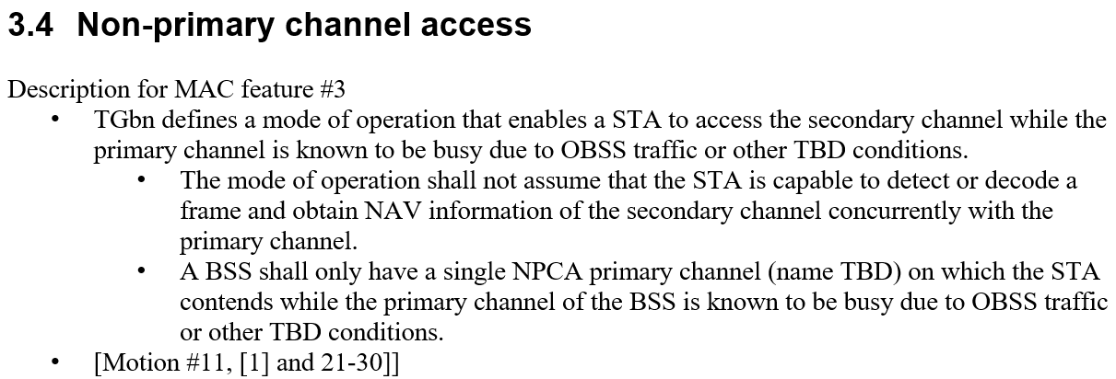
Introduction
TGbn has agreed to define NPCA
In this contribution, we discuss the different view problems of NPCA
24/209r3 (Specification Framework for TGbn)

Slide 3
Different view problems (Case 1/Case 2)
Problems from the different views on the primary channel between AP and STA [1]
  Case 1: AP side is busy, but non-AP STA side is idle
    Non-AP STA Tx to the AP on P-channel, but the AP is not on the P-channel
    AP Tx on the nP-channel, but the non-AP STA is on the P-channel
  Case 2: AP side is idle, but non-AP STA side is busy
    Same problems occur as in Case 1 with the opposite Tx direction
A solution for mitigating the problems was proposed in [2] (see APPENDIX for details)
  AP shares OBSS AP list that it detects to non-AP STAs
  A non-AP STA moves to nP-channel only when P-channel is occupied by an OBSS within the list
  AP can be sure that all non-AP STAs are on P-channel when it is on P-channel
  As a result, the solution mitigates problems regarding Case 2
  However, it appears that the solution is not effective for Case 1 (further discussed in next slide)

Slide 4
Remaining problems (Case 1)
Case 1: AP side is busy, but non-AP STA side is idle
Applying similar approaches for Case 1 may have limitations:
  Retrieving each OBSS AP list from each non-AP STA may incur overhead
  Still a non-AP STA cannot be sure that the AP is on P-channel
    Since the AP may move to nP-channel due to OBSS TXOP that is hidden from a certain non-AP STA
The same problems caused by Case 1 are already being experienced today
  APs do not respond to its non-AP STA when they see its P-channel busy
Therefore, instead of introduce a new solution for Case 1, we can define relevant rules for NPCA AP/STAs when Case 1 is occurred to mitigate the effects from the problem

Slide 5
AP’s responding rule for Case 1
An AP on nP-channel receives an initial frame from a non-AP STA still on P-channel
  The AP could partially receive the frame on nP-channel if it is carried in non-HT duplicate PPDU
  The non-AP STA might be a legacy STA which doesn’t support NPCA, or
  The non-AP STA might be a NPCA STA hidden from the OBSS occupying P-channel of the AP
  802.11 baseline doesn’t provide the rules to response to the frame partially received on nP-channel
Therefore, initial control frame responding rule for an NPCA AP for Case 1 should be defined
AP receives frame on nP-Channel
Non-HT
Non-HT
S80
Non-HT
nP-Channel
Non-HT
OBSS TXOP
(AP-side)
Non-HT
Non-HT
P80
Non-HT
P-Channel
Non-HT
Tx by a P-channel STA
Frame exchange sequence (AP’s view)

Slide 6
nP-channel AP’s ICF Responding Rule
Possible options for nP-channel AP’s ICF responding rule
  Option 1: nP-channel AP responds to an ICF sent from both P-channel/nP-channel STAs
  Option 2: nP-channel AP responds to an ICF sent from only nP-channel STA
  Basic assumption: nP-channel AP does not respond to legacy STAs
*P-channel STA: An NPCA STA operating on primary channel
*nP-channel STA: An NPCA STA operating on non-primary channel

Slide 7
Option 1
S80
Rx RTS
CTS
Frame exchanges
(TXOP of non-AP STA)
Rule: nP-channel AP responds to an ICF sent from both P-channel/nP-channel STAs
  Pros
    P-channel STA can exchange frame with nP-channel AP even under Case 1 scenario
  Cons
    Enhancement on frame exchange sequence required on both AP and non-AP STA
Requirements
  P-channel STA
    After sending ICF, P-channel STA needs to detect and decode ICR on nP-channel and switch to nP-channel operation
  nP-channel AP
    Needs to determine whether the received ICF is from a NPCA STA before transmitting ICR
    AP should not respond to frames from a legacy STA
Rx RTS
CTS
MSD..
Rx RTS
CTS
Rx RTS
CTS
P80
OBSS TXOP
AP side
S80
RTS
Rx CTS
Frame exchanges
(TXOP of non-AP STA)
RTS
Rx CTS
RTS
Rx CTS
RTS
Rx CTS
P80
RTS
RTS
RTS
RTS
Non-AP STA side
(hidden from the OBSS)
(AP is operating on S80 due to OBSS TXOP)
A non-AP STA transmits RTS frame using 160 MHz non-HT duplicate PPDU
AP operating on S80 receives the PPDU and respond with CTS frame on S80
The non-AP STA performs frame exchange on S80 after receiving the CTS frame
Non-AP STA
AP
OBSS
(Occupying P80)

Slide 8
Option 2
AP does not respond to RTS frame transmitted by STA1 (P-channel STA)
Rule: nP-channel AP responds to an ICF sent from only nP-channel STA
  Pros
    Simpler non-AP STA operation than Option 1
  Cons
    Enhancement on frame exchange sequence required on AP
Requirements
  nP-channel AP
    Needs to determine whether the received ICF is from a nP-channel STA before transmitting ICR
    To help AP operation, NPCA non-AP STAs may indicate the current operating channel (P- or nP-) information when it transmit an ICF
Rx RTS
(STA1)
Rx RTS
(STA2)
CTS
Frame exchanges
(TXOP of STA2)
S80
Rx RTS
(STA1)
Rx RTS
(STA2)
CTS
Rx RTS
(STA1)
Rx RTS
(STA2)
CTS
MSD..
Rx RTS
(STA1)
Rx RTS
(STA2)
CTS
OBSS TXOP
Rx RTS
(STA1)
P80
Rx RTS
(STA1)
Rx RTS
(STA1)
Rx RTS
(STA1)
AP side
(AP and STA2 are operating on S80 due to OBSS TXOP)
STA1 transmits RTS frame using 160 MHz non-HT duplicate PPDU
AP operating on S80 receives the PPDU and does not respond to the RTS frame sent from P-channel STA1
STA2 transmits RTS frame on S80
AP responds to the RTS frame sent from nP-channel STA2
STA2 performs frame exchange on S80 after receiving the CTS frame
STA 1
AP
STA 2
OBSS
(Occupying P80)

Slide 9
AP’s channel access after not responding an ICF
In both options, nP-channel AP would not repose to an ICF (e.g., RTS) addressed to it when
  The ICF is from legacy STA (Option 1&2) or the ICF is from P-channel STA (Option 2)
Then the AP continues channel access after not responding to the ICF
  The AP resets MediumSyncDelay timer after receiving the ICF
    Assumption: MSD timer (11be) is applied for the AP, and the timer can be reset when the AP receives an MPDU (as defined in 11be for the non-AP STA)
  Since the frame is addressed to the AP, it doesn’t set its NAV while the other STAs set their NAVs
    The other STAs may reset their NAV after NAVTimeout period if the ICF is RTS
    During the NAVTimeout period (or whole NAV duration), AP gains an advantage in the contention on nP-channel
AP can decrease backoff counter after this slot boundary
The other STAs on nP-channel received the RTS frame have non-zero NAV until here
NAVTimeout
Rx RTS
Rx RTS
S80
Rx RTS
Slot boundaries
nP-Channel
MSD
Rx RTS
AIFS
OBSS TXOP
(AP-side)
Rx RTS
Rx RTS
P80
Rx RTS
P-Channel
Rx RTS

Slide 10
AP’s channel access after not responding an ICF (cont.)
NAVTimeout period is long enough for the AP to complete its exclusive channel access
  NAVTimeout: 2×aSIFSTime + CTS_Time + aRxPHYStartDelay + 2×aSlotTime
    CTS_Time is 44 us for 6 Mbps RTS frame and 28 us for 24 Mbps RTS frame
    aRxPHYStartDelay is at least 20 us
  The AP have more than 7 contention-free slot boundaries (for AC_VO(AIFSN=2)) during NAVTimeout
  Thus nP-channel AP’s backoff procedure after not responding to an ICF can be regarded as unnecessary overhead
To reduce the overhead, it would be advantageous to allow nP-channel AP to access the channel after receiving an ICF (RTS) frame from a P-channel/Legacy STA
  i.e., AP transmits its own ICF to other nP-channel STA after SIFS/PIFS
TXOP of AP
- Option 1: AP can leverage ICF (RTS) from legacy STA
- Option 2: AP can leverage ICF (RTS) from legacy STA and P-channel STA
Rx RTS
Tx ICF
Rx ICR
80 MHz
Frame exchanges
Rx RTS
Tx ICF
Rx ICR
S80
nP-Channel
Rx RTS
Tx ICF
Rx ICR
MSD
Rx RTS
Tx ICF
Rx ICR
OBSS TXOP
(AP-side)
Rx RTS
Rx RTS
P80
Rx RTS
P-Channel
Rx RTS
*Frame exchange sequence (AP’s view)

Slide 11
Summary
Different view problems of NPCA have been discussed
  Case 1: AP side is busy, but non-AP STA side is idle
  Case 2: AP side is idle, but non-AP STA side is busy
For Case 1, two ICF responding options of nP-channel AP have been discussed
Also, channel access enhancements for nP-channel AP after not responding an ICF have been discussed

Slide 12
(deleted) Straw Poll 1
Do you support to define in 11bn a mode of operation that enables a STA to access the secondary channel while the primary channel is known to be busy due to OBSS traffic or other TBD conditions?

Slide 13
Straw Poll
Do you agree to define mechanisms to mitigate problems caused by the different views on the primary channel between AP and non-AP STA for the following two cases?
  Case 1: An AP determines the primary channel is idle while a non-AP STA determines the primary channel is busy
  Case 2: A non-AP STA determines the primary channel is idle while an AP determines the primary channel is busy

Slide 14
References
[1] 11-23/961 UHR secondary channel access Minyoung Park
[2] 11-23/2005 Non-primary channel access Minyoung Park
[3] 11-23/34 Non-primary channel utilization Sindhu Verma
[4] 11-23/631 Secondary channel usage and secondary 20MHz channel backoff Liwen Chu
[5] 11-23/797 Non-primary channel access Yongho Seok
[7] 11-23/962 UHR secondary channel access evaluation Dibakar Das
[8] 11-23/1112 Thoughts on secondary channel access Insun Jang
[9] 11-23/1288 Non-primary channel utilization – follow-up Sindhu Verma
[10] 11-23/1414 Secondary channel usage follow up Liwen Chu
[11] 11-23/1444 Non-primary channel access evaluation – follow-up Dibakar Das
[12] 11-23/1911 Secondary channel access and frame transmission Dongju Cha
[13] 11-23/1913 Secondary channel access operation Dongju Cha
[14] 11-23/1935 Secondary channel usage follow up Liwen Chu
[15] 11-23/1951 Concurrent CCA for non-primary channel access Leonardo Lanante
[16] 11-23/2039 Secondary channel usage follow up Liwen Chu
[17] 11-24/70 Some details about non-primary channel access Yunbo Li
[18] 11-24/538 SP-based non-primary channel access Yue Zhao
[19] 11-23/1365 Discussions on non-primary channel access Sanghyun Kim
[20] 11-23/2023 Further discussion on non-primary channel access Sindhu Verma
[21] 11-24/486 Some considerations on non-primary channel access Ming Gan
[22] 11-24/573 Channel bonding rules in EN 301 893 & EN 303 687 Guido R. Hiertz
[23] 11-24/458 Considerations on Non-Primary Channel Access Salvatore Talarico

Slide 15
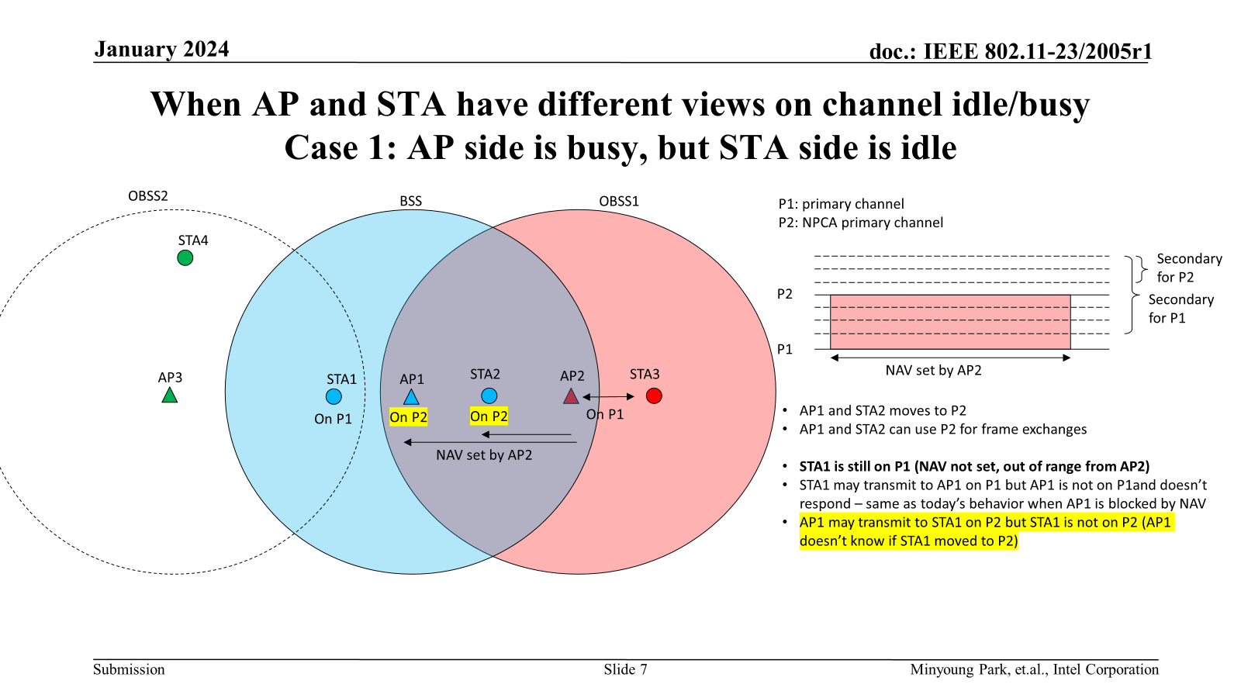
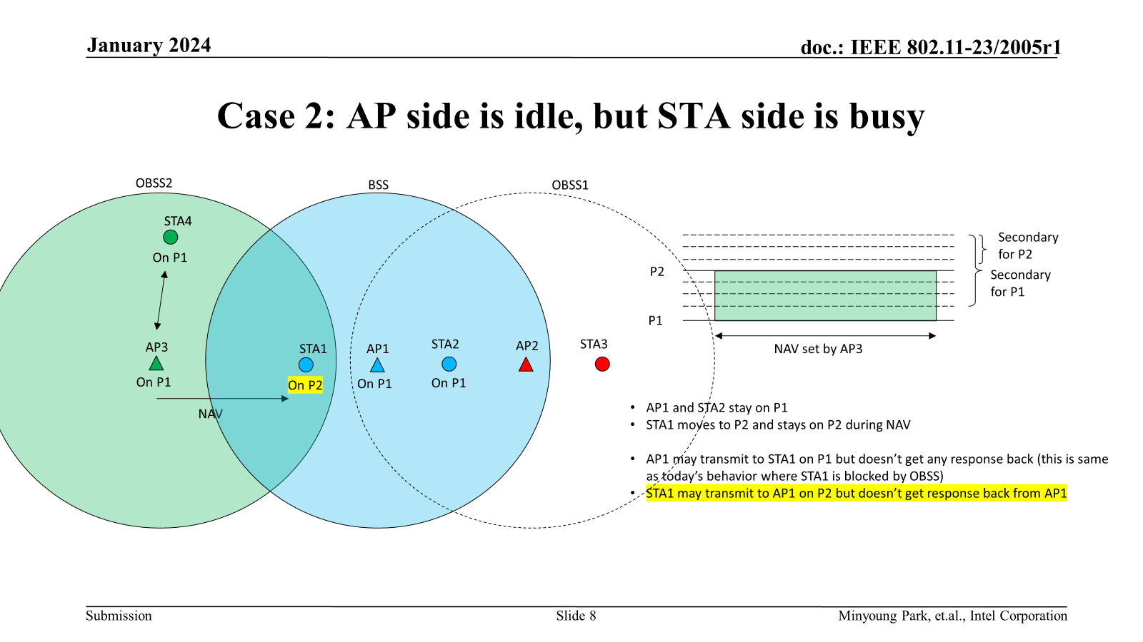
APPENDIX (11-23/2005r1)
Proposal to address different views of medium busy/idle
In a BSS, each AP/STA build a list of OBSS APs (for simplicity) that they can hear on the primary channel (see examples below)
- AP1{AP2}
- STA1{AP3}
- STA2{AP2}
AP announces to its associated STAs the list of OBSS APs that it received (e.g., in a beacon frame)
– AP1 {AP2}
Each STA compares the OBSS AP list that it received from the AP with the list of OBSS APs each STA can hear and indicate this to the AP
- STA1{none}
- STA2{AP2}
When a STA receives a frame from an OBSS AP that was included in the OBSS AP list received from the AP, the STA moves to P2 and may initiate TXOP to the AP; otherwise stays on P1.
- STA1: doesn’t move to P2 when it receives a frame from AP3
- STA2: moves to P2 when it receives a frame from AP2; may initiate TXOP to AP1
When the AP receives a frame from an OBSS AP that it included in the OBSS AP list and the OBSS AP was indicated by a STA in c), it moves to P2 and may initiate TXOP to the STA.
- AP1: moves to P2 when it receives a frame from AP2; may initiate TXOP to STA2

