Slide 1
Seamless Roaming Signaling Details
Date: 2024-11-08
Authors:

Slide 2
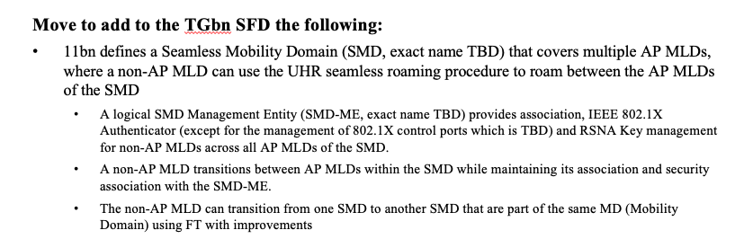
Introduction
11bn SFD captures following motion for SMD roaming, adopting SMD level association, authentication and RSNA key management
In this presentation, we provide next level of signaling details and considerations for Seamless Roaming (SR) for the following aspects, for roaming through current AP MLD:
  SMD discovery
  Initial SMD association
  Roaming preparation
  Roaming execution

Slide 3
SMD Discovery
A non-AP MLD needs to first discover an SMD for performing SMD level association
We propose to define a new SMD element (SMDE) to provide info about SMD. The SMDE is included in Probe Resp (TBD for Beacon) and Authentication + (Re)Association Req/Resp for SMD level auth and assoc
Having a separate SMDE is preferred over including SMD info in Basic ML element, due to potential interop issues if Basic ML element is extended
SMDE includes a unique SMD Identifier (in a MAC Address format) plus SMD level capabilities and operations
  The unique SMD Identifier is also 802.1X Authenticator address for the SMD-ME, and is used in the generation of SMD level PMK and PTK for a non-AP MLD
SMD level capabilities can include (more discussion needed):
  Data Transfer between APs Support
  Resource Reservation on Target AP Support
  …

Slide 4
RNR Enhancements for SMD Discovery
RNR should be enhanced to indicate whether a reported AP is part of the same SMD as the reporting AP
  Use a Reserved bit for ‘Same SMD’ indication in MLD parameters or BSS parameters
At the edge of two or more SMDs, we need to enable discovering AP MLDs in current SMD as well as in the neighboring SMDs (one or more)
  Provide a short SMD ID (e.g. 1 octet) when ‘Same SMD = 0’ to identify SMDs for reported APs, this can assist clients in selecting an AP for roaming
  SMD ID is included wherever RNR provides info for APs not in the same SMD (e.g. in Probe Response, may not be included in RNR in Beacon due to Beacon bloating concern)

Slide 5
NR Enhancements for SMD Discovery
The Neighbor Report element is returned in BTM Request and Neighbor Report Response, to provide information for reported neighboring APs
Propose to enhance NR element to also provide SMD related information for a reported AP
  Add a ‘Same SMD’ indication in the BSSID Information in the NR element, to signal whether the reported neighboring AP is part of the same SMD as the reporting AP
  Allow including an SMD element in the Optional Subelements of the Neighbor Report element, when reported neighboring AP is not part of the same SMD.
  Spec can add the rule to always include SMDE for a reported neighboring AP that belongs to an SMD, and is not part of the same SMD as the reporting AP

Slide 6
Initial SMD Association
Pre-association, the non-AP MLD discovers SMD through baseline scanning process
After SMD discovery, a non-AP MLD performs auth+ association with the SMD (per SFD motion)
SMDE is included in Authentication frame to signal that authentication is with the SMD-ME
SMDE is included in (Re)Association Req/Resp frames to signal association with the SMD-ME
4-way HS messages include the unique SMD Identifier for SMD level PTK generation
SMD level PMK and shared PTK generation tied to the unique SMD Identifier

Slide 7
Roaming Preparation
Use EHT Link Reconfiguration Req/Resp frames with extensions for roaming prep
  Add Roaming Control info for SR in Req and Resp
  Request: Reconfiguration ML element with Per-STA Profiles, Roaming control (Prep Indication, context transfer,…)
    Reconfig ML element Common Info can be extended to include a Target AP MLD MAC
  Response: Basic ML element with Per-STA profiles for accepted links, Roaming control (Status, Prep Indication, context transfer status,…)
Resources at target AP MLD (e.g. links etc.) are reserved for a Roaming Exec Deadline, roaming execution will be accepted within this period

Slide 8
Roaming Preparation with Multiple Target AP MLDs
In deployments such as IIoT (AGVs/AMRs), Automotive a client can benefit from preparing more than one target AP (e.g. 2 or 3) and then roam to one of those based on client’s actual mobility
We should allow a client to request preparing more than one AP MLD
For keeping protocol simplicity, we can support preparing each target AP MLD using separate Link Reconfig Req/Resp exchange
SMD/AP policy can be announced to the client for multiple Target AP MLDs preparation
  Serving AP MLD can prepare a smaller set of target AP MLDs than requested, based on its policy and network conditions

Slide 9
SCS Context Transfer during Roaming Preparation
To provide continuity for QoS requirements for SCS streams, during roaming preparation current AP MLD should transfer already established SCS streams to the target AP MLD as part of context transfer
Target AP MLD may accept a subset of SCS streams based on its resource availability
If the target AP MLD accepts at least one requested link for the non-AP MLD, then the roaming prep response frame should indicate list of SCS streams that have been accepted by the target AP MLD
Since target AP MLD may not be able to reserve resources for all SCS streams due to resource constraint, a client may optionally request to prioritize certain SCS streams for resource reservation
  Client can signal set of SCS streams to prioritize for reserving resources in the roaming prep request
  Target AP MLD will consider those SCS streams first for resource reservation
In either cases, serving AP MLD indicates to the client set of SCS streams for which resources are reserved on the target AP MLD

Slide 10
Roaming Execution
Use EHT Link Reconfiguration Req/Resp frames with extensions for roaming execution
  Add Roaming Control info for SR in Req and Resp
  Request: Reconfiguration ML element, SMDE, Roaming control (Exec Indication, context transfer,…)
    Per-STA Profiles omitted when link prep is already done
  Response: Basic ML element, SMDE, Roaming control (Status, Exec Indication, context transfer status,…), Group Keys, AID, Buffered DL Data Drain Timeout
    Per-STA Profiles omitted when link prep already done
After DS mapping update is initiated, links on target AP MLD are active and 802.1X port is open

Slide 11
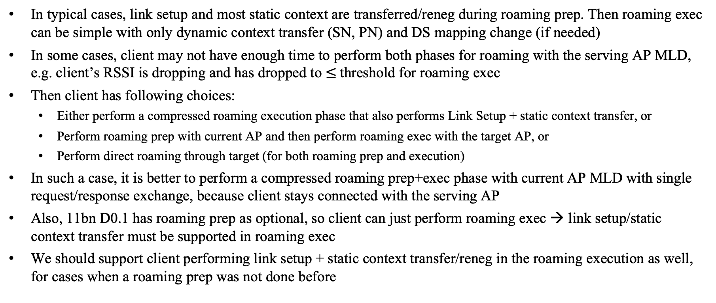
Performing Roaming Prep and Exec in One Step
In typical cases, link setup and most static context are transferred/reneg during roaming prep. Then roaming exec can be simple with only dynamic context transfer (SN, PN) and DS mapping change (if needed)
In some cases, client may not have enough time to perform both phases for roaming with the serving AP MLD, e.g. client’s RSSI is dropping and has dropped to $≤$threshold for roaming exec
Then client has following choices:
  Either perform a compressed roaming execution phase that also performs Link Setup + static context transfer, or
  Perform roaming prep with current AP and then perform roaming exec with the target AP, or
  Perform direct roaming through target (for both roaming prep and execution)
In such a case, it is better to perform a compressed roaming prep+exec phase with current AP MLD with single request/response exchange, because client stays connected with the serving AP
Also, 11bn D0.1 has roaming prep as optional, so client can just perform roaming exec → link setup/static context transfer must be supported in roaming exec
We should support client performing link setup + static context transfer/reneg in the roaming execution as well, for cases when a roaming prep was not done before

Slide 12
Link Reconfiguration Request extensions for SR
EHT Link Reconfiguration Request (with extensions)
Notes:
Reconfig ML element extended to add a Target AP MLD MAC, such that MLD MAC Address and Per-STA Profile for requested links are in same element
SMDE signals request for seamless roaming (SR) in the SMD.
Roaming Req Control element provides extended parameters needed for SR request
Context Parameters Subelements can carry any subelements, for context to be renegotiated (if any)
Order | Meaning
1 | Category
2 | Protected EHT Action
3 | Dialog Token
4 | Reconfiguration ML element
5 | OCI element
6 | SMD element
7 | Roaming Req Control element
8 | Context Parameters Subelements (optional)
Add a new Target MLD MAC Address in the Common Info
Element ID
Length
Element ID Extension
Roaming Phase Indication
Context Transfer Request
Context Renegotiation Request
Resource Reservation Request
…
Prep or exec phase
Include any renegotiated params, e.g. BA Agreements etc.
Signal context transfer e.g. BA Agreements, SCS streams etc.
Signal context reneg. e.g. BA Agreements etc.
Signal resource reservation preference e.g. for SCS streams

Slide 13
Link Reconfiguration Response extensions for SR
EHT Link Reconfiguration Response (with extensions)
Order | Meaning
1 | Category
2 | Protected EHT Action
3 | Dialog Token
4 | Count
5 | Reconfiguration Status List
6 | Group Key Data
7 | OCI element
8 | Basic ML element
9 | SMD element
10 | Roaming Resp Control element
11 | Context Parameters Subelements (optional)
Notes:
SMDE signals response for seamless roaming in the SMD. Response element carries same SMDE as in request.
Roaming Resp Control element provides extended parameters needed for SR response
Context Parameters Subelements can carry any params/counter suggestions returned by Target AP MLD e.g. SCS suggested params
MLD MAC Address in Common Info set to Target AP MLD MAC
Element ID
Length
Element ID Extension
Roaming Phase Indication
Overall Status
Target AP MLD MAC
Context Transfer Status Info
Context Renegotiation Status Info
Resource Reservation
Status Info
Roaming Execution Deadline
AID
DL Data Drain Timeout
…
Status + info for context transfer
Status + info for context renegotiation
Status + info for resource reservation
Deadline to perform roaming exec
AID assigned by target AP
Timeout for DL data drain
Any params/counter suggestions returned by Target AP e.g. SCS suggested params
Notes:
Gra

Slide 14
Cancelling Previous Roaming Preparation
After a client has performed roaming prep, it is possible that the client may change its target AP MLD selection e.g. due to changes in RSSI, channel load, movement of client etc.
Client can also prepare multiple target AP MLDs.
If client’s conditions change, and it is not interested in a previous roaming prep, then client should cancel the previous roaming preparation so that network resources can be released.
We should define a way for client to signal ‘Cancel previous roaming preparations’ in the roaming preparation request, if client is no longer interested in any of the previously prepared target AP MLD(s).

Slide 15
Summary
This presentation covers further signaling details and considerations for seamless roaming
We proposed following enhancements for seamless roaming:
  SMD Discovery: Provide SMD info in Probe Resp (Beacon TBD), define a unique SMD identifier (e.g. a MAC Address) for SMD and the 802.1X Authenticator in the SMD-ME, add SMD info to NR and RNR
  Initial SMD Association: Add SMDE to Authentication and (Re)Association Req/Resp, add SMD Identifier to 4-way HS messages, tie PMKSA and PTKSA generation with unique SMD Identifier.
  Roaming preparation: Extend EHT Link Reconfiguration Request/Response for roaming prep, roaming execution is performed with a Roaming Exec Deadline. Allow clients to perform roaming prep with multiple target AP MLDs using separate request/response exchange. Allow SCS context transfer during roaming prep.
  Roaming execution: Extend EHT Link Reconfiguration Request/Response for roaming execution. Response provides Buffered DL Data Drain timeout. Allow clients to perform roaming exec even when prep was done before e.g. for last minute roam through serving AP MLD.
  Cancelling roaming preparations: Allow client to cancel any previous roaming prep that the client is not interested in anymore.

Slide 16
Straw Poll 1
For seamless roaming, do you support to allow a non-AP MLD to request preparing more than one candidate target AP MLDs in an SMD during the roaming preparation phase?
Preparation with multiple AP MLDs is performed using a separate roaming preparation request for each AP MLD
If successful roaming preparation was performed with multiple candidate target AP MLDs, then the non-AP MLD shall attempt roaming execution with only one of those target AP MLDs at a time.
  Retries with other target AP MLDs are permitted for roaming execution
TBD on policy indication from the AP on multiple target AP MLDs preparation

Slide 17
Straw Poll 2
Do you agree to define an SMD element, that provides identification for the SMD and SMD level capabilities for a seamless mobility domain?
The SMD element is provided in Probe Response frames
The SMD element is included in Authentication frames when performing authentication with an SMD
The SMD element is included in (Re)Association Request & Response frames when performing initial association with the SMD-ME

Slide 18
Straw Poll 3
Do you agree to enhance Neighbor Report element to provide SMD related information?
Add a ‘Same SMD’ indication in the BSSID Information in the NR element, to signal whether the reported neighboring AP is part of the same SMD as the reporting AP
Allow including the SMD element as a subelement in the Optional Subelements of the Neighbor Report element, when reported neighboring AP is not part of the same SMD

Slide 19
Straw Poll 4
Do you support that the EHT Link Reconfiguration Request/Response frames are used with necessary extensions for seamless roaming preparation phase when roaming within an SMD?
TBD signaling is added to indicate the roaming preparation phase
Other extensions are TBD

Slide 20
Straw Poll 5
Do you support that the EHT Link Reconfiguration Request/Response frames are used with necessary extensions for roaming execution phase when roaming within an SMD?
TBD signaling is added to indicate the roaming execution phase
Other extensions are TBD

Slide 21
Straw Poll 6
Do you agree that during roaming preparation, after receiving a request from a non-AP MLD, the current AP MLD shall transfer all the SCS streams of that non-AP MLD to the target AP MLD?
The target AP MLD may accept or reject an SCS stream received from the current AP MLD (e.g. based on its resource availability)
If the target AP MLD accepts at least one link, the response sent to the non-AP MLD provides list of SCS streams that have been accepted by the target AP MLD

Slide 22
Straw Poll 7
Do you agree that as part of the request frame for roaming preparation procedure, a non-AP MLD can request that the target AP MLD prioritizes resource reservation for certain SCS streams?
The target AP MLD considers requested SCS streams from the non-AP MLD when reserving resources for SCS streams
The response frame indicates accepted SCS streams for which resources have been reserved at the target AP MLD

Slide 23
Straw Poll 8
Do you agree that a non-AP MLD can perform seamless roaming execution to a target AP MLD through the serving AP MLD, when an earlier roaming preparation was not performed for that target AP MLD?
In this case roaming preparation and roaming execution happen in the same step

Slide 24
Straw Poll 9
Do you agree to extend the Reconfiguration Multi-link element to add a Target AP MLD MAC Address in the Common Info field for seamless roaming and using a bit in the Presence Bitmap to indicate the presence of the Target AP MLD MAC Address?

Slide 25
Straw Poll 10
Do you agree that for seamless roaming, the roaming execution response frame provides the AID assigned by the target AP MLD for the non-AP MLD and provides the set of Group keys for successfully setup links at the target AP MLD?

