Slide 1
A case for opportunistic relaying
Date: 2024-04-02
Authors:

Slide 2
Abstract
Ubiquity of 802.11 user devices can be exploited by opportunistic two-hop relaying to improve throughput for devices in low to median SNR regime
  Selecting a suitable nearby user device as relay can produce a similar gain as the user moving a few meters to get out of adversely shadowed or blocked location to a favorable location.
Opportunistic relaying using a nearby device can also be used to break a high-mobility NLOS channel (e.g., HMD to AP) into two hops: LOS with high mobility (e.g., HMD to laptop) and NLOS with low mobility (laptop to AP)
Such two-hop opportunistic relaying produces a throughput benefit not just for the user with poor SNR, but also for the entire network, due to reduced channel utilization and interference

Slide 3
Opportunistically using a nearby non-AP STA as relay
Rly candidate STAs
AP
End STA
2nd hop
1st hop
Selected rly STA
Direct link
Terminology
  End STA: non-AP STA with poor SNR that needs a relay
  Relay candidate STAs: non-AP STAs that can act as a relay b/w the AP and End STA
    E.g. other mobile devices owned by user and family, laptops, appliances in the house
  1st Hop: Link between End STA and selected Relay STA
  2nd Hop: Link between Selected Relay STA and AP
  Direct link: Link between End STA and AP

Slide 4
Opportunistically using a nearby non-AP STA as relay (1/4)
Rly candidate STAs
AP
End STA
2nd hop
1st hop
Selected rly STA
Direct link
How does Relay improve end-to-end throughput:
  Distance: Cut longer Direct link into two shorter (albeit half-duplex) links [1]
  Walls: Distribute the walls between AP and End STA across two links [1]
  Multiuser (selection) diversity across shadow fading realization of relay candidates

Slide 5
Opportunistically using a nearby non-AP STA as relay (1/4)
Rly candidate STAs
AP
End STA
2nd hop
1st hop
Selected rly STA
Direct link
How does Relay improve end-to-end throughput:
  Distance: Cut longer Direct link into two shorter (albeit half-duplex) links [1]
  Walls: Distribute the walls between AP and End STA across two links [1]
  Multiuser (selection) diversity across shadow fading realization of relay candidates
See appendix

Slide 6
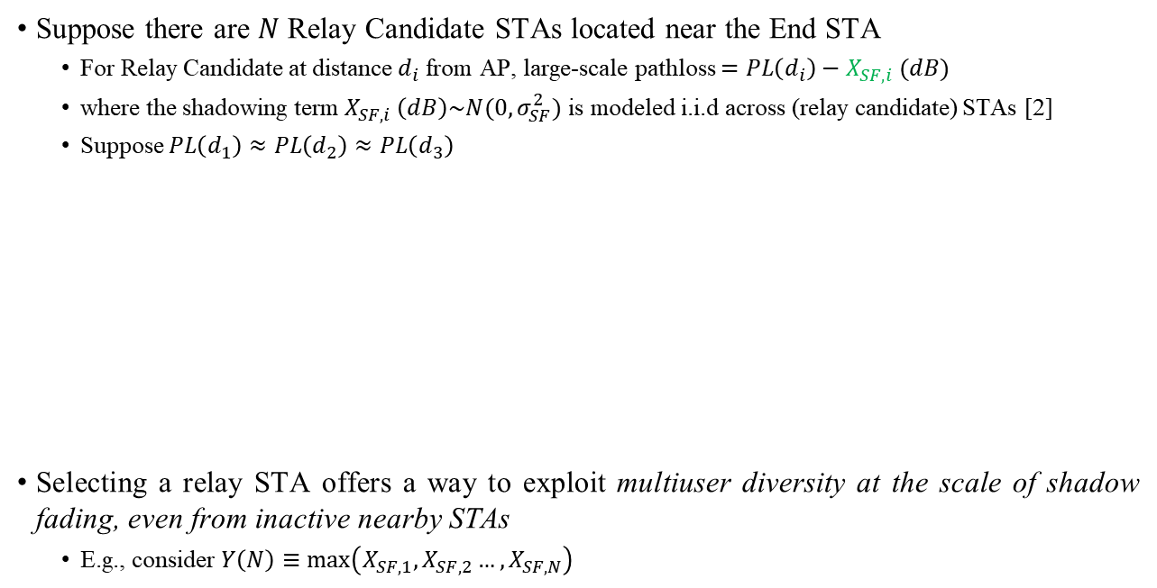



3. Opportunistic relaying exploits multiuser diversity at the scale of shadow fading (2/4)
Suppose there are $N$ Relay Candidate STAs located near the End STA
  For Relay Candidate at distance $d_{i}$ from AP, large-scale pathloss $=PL\left(d_{i}\right)−X_{SF,i} (dB)$
  where the shadowing term $X_{SF,i} \left(dB\right)\sim N(0,σ_{SF}^{2})$ is modeled i.i.d across (relay candidate) STAs [2]
  Suppose $PL\left(d_{1}\right)≈PL\left(d_{2}\right)≈PL\left(d_{3}\right)$
Selecting a relay STA offers a way to exploit multiuser diversity at the scale of shadow fading, even from inactive nearby STAs
  E.g., consider $Y\left(N\right)≡\max\left(X_{SF,1}, X_{SF,2}…,X_{SF,N}\right)$
Rly candidate STAs
$$PL\left(d_{1}\right)−X_{SF,1}$$
AP
End STA
$$PL\left(d_{2}\right)−X_{SF,2}$$
$$PL\left(d_{3}\right)−X_{SF,3}$$

Slide 7
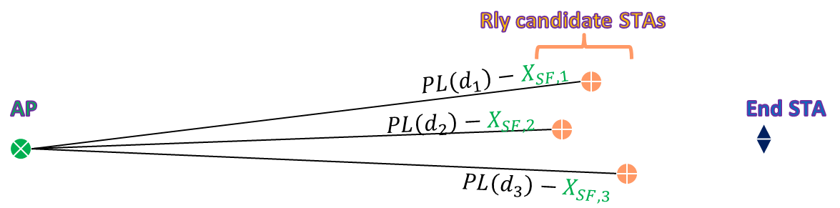
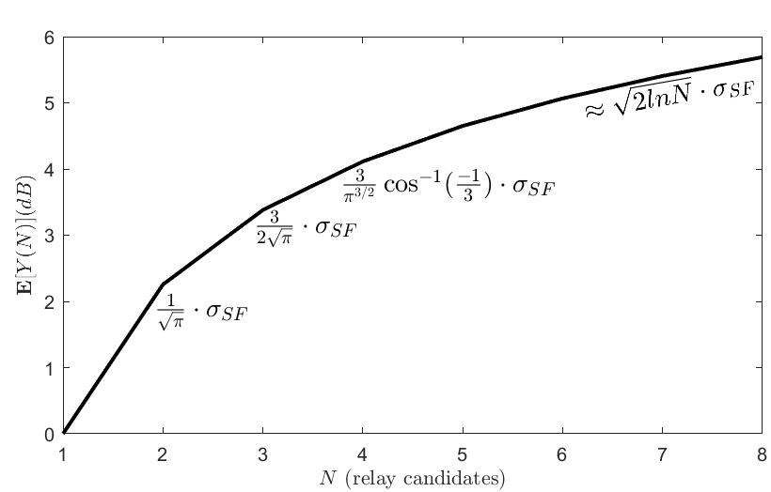

3. Opportunistic relaying exploits multiuser diversity at the scale of shadow fading (3/4)
Selecting a relay STA offers a way to exploit multiuser diversity at the scale of shadow fading, even from inactive nearby STAs
  E.g., consider $Y\left(N\right)≡\max\left(X_{SF,1}, X_{SF,2}…,X_{SF,N}\right)$
  Then $E\left[Y\left(N\right)\right]≈{\sqrt{2\ln{N}}⋅σ}_{SF} dB$
  for i.i.d shadow fading across relay candidates

Slide 8



3. Opportunistic relaying exploits multiuser diversity at the scale of shadow fading (4/4)
Selecting a relay STA offers a way to exploit multiuser diversity at the scale of shadow fading, even from inactive nearby STAs
Selecting a nearby STA as relay produces a similar gain as the user moving a few meters to get out of adversely shadowed location to a favorable location
Even though the user is using End STA, now user’s nearby devices are also able to help improve end-to-end throughput! (through relay selection diversity)
Rly candidate STAs
$$PL\left(d_{1}\right)−X_{SF,1}$$
AP
End STA
$$PL\left(d_{2}\right)−X_{SF,2}$$
$$PL\left(d_{3}\right)−X_{SF,3}$$

Slide 9
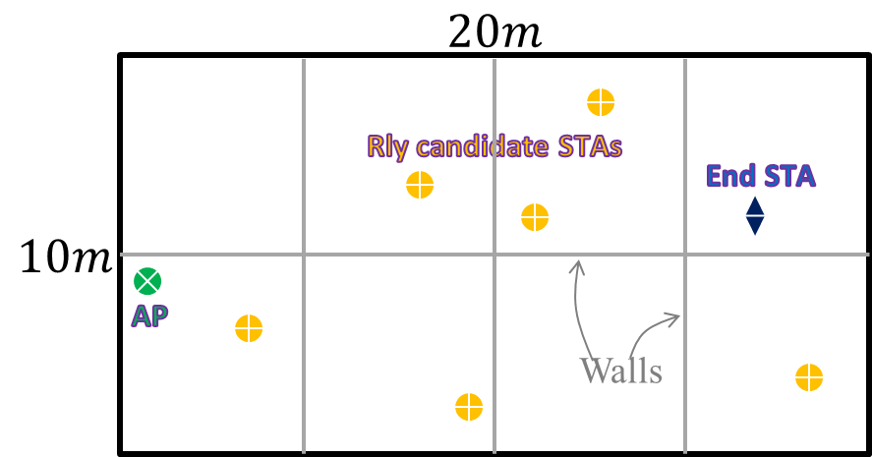
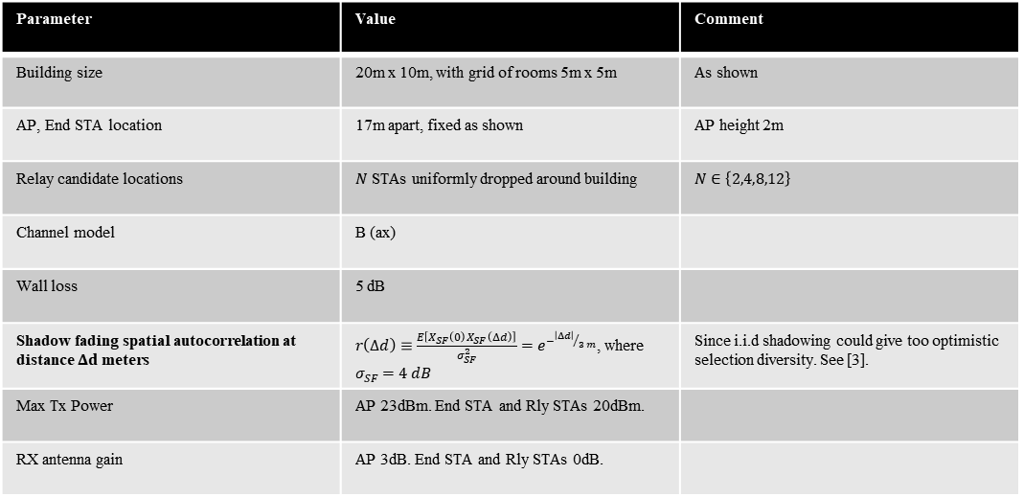
Opportunistic relaying – UL simulation (1/3)
Parameter | Value | Comment
Building size | 20m x 10m, with grid of rooms 5m x 5m | As shown
AP, End STA location | 17m apart, fixed as shown | AP height 2m
Relay candidate locations | $N$ STAs uniformly dropped around building | $N∈\left\{2,4,8,12\right\}$
Channel model | B (ax)
Wall loss | 5 dB
Shadow fading spatial autocorrelation at distance $Δd$ meters | $r\left(Δd\right)≡\frac{E\left[X_{SF}\left(0\right)X_{SF}\left(Δd\right)\right]}{σ_{SF}^{2}}=e^{−{\left|Δd\right|}/{3 m}}$, where $σ_{SF}=4 dB$ | Since i.i.d shadowing could give too optimistic selection diversity. See [3].
Max Tx Power | AP 23dBm. End STA and Rly STAs 20dBm.
RX antenna gain | AP 3dB. End STA and Rly STAs 0dB.

Slide 10
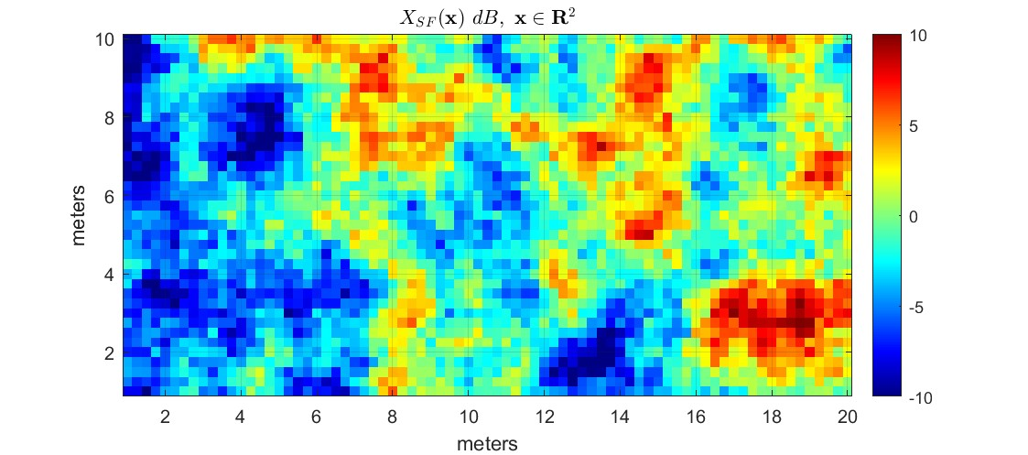
Opportunistic relaying – UL simulation (2/3)
A realization of spatially correlated shadowing between AP and STA locations
  Since i.i.d shadowing as typically modeled would give too optimistic selection diversity gain, shadowing is modeled as spatially correlated

Slide 11
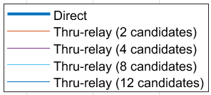


Opportunistic relaying – UL simulation (3/3)
Legends
  Direct: UL throughput if End STA transmits directly to AP (baseline)
  Thru-relay (N candidates): Max of (1) and (2) below
    End-to-end UL throughput through the best relay out of N relay candidates
    UL throughput of direct link
Takeaways
  Significant throughput gain even with 4 to 8 relay candidates in the whole house
  Selecting the best relay out of 4 candidates gives
    Median UL throughput gain 80%
    10%-tile UL throughput gain 160%
    In 90% of the situations, Thru-relay UL throughput is better than Direct UL throughput
      I.e., high probability of using a relay instead of going direct to AP
$$80\%$$
$$160\%$$

Slide 12
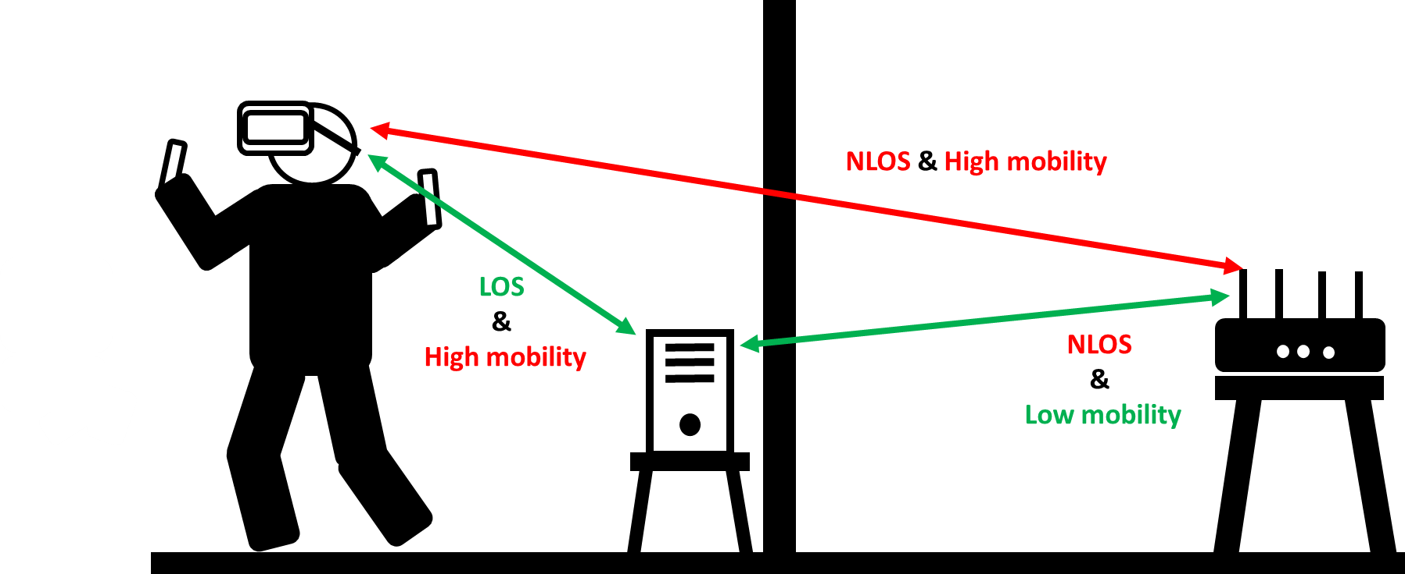
Opportunistic relaying – Other scenarios
Relay benefit for high mobility STAs (e.g., HMD): Break NLOS high-mobility channel b/w AP and HMD into
  High mobility LOS channel b/w Relay STA and HMD STA, and
  Low mobility NLOS (or possibly LOS) channel b/w AP and Relay STA
MLO (NSTR and STR) between 1st hop and 2nd hop: further throughput & latency improvement
Channel and bandwidth adaptation of 1st hop (Relay STA—End STA link)
System-wide analysis with multiple active STA and OBSS

Slide 13
Conclusion
Enabling a nearby user device (non-AP STAs) to act as a relay between the AP and the end STA can significantly improve throughput in the low to median SNR regime
Network burden to network asset: This relay feature turns large number of 802.11 devices (including inactive/idle ones) present in a BSS into a network asset.
  Since devices in poor coverage utilize more resources, such relays have a system-wide benefit.
From the POV of end user: even though the user is active on one device, the user’s other nearby devices can still contribute to improving user’s throughput, especially when user is in poor coverage.
Through relay selection from amongst the nearby devices, this relay feature enables harvesting a form of multiuser diversity at the scale of shadowing fading and wall-loss, even from inactive/idle devices.
Defining such a relay feature in 802.11bn would significantly deliver on RvR promise.

Slide 14
References
[1] UHR Rate-vs-Range Enhancement with Relay, IEEE 802.11-22/1908r1
[2] IEEE 802.11ax Channel Model Document, IEEE 802.11-14/0882r4
[3] Study on channel model for frequencies from 0.5 to 100 GHz, 3GPP TR 38.901

Slide 15
Appendix

Slide 16
Opportunistically using a nearby non-AP STA as relay (1/4)
Rly candidate STAs
AP
End STA
2nd hop
1st hop
Selected rly STA
Direct link
How does Relay improve end-to-end throughput:
  Distance: Cut longer Direct link into two shorter links [1]
  Walls: Distribute the walls between AP and End STA across two links [1]
  Selection diversity across Shadow fading realization of relay candidates

Slide 17
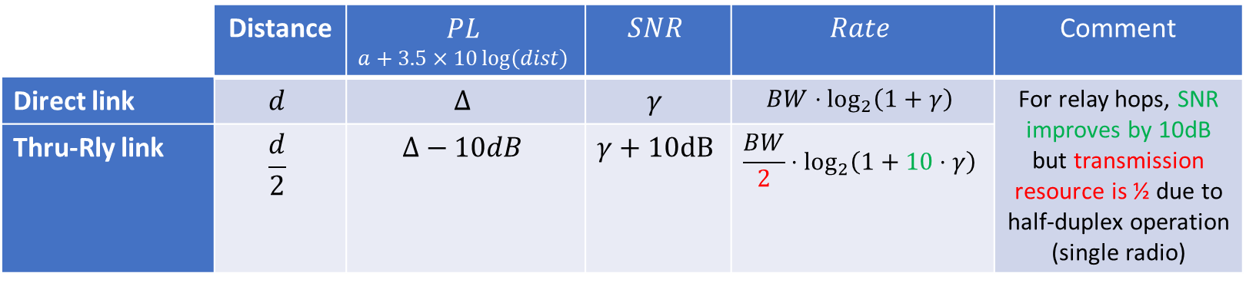
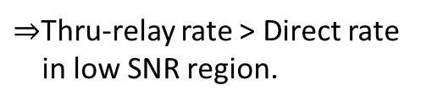
1. Distance (2/4)
AP
Rly STA
End STA
2nd hop
1st hop
Direct link
$⇒$Thru-relay rate > Direct rate
in low SNR region.

Slide 18
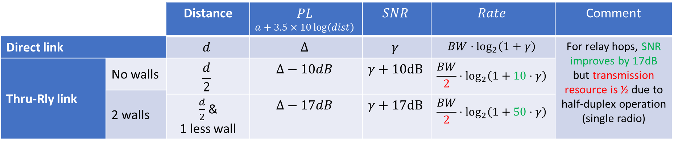
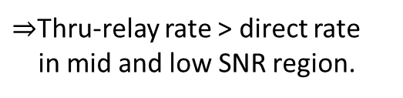
2. Walls (3/4)
Wall, 7dB
Wall, 7dB
AP
Rly STA
End STA
2nd hop
1st hop
Direct link
$⇒$Thru-relay rate > direct rate
in mid and low SNR region.

Slide 19
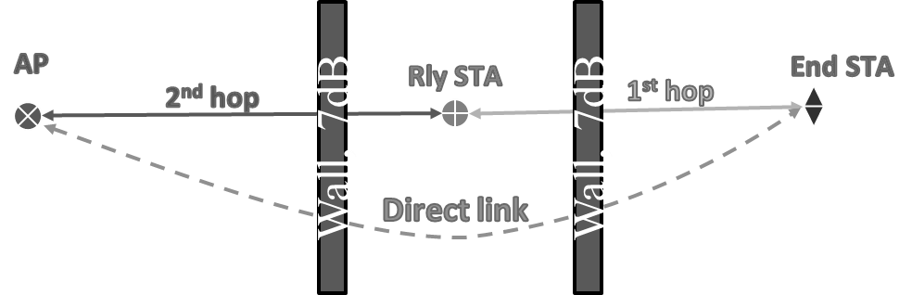
2. Walls (cont.) (4/4)
Near edge of coverage, two-hop relaying can significantly improve both coverage & capacity
  2x—4x capacity gain when direct link is around MCS2
  Coverage extension of >10dB
Capacity gain near edge of coverage
Coverage extension

Slide 20
Simulation technique for 2-hop communication
Configure relay node with a small forwarding buffer threshold (e.g., sufficient to hold a few PPDUs from the ingress link)
If relay buffer exceeds threshold, disallow (turn off) ingress link to the relay.
I.e., ingress link to relay will contend for channel only if relay buffer is under the threshold
This ensures that in the long-run, throughputs on the ingress link and the egress link of relay (the 1st hop and the 2nd hop in terminology introduced earlier) are equal.
  All the data that the relay received on ingress link, the relay forward on the egress link (except for a small amount of data possibly still in relay’s forwarding buffer)

