Slide 1
Consideration on C-SR Types
Date: 2024-5-10
Authors:

Slide 2
Introduction
Coordinated Spatial Reuse (C-SR) is one of the Multi-AP coordination schemes for TGbn
C-SR can improve system throughput with lower complexity in multiple BSS environment
Transmit power control method of C-SR is considered
In this contribution, we considered control information required for each C-SR type and evaluated the throughput and fairness of each C-SR type

Slide 3
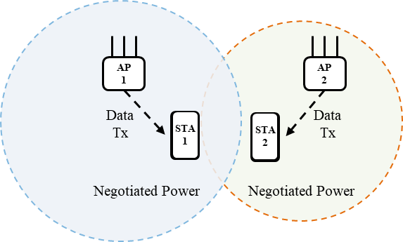
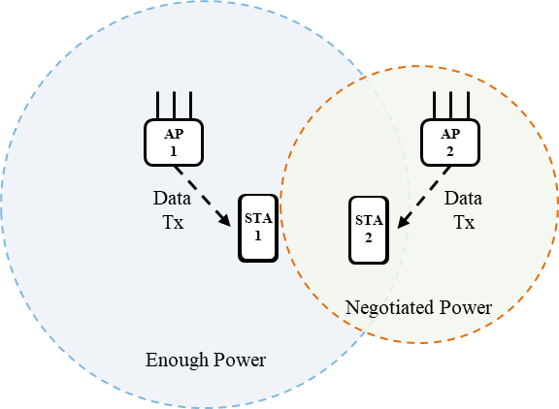
Recap of C-SR
AP which obtains a TXOP and initiates the multi-AP coordination is the sharing AP. AP which is coordinated for multi-AP transmission by the sharing AP is the shared AP[1]
Optimal
coordination
Following two C-SR types are considered
Optimal coordination[2][3]
Sharing AP determines Tx power for each AP by using measurement information of OBSS transmitted from associated STA and OBSS AP
Prerequisites for maximizing throughput need to be considered
One-way coordination[4]
Sharing AP determines own Tx power without using measurement information transmitted from OBSS AP
Shared AP determines own Tx power based on the transmit parameter of sharing AP
Low overhead compared to optimal coordination
One-way
coordination

Slide 4
C-SR sequence
Measurement phase
Each STA measures RSSI from OBSS AP by using beacon signal
AP requests STAs in its BSS to transmit measurement report including RSSI from OBSS AP
AP calculates pathloss a), b) based on the Tx power and RSSI of the measurement report received from the associated STAs
The role of each AP (sharing AP/shared AP) is not decided in this phase
Calculate pathloss of a)
AP1
c)
d)
AP2
RSSI of d)
a)
STA
1
STA
2
b)
Calculate pathloss of b)
RSSI of c)

Slide 5
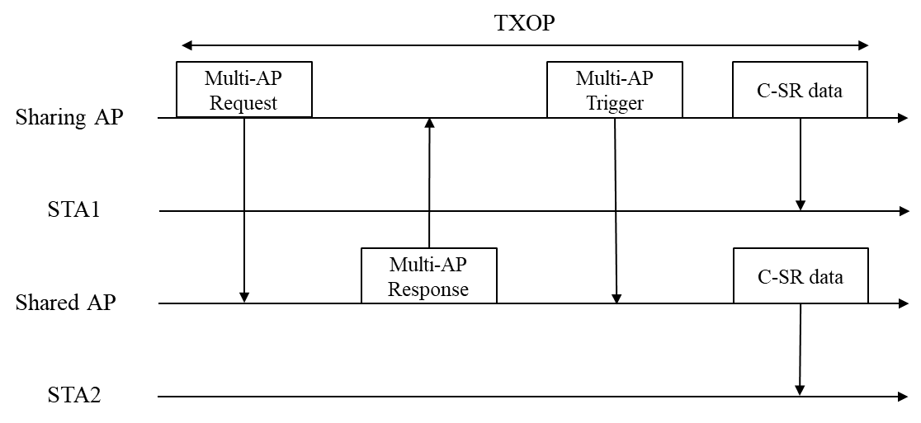
C-SR sequence
Multi-AP Request
AP1 that has acquired TXOP becomes a sharing AP and notifies shared AP of Multi-AP coordination method (JT, C-BF, C-SR etc.) by using Multi-AP request frame
If two C-SR control types are defined, the frame requesting C-SR indicates one of the C-SR control types (optimal or one-way).
The Multi-AP request frame has the following additional information depending on C-SR type
Optimal coordination: no additional information
One-way coordination: Acceptable Tx power of AP2 (maximum Tx power of AP2)
AP1
c)
d)
AP2
a)
STA
1
STA
2
b)

Slide 6
C-SR sequence
Multi-AP Response
Shared AP notifies whether it can participate in notified Multi-AP coordination method by using Multi-AP response frame
If shared AP can participate in notified Multi-AP coordination method, Multi-AP response frame has the following additional information depending on C-SR type
Optimal coordination: Acceptable Receiver Interference Level (ARIL) of STA2 and pathloss of b), c)
One-way coordination: no additional information
AP1
c)
d)
AP2
a)
STA
1
STA
2
b)

Slide 7
C-SR sequence
Multi-AP Trigger
Sharing AP receives the multi-AP response frame and, if the shared AP can cooperate, notifies scheduling information (transmission timing, frequency resources) necessary for Multi-AP coordination by Multi-AP trigger frame
In optimal coordination, sharing AP notifies destination STA ID and Tx power for each shared AP
In one-way coordination, sharing AP may notify acceptable Tx power of AP2 by Multi-AP trigger frame

Slide 8
Simulation Setup
Simulation Environment
Layout
One AP and one STA are placed in each 15[m] x 10[m] room
STAs are deployed with a granularity of 1[m]
Parameter
Eq(1): Pathloss = $40.05+20×\log_{10}\left(f_{c}/2.4\right)+20×\log_{10}\left(min\left(d, 5\right)\right)+\left(d>5\right)×35×\log_{10}\left(d/5\right)+5×W$
𝑑 = max(2D distance[m], 1)
$f_{c}$ = 5[GHz]
𝑊 = number of walls traversed
Frequency, Bandwidth | 5[GHz], 80[MHz]
Tx Power | -10 ~ 20[dBm]
Tx/Rx Antenna | (AP, STA) = (4, 2)
Stream | 2 per STA
Precoding | SVD
MCS index | 0 ~ 11
Fading Model | Model-D
Noise Figure | 7 [dB]
Path loss model | Eq.(1)
y[m]
15[m]
10
9
8
STA1
7
6
AP1
AP2
10[m]
5
4
3
2
1
STA2
0
0
1
2
3
4
5
6
7
8
9
10
11
12
13
14
15
16
17
18
19
20
21
22
23
24
25
26
27
28
29
30
x[m]
16[m]

Slide 9
Comparison Methods
TDMA
Sharing AP transmits maximum Tx power and MCS
Shared AP doesn’t transmit
Optimal coordination
Sharing AP determines Tx power and MCS of each AP to maximize system throughput
Optimal coordination, MaxMCS
Sharing AP uses same MCS as TDMA
Tx power of each AP determined based on pathloss between each AP and STA and ARIL of STA

Slide 10
Comparison Methods
One-way coordination
Sharing AP determines own Tx power that satisfies SINR of the target MCS based on pathloss between sharing AP and destination STA as following
TxPower_{Sharing AP} = IN_{Destination STA,max} + SINR_{required} + Pathloss_{Sharing AP, Destination STA}
IN_{Destination STA,max} = RSSI_{Shared AP beacon}
Sharing AP also determines acceptable Tx power of shared AP as following
AcceptableTxPower_{Shared AP} = ARIL_{Destination STA} + Pathloss_{Shared AP, Destination STA}
Shared AP determines Tx power less than or equal to AcceptableTxPower_{Shared AP} based on ARIL of destination STA of shared AP

Slide 11
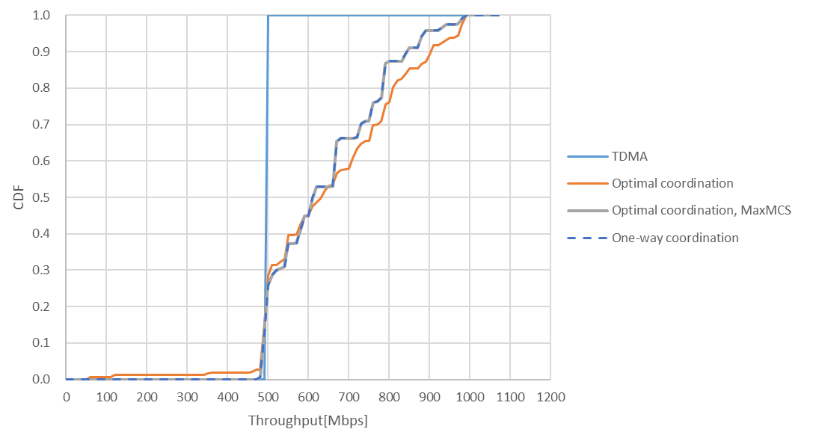
Simulation Result
Comparing the throughput CDF of each C-SR type
Optimal coordination can achieve maximum throughput but will be less fairness
One-way coordination can achieve throughput and fairness equivalent to optimal coordination_MaxMCS
5%-tile throughput

Slide 12
Summary
We considered control information used in C-SR and evaluated the throughput for each C-SR type
Optimal coordination showed high throughput with large overhead
One-way coordination showed throughput higher than TDMA and lower than optimal coordination with less overhead while guaranteeing fairness

Slide 13
References
[1] Edward Au (Huawei), “Compendium of straw polls and potential changes to the Specification Framework Document Part 2,” 20/1935r66, May, 2022
[2] Kanke Wu (Qualcomm), “Performance of Coordinated Spatial Reuse,” 23/1037r0, June, 2023
[3] Kosuke Aio (Sony), “Evaluation of Coordinated Spatial Reuse - Follow Up,” 23/1972r1, November, 2023
[4] Jonghun Han (Samsung), “Coordinated Spatial Reuse: Focus on Downlink,” 20/590r5, May, 2020

