Slide 1
MAC protocol aspects of multi-AP coordination
Date: 2024-06-20
Authors:
Name | Affiliations | Address | Phone | Email
Sindhu Verma | Broadcom |  |  | sindhu.verma@broadcom.com
Srinath Puducheri |  |  |  | srinath.puducheri@broadcom.com
Shubhodeep Adhikari |  |  |  | shubhodeep.adhikari@broadcom.com
Matthew Fischer |  |  |  | matthew.fischer@broadcom.com
Ron Porat |  |  |  | ron.porat@broadcom.com
Vinko Erceg |  |  |  | vinko.erceg@broadcom.com
Notes:
November 2012

Slide 2
Abstract
This contribution discusses MAC protocol aspects of Coordinated Beamforming (CBF) including simulation results. The protocol aspects are extensible to other multi-AP coordination schemes for all of which, it is desirable to have a common framework.

Slide 3
Overview
Step | Operation | Time-scale | Details
1 | AP discovery | BSS setup, or new channel | Identify peer “CBF” APs, capability-exchange CBF configuration (security, BSS color, etc.)
2 | Non-AP STA identification | Few 100ms - few seconds | Identify candidate non-APs per-AP for CBF E.g., based on active DL traffic Could be limited to a few non-AP STAs across both APs (e.g., when in-BSS DL MU-MIMO is less likely). Exchange semi-static info common for multiple TXOPs (e.g., non-AP capabilities, AIDs, PPDU params)
3 | Sounding | ~ DL-MUMIMO sounding | In-BSS and cross-BSS CSI acquisition
4 | Per-TXOP coordination | ~5ms | Identify non-AP STAs to be serviced in current TXOP, Nss configuration - to identify/compute precoder. Exchange info needed for CBF PPDU construction (e.g., preamble and duration)

Slide 4
Initial AP discovery and configuration
At initialization or semi-statically, APs identify partner CBF APs within a coordinated multi-AP system:
May explicitly poll each other or detect capabilities advertised by other APs (for e.g., in beacon frames, through centralized distribution of AP information to other APs, etc.)
Candidate APs may perform a handshake to exchange various capabilities, such as:
Number of Tx antennas/sounding dimensions/nulling capabilities supported by each AP
Maximum number of candidate OBSS CBF clients supported by each AP:
To manage/limit AP complexity (e.g., channel sounding, scheduling, etc)
Following the above capability exchange and if CBF is chosen, the parameters corresponding to each of the capabilities are negotiated. The APs could configure the following joint parameters:
Security keys for any protected messages that need to be received by partner CBF APs
BSS color for CBF transmissions (for aligning the PHY preamble of the CBF PPDU)
Etc.

Slide 5
Candidate non-AP identification
This occurs at a slow time-scale, e.g., 100s of ms
APs identify a subset of non-APs likely to participate in CBF, for e.g., based on:
Non-AP capabilities,
Presence of active DL traffic,
Etc.
The APs exchange the following information between them
AID of each candidate non-AP (e.g., for bookkeeping/identification)
PHY capabilities of each candidate non-AP (e.g., operating bandwidth, max Rx Nss, etc.)
The identified candidate non-APs are also notified of the configuration, e.g., other APs MAC address, the common BSS color, etc. This amounts to the setup of a CBF configuration at a non-AP
Similar to the setup of a CBF configuration at a non-AP based on favourable capabilities and DL traffic conditions, there needs to be a mechanism for a CBF-teardown message exchange. This will tear down the existing CBF configuration at the non-APs currently operating within it when the conditions are no longer favorable

Slide 6
Sounding
This occurs at a time-scale similar to DL MU-MIMO
APs acquire CSI from non-APs (in-BSS and cross-BSS). The additional overhead for performing CBF is only due to cross-BSS CSI
There are multiple possible methods for this sounding operation. For example,
Sequential, where feedback for each of the 2 APs is obtained from the non-AP one at a time
Joint, where feedback for the 2 APs is obtained from the non-AP in a single report

Slide 7
Per-TXOP coordination and frame exchange (1)
Purpose: APs identify which non-AP STAs will be serviced in the current TXOP and exchange information needed for the CBF PPDU transmission.
Participating APs need the following information prior to a CBF PPDU transmission:
Which non-AP STAs will be serviced and corresponding per-STA Nss (to determine BF+nulling directions)
TXOP duration, contents of the shared preamble of the CBF PPDU (e.g. puncturing, GI+LTF, # of LTFs, per-STA MCS, etc.)
We propose a per-TXOP coordination that provides adequate flexibility to the participating APs:
The shared AP communicates in a response frame to the sharing AP, the set of non-APs the shared AP wants to transmit to. This allows the shared AP some flexibility in selecting its non-APs based on queued traffic, QoS parameters, PHY parameters, etc.
Exchange of non-AP MCS, Nss, etc between the sharing and shared APs, for correct nulling, construction of a common preamble, duration adjustment in the CBF PPDU.
Using the control frame transmissions from both the sharing and shared AP to also notify participating non-APs in both BSSs of impending CBF data transmission in the TXOP, and potentially, enabling them to clear the medium in response.

Slide 8
Per-TXOP coordination and frame exchange (2)
TXOP
MU-RTS / BSRP + AP2 notification
SIFS
SIFS
SIFS
SIFS
CBF PPDU
SIFS
AP1
AP2
MU-RTS / BSRP + AP1 response
CBF PPDU
AP1-STA
CTS / BSR
TB-ACK
AP2-STA
CTS / BSR
TB-ACK
AP1 initiates the TXOP with initial-control frame (ICF) addressed to AP1-STAs (e.g., MU-RTS/BSRP) and to AP2.
Performs the usual functions of ICF (e.g., for EMLSR, etc.).
Signals the possibility of CBF transmissions during this TXOP.
Additionally, embeds “AP2-notification” to signal info needed by AP2 for CBF
Can be contained in UserInfo fields with a special AID12 value.
AP1-STAs respond to ICF with ICR (e.g. CTS/BSR):
When ICF frame signals CBF, AP1-STAs may not be serviced by AP1 immediately after they respond.

Slide 9
Per-TXOP coordination and frame exchange (3)
AP2 transmits an ICF (a second control frame such as MU-RTS/BSRP) addressed to any candidate AP2-STAs it identifies for CBF (e.g., based on traffic), and to AP1.
If AP2-STAs are addressed, performs the usual functions of an ICF.
Additionally embeds “AP1-response” to signal response to AP1
Can be contained in UserInfo fields with a special AID12 value.
If any AP2-STAs are addressed by AP2’s ICF, they respond with an ICR (e.g. CTS/BSR).
If no AP2-STAs are addressed and AP1-response reflects that AP2 cannot participate in CBF, AP1 initiates non-CBF transmission to AP1-STAs.
If AP2 indicates participation in CBF, then AP1 and AP2 initiate CBF PPDU transmission SIFS after the response from AP2-STAs.
SIFS after CBF PPDU, both APs’ STAs transmit their BAs respectively in a common TB PPDU (on separate RUs).

Slide 10
Simulation Results for CBF performance

Slide 11
Simulation Configuration
Network topology:
2 APs (4x4) with 1 client (2x2) each
Both APs are visible to each other
Varying SNR between an AP and its client : SNR
Varying interference I from one AP to the other APs client: SNR - X = I
Bandwidth: 80MHz, Single Link
Overheads modeled for per TXOP exchange : 24Mbps MU-RTS/CTS, MU-RTS with 0/64us padding
Traffic types: DL traffic only: 1 flow per client, Full buffer
The intent of this round of simulations is to evaluate the impact of per TXOP overheads

Slide 12
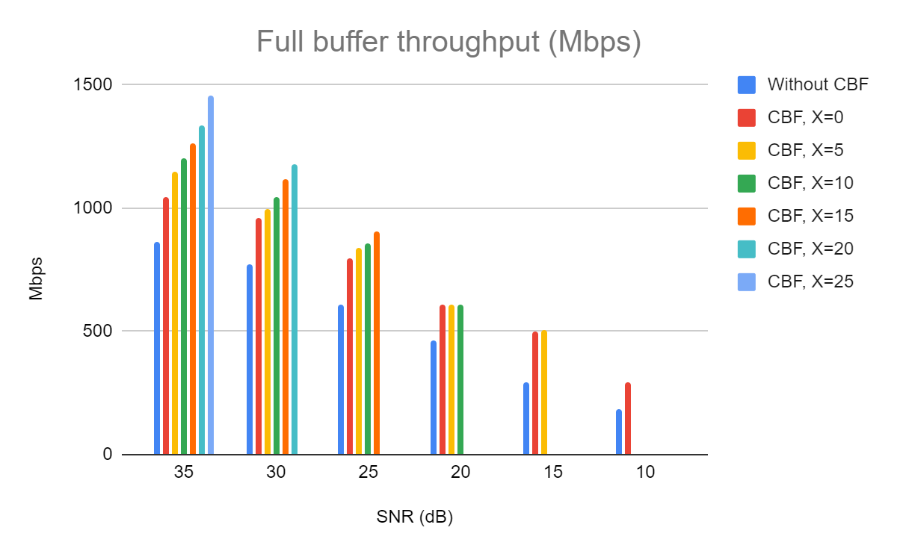
Full Buffer DL throughput in Mbps with 0us MU-RTS padding
Observations:
CBF throughput gains over without CBF increase with increase in X. This happens as the CBF PHY rates increase with reduction in the relative interference from its partner CBF AP.

Slide 13
Normalized Full Buffer DL throughput with 0us MU-RTS padding
 | SNR (dB)
With CBF | X (dB) | 35 | 30 | 25 | 20 | 15 | 10
 | 0 | 1.21 | 1.24 | 1.31 | 1.32 | 1.72 | 1.60
 | 5 | 1.33 | 1.29 | 1.37 | 1.32 | 1.74
 | 10 | 1.39 | 1.35 | 1.40 | 1.31
 | 15 | 1.46 | 1.45 | 1.48
 | 20 | 1.55 | 1.53
 | 25 | 1.68
Without CBF |  | 1.00 | 1.00 | 1.00 | 1.00 | 1.00 | 1.00

Slide 14
Normalized Full Buffer DL throughput with 64us MU-RTS padding
 | SNR (dB)
With CBF | X (dB) | 35 | 30 | 25 | 20 | 15 | 10
 | 0 | 1.20 | 1.23 | 1.29 | 1.30 | 1.70 | 1.58
 | 5 | 1.31 | 1.27 | 1.36 | 1.30 | 1.72
 | 10 | 1.37 | 1.33 | 1.39 | 1.30
 | 15 | 1.44 | 1.43 | 1.47
 | 20 | 1.53 | 1.51
 | 25 | 1.66
Without CBF |  | 1.00 | 1.00 | 1.00 | 1.00 | 1.00 | 1.00
Observations:
Even with 64us padding overhead and the additional MU-RTS/CTS exchange, CBF continues to show significant gains

Slide 15
Straw Poll
Do you agree that TGbn shall define a Coordinated Beamforming and Nulling procedure as one variant of the Multi-AP topic?

Slide 16
References
[1] IEEE P802.11be™/D6.0
[2] 11-23/0776r1 Performance of C-BF and C-SR

