Slide 1
MAC protocol aspects of multi-AP coordination
Date: 2024-03-06
Authors:
Name | Affiliations | Address | Phone | Email
Sindhu Verma | Broadcom |  |  | sindhu.verma@broadcom.com
Srinath Puducheri |  |  |  | srinath.puducheri@broadcom.com
Shubhodeep Adhikari |  |  |  | shubhodeep.adhikari@broadcom.com
Matthew Fischer |  |  |  | matthew.fischer@broadcom.com
Ron Porat |  |  |  | ron.porat@broadcom.com
Vinko Erceg |  |  |  | vinko.erceg@broadcom.com
Notes:
November 2012

Slide 2
Abstract
This contribution discusses MAC protocol aspects of Coordinated Beamforming (CBF) including simulation results. The protocol aspects are extensible to other multi-AP coordination schemes.

Slide 3
Overview
Step | Operation | Time-scale | Details
1 | AP discovery | BSS setup, or new channel | Identify peer “CBF” APs, capability-exchange CBF configuration (security, BSS color, etc.)
2 | Non-AP STA identification | Few 100ms - few seconds | Identify candidate non-APs per-AP for CBF E.g., based on active DL traffic Could be limited to a few non-AP STAs across both APs (e.g., when in-BSS DL MU-MIMO is less likely). Exchange semi-static info common for multiple TXOPs (e.g., non-AP capabilities, AIDs, PPDU params)
3 | Sounding | ~ DL-MUMIMO sounding | In-BSS and cross-BSS CSI acquisition, e.g., via “joint-sounding”
4 | Per-TXOP coordination | ~5ms | Identify STAs to be serviced in current TXOP, Nss configuration - to identify/compute precoder. Exchange info needed for CBF PPDU construction (e.g., preamble and duration)

Slide 4
Initial AP discovery and configuration
At initialization or semi-statically, APs identify partner CBF APs within a coordinated multi-AP system:
May explicitly poll each other or detect capabilities advertised by other APs (for e.g., in beacon frames, through centralized distribution of AP information to other APs, etc.)
Candidate APs may perform a handshake to exchange various capabilities, such as:
Number of Tx antennas/sounding dimensions/nulling capabilities supported by each AP
Maximum number of candidate OBSS CBF clients supported by each AP:
To manage/limit AP complexity (e.g., channel sounding, scheduling, etc)
Following the above capability exchange and if CBF is chosen, the parameters corresponding to each of the capabilities are negotiated. The APs could configure the following joint parameters:
Security keys for any protected messages that need to be received by partner CBF APs
BSS color for CBF transmissions (for aligning the PHY preamble of the CBF PPDU)
Etc.

Slide 5
Candidate non-AP identification
This occurs at a slow time-scale, e.g., 100s of ms
APs identify a subset of non-APs likely to participate in CBF, for e.g., based on:
Non-AP capabilities,
Presence of active DL traffic,
Etc.
The APs exchange the following information between them
AID of each candidate non-AP (e.g., for bookkeeping/identification)
PHY capabilities of each candidate non-AP (e.g., operating bandwidth, max Rx Nss, etc.)
The identified candidate non-APs are also notified of the configuration, e.g., other APs MAC address, the common BSS color, etc. This amounts to the setup of a CBF configuration at a non-AP
Similar to the setup of a CBF configuration at a non-AP based on favourable capabilities and DL traffic conditions, there is a mechanism for a CBF-teardown message exchange which will tear down the existing CBF configuration at a non-APs currently operating within it when the conditions are no longer favorable

Slide 6
Sounding
This occurs at a time-scale similar to DL MU-MIMO
APs acquire CSI from non-APs (in-BSS and cross-BSS). The additional overhead for performing CBF is only due cross-BSS CSI
Joint-sounding, done per-BSS (with MU sounding sequence)
Each AP sounds only its own non-APs
For eg. if each AP is 4x4 and each non-AP is 2x2, the joint NDP is transmitted with 8 N_{STS} (i.e. it has 8 LTFs) and the sounding feedback report is 8x2

Slide 7
Per-TXOP coordination and frame exchange (1)
Purpose: APs identify which STAs will be serviced in the current TXOP and exchange information needed for CBF PPDU transmission.
Participating APs need the following information prior to a CBF PPDU transmission:
Which STAs will be serviced and corresponding per-STA Nss (to determine BF+nulling directions)
TXOP duration, contents of shared preamble of CBF PPDU (e.g. puncturing, GI+LTF, # of LTFs, per-STA MCS, etc.)
We propose a per-TXOP coordination that enables adequate flexibility to the participating APs:
The shared AP communicates in a response frame to the sharing AP, the set of non-APs the shared AP wants to transmit to. This allows the shared AP some flexibility in selecting its non-APs based on queued traffic, QoS parameters, PHY parameters, etc.
Exchange of non-AP MCS, Nss, etc between the sharing and shared APs, for correct nulling, construction of a common preamble, duration adjustment in the CBF PPDU.
Using the control frame transmissions from both the sharing and shared AP to also notify participating non-APs in both BSSs of impending data transmission in the TXOP, and potentially enabling them to clear the medium in response.

Slide 8
Per-TXOP coordination and frame exchange (2)
AP1 initiates TXOP with initial-control (IC) frame addressed to AP1-STAs (e.g., MU-RTS/BSRP) and to AP2.
Performs the usual functions of IC frame (e.g., for EMLSR, etc.).
Additionally signals the possibility of CBF transmissions during this TXOP.
Additionally embeds “AP2-notification” to signal info needed by AP2 for CBF (details on subsequent slide).
Can be contained in UserInfo fields with a special AID12 value.
AP1-STAs respond to IC with CTS/BSR:
When IC frame signals CBF, AP1-STAs may not be serviced by AP1 immediately after they respond.
AP2 transmits a second IC frame (MU-RTS/BSRP) addressed to any candidate AP2-STAs it identifies for CBF (e.g., based on traffic), and to AP1.
If AP2-STAs are addressed, performs the usual functions of IC frame.
Additionally embeds “AP1-response” to signal response to AP1 (details on subsequent slide).
Can be contained in UserInfo fields with a special AID12 value.
If any AP2-STAs are addressed by AP2’s IC frame, they respond with CTS/BSR.
If no AP2-STAs are addressed and AP1-response reflects that AP2 cannot participate in CBF, AP1 initiates non-CBF transmission to AP1-STAs.

Slide 9
Per-TXOP coordination and frame exchange (3)
If AP2 indicates participation in CBF, then AP1 and AP2 initiate CBF PPDU transmission SIFS after the response from AP2-STAs.
AP1 and AP2 are share the preamble of the CBF PPDU, signaling the same content which enables either AP’s STAs to decode their intended spatial streams.
SIFS after CBF PPDU, both APs’ STAs transmit their BAs respectively in a common TB PPDU (on separate RUs).
TXOP
MU-RTS / BSRP + AP2 notification
SIFS
SIFS
SIFS
SIFS
CBF PPDU
SIFS
AP1
MU-RTS / BSRP + AP1 response
CBF PPDU
AP2
AP1-STA
CTS / BSR
TB-ACK
AP2-STA
CTS / BSR
TB-ACK

Slide 10
Per-TXOP coordination and frame exchange (4)
AP2-notification may signal the following:
‘N’ candidate groups/combinations of AP1-STAs and AP2-STAs (up to 4 STAs per group) for C-BF TXOP
AP1-STAs would be the same as those addressed by the IC frame
Groups may be identified by an identifier (e.g., similar to VHT GID)
Possible information signaled per group: Nss per STA, MCS per AP1-STA.
Shared info across groups as needed for CBF preamble:
E.g., L-SIG length, BW, Puncturing Info, GI+LTF, # of LTFs.
Misc:
Certain parameters of CBF preamble/PPDU may be pre-negotiated, such as: BSS color, etc.
Likewise parameters needed for triggering the TB-ACK may be pre-negotiated.
AP1-response may signal the following:
Preferred group among those signaled in AP2-notification, including “No group” indicating no participation in C-BF for this TXOP.
If valid preferred group chosen, then any relevant info for each AP2-STA in that group (e.g., MCS) as needed for preamble.

Slide 11
Simulation Results for CBF performance

Slide 12
Simulation Configuration
Network topology:
2 APs (4x4) with 1 client (2x2) each
Both APs are visible to each other
Varying SNR between an AP and its client : SNR
Varying interference I from one AP to the other APs client: SNR- X = I
Bandwidth: 80MHz, Single Link
Overheads modeled for per TXOP exchange : 24Mbps MU-RTS/CTS, MU-RTS with 0/64us padding
Traffic types: DL traffic only: 1 flow per client, Full buffer
The intent of this round of simulations is to evaluate the impact of per TXOP overheads

Slide 13
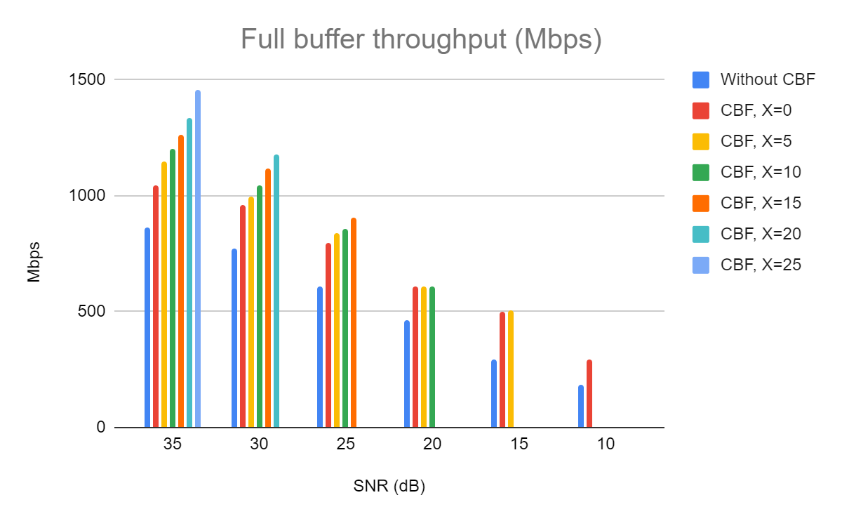
Full Buffer DL throughput in Mbps with 0us MU-RTS padding
Observations:
CBF throughput gains over without CBF increase with increase in X. This happens as the CBF PHY rates increase with reduction in the relative interference from its partner CBF AP.

Slide 14
Normalized Full Buffer DL throughput with 0us MU-RTS padding
 | SNR (dB)
With CBF | X (dB) | 35 | 30 | 25 | 20 | 15 | 10
 | 0 | 1.21 | 1.24 | 1.31 | 1.32 | 1.72 | 1.60
 | 5 | 1.33 | 1.29 | 1.37 | 1.32 | 1.74
 | 10 | 1.39 | 1.35 | 1.40 | 1.31
 | 15 | 1.46 | 1.45 | 1.48
 | 20 | 1.55 | 1.53
 | 25 | 1.68
Without CBF |  | 1.00 | 1.00 | 1.00 | 1.00 | 1.00 | 1.00

Slide 15
Normalized Full Buffer DL throughput with 64us MU-RTS padding
 | SNR (dB)
With CBF | X (dB) | 35 | 30 | 25 | 20 | 15 | 10
 | 0 | 1.20 | 1.23 | 1.29 | 1.30 | 1.70 | 1.58
 | 5 | 1.31 | 1.27 | 1.36 | 1.30 | 1.72
 | 10 | 1.37 | 1.33 | 1.39 | 1.30
 | 15 | 1.44 | 1.43 | 1.47
 | 20 | 1.53 | 1.51
 | 25 | 1.66
Without CBF |  | 1.00 | 1.00 | 1.00 | 1.00 | 1.00 | 1.00
Observations:
Even with 64us padding overhead and the additional MU-RTS/CTS exchange, CBF continues to show significant gains

Slide 16
Straw Poll
Do you agree that TGbn shall define a Coordinated Beamforming and Nulling procedure as one variant of the Multi-AP topic?

Slide 17
References
[1] IEEE P802.11be™/D5.1
[2] 11-23/0776r1 Performance of C-BF and C-SR

