Slide 1
March 2024
Multi-AP Preemption
for Low-Latency Traffic
Date: 2024-03-27
Authors:
Name | Affiliations | Address | Phone | email
Si-Chan Noh | Newracom |  |  | sc.noh@newracom.com
Joonsoo Lee |  |  |  | js.lee@newracom.com

Slide 2
Introduction
Preemption has been discussed in UHR SG and 11bn TG to support low latency application in different scenarios [1-4]
Most of the contributions are discussing preemption techniques in UL/DL TXOP cases to support DL/UL latency sensitive traffic within single BSS [1-4]
However, when the OBSS APs have a low latency sensitive traffic, it cannot support its LL traffic through single BSS preemption and wait until the end of the ongoing TXOP of other BSS’s
This contribution discuss about general Multi-AP preemption method and some issues focusing on where the OBSS APs have latency sensitive traffic to be transmitted urgently

Slide 3
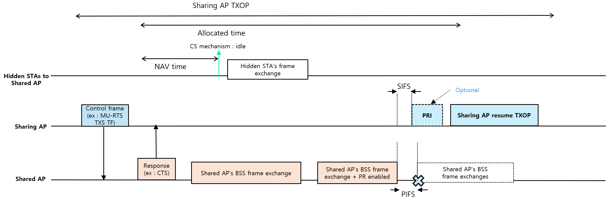
Recap - [5]
In the previous contribution, we discussed returning TXOP of shared AP to sharing AP through PR Enabled/PRI frame in C-TDMA
In this contribution, we share our thoughts of Multi-AP Preemption in more general scenarios when OBSS APs have LL traffic to be transmitted urgently

Slide 4
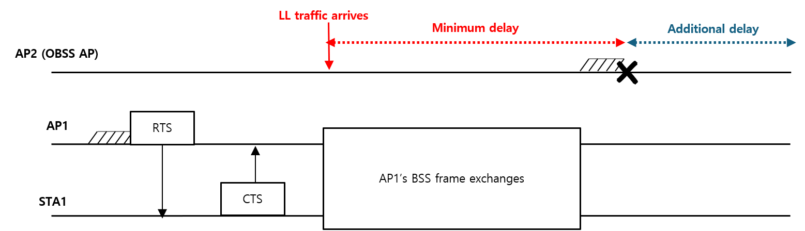
Problem Statement
When an AP reserves the medium, the other OBSS APs cannot transmit LL traffic until the end of ongoing TXOP
The LL traffic could be handled through several coordinated AP techniques
  For example, LL traffic could be handled at the membership AP on the R-TWT schedule between APs or shared AP side during allocated time in C-TDMA
  Those techniques can handle LL traffic when STAs get TXOP
Moreover, after completion of ongoing TXOP, we may not guarantee of transmitting LL traffic due to the contention with other devices
If we can extend single BSS’s preemption mechanism to multi-AP preemption, we can grant an opportunity to OBSS APs to transmit its LL traffic without large delay

Slide 5
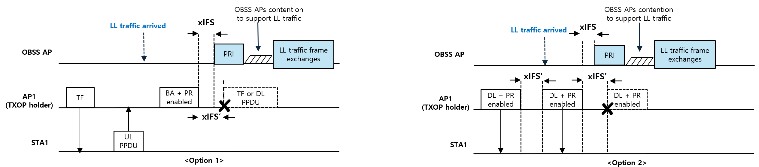
General solution for Multi-AP Preemption
TXOP holder AP can send a PR Enabled indication to grant preemption opportunity for OBSS APs which has LL traffic
  Here, the PR Enabled indication for Multi-AP preemption can be identified between APs
  The PR Enabled indication can be included in immediate response frame (e.g., BA) or small DL PPDUs
The OBSS APs can transmit Preemption Traffic Indication (PRI)
  After receiving PR enabled, the OBSS AP can transmit PRI
  When the OBSS APs set NAV due to the previous frame exchange of TXOP holder BSS, it can neglect it and can transmit PRI
    Option 1 : xIFS(e.g., xIFS > xIFS’) after the immediate response frame
    Option 2 : xIFS(e.g., xIFS > xIFS’) after the small DL PPDUs
After transmitting PRI, the OBSS APs can start contending (e.g., EDCA-based)
  The OBSS APs which are send PRI frame may participate contention to support LL traffic

Slide 6
Some issues in Multi-AP Preemption
Ignoring NAV value when the OBSS APs try to transmit PRI
  The NAV can be set not only due to TXOP holder BSS’s frame exchanges also updated from third party STA
  In case of when third party STA is hidden to the TXOP holder BSS, transmitting PRI frame can affect third party STA’s frame exchanges
Hidden node issues
  STAs associated to TXOP holder AP may not overhear PRI from LL clients(i.e., APs), it can affect interference
  Moreover, if the OBSS APs are hidden to each other, the collision can be happened
The TXOP holder AP could not aware of ending time of OBSS AP’s frame exchanges
  OBSS AP_1 and OBSS AP_2 are hidden each other
  OBSS AP_2 may success preemption and finish its LL traffic frame exchanges
  However, OBSS AP_1 may think the medium is IDLE, it can start its frame exchanges
  TXOP holder AP may not expecting the ending time
The other issues can be happened during when allowing Multi-AP preemption and address those issues can be too complicated or it may bring too many restrictions

Slide 7
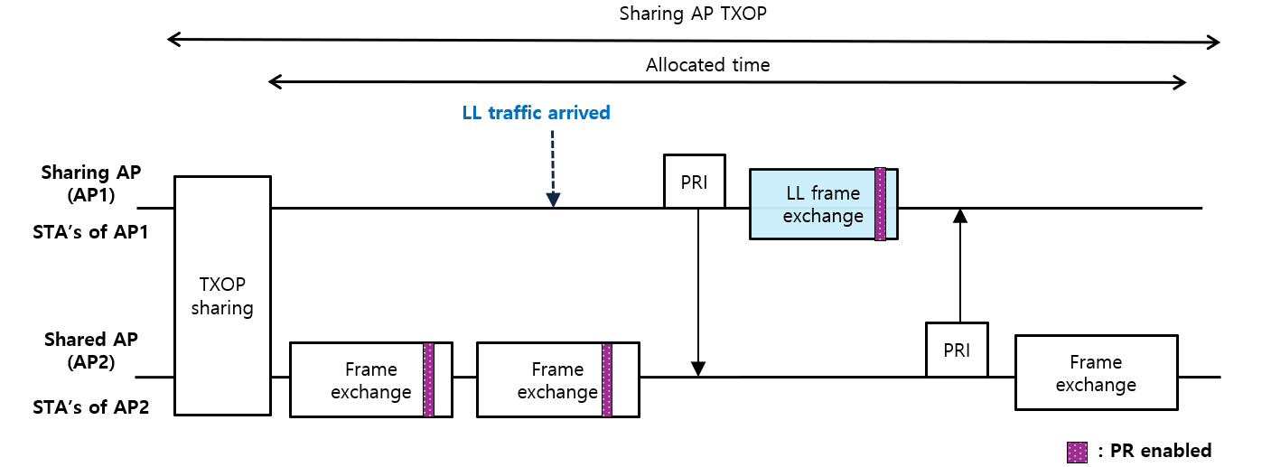
Some issues in Multi-AP Preemption
Appropriate scenarios for allowing Multi-AP preemption
  Allow Multi-AP preemption in more protected scenarios can be better way to relieve those issues
  Such as Coordinated APs techniques can be one of the protected scenario and it can be more efficient way in terms of latency and efficiency compared to in general scenarios
For example, when we assume well protected C-TDMA scenario:
  Sharing AP and shared AP identify
  each other, and can easily monitor their
  frame exchanges
  The Shared AP can allow preemption
  for the sharing AP, and vice versa
  After supporting LL traffic,
  the shared AP can resume its TXOP

Slide 8
Summary
In this contribution, Multi-AP Preemption is discussed to support OBSS AP’s LL traffic without large delay
However, some issues exist in Multi-AP Preemption
Some details should be discussed to allow preemption at AP’s level

Slide 9
Reference
[1] 23/0092r0, Preemption
[2] 23/1229r0, Preemption for Low Latency Application (follow up)
[3] 23/1886r3, Preemption techniques to meet low-latency (LL) targets
[4] 24/0168r0, TXOP preemption in 11bn
[5] 24/0375r0, NAV protection for C-TDMA

