Slide 1
Coordinated Spatial Re-Use and Coordinated Spatial Nulling Follow-Up
Date: 26-Mar-24

Slide 2
Introduction
In previous submissions [1, 2], the spatial nulling concept and simulations were presented
  MU-MIMO based spatial nulling performance
  Coordination scenarios
  Precoder computation options
This contribution addresses some feedback received on previous submissions
  Relation of coordinated spatial re-use (C-SR) and coordinated spatial nulling (C-SN)
  Comparison between coordinated beamforming and coordinated spatial nulling
  Synchronization requirements (example)
  Straw poll

Slide 3


  Coordinated Spatial Re-use (C-SR) and Coordinated Spatial Nulling (C-SN)
C-SN is an extension to C-SR in cases, where C-SR is inefficient
  When there are free resources (more Tx antennas than spatial streams transmitted) and an un-associated STA is close, perform spatial nulling
  If there is no gain, keep C-SR or TDMA
Low interference,
Reduce power
2 streams
2 streams
High interference, spatial null
2 streams
2 streams
1 streams

Slide 4

Beamforming vs. MU-MIMO
In our contributions, TDMA MU-MIMO is used as a baseline
For C-SR and C-SN, MU-MIMO transmission is assumed, too (e.g., each AP serves more than one STA at a time)
The reason is that MU-MIMO always outperforms beamforming, which is shown in the following simulation results
Scenario
  TDMA Beamforming
  C-SR/C-SN Beamforming
t₂
t₄
t₁
t₃
t₂
t₁

Slide 5
Aggregated Rates
TDMA vs. C-SR
TDMA vs. C-SN

Slide 6
STA Rates
TDMA vs. C-SR
TDMA vs. C-SN

Slide 7
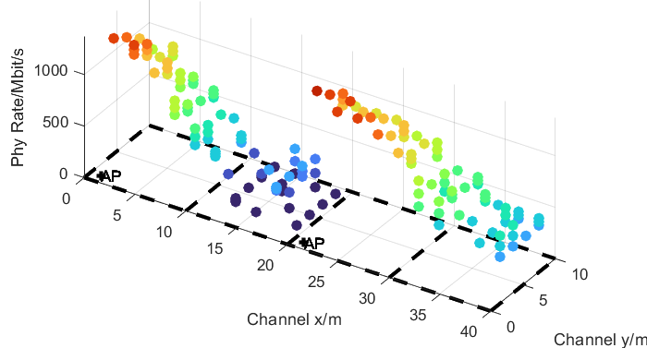
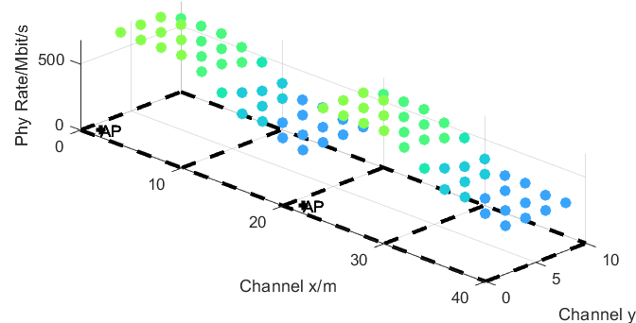
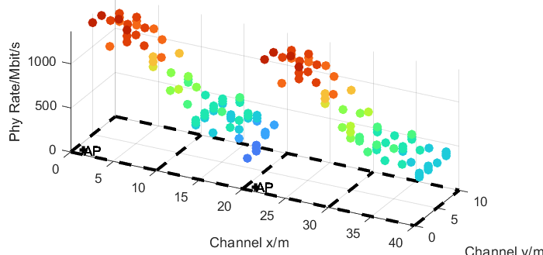
Rate Distribution in Space
Beamforming TDMA
Beamforming C-SR/C-SN
Half coordinated C-SR
Fully coordinated C-SN

Slide 8
Spatial Nulling and Symbol Alignment
On OFDM symbol boundaries, spatial nulling is not perfect [3]
  The interference at the symbol boundaries depends on the channel characteristics (e.g., a flat channel doesn‘t cause interference at the symbol boundaries)
  Interference depends on the transmit signal characteristics, e.g., tx windowing
If OFDM symbol boundaries are aligned, this interference doesn‘t affect the receiver.

Slide 9
Alignment requirements
Time and Clock Synchronization
  The synchronization requirements are much lower than e.g., for joint transmission [4], where the acceptable drift of the sample timing is only a fraction of a sample.
  Depending on the channel conditions a shift of a few samples is acceptable.
  A clock accuracy of +-0.07ppm is sufficient to stay within this range.
65.2ns

Slide 10
Straw Poll
Do you agree to include the following text to the 11bn SFD:
11bn will define coordinated spatial re-use
Coordinated spatial reuse may optionally include spatial nulling
Yes
No

Slide 11
References
[1] Rainer Strobel et.al.,”Coordinated Spatial Nulling (C-SN) Concept”, IEEE 802.11-24/0011r0
[2] Rainer Strobel et.al.,”Coordinated Spatial Nulling (C-SN) Simulations”, IEEE 802.11-24/0012r0
[3] Sigurd Schelstraete et.al., “Nulling and coordinated beamforming” IEEE 802.11-19/0638
[4] Rainer Strobel, “Multi-AP Simulations: follow-up”, IEEE 802.11-23/1843r0

Slide 12
APPENDIX

Slide 13
Simulation parameters
Parameter | Value
TX/RX Antennas | 4/2
APs/STAs | 2/4 (2 STAs per AP)
Spatial streams | 1 or 2 (optimized)
Bandwidth | 160 MHz
AP TX Power | 21 dBm
Channel model | D NLOS [8]
MCS | 0-13 (optimized)
Frequency | 5.25GHz
GI | 1.6µs
TX/RX SNR | 41dB/43dB
Channel aging/Doppler | 1.2km/h, 6Hz
BF quantization | ideal
Precoder type | ZF (HC), MMSE (FC)
Sounding interval | 100ms (SU), 10ms (MU)
Overhead | Sounding and MAC overhead not considered
SU time allocation | 25% for each STA
MU allocation | 2 STAs served by one AP 50% time for per AP

