Slide 1
MAPC C-SR Scheduling with Multi-Armed Bandits
Date: 2024-05-14
Authors:

Slide 2
Abstract
AIML TIG Technical Report presents a use case for Multi-AP Coordination, in which AIML can select which devices (AP-STA pairs) to involve (to leverage coordinated transmissions)
We present the first AIML method for Coordinated Spatial Reuse
Multi-armed bandits (MABs) can learn the best AP-STA pairs without a priori knowledge in a variety of scenarios
We design a hierarchical MAB framework to reduce the action space
Upper confidence bound (UCB) is particularly effective
  Rapid convergence, adaptability to changes, and sustained performance

Slide 3
Background
Co-channel interference becomes a problem with the increasing density of multi-AP networks
UHR SG will be “considering scenarios with multiple overlapping networks” [1]
One solution is for APs to coordinate and transmit in parallel (spatial reuse opportunities) → Multi-AP Coordination (MAPC)
MAPC may be included as one of the features in UHR [2]
Multiple MAPC transmission strategies, have been proposed in the literature: coordinated TDMA, coordinated OFDMA, coordinated spatial reuse, coordinated beamforming, and joint transmissions

Slide 4
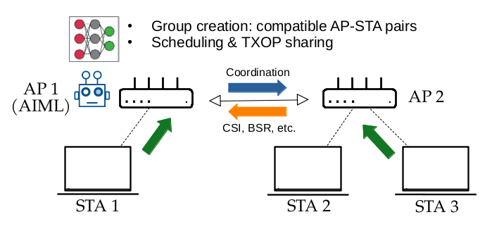
MAPC example scenario [3]
Notes:
„To illustrate AIML-enhanced MAPC operation, Figure 1 shows a simple scenario with 2 BSSs. AP 1 of BSS 1 is able to execute AIML models, which may be trained in AP 1, in other APs such as AP 2, or outside the 802.11 network. It collects channel state information (CSI), buffer state reports (BSRs) and any other suitable information from AP 2 of BSS 2 and all stations (STAs 1, 2, and 3), either directly or through AP 2. Using the collected information as the input for the AIML model, AP 1 is then able to a) determine if AP 1 and AP 2 can form an MAPC group, and b) select the most adequate transmission strategy depending on which AP-STA pairs are scheduled (including SU or MU, DL or UL). For example, while STA 1 and STA 3 can transmit simultaneously by leveraging coordinated spatial reuse, transmissions from STA 1 and STA 2 require coordinated OFDMA.” [3]

Slide 5
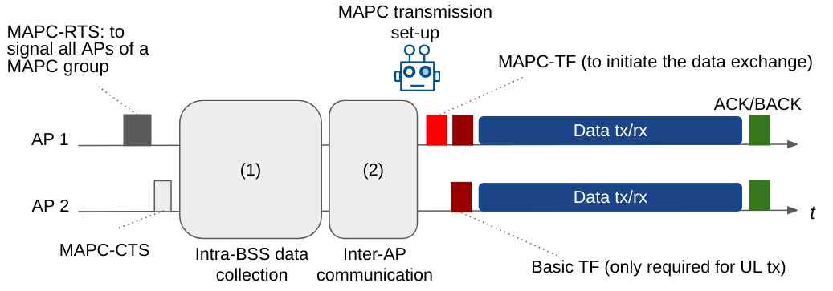
Example of AIML-enhanced MAPC message exchange [3]
Notes:
„Figure 2 presents an example message exchange for an AIML-enhanced multi-AP coordinated transmission. (This is an illustrative example only, the exact exchange of MAPC messages will be determined by UHR.) The MAPC exchange is triggered by a sharing AP (AP 1) with an MAPC-RTS/MAPC-CTS exchange between all APs involved in the upcoming coordinated transmission. This RTS/CTS may be optional. Then, in an initial phase —indicated by (1) in Figure 2— each AP collects information from its associated stations. Note that this data collection and report phase may not be required if AIML can predict measurement reports, or in the case that some measurements are quasi-static. Moreover, principal component analysis (PCA) can be used to reduce the amount of data to exchange (i.e., exchanging only a fraction of the total data, and reconstructing the missing data at the destination). However, since the reconstructed data may incur information loss, the accuracy-overhead trade-off needs to be considered. In the second phase —indicated by (2) in Figure 2— these reports are communicated to the sharing AP which uses AIML to select and configure the MAPC transmission strategy to be used in the final phase of transmission. It is expected that the pre-trained AIML model provides either a near-instantaneous response for immediately scheduling the coordinated transmission or schedules coordinated transmissions in the near future.” [3]

Slide 6
State of the art (Applying ML for MAPC)
Literature review provided in the technical report [3]
Examples
  Distributed MIMO [4]
  Optimizing RU allocation in OFDMA networks [5]
All closely related but not directly MAPC
Research goal: prove that AIML can enhance MAPC
  Focusing on C-SR

Slide 7
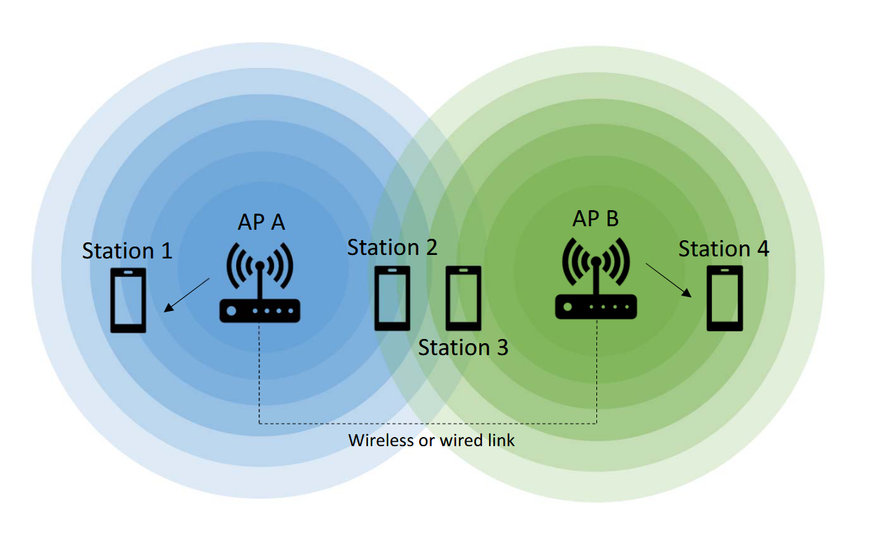
Coordinated Spatial Reuse (C-SR)
Concurrent transmissions on the same channel in overlapping networks
More transmission opportunities: higher throughput, faster channel access [6]
Different than 802.11ax SR!
Main challenge: determining which AP-station pairs can transmit simultaneously

Slide 8
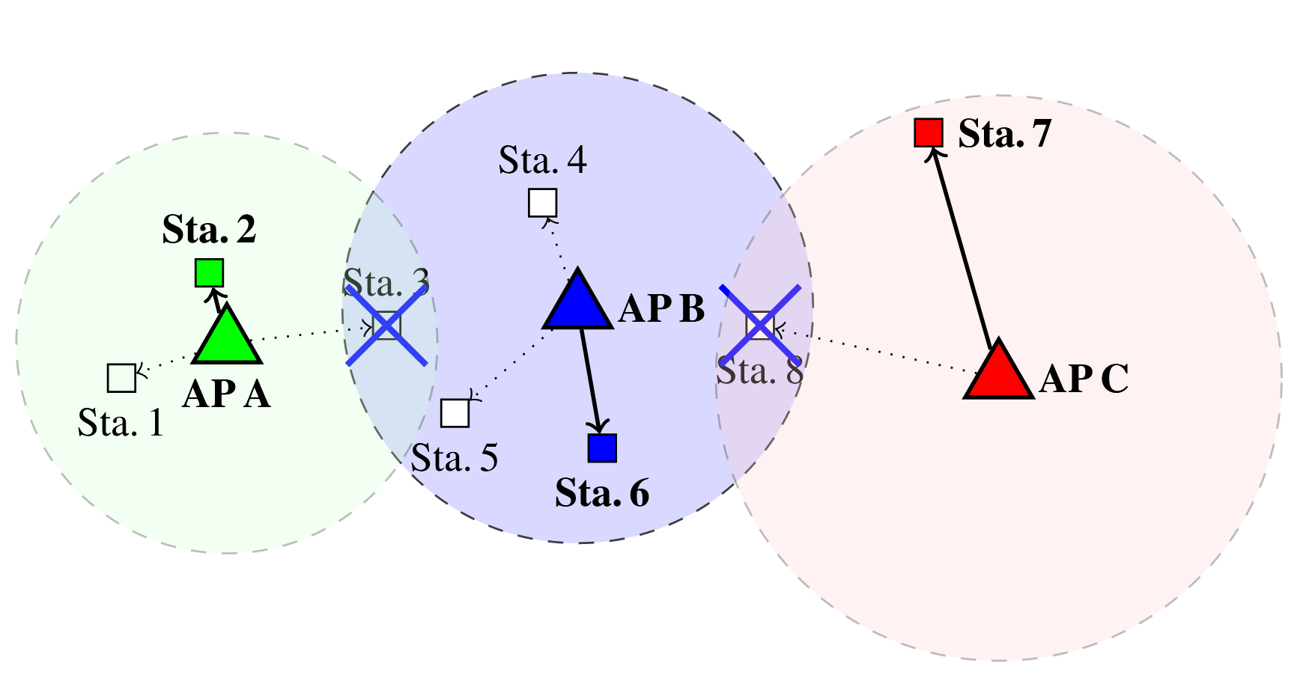
Determining AP-station pairs
Collecting RSS values?
  High variance [7]
  Overhead [8]
Our approach: reinforcement learning
  No a priori knowledge
  Online learning
  Adaptable to randomness of 802.11 topologies

Slide 9
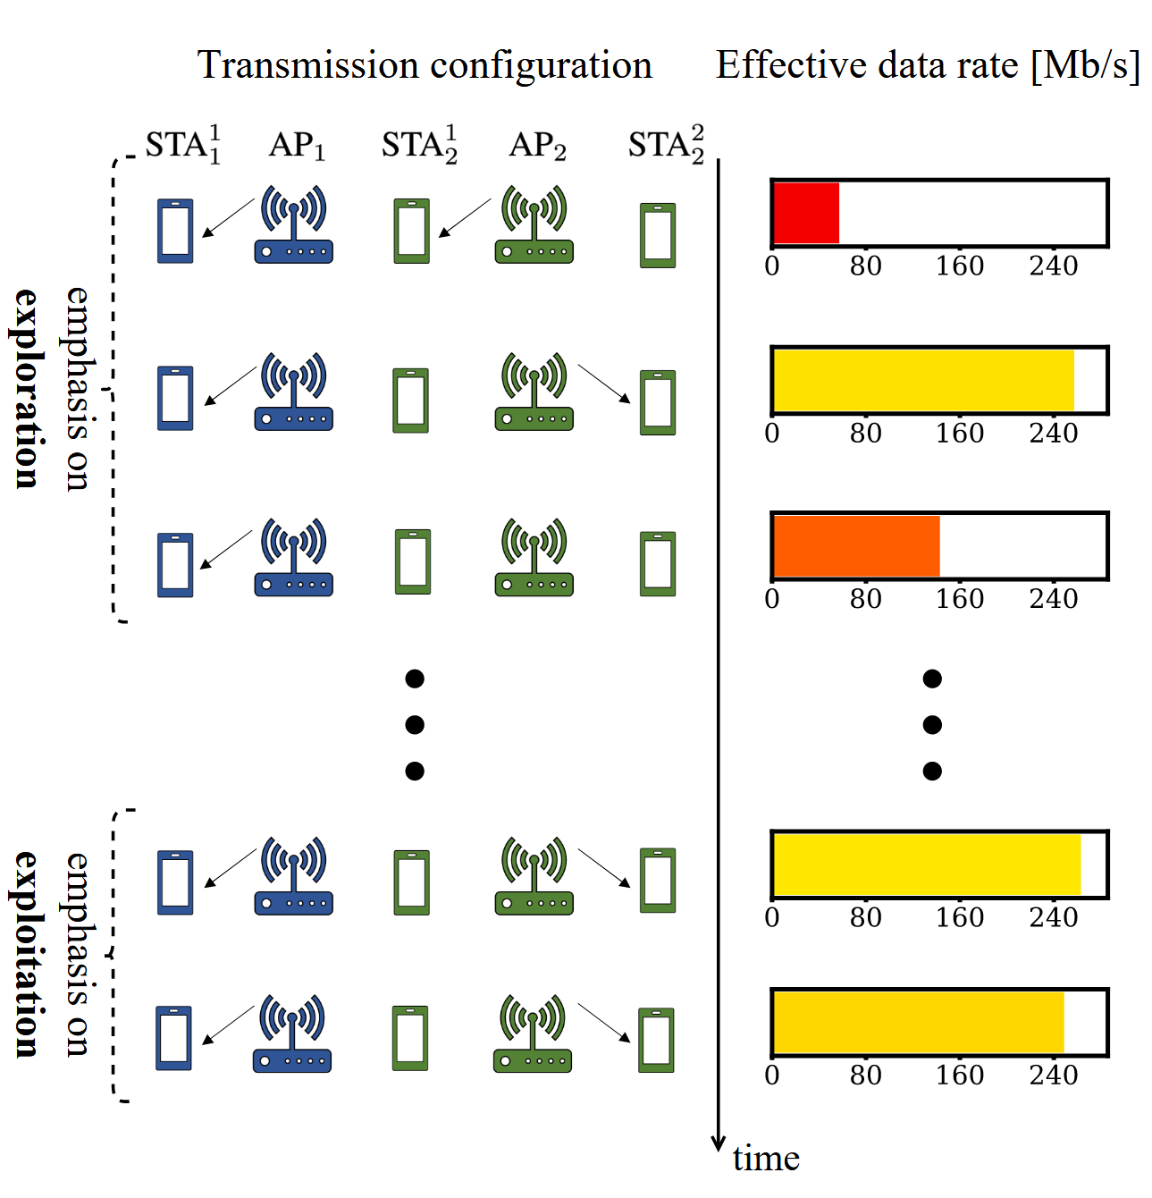
MAB Agents and their Learning Process
Sequential interaction between the agent and the environment:
  action 1 → reward 1; action 2 → reward 2
No states, only actions and rewards
Exploration-exploitation trade-off, the agent:
  Explores: selects an action ‘randomly’
  Exploits: selects the action with higher reward
Different approaches: simple, low-computing requirements
  ε-greedy, Thompson Sampling, UCB, EXP3, etc.

Slide 10
Proposed Hierarchical MAB Scheme
Assumption: downlink traffic
Hierarchical MABs to reduce the large search space [9]
Two-level hierarchy
  Level one – select APs to transmit simultaneously
  Level two – select non-AP STAs to receive transmissions (given a set of APs)
Phases
  Sharing AP is chosen randomly (DCF)
  Designated non-AP STA is chosen randomly from set of associated STAs (first transmitting pair)
  First-level agent selects set of APs (for concurrent transmission)
  Second-level agents select non-AP STAs to establish AP-STA pairs

Slide 11
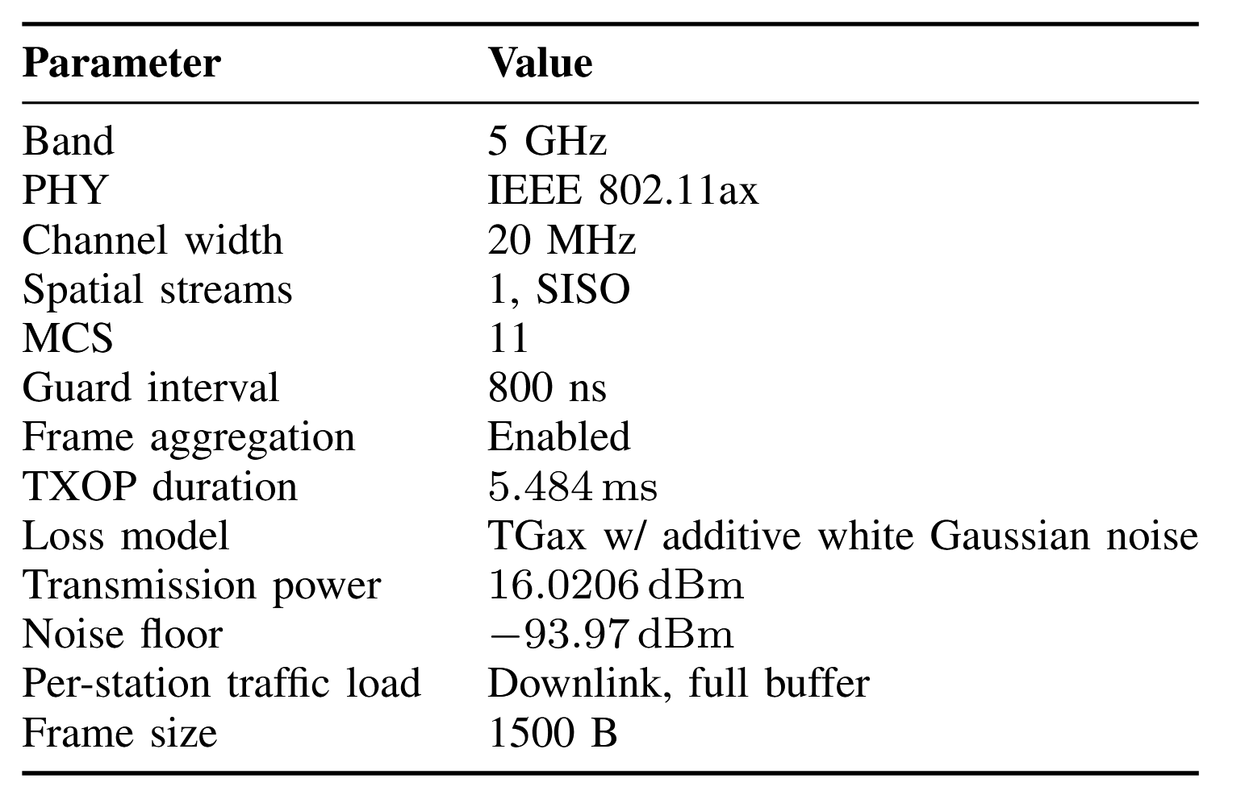
Simulation Model
Monte Carlo simulation model
Iterate over consecutive TXOPs
Path loss – TGax model for enterprise scenarios [10]
Open-source
https://github.com/ml4wifi-devs/mapc-sim
https://github.com/ml4wifi-devs/mapc-mab
MAB hyperparameters optimized with randomly generated scenarios

Slide 12
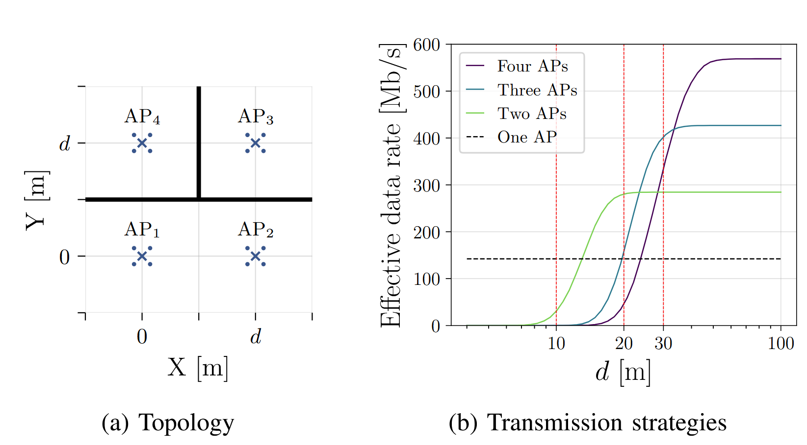
Test Scenario
In (a), crosses denote APs, dots – stations, thick black lines – walls. APs are placed on the corners of a d-sided square, and stations are evenly distributed 2 m from their APs. In (b), where transmissions are only to the outermost stations, the effective data rates of the coordinated transmission strategies (number of concurrently transmitting APs) depend on the square side d, assuming a fixed MCS of 11. The three operational points studied in further simulations are denoted by vertical lines.

Slide 13
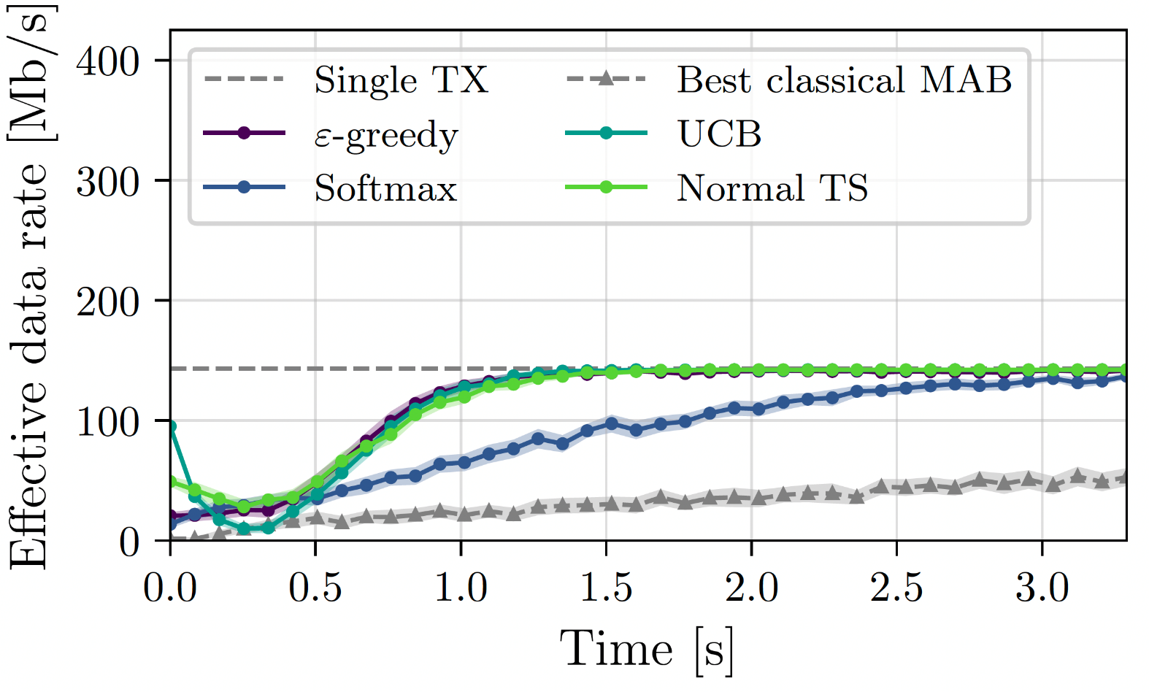
Results (d = 10 m)
Can MABs identify 'single AP TX' as the best case? Yes!
Most MABs converge within 1.0-1.5 s
Baseline: non-hierarchical (flat) MAB
  Longer convergence time

Slide 14
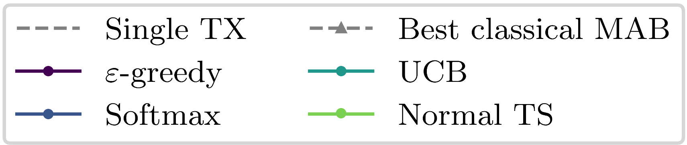
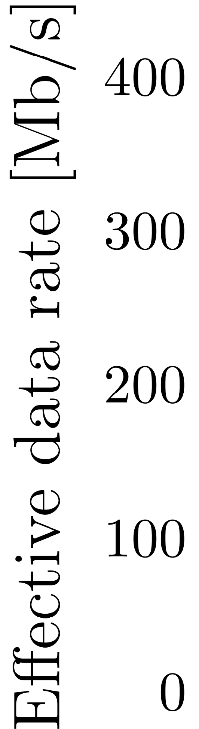
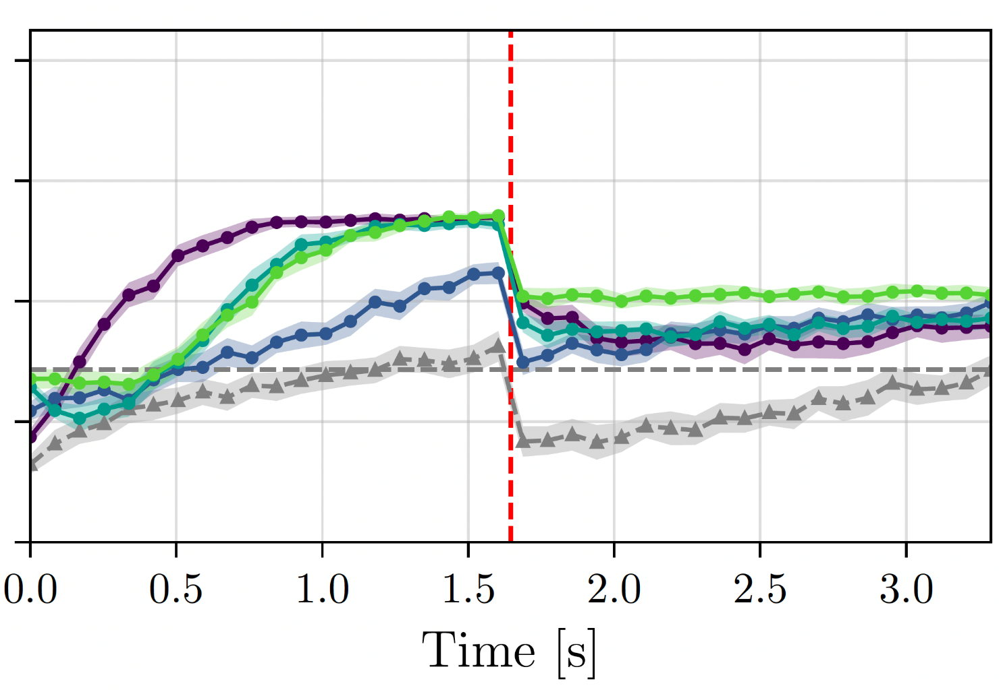
Results (d = 20 m)
C-SR at 20 m allows two concurrent TXs
MABs quickly find this solution (especially ε-greedy)
STAs begin at 2 m from their APs, but halfway through relocate to 3 m from the AP
MABs can quickly adapt

Slide 15
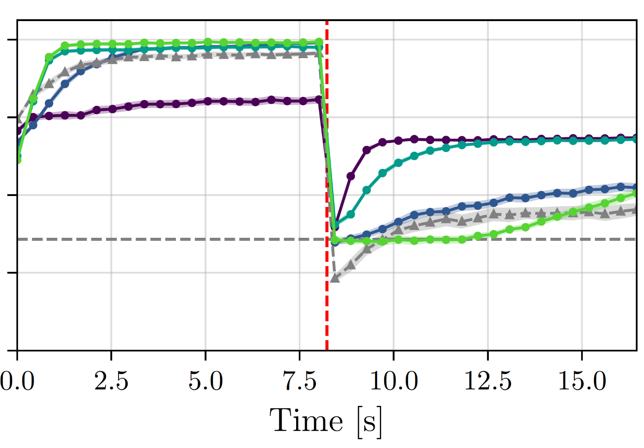
Results (d = 30 m)
C-SR at 30 m allows three concurrent TXs
Larger time scale, most MABs converge on best solution, improving over time
STAs begin at 2 m from their APs, but halfway through relocate to 4 m from the AP
This mobility disrupts performance, but most MABs quickly bounce back

Slide 16
Obervations on MAB Performance
ε-greedy has short convergence due to intensive exploration
TS can easily discover the best solution and slightly outperform other approaches in the long, static run
UCB, as an asymptotically optimal algorithm, strikes a balance between exploration and exploitation, and is the best general-purpose choice in terms of our tests
UCB is straightforward to implement and excels in performance: it quickly converges, adapts to rapid changes, and exhibits long-term effectiveness
Softmax behaves slightly worse in some scenarios, both in terms of convergence time and effective data rate achieved (inherent tradeoff between swift convergence and peak performance)

Slide 17
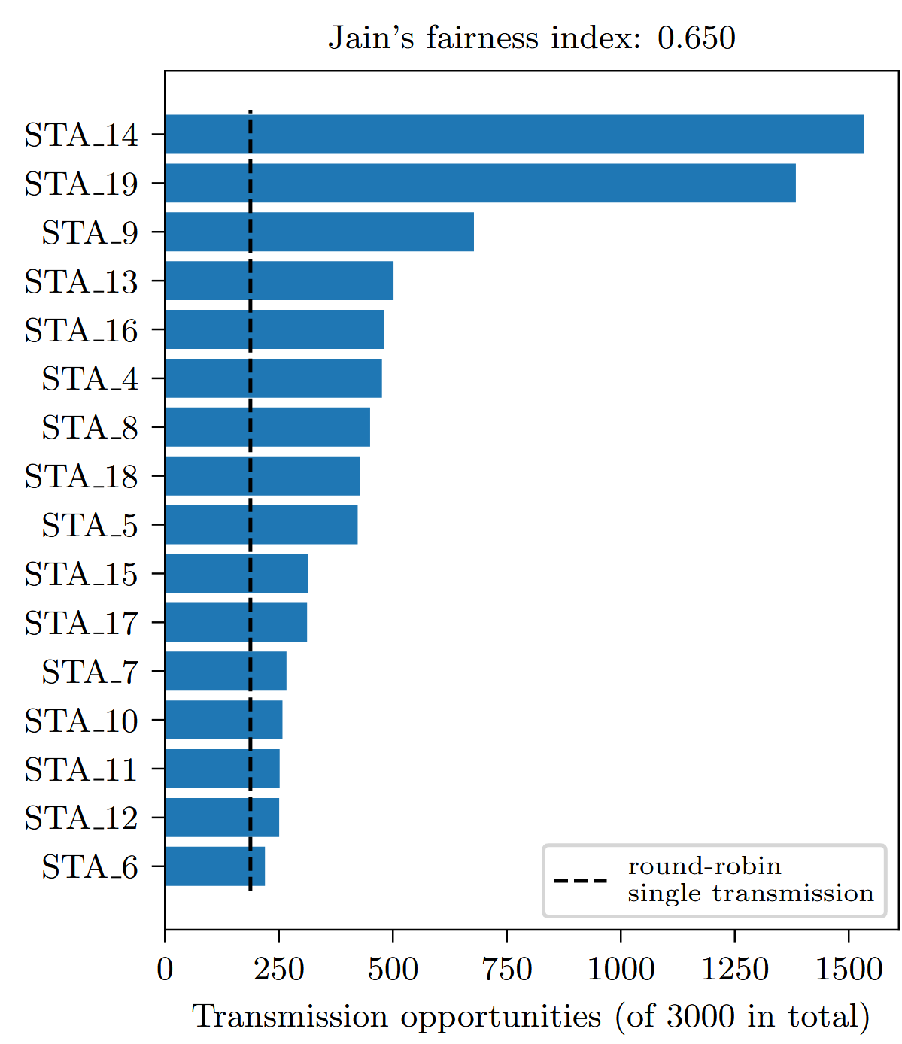
Fairness
All stations have more TXOPs than in the case of a perfectly-fair round robin single AP transmission scheme

Slide 18
Conclusions & Future Work
AIML can improve MAPC performance
MABs can be used to solve the C-SR problem of AP-STA pairs selection, convergence within seconds without signaling overhead
However, MABs require
  a hierarchical approach to decrease the action space
  hyperparameter tuning
Future work
  Variable transmission power settings [in progress]
  Data rate selection
  Experimental validation [in progress]
Potential standard impact: allow for the sharing AP to skip data collection phase

Slide 19
References
[1] 802.11 UHR Draft Proposed PAR, doc.: IEEE 802.11-22/0078r3
[2] 11-22/1516 "Considerations on Multi-AP Coordination"
[3] AIML TIG Technical Report, 11-22/0987r25
[4] N. Nurani Krishnanet al., "Optimizing Throughput Performance in Distributed MIMO Wi-Fi Networks Using Deep Reinforcement Learning," in IEEE Transactions on Cognitive Communications and Networking, vol. 6, no. 1, pp. 135-150, March 2020.
[5] D. Kotagiri, K. Nihei and T. Li, "Distributed Convolutional Deep Reinforcement Learning based OFDMA MAC for 802.11ax," ICC 2021 - IEEE International Conference on Communications, 2021
[6] D. Nunez, F. Wilhelmi, S. Avallone, M. Smith, and B. Bellalta, “TXOP sharing with coordinated spatial reuse in multi-AP cooperative IEEE 802.11be WLANs,” in 2022 IEEE 19th Annual Consumer Communications & Networking Conference (CCNC). IEEE, 2022, pp. 864–870.
[7] Y. Kim, H. Shin, Y. Chon, and H. Cha, “Smartphone-based Wi-Fi tracking system exploiting the RSS peak to overcome the RSS variance problem,” Pervasive and Mobile Computing, vol. 9, no. 3, 2013.
[8] Y. e. a. Seok, “Coordinated Spatial Reuse (C-SR) Protocol,” May 2020, doc.: IEEE 802.11-20/0576r1.
[9] L.-H. Shen, Y. Ho, K.-T. Feng, L.-L. Yang, S.-H. Wu, and J.-M. Wu, “Hierarchical Multi-Agent Multi-Armed Bandit for Resource Allocation in Multi-LEO Satellite Constellation Networks,” in 2023 IEEE 97th Vehicular Technology Conference (VTC2023-Spring), 2023, pp. 1–5.
[10] S. Merlin, “TGax Simulation Scenarios,” Nov. 2015, doc.: IEEE 802.11-14/0980r16

