Slide 1
Wi-Fi AFC Spectrum Sharing for Radio Astronomy
Date: 2024-03-12
Authors:
Name | Affiliations | Address | Phone | Email
Kevin Gifford | CU-Boulder, Winn Forum |  |  | kevin.gifford@colorado.edu
Andy Clegg | Google, Winn Forum |  |  | aclegg@google.com

Slide 2
Abstract
When the FCC opened the 6 GHz band for unlicensed use, the FCC stipulated two types of operations: Low-power indoor operations and standard power operations. In order to avoid interference with incumbent fixed microwave systems and radio astronomy at a limited number of observatories, standard power access points and fixed client devices have to operate under the control of AFC systems in two portions of the band: The U-NII-5 band at 5.925-6.425 GHz and the U-NII-7 band at 6.525-6.875 GHz.
We’ll discuss aspects of incumbent protections in the 3.5 GHz Citizens Broadband Radio Service (CBRS) and 6 GHz Automated Frequency Coordination (AFC) bands that are relevant to passive/active coexistence.

Slide 3
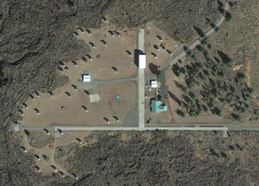
Wi-Fi AFC Spectrum Sharing for Radio Astronomy CU-Boulder | UC-Berkeley | HCRO | Google Kevin Gifford (CU), Andy Clegg (Google) Co-Chairs of Winn Forum Passive Active Spectrum Sharing WG 12-Mar-2024
Arecibo
ATA at HCRO
Green Bank
Very Large Array (NM)
VLBA (all 10 sites)

Slide 4
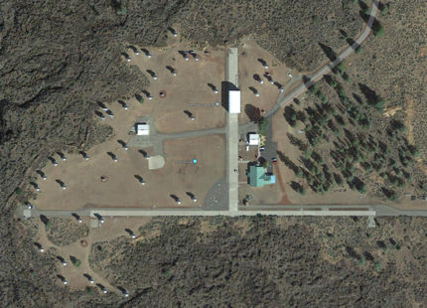
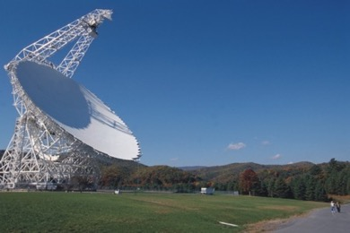
Emphasis: bi-directional spectrum sharing
GOAL: Enable bidirectional spectrum sharing and protect RA observations
Multi-stakeholder emphasis
Focus is on spectrum sharing: active Wireless comms: LTE, 5G, Wi-Fi
Sharing with passive Radio Astronomy (RA), Earth Exploration Satellite System (EESS)
Radio Astronomy (RA) and Earth Exploration Satellite Service (EESS) are passive RF systems: no Tx, Rx only

Slide 5
Big spectrum sharing take aways for R.A.
Satellites are the great equalizer We (R.A.) can’t hide, we must share…

Slide 6
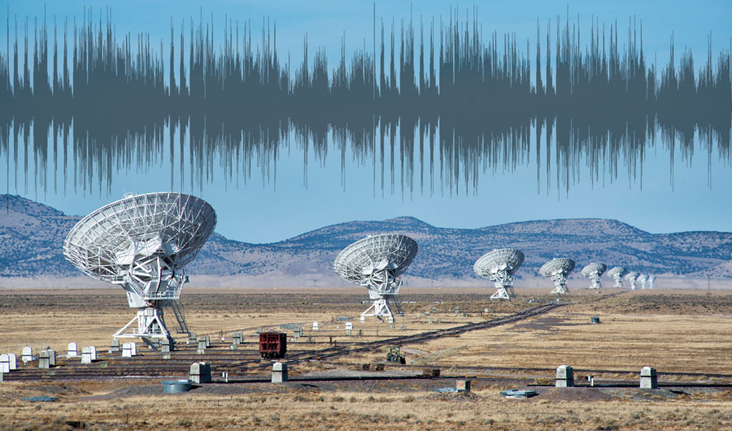
Problem: Active emitters disrupt RA scientific observations

Slide 7
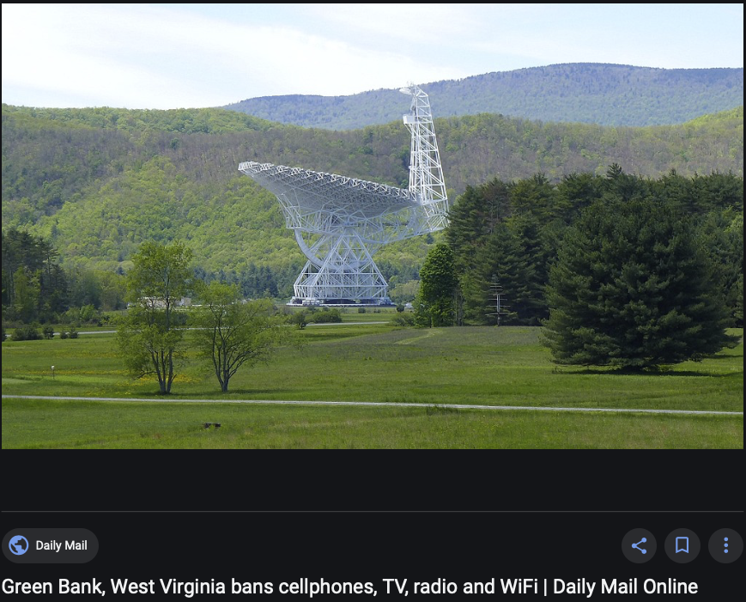
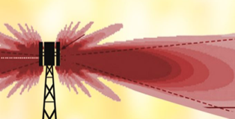
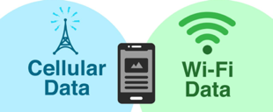
Problem: Active emitters disrupt RA scientific observations

Slide 8
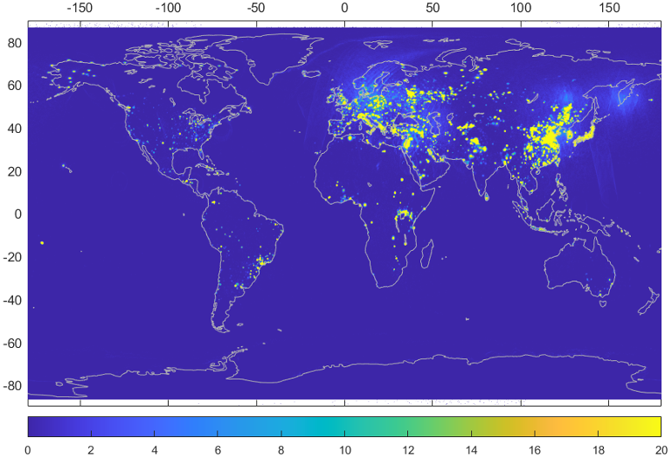
Problem: Active emitters disrupt EOS scientific observations
Percent of time that the 1.413 GHz passive microwave sensor on NASA’s SMAP mission detects RFI level of > 5 K between April 2015 and March 2016. ITU recommended interference limit is 0.05 K.
(Mohammed et al., IEEE Trans. Geosci. Remote Sens., 2016, cited in CORF publications).

Slide 9
Passive RF systems concerns
Passive radio frequency observations provide unique information that is of great value to scientific research and society (origins, climate, moisture, weather forecasting, etc.)
The bands in which these observations are made are, in most cases, dictated by mother nature – they cannot be moved, or traded
The signals being measured are very small, and thus particularly susceptible to interference, which corrupt observations
Some areas of concern for the passive community:
Out of band and spurious emission into passive-only bands
In-band emission in to shared bands (e.g., when previously ground-based transmissions are allowed to become airborne)
Increased utilization of mobile transmissions (interference from fixed sources is generally far easier to ameliorate)

Slide 10
Summary: RA and passive spectrum concerns
Problem: Active emitters disrupt RA scientific observations
A generalized spectrum sharing architecture has the potential to both protect RA and assist RA in observations outside of RA-protected bands.
Coordination/sharing with terrestrial emitters is a primary goal.
Inclusion of satellite emphemera (orbit and transmission frequency information) can be utilized by the RA facilities for coordinated scientific observations in non-protected RA bands. Satellites are particularly problematic interference sources for radio astronomy.

Slide 11
Examples of Methods Used to Protect Incumbents in 3.5 GHz CBRS and 6 GHz AFC with Relevance to Passive/Active Spectrum Sharing
When the FCC opened the 6 GHz band for unlicensed use, the FCC stipulated two types of operations: Low-power indoor operations and standard power operations. In order to avoid interference with incumbent fixed microwave systems and radio astronomy at a limited number of observatories, standard power access points and fixed client devices have to operate under the control of AFC systems in two portions of the band: The U-NII-5 band at 5.925-6.425 GHz and the U-NII-7 band at 6.525-6.875 GHz.
We’ll discuss aspects of incumbent protections in the 3.5 GHz Citizens Broadband Radio Service (CBRS) and 6 GHz Automated Frequency Coordination (AFC) bands that are relevant to passive/active coexistence.

Slide 12
Citizens Broadband Radio Service (CBRS)
CBRS operates in 3550-3700 MHz and shares spectrum with government radars and fixed-satellite service downlinks
There are no passive services in the CBRS band, but there are incumbents that must be protected from harmful interference
A cloud-based controller called a Spectrum Access System (SAS) manages CBRS devices so that they do not cause interference to incumbents
Federal government incumbents (i.e., DoD radar) are protected predominantly by a concept called Dynamic Protection Areas (DPAs)
Fixed-satellite service (FSS) receive-only earth stations are protected through the use of coordination areas, which are effectively “non-dynamic” Dynamic Protection Areas

Slide 13
Dynamic Protection Areas (DPAs) are used to protect incumbent users from harmful interference due to secondary users sharing the same or adjacent frequencies
A DPA is a pre-defined area (or a point) in/at which an incumbent operates on a dynamic basis (i.e., operations change with time and frequency)
When an incumbent is operating in a DPA, secondary users in the neighborhood of the DPA could be required to change their operating parameters to protect the DPA
For example, a secondary user’s device may need to change its frequency and/or power to protect the incumbent
A DPA neighborhood is a pre-defined area surrounding the DPA in which a secondary user could in theory contribute to producing harmful interference to the incumbent, typically based on worst-case assumptions (DPA sensitivity analyses)
Secondary users outside of the DPA are not expected to cause interference and are not affected by the presence of the DPA
The size of the neighborhood is based on assumed deployment models, the DPA interference criterion, and a standardized propagation model
200 km and random emitters
200 km and 100 km DPA

Slide 14
Dynamic Protection Area (DPA)
DPAs are not exclusion zones
DPAs are where the incumbent operates, not where secondary users might be prohibited from operating, or need to change their operating parameters, to protect the incumbent
DPA neighborhoods are not exclusion zones
Whether a particular secondary device is or isn’t allowed to operate in a DPA neighborhood depends on a number of factors, including its predicted contribution to harmful interference into the DPA
A given secondary user may be able to continue operating as is, or continue operating after a change of parameters (e.g., frequency or power), in a DPA neighborhood
Under certain situations a secondary user may need to cease operation altogether while the incumbent is operating in the DPA

Slide 15
DPAs vs Exclusion Zones
Knowledge as to whether an incumbent is operating in its DPA, and at which frequency or frequencies, may be determined by at least two methods
Sensing: Receivers in or near the DPA listen for incumbent activity in the DPA (i.e., CBRS Environmental Sensing Capability, or ESC)
Obviously, sensing would not work for passive services
Informing Incumbent Capability (IIC): The incumbent notifies secondary users when it plans to operate in a DPA, and at which frequency or frequencies (i.e., CBRS portal-controlled DPAs)
DPAs are used to protect federal government radar incumbents in the Citizens Broadband Radio Service (CBRS)
ESC is used to detect DPA activity in most coastal DoD operating areas
ESC sensors must be able to detect pre-ordained radar signatures
Incumbent Informing Capability (IIC) is used to inform DPA activity in 11 inland radar sites, and American Samoa
Some radar activities in the inland areas are experimental and cannot be effectively detected by pre-ordained detection algorithms, and some activities in these areas that require protection are receive-only
Note: Periodic Use Areas (PUAs) in the budding 3.45 GHz band (3450-3550 MHz) may share some characteristics of DPAs

Slide 16
Use of DPAs for Incumbent Protection
A CBRS Spectrum Access System (SAS) obtains geographic and technical descriptions of DPAs
Geographic and other technical information about DPAs that must be monitored by ESC is contained in an NTIA-maintained file*, e-dpas.kml
Similar information for DPAs that must be monitored by an IIC portal is contained in an NTIA- maintained file*, p-dpas.kml
In addition to the geographic definition of the DPAs, the files contain metadata related to DPA protection, such as protection criteria, DPA neighborhood size, etc.
A SAS reads these files on a regular basis from the NTIA website, but their contents are not expected to change frequently (i.e., advance notice from DoD is expected if the DPA descriptions are to be changed)
* kml files are text files containing standardized geographic information and metadata, which can be read and displayed by common programs such as Google Earth, and can be opened by standard text editors such as Notepad and Word

Slide 17
How DPAs Work in CBRS: Step 1 – DPA info
A SAS becomes aware of incumbent activity in a DPA
In the case of ESC, a message is sent from the ESC network to the SAS telling it which DPA the incumbent is operating in, and which frequency ranges the incumbent is operating over
In the case of a portal-controlled IIC DPA, a spectrum manager responsible for operations at the given portal DPA site logs into a calendar and specifies when, and at which frequencies, they plan to operate. SASs read the portal DPA calendars on a regular basis and protect the DPAs accordingly when an operating event is scheduled
The DPA is considered to be “activated” in that frequency range when the incumbent is operating
If a SAS does not have access to an ESC or the ESC has suffered a failure, or there is a problem with the SAS accessing the portal, the respective DPA must be assumed to be active on all unmonitored frequencies (“fail safe”)

Slide 18
How DPAs Work in CBRS: Step 2 – DPA Activation
When a DPA is activated, SASs reconfigure CBSDs within the DPA neighborhood such that the DPA’s interference criterion is not predicted to be exceeded at any point in the DPA at the frequency range in which the incumbent is operating
Interference predictions are based on standardized pre-established propagation models and other standardized methodologies
CBRS DPA neighborhoods are defined by a maximum distance from the boundary of the DPA
Cat A (in/outdoors, <= 1 W EIRP) and Cat B (outdoor only, <= 50 W EIRP) CBRS devices have different neighborhood distances (Cat B neighborhood distances are >= Cat A neighborhood distances)
For some DPAs, neighborhood distances are established for out-of-band emissions that impact federal incumbent operations below 3550 MHz

Slide 19
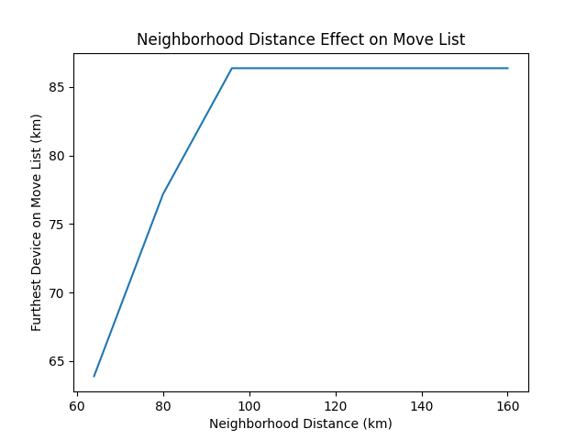
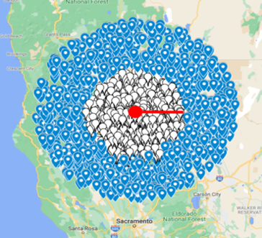
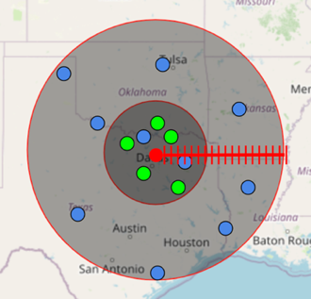
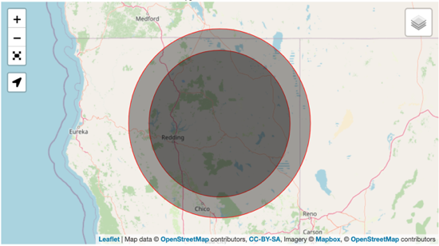
ITU-R RA.769-2. Protection criteria for radio astronomical measurements
Location: 40.81734, -121.46933
Height: 6.1 meters
Beamwidth: 0.98°
3.55° / 3.625
Azimuth range: 0°-360°
RIT ≅ -160 dBm
NF_{Rx} = 10*log(30K/290K +1) ≅ 0.43
I/N_{ratio} = -10
AntGain_{Rx} = 50
Representation of a DPA neighborhood distance.
Effect of the tested neighborhood distance on the calculated move list.
Simulation radius
Category A
200 kilometers
2,790 APs
Category B
500 kilometers
369 APs
Threshold: -160 dBm
1000 iterations
Distance
Category A: 112 kilometers
Category B: 144 kilometers
Interference
Category A: -172 dBm
Category B: -173 dBm
The calculated category A and category B neighborhoods for Hat Creek Radio Observatory, which are the inner and outer circles, respectively.
Representation of the search resolutions for a neighborhood distance.

Slide 20
How DPAs Work in CBRS: Step 3 – Interference Protection
When and ESC no longer detects activity, or a scheduled event in the portal IIC expires, the SAS reconfigures CBRS use in the neighborhood back to normal
In the case of ESC-detected activity, a two-hour delay after last activity is added, in part to avoid hysteresis effects

Slide 21
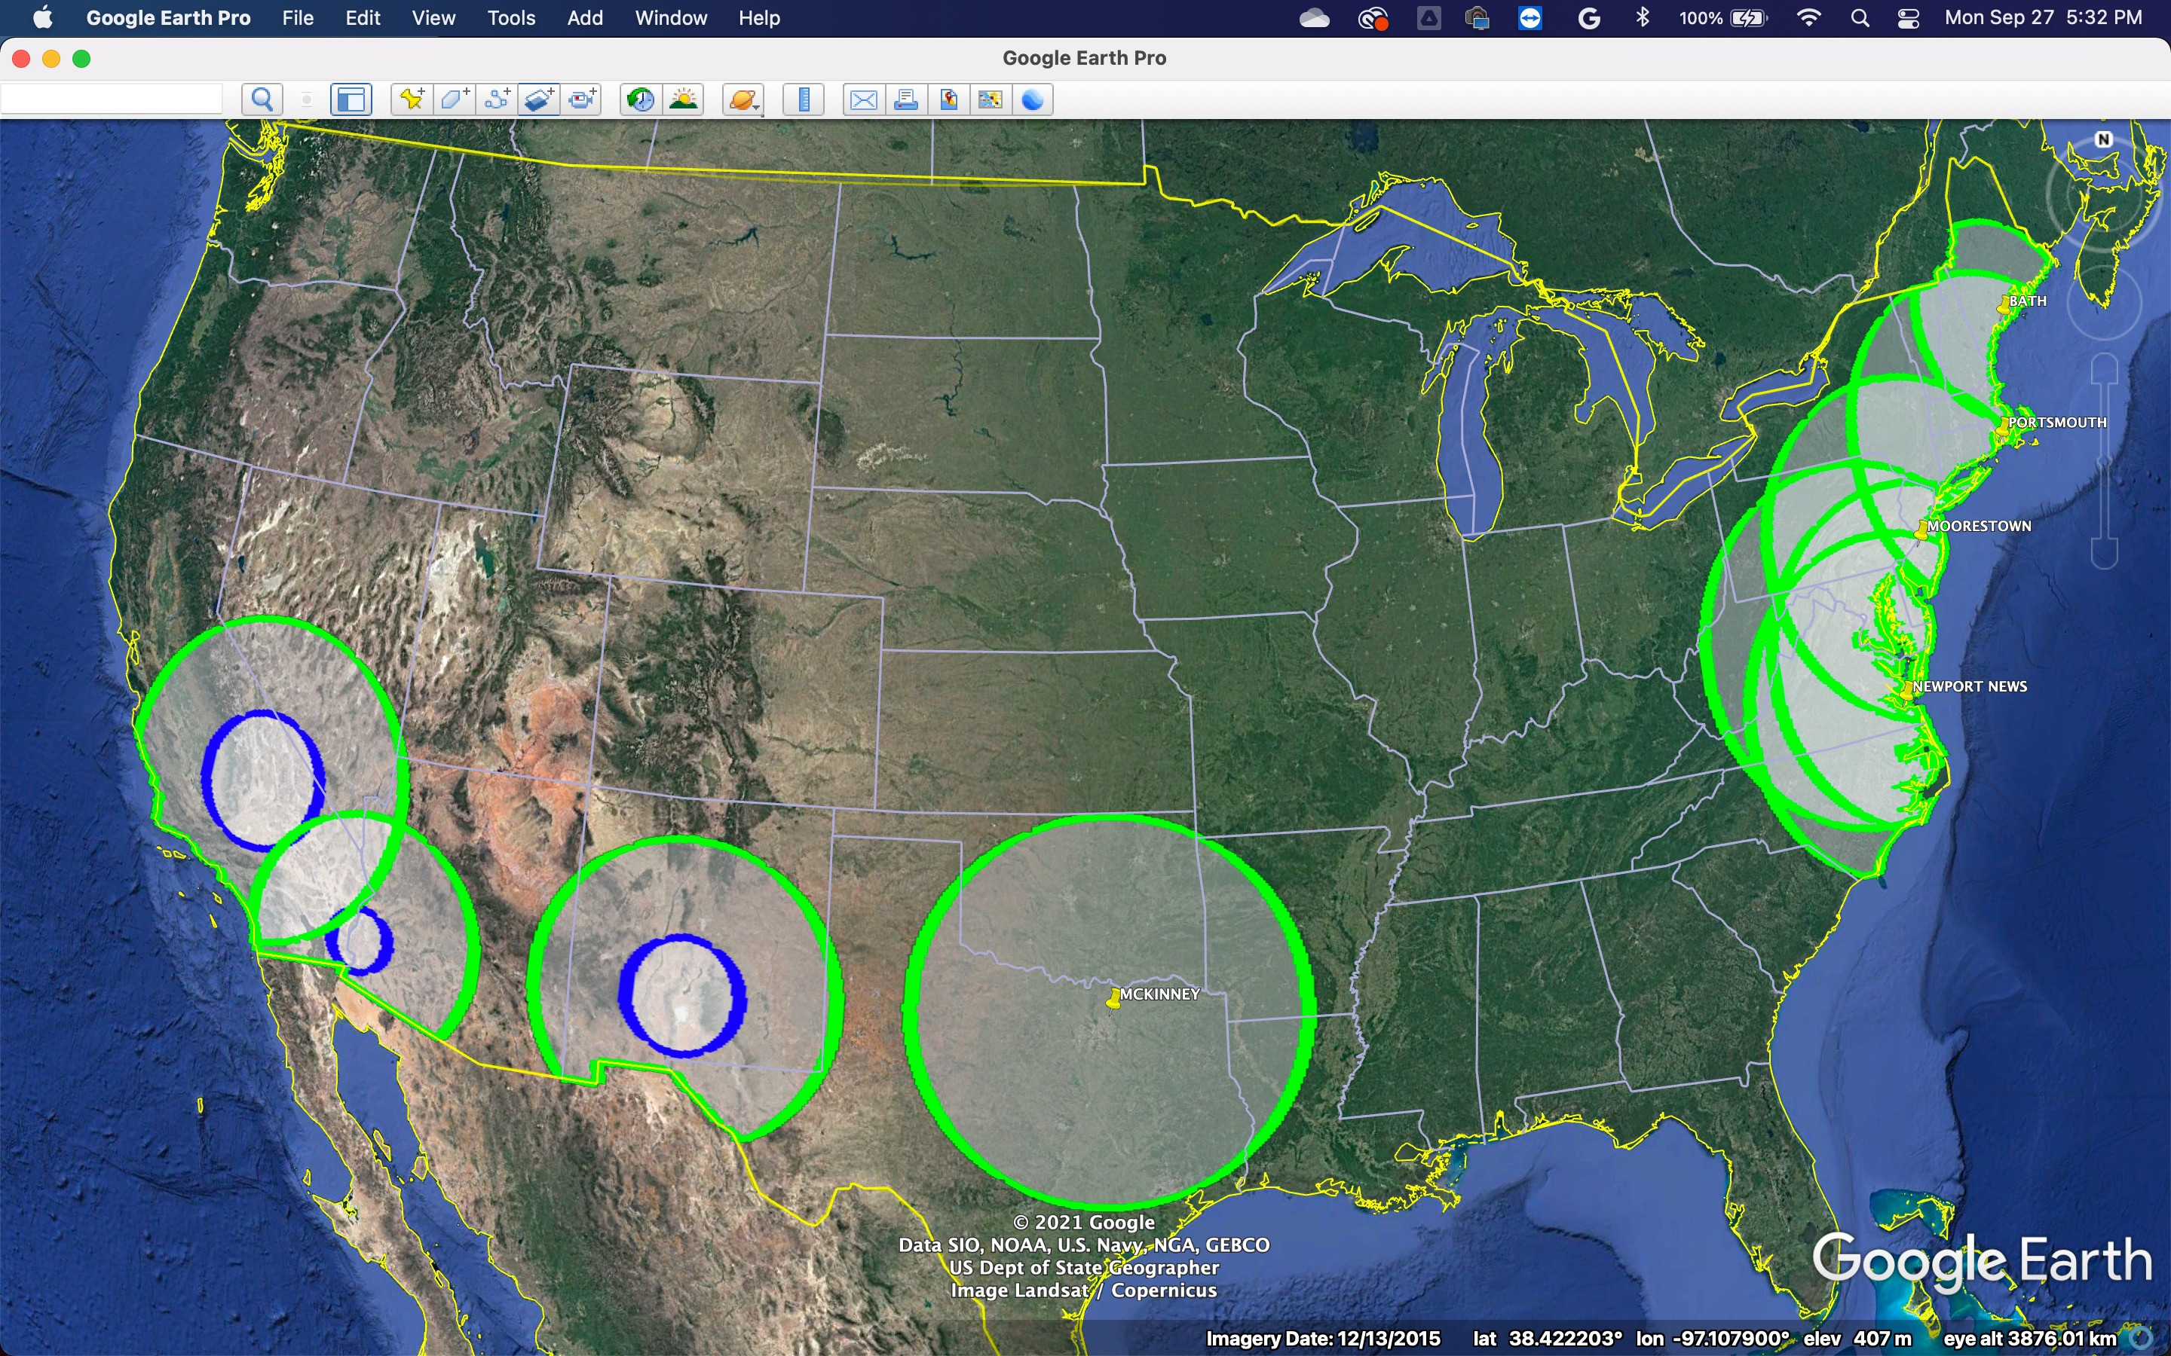
Portal-Managed DPA Neighborhoods
(In-band Category B) in the Contiguous U.S.
21

Slide 22
6 GHz Automated Frequency Coordination (AFC)
A portion of the bands in which SPAPs operate under AFC management is noted to be used for radio astronomy observations in the 6650-6675.2 MHz range
Footnotes US342 to the allocation table notes frequency range; footnotes US131 and US385 provide coordinates
The Part 15 rules under which 6 GHz devices and AFC systems operate require protection of designated radio astronomy by way of exclusion zones whose size depend on the heights (AGL) of the RA receiver and the AP
Based on mutual radio horizon calculation, but does not take terrain into account
New Unlicensed Designations
U-NII 5 U-NII 6
U-NII 7 U-NII 8
Low-Power Indoor
Standard Power AFC-controlled
Standard Power AFC-controlled
Current Use
Ultrawideband (unlicensed)
Standard Frequency and Time Signal-Satellite Downlink ➝
Radio Astronomy
NGSO MSS Feeder Downlinks
CARS
RA
CARS
BAS
BAS
ESV Uplinks
Passive Microwave Sensors
FSS Uplinks
Fixed Microwave
Fixed Microwave
5925
6425
6525
6700
6875
7075
7125
Not allocated (footnote consideration only)
Not allocated (unlicensed designation)

Slide 23
6 GHz Band (AFC)
47 CFR 15.407(m)
Incumbent Protection by AFC system: Radio Astronomy Services. The AFC system must enforce an exclusion zones to the following radio observatories that observe between 6650-6675.2 MHz: Arecibo Observatory, the Green Bank Observatory, the Very Large Array (VLA), the 10 Stations of the Very Long Baseline Array (VLBA), the Owens Valley Radio Observatory, and the Allen Telescope Array. The exclusion zone sizes are based on the radio line-of-sight and determined using4/3 earth curvature and the following formula:
dkm_los = 4.12 * (sqrt(Htx) + sqrt(Hrx)),
where Htx is the height of the unlicensed standard power access point or fixed client device and Hrx is the height of the radio astronomy antenna in meters above ground level. Coordinate locations of the radio observatories are listed in section 2.106, notes US 131 and US 385 of this part.
Arecibo
ATA at HCRO
Green Bank
Very Large Array (NM)
VLBA (all 10 sites)

Slide 24
AFC RA Protections are Exclusion Zones
No consideration for terrain, clutter, or other factors
No consideration for case-by-case predicted level of interference
No consideration for dynamic operations of the RA observatories
Actual use of the 6 GHz band for observing is not taken into account
Based on available data, percentage of time that the 6 GHz band is used for RA is extremely low (e.g., effectively 0% utilization of the 6 GHz band at Green Bank from 2003-2011 based on study by Clegg et al., 2012)
Exclusion zones like these are typically worst-case and can be vastly over- protective
Protections would be much more efficiently implemented by way of Dynamic Protection Areas

Slide 25
A Proposed Method to Protect RA Sites in a Shared Spectrum Environment
Utilize DPAs to protect RA sites
Establish a point-DPA at the location of the telescope
Establish a corresponding neighborhood based on actual terrain and clutter data and predicted path loss from each point to the DPA
Automatically connect the observatory’s observing schedule to a portal-based informing incumbent capability
E.g., a script that reads the observatory’s schedule on a regular basis and places API calls to enter reservations into the portal calendar
Updates portal at least 24 hours in advance
Cloud-based sharing systems such as AFC utilize the portal calendar to enforce protections for the observatory

Slide 26
Benefits of IIC for General RA Protection
Allows efficient use of a shared band while fully protecting the observatory when needed
Could enable RA access to active bands on an opportunistic basis
As pointed out by RA, they often need access to bands not allocated for RA, for example to observe doppler-shifted spectral lines or fill coverage gaps in continuum observations to better determine spectral shape
Could enable active use of RA bands on an opportunistic basis in exchange for other considerations (lease payments, equipment, etc.)
This could meet temporary surges in demand, for example in emergency situations such as storms (e.g., Hurricane Maria in PR); or help meet need for IoT spectrum, in which devices are readily able to take advantage of opportunistic access

Slide 27
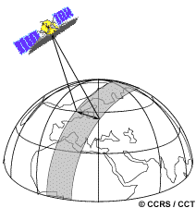
Could DPAs and IIC be Used for Satellite Protections?
RA observatories are particularly vulnerable to satellite-based interference
Passive EESS satellites see large swaths of ground as they pass over
Could IIC be used to synchronize satellite and ground-based passive and active spectrum use?
Turn off ground-based emitters in satellite field of view during brief overpasses
Alert RA telescope of upcoming satellite passes to avoid acquiring data during noisy (or potentially dangerous!) overpasses
Satellite ephemerides could be used to implement DPA protections by way of an IIC portal

Slide 28
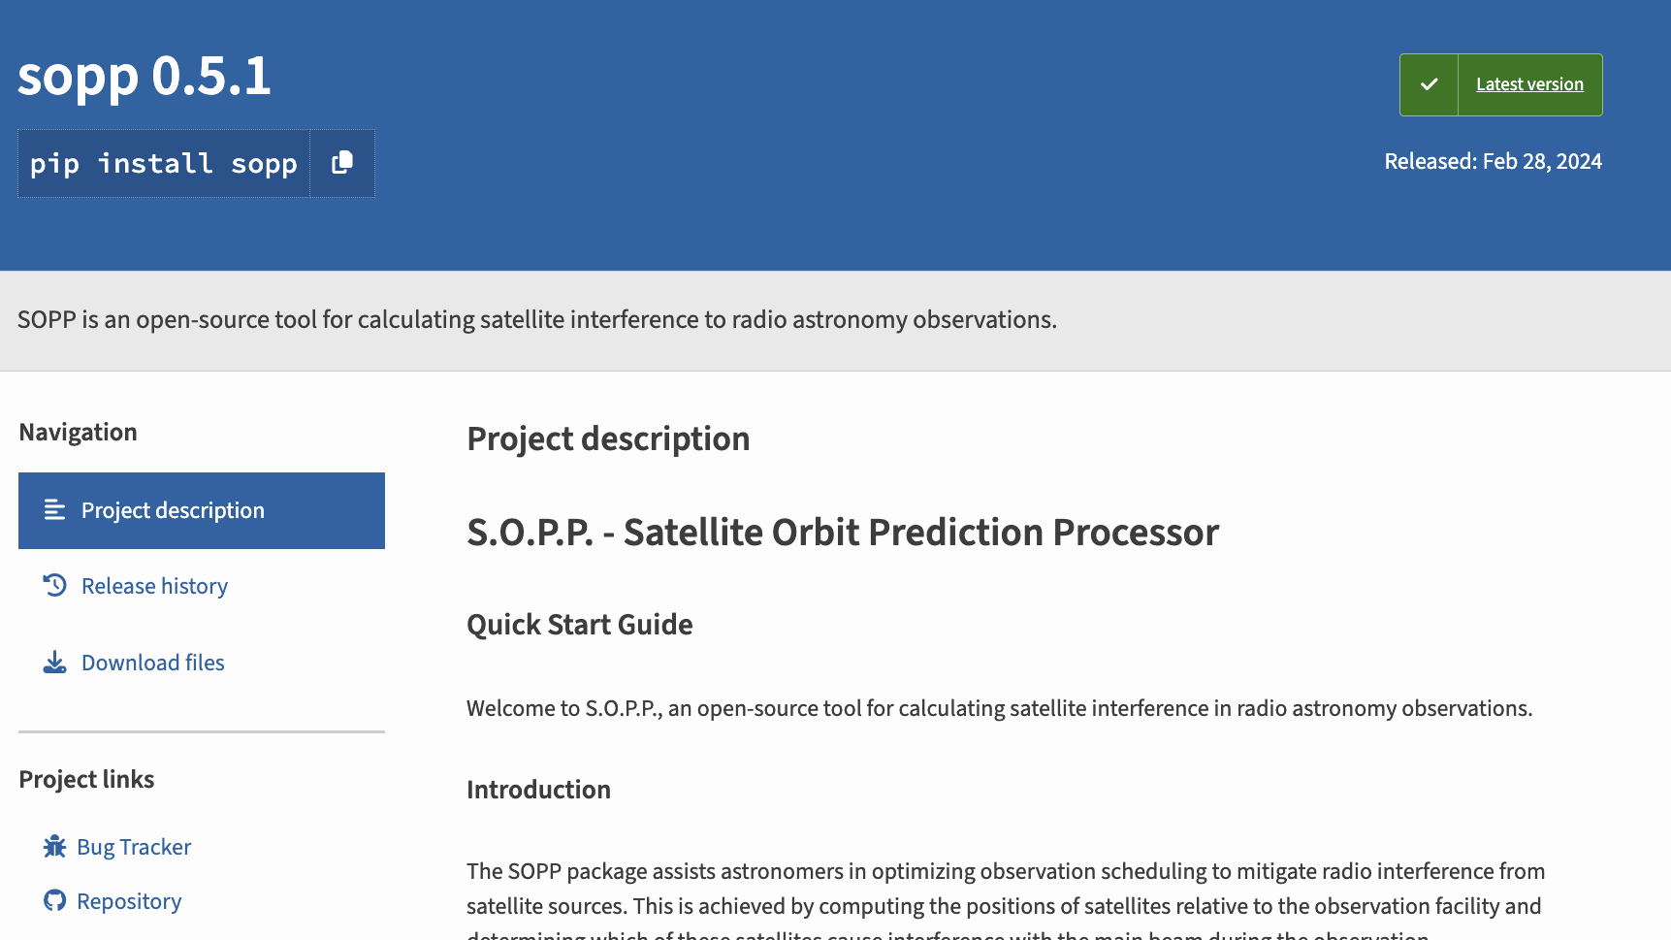

Slide 29
Conclusions
DPAs have been successfully used in CBRS to protect incumbent federal radar operations, when and where they need protection
DPAs are a more efficient protection method than exclusion zones and static coordination zones
DPAs are a promising method for passive/active spectrum sharing
Observatory schedules and satellite ephemerides could be connected to a portal-based informing incumbent capability to effect protections via cloud-based sharing systems similar to AFC and SAS
A current NSF-funded project includes a proof-of-concept experiment in which an observatory will be “protected” by way of a DPA in a test SAS using an IIC portal, with possible extension to satellite protections

Slide 30
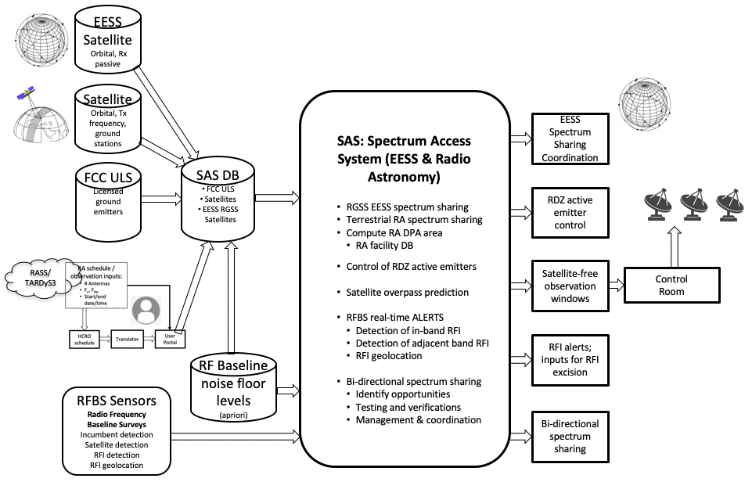
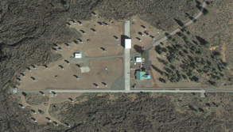
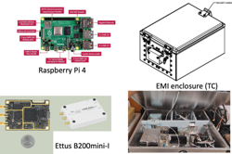
HCRO NRDZ: Top-level components and Concept of Operations

Slide 31
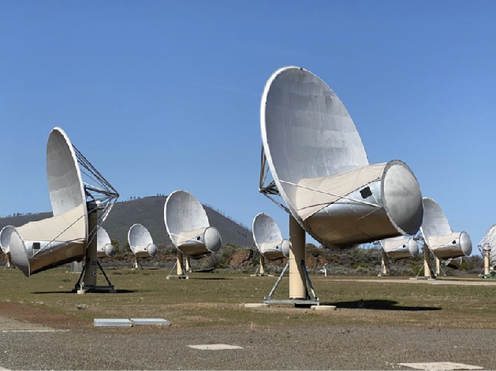
Thanks

