Slide 1
Candidate Statement Mark Hamilton
Date: 2024-03-11
Authors:

Slide 2
Abstract
Candidate information statement

Slide 3
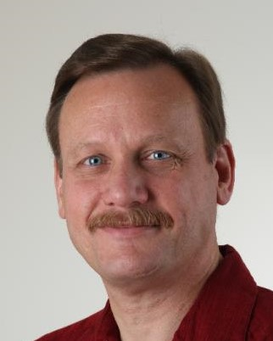
Mark Hamilton
2024 Candidate for IEEE 802.11 Vice-Chair

Slide 4
IEEE Experience
Active 802.11 member, 2008-present
Chair, TGbh since Feb 2021
Instrumental in formation and completion of RCM TIG and SG, which led to TGbh and TGbi projects
Chair, ARC SC since July 2011
Represented 802.11 interests in IEEE Std 802, 802.1 projects (802.1Q, 802.1AC)
Vice Chair and MAC ad hoc Chair, REVmc/REVmd/REVme since Sept 2012
Vice Chair, TGak, March 2014-March 2018
Also, several Chair, Vice/Co-Chair and Editor roles in Wi-Fi Alliance and Wireless Broadband Alliance, and participation at CSA, WInnForum

Slide 5
Vision for and Commitment to the Working Group
Vision: Well …
Commitment: Absolutely. I have, and will continue, to participate in WG activities and help out the leadership at every opportunity!
Notes:
I believe:
Working Group Officers serve the needs of the Working Group.
Diligence, integrity and stability are as important as capability and execution.
The IEEE 802.11WG members should choose officers that are able to facilitate the Working Group process in order to provide standards that fulfill the requirements of the consumers in marketplace.

