Slide 1
Robert Stacey: Candidate for 802.11 WG Chair
Date: 2024-03-10
Authors:

Slide 2
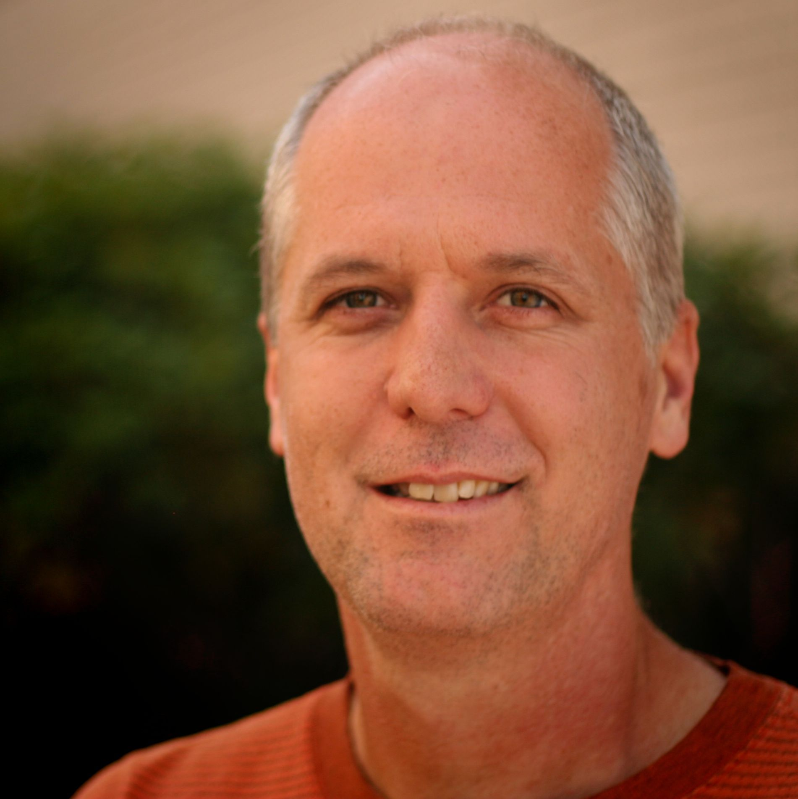
Robert Stacey Candidate for 802.11 WG Chair
Member of IEEE and IEEE SA
Letters of Affiliation and Support with 802 EC recording secretary

Slide 3
Qualifications
Active member of 802.11 since around 2002.
802.11 WG Vice Chair (2018 – present)
802.11 Technical Editor (2014 – present)
802.11 ANA (2014 – present)
802.11 TGac Technical Editor (2009 – 2013)
802.11 TGax Technical Editor (2014 – 2021)
IEEE SA RevCom member 2022
Experience outside of IEEE: Wi-Fi Alliance board member (2012-2013), Wi-Fi Alliance participant, 3GPP participant (2006-2007)

Slide 4
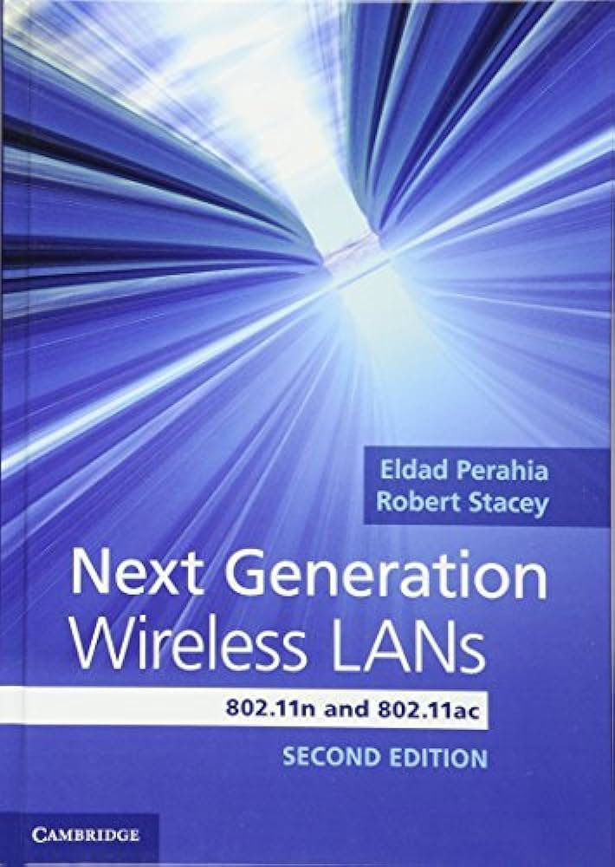
Candidate statement
I have both a deep technical understanding of the 802.11 standard and the group’s policies and procedures.
I have been with the group long enough to appreciate its culture and what makes it an effective force in the industry.
I promise to
Progress our work with high quality and a predictable schedule
Make 802.11 a truly international organization
Continue and strengthen our outreach to other organizations: WFA, IETF, ITU, and others
Advocate for 802.11 on the 802 EC and inside IEEE SA
Promote 802.11 publicly
Improve our tools and processes

