Slide 1
Modeling and Generation of Realistic Network Activity
Date: 2024-03-12
Authors:

Slide 2
Abstract
The growing quantity of wireless network activity generated every second of every day creates challenges for network operators, such as detecting anomalies and providing sufficient capacity. This same network activity also creates opportunities for Smart and Connected Systems (SCSs) to adapt to changing population dynamics, detect and proactively adapt to unexpected events such as public safety threats, traffic jams, or adverse weather events, for example. The GHOST project is researching the challenges of modeling, analyzing, and generating patterns of network activity. The GHOST project has demonstrated that Nonnegative Matrix Factorization (NMF) provides a robust mechanism for modeling network activity patterns that can be used to generate realistic network activity. The GHOST team has further demonstrated the capability for injecting programmed activity patterns into a live, functioning wireless network.

Slide 3
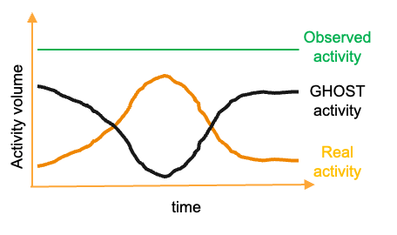
Overview
Cell phone internet traffic:
  Risen worldwide from 0.7% in 2009 to over 50% of all traffic by 2023
  Further accelerated by 5G
  Even larger share in Africa: 70%
Opportunity for Smart and Connected Systems
  Use monitored activity to adapt to patterns
University of Colorado Boulder
  One large connected system
NSF Convergence Accelerator - Track G
  GHOST - 5G Hidden Operations through Securing Traffic

Slide 4
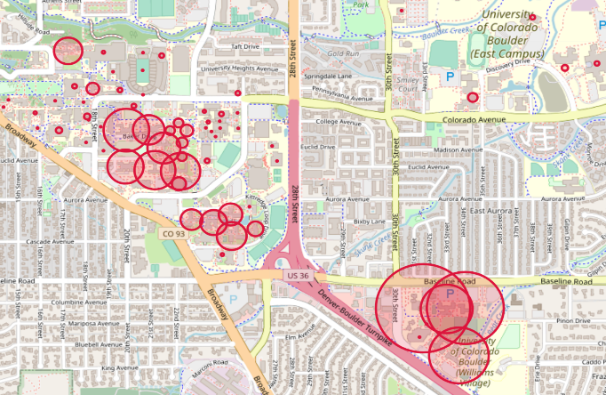
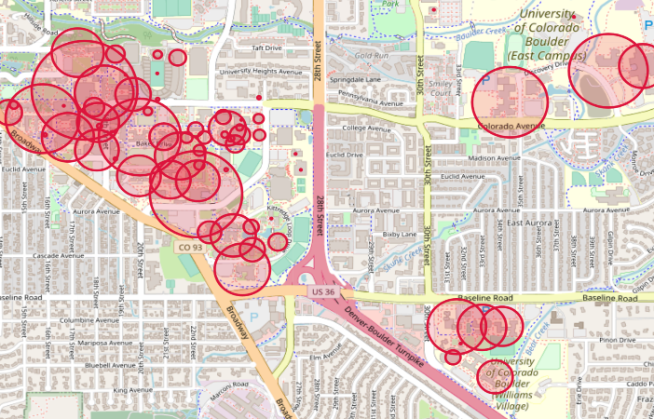
Motivation
Increasingly challenging for network operators to detect anomalies and ensure sufficient network capacity
Tracking network activity can reveal the behavior of users, populations, and organizations
Create patterns of life that predict regular behavior and detect changes and inject programmed activity into a live wireless network
Network device count at 6:58 am
Network device count at 12:40 pm

Slide 5
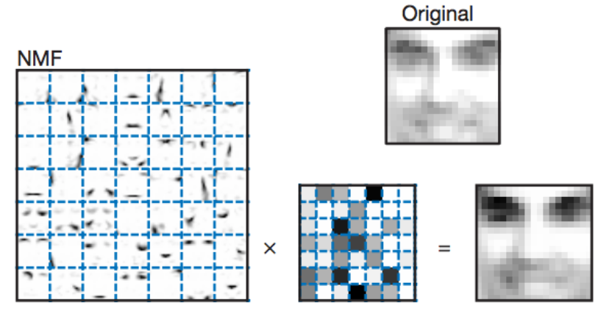
Non-Negative Matrix Factorization
Non-Negative Matrix Factorization (NMF)
  NMF factors a non-negative matrix Dm x n into two lower rank matrices, W and H
  D ≈ W · H
  Pattern matrix Wm x k
  Weighted matrix Hk x n
  Inner dimension k
Some limitations to NMF
Application of NMF
  More intuitive
  Modeling patterns and trends
“Learning the parts of objects by non-negative matrix factorization” , Daniel D. Lee & H. Sebastian Seung

Slide 6
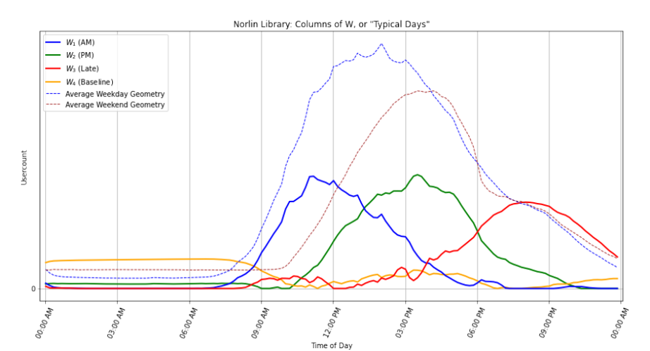
Dataset
Dataset provided by UCB Office of Information Technologies (OIT)
  Data anonymity and irregularities
NMF Interpretation
  W represents activity patterns
  H represents pattern importance in the original data
NMF model simulates user counts at specific locations to mimic real user behavior

Slide 7
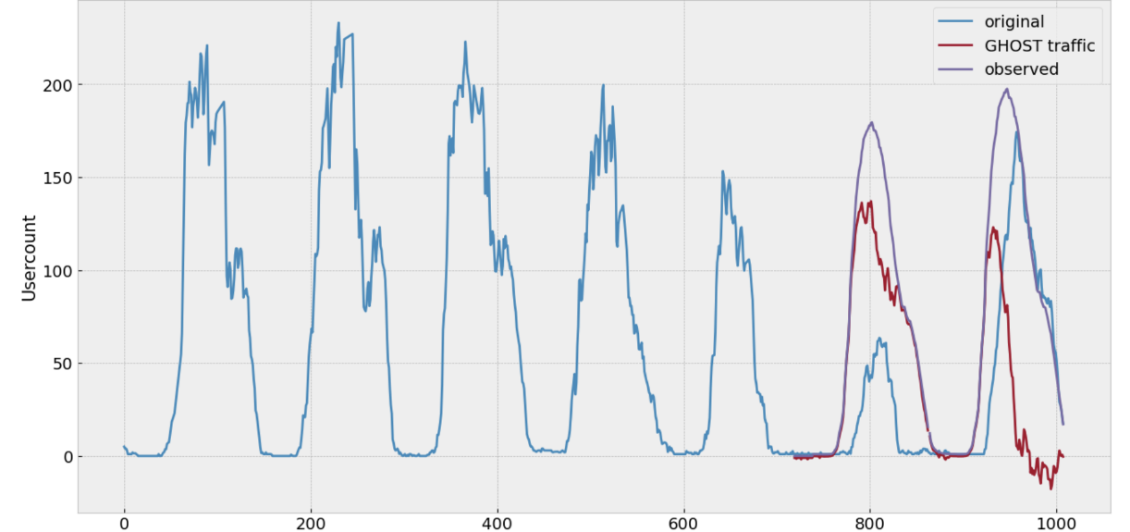
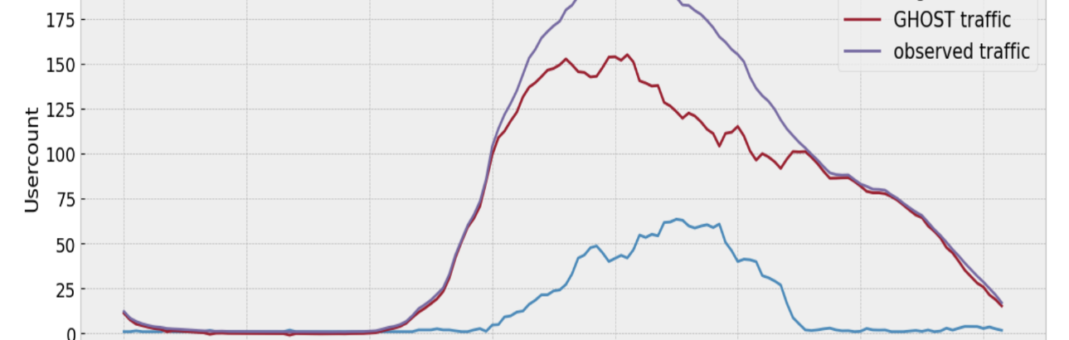
NMF Decomposition
NMF decomposition can be used to generate scalable patterns of network activity
  "GHOST activity" can be injected into existing patterns to alter their appearance
However: How to inject GHOST traffic into a live wireless network?
Fig 1. Make Weekend Look Like a Weekday
Fig 2. Injecting a Saturday with GHOST traffic

Slide 8
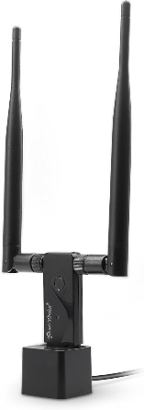
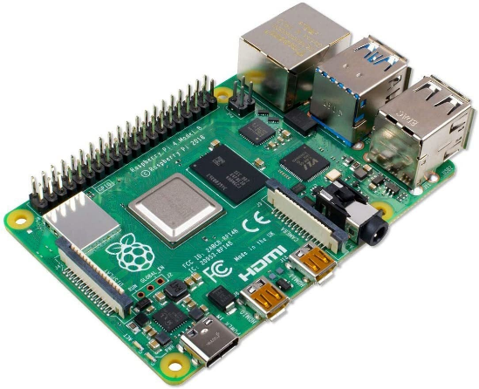
Model Implementation
Wi-Fi Device Simulation:
Use a single Raspberry Pi, USB Wi-Fi adapter, and Scapy to recreate authentication process
  Authentication
  Association
  DHCP
  Web Access
Repeat the process for a list of valid MAC addresses
  Each MAC address is now associated with an IP address provided by the network
  Can be done quickly (seconds)

Slide 9
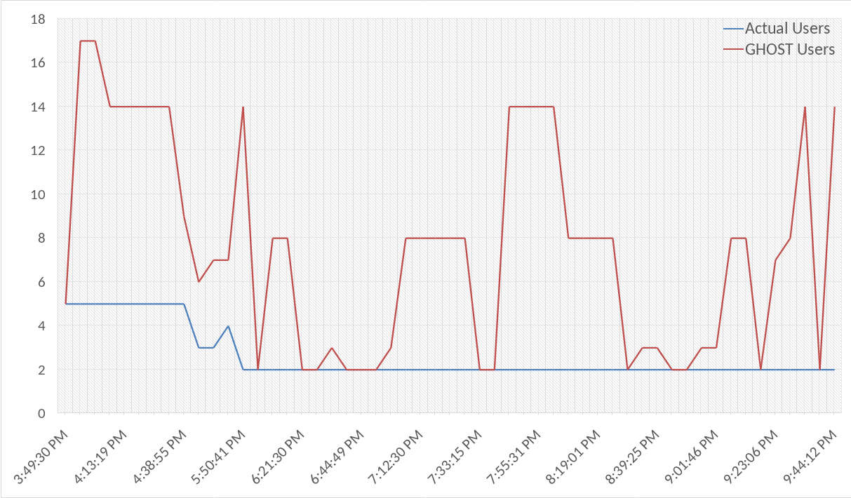
Results
Network operator view:
Expected for a Thursday afternoon:
  Declining activity and traffic
Instead:
  Increased activity, groups of users passing through the area
  Peaks of activity and calm periods
Baseline:
  Often vending machines, printers, “always-on” devices, etc.

Slide 10
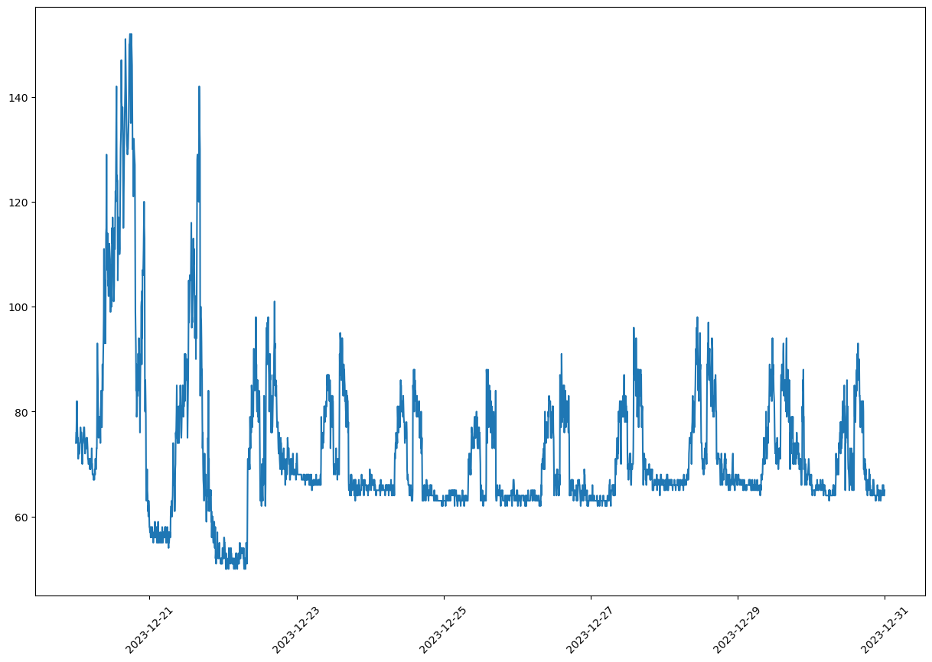
Results

Slide 11
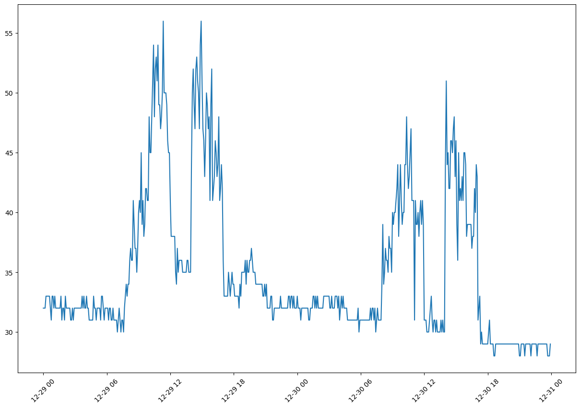
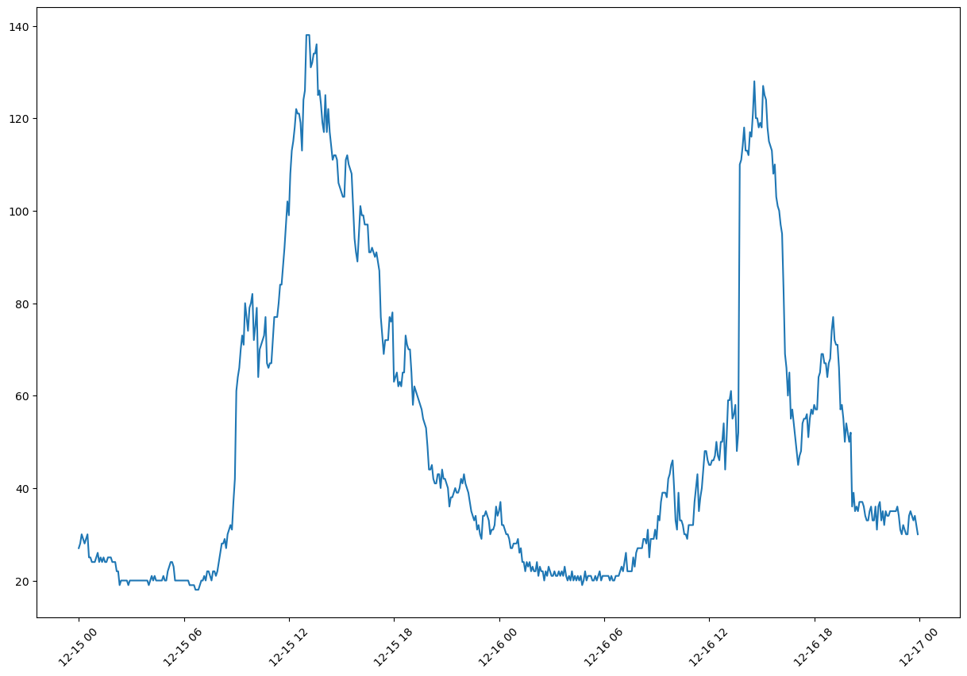
Results

Slide 12
Current Work
Data Exploration
  Average Campus Behavior
  New visualization methods: spectrograms, RGB, 3D
  Sonification
Clustering
Capacity Planning and Management
  Which cluster (type of building) does a new building belong to?
  Changes over time?
Event Classification
Sparse Identification of Nonlinear Dynamical systems (SINDy)

Slide 13
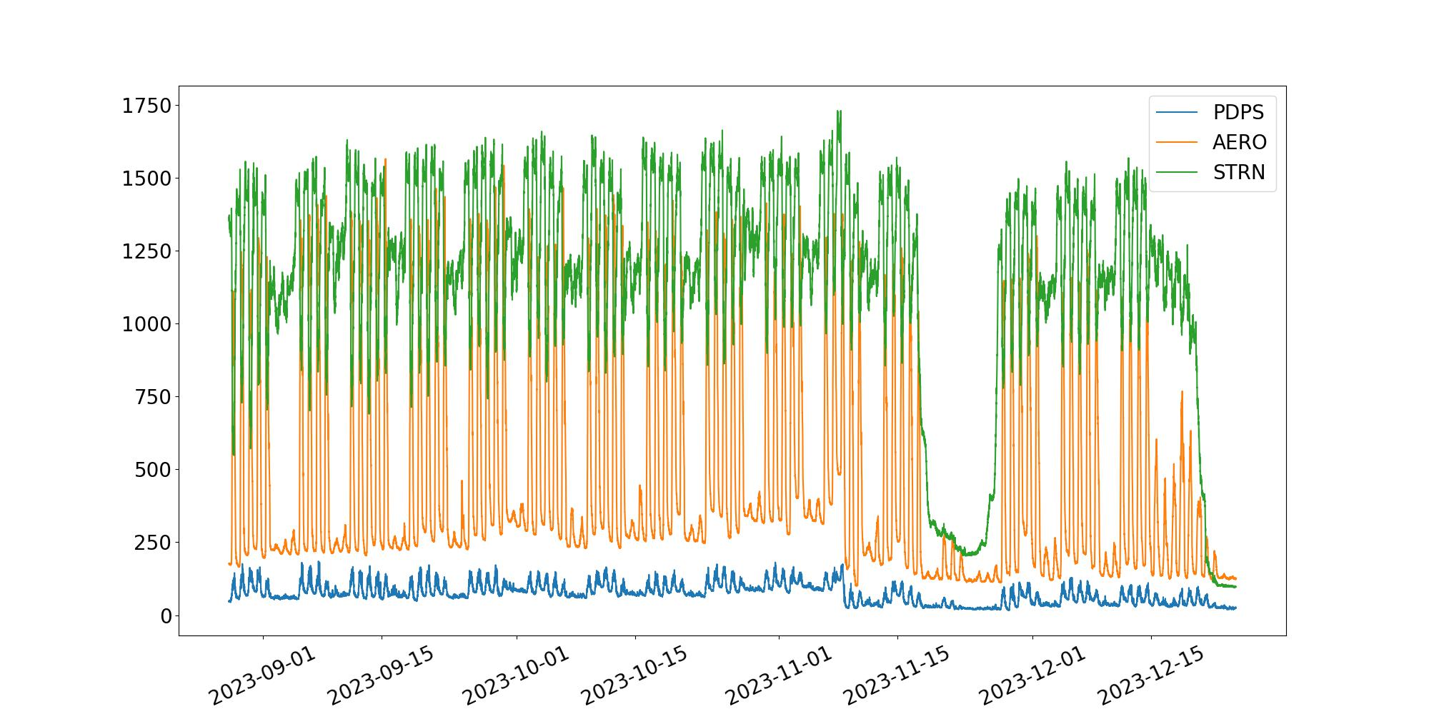
Data Exploration
Remember:
  5-minute time intervals
  ~5500 access points
  > 100 buildings
  Client counts

Slide 14
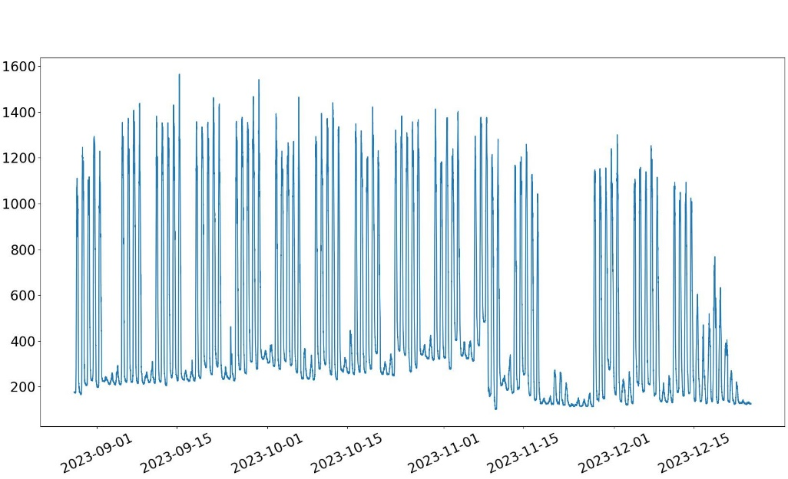
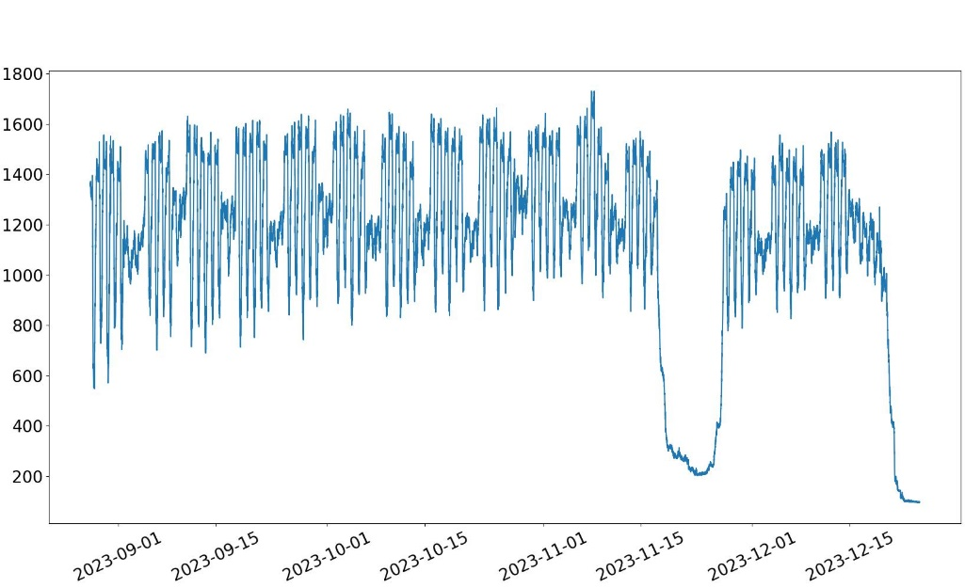
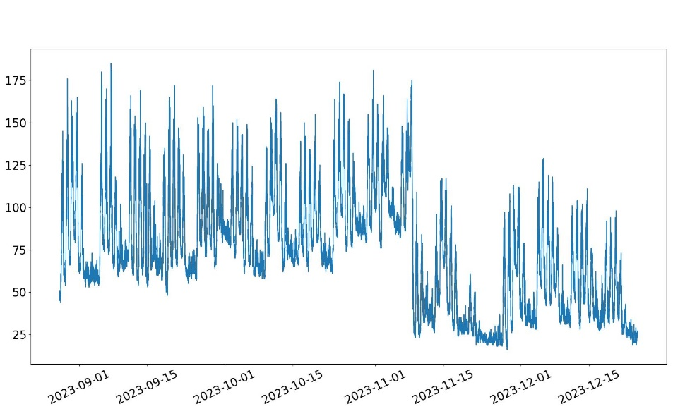
Data Exploration
AERO
STRN
PDPS

Slide 15
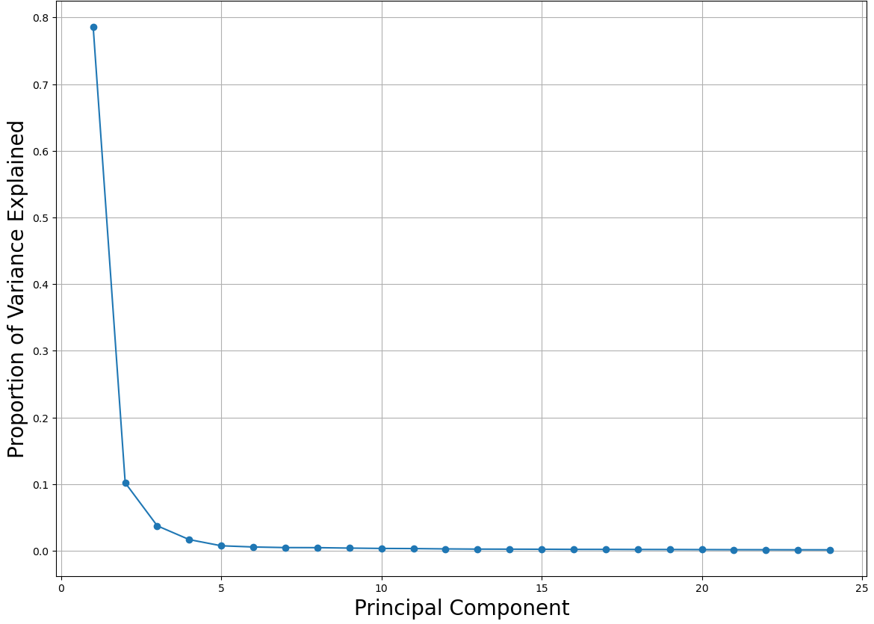
Clustering
Normalized data
  Remove absolute size as a factor
Time series decomposed into 3 components
  NMF and PCA
  Explain most variability

Slide 16
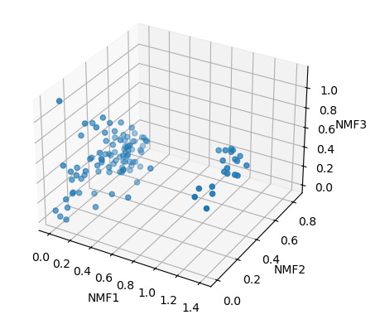
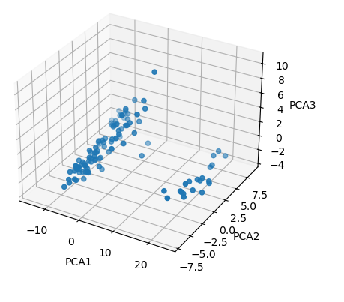
Clustering

Slide 17
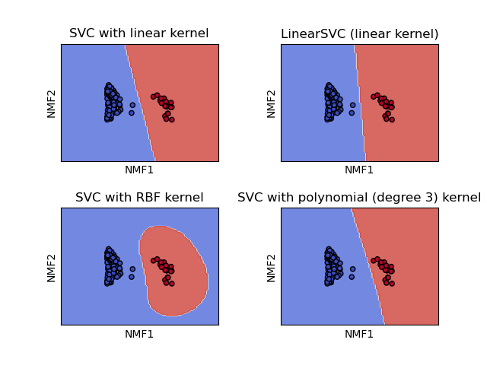
Clustering
Clustering:
Dormitories
“Academic”
“Rest”: Stadium, Ticket Booth, Rec Center, Indoor Practice Facility, Planetarium, Admin, etc.
  More features for further clustering?

Slide 18
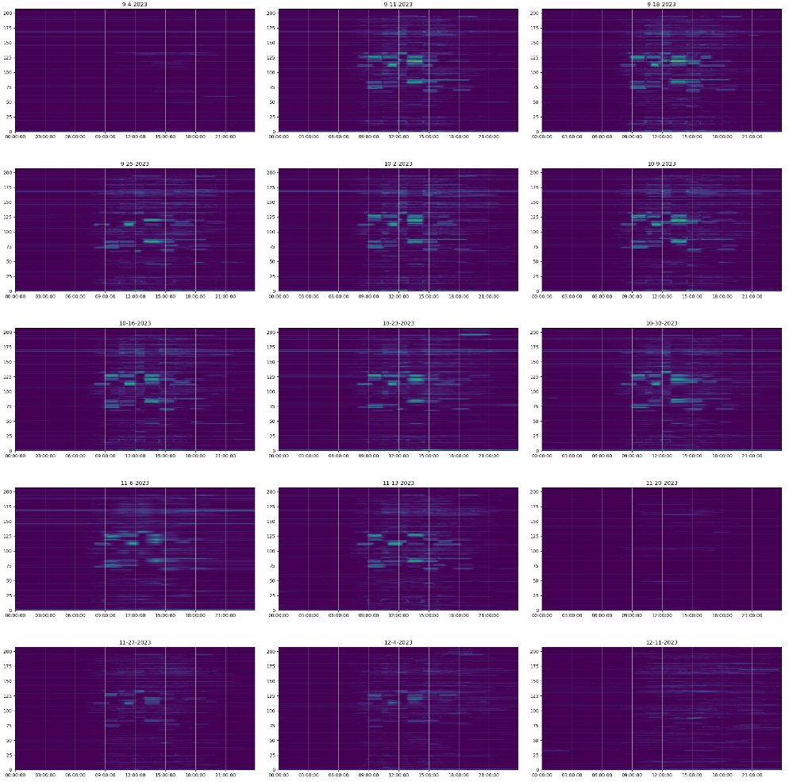
Capacity Planning & Management
Visualizing data in unusual ways
  Reveal new information
Spectrograms
  Y-axis: access points
  X-axis: time
  Color: client counts
RGB Color Channels
  3 Wi-Fi networks
  3 color channels
How to display spatial and temporal differences?

Slide 19
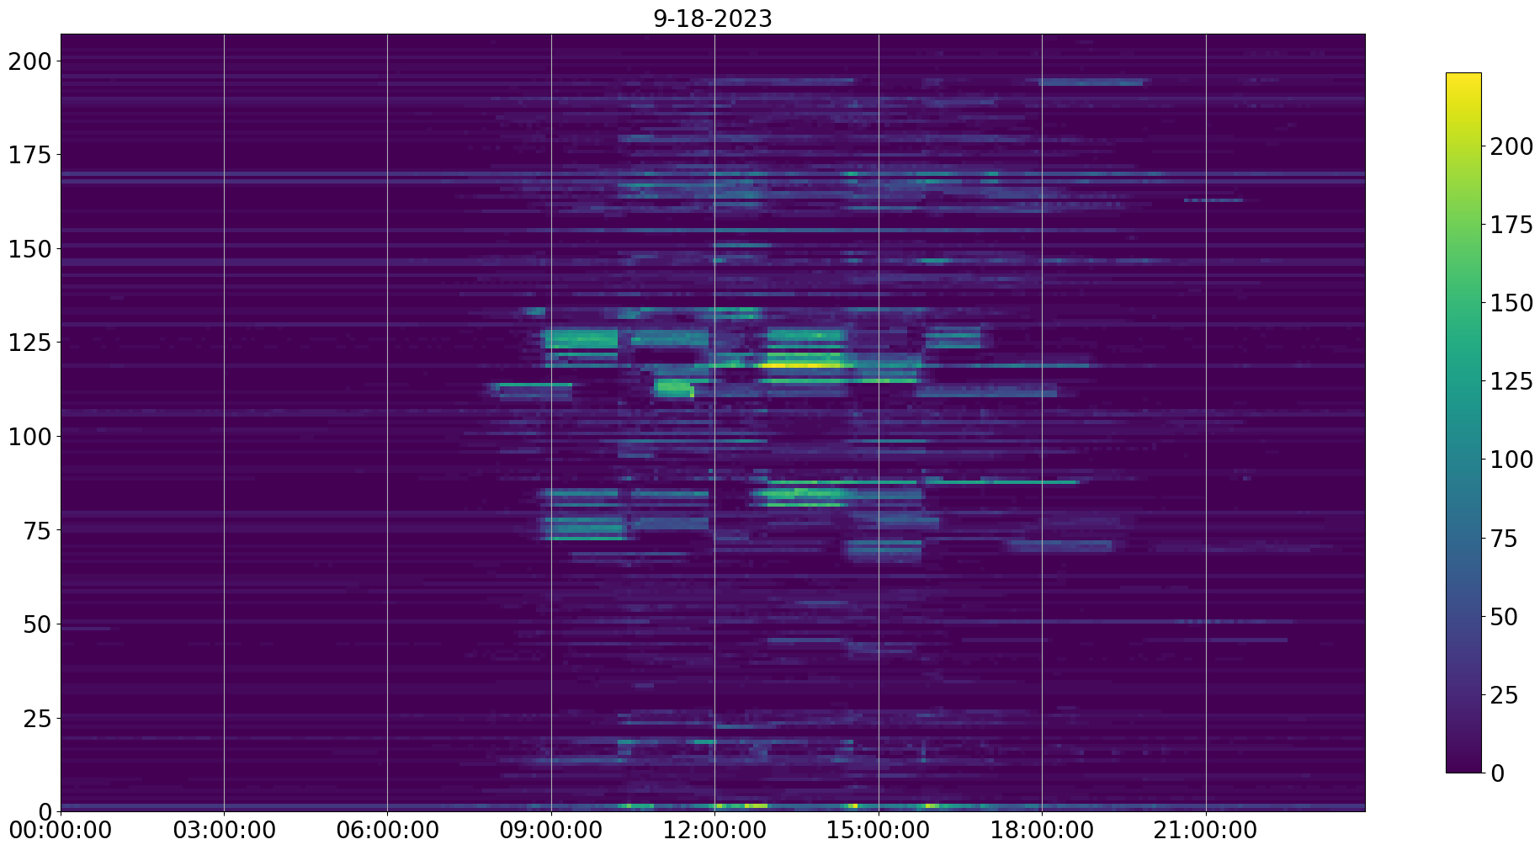

Slide 20
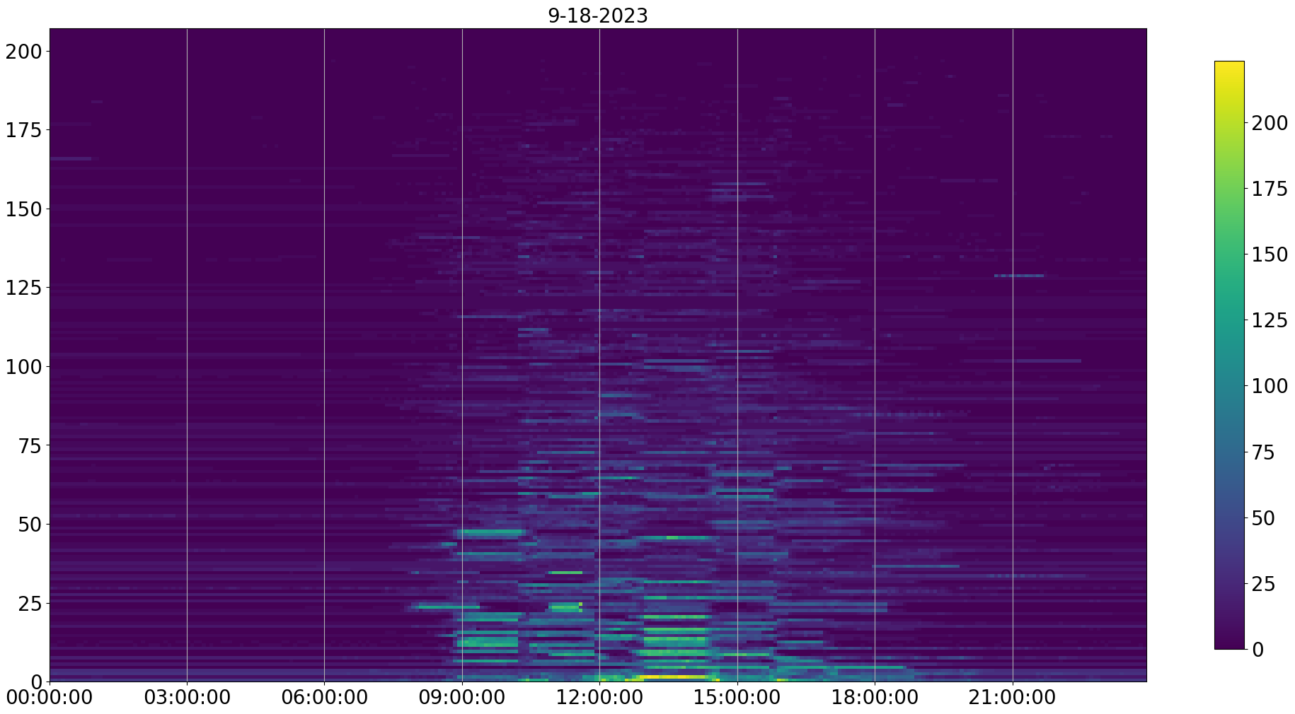

Slide 21
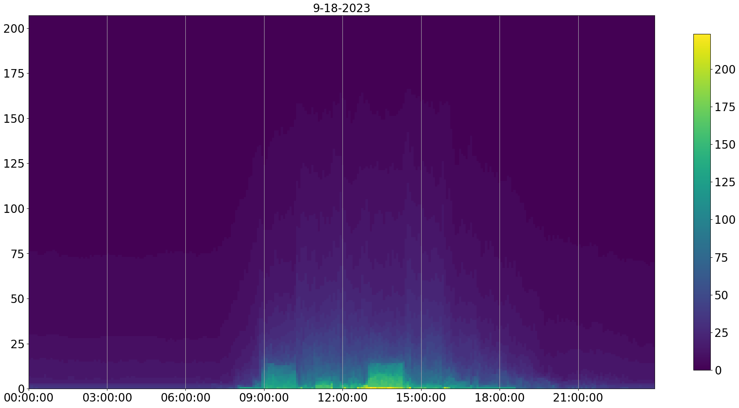

Slide 22
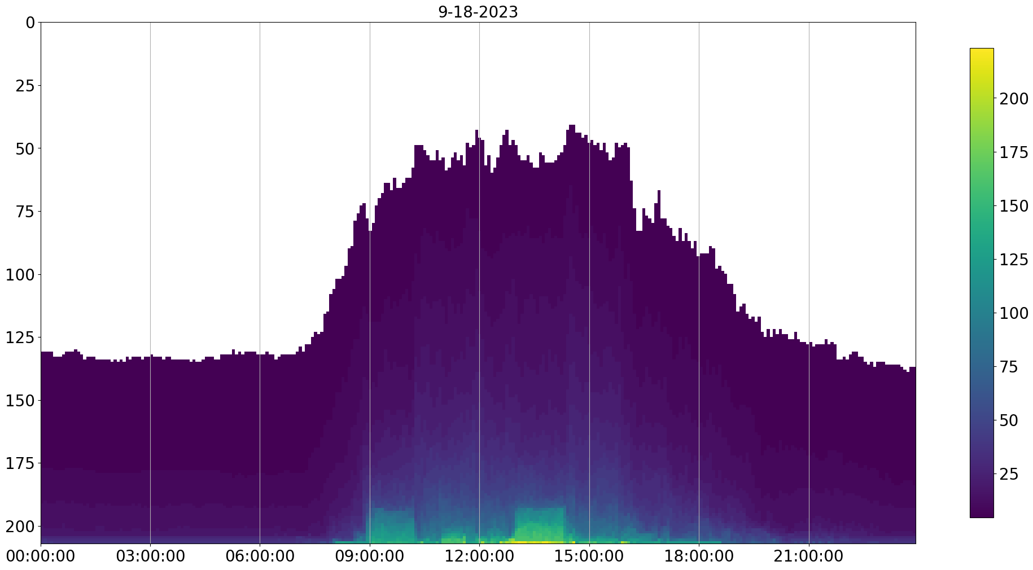

Slide 23
Results
Assuming:
  Commercial electricity rate: $0.0916
  Residential electricity rate: $0.1105
  Average router power consumption: 10 Wh
  Extrapolated from 17 weeks of data to the entire year
  Extrapolated from a single building to the campus data we have access to
= ~ $25,771/year (commercial)
= ~ $31,087/year (residential)

Slide 24
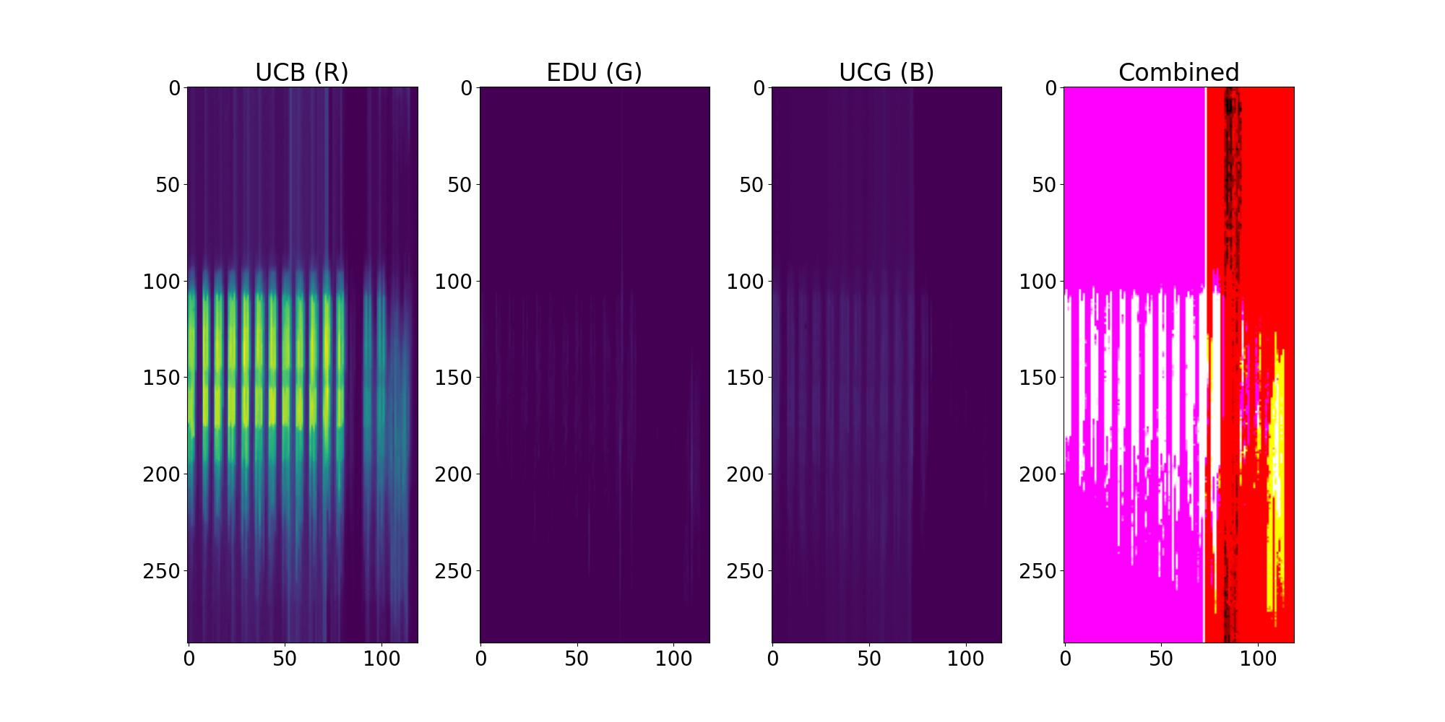
Alternative Visualizations

Slide 25
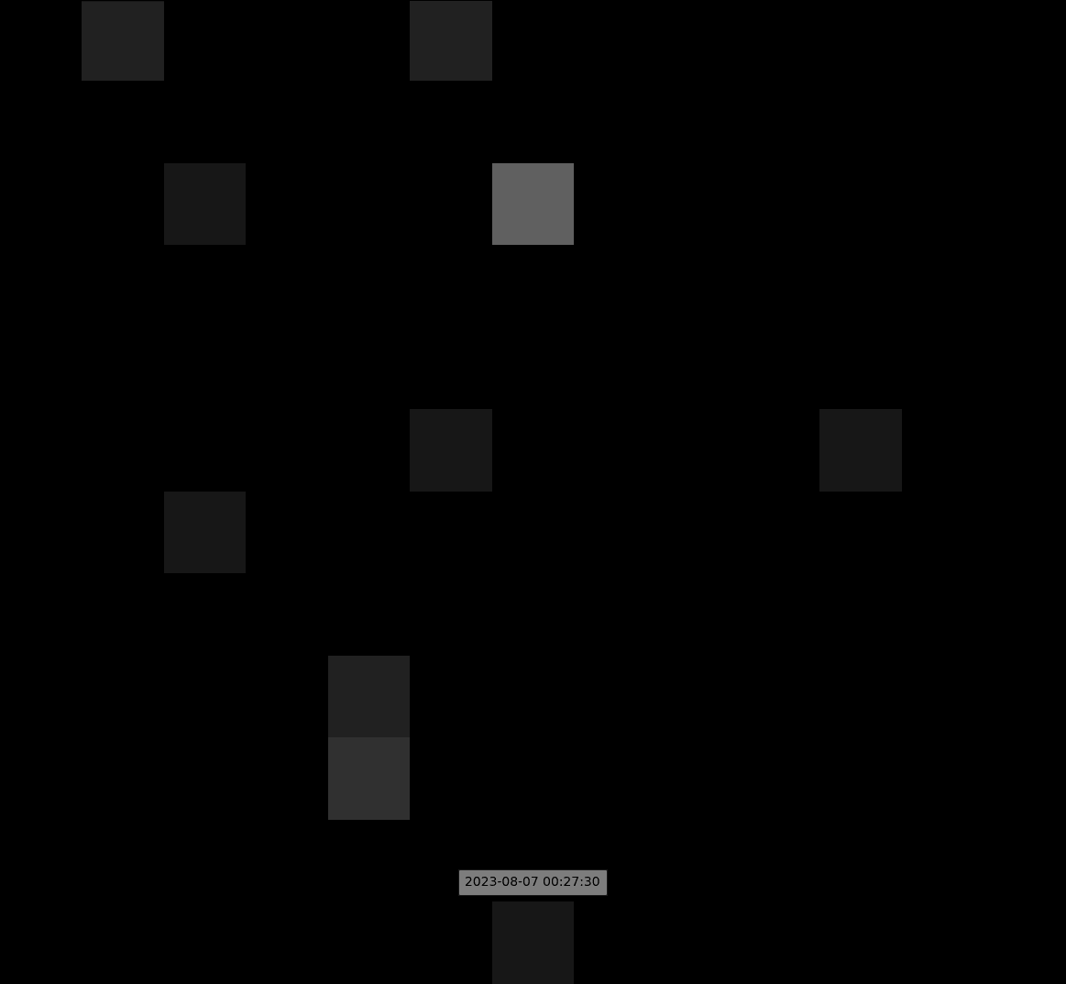
Alternative Visualizations

Slide 26
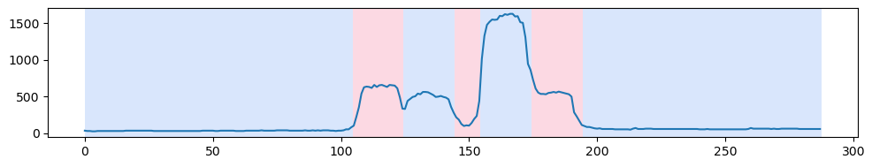
Future Work
Automated Event Detection using Wi-Fi client count changes
  Multiple categories of campus events
  Sliding multi-window (current and future) to detect change in:
    mean
    variance
    periodicity
    pattern

Slide 27
Conclusion
Understanding and adapting to changing patterns of life
Monitor geospatial and temporal dynamics
Use NMF or PCA decomposition to detect and alter patterns
For Wi-Fi:
  A single device can be used to appear as multiple devices
  Can be used to replicate patterns detected by NMF
Future Work
  Develop a library of parameterized NMF models
  Model anomalous events and automatically identify
  Combine device multiplication with traffic generation

Slide 28
References
P. Taylor. (2022) Volume of data/information created, captured, copied, and consumed worldwide from 2010 to 2020, with forecasts from 2021 to 2025. Online; accessed 05-May-2023.
T. Bianchi. (2023) Mobile internet traffic as percentage of total web traffic in january 2023, by region. Online; accessed 05-May-2023.
J. Mcgrath, A. Davis, J. Curry, O. Gartner, G. Rodrigues, S. Spielman, and D. Massey, “Weather of the dorm wifi ecosystem at the university of colorado boulder for fall semester 2019 to spring semester 2020 a case study of wifi and a campus response to the covid-19 perturbation,” 2021.
J. Schogol. (2022) Russian troops are proving that cell phones in war zones are a very bad idea. Online; accessed 05-May-2023.
M. Huffman, A. Davis, J. Park, and J. Curry, “Identifying population movements with non-negative matrix factorization from wi-fi user counts in smart and connected cities,” 2021
R. Craddock, D. Watson, and W. Saunders, “Generic pattern of life and behaviour analysis,” in 2016 IEEE International Multi-Disciplinary Conference on Cognitive Methods in Situation Awareness and Decision Support (CogSIMA), 2016, pp. 152–158.
Y. Peng, T. Feng, C. Yang, C. Leng, L. Jiao, X. Zhu, L. Cao, and R. Li, “Hmm-lstm for proactive traffic prediction in 6g wireless networks,” in 2021 IEEE 21st International Conference on Communication Technology (ICCT), 2021, pp. 544–548.
S. Li, J. Song, L. Xu, Y. Hu, W. Luo, and X. Zhou, “Network traffic prediction based on the feature of newly-generated network flows,” in 2022 IFIP Networking Conference (IFIP Networking), 2022, pp. 1–8.
N. Gillis, Nonnegative Matrix Factorization. Society for Industrial and Applied Mathematics, 2021.
P. Paatero and U. Tapper, “Positive matrix factorization: a non-negative factor model with optimal utilization of error estimates of data values,” in Fourth International Conference on Statistical Methods for the Environmental Sciences ”Environmetrics”, 1994.
D. Lee and H. Seung, “Learning the parts of objects by non-negative matrix factorization,” Nature, no. 401, pp. 788–791, 1999.
M. W. Berry, M. Browne, A. N. Langville, V. P. Pauca, and R. J. Plemmons, “Algorithms and applications for approximate nonnegative matrix factorization,” Computational Statistics & Data Analysis, vol. 52, no. 1, pp. 155–173, 2007.
N. Gillis, “The why and how of nonnegative matrix factorization,” 2014.

