Slide 1
Close-range AMP WiFi Reader Feasibility Study
Date: 2024-03-09
Authors:

Slide 2
Introduction
The concept of AMP close-range backscattering using WiFi device as AMP tag reader was proposed [1]
In this presentation, we answer two questions
  The need of AMP tag rather than NFC tag
  The feasibility of WiFi device reading AMP tag using backscattering

Slide 3










Recap: use cases
10’s of billions of AMP+UHF tags can be read with a mobile device?
  UHF operation in sub-1GHz for 2B scenarios with 10+m range
  Consumer usage in 2.4GHz with WiFi device in close range
Read range requirement: 5~10cm

Slide 4
Questions?
Q1: AMP tag vs NFC tag
Q2: Feasibility of using existing WiFi hardware for backscattering

Slide 5
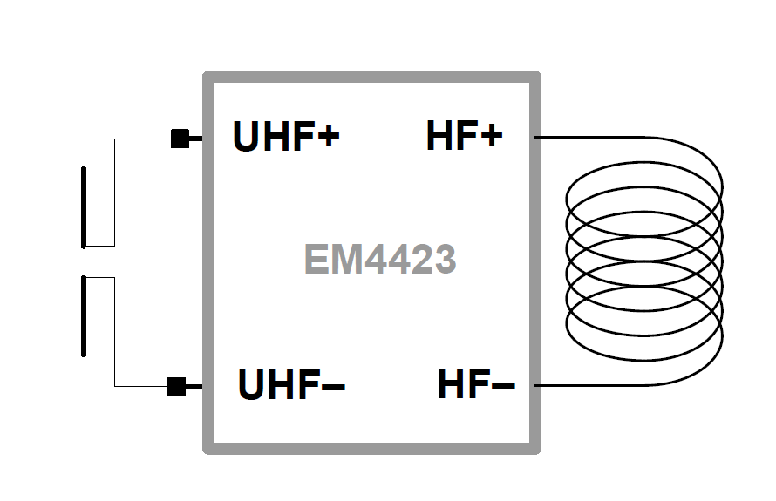
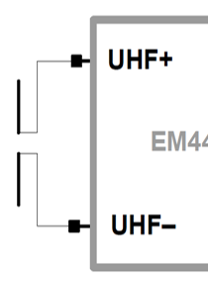
AMP vs NFC
AMP vs NFC
  NFC tag is ~3x pricier than UHF tag (AMP tag)
  NFC read range is very limited with contact
Synergy with UHF
  NFC+UHF:
    RF front end
    SoC requirement is also different: supply, memory, security
    Tx power: large with NFC, heat issue
  AMP+UHF: similar
    Share RF front-end with extension to 2.4GHz
    Share digital IC for backscattering modulation
    Shared SoC components
SoC
AMP+
SoC
AMP-

Slide 6
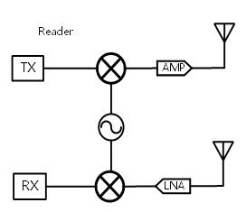
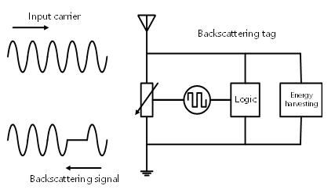
WiFi AMP Tag Reading
WiFi AMP reader
AMP tag
WiFi reader: WiFi transceiver with 2+ antennas
  One set of antennas send reading energizer/carrier signal and
  Second set of antennas decode the backscattered tag signal

Slide 7
WiFi Reader Rx Signal
Leakage signal
Backscattered signal
$$y=h_{lk}∗\left(x+w_{t}\right)+h_{bs}∗((x+w_{t})∙f\left[n\right]+w_{t,bs})+w_{r}$$
Tx-Rx leakage channel
transmitted waveform
transmit noise (TxEVM)
backscattered channel
modulated bit n
modulation noise (TxEVM)
receiver noise (SNR)
Note:
  Power difference between leakage and backscattered signal is modeled into the channel
  Backscattering modulation: OOK
 |  |  |  |  |  |  |  | …
Leakage signal
BS signal
 |  |  |  |  |  |  |  | …
Bit[0]
Bit[1]

Slide 8
WiFi AMP Reader Design
Tx carrier waveform
  11b pulse waveform or OFDM waveform
  Same waveform can be repeated N times, and AMP tag will repeat each information bit N times
Rx path processing:
  Fixed AGC gain to get I/Q samples
  Match filter to boost Rx SNR
  Differential decoding to remove leakage waveform
  Repetition combining to decode modulated info
    OOK based detection

Slide 9
Simulation Settings
2x2 WiFi device in “1Tx + 1Rx” mode
  Antenna isolation is 20dB → Rx power of -20dBm
    Effective Rx noise floor varies from -35dBr to -50dBr
    Note: assume TxEVM after differential is below Rx NF
  Waveform: pulse, OFDM
AMP tag backscattering data rate: 250kbps
  250kbps data rate, i.e. one-bit modulated on a 4us waveform
    Repetition coding of 1/N
  OOK modulation: -20 dBr Tx noise
  Payload: 1000 bits
WiFi reader Rx BW = 40MHz, 10-bit ADC
Leakage signal: 0dBr
BS signal level: e.g. -30dBr
Rx noise floor: e.g. -45dBr

Slide 10
WiFi AMP tag reading performance
Pathloss modeling uses Friss model is as in [1]
Pulse waveform:
  RxNF=-35dBr, read a tag within ~20cm; RxNF=-50dBr, read within ~45cm
OFDM waveform has shorter reading range (~2/3 of the range)

Slide 11
Repetition Gain
To achieve the reading range of 50cm (-50dB SLR) with NF of -44dBr, repetition coding can help to achieve 1% PER:
  N=7 for pulse waveform, and N=31 for OFDM waveform

Slide 12
Summary
AMP tag can have good synergy with UHF RFID to enable cost-effective integrated tag design to support many end-to-ed to-Business and to-Consumer applications.
WiFi 2x2 device can achieve AMP reader function with common impairment parameters
  Pulse waveform has about 1/3 longer reading range than OFDM
  Repetition coding can help to extend the reading range

Slide 13
References
[1] 11-23/2038r01, Close Range AMP Backscattering in 2.4GHz

Slide 14
Appendix

Slide 15


Link Budget Analysis [1]
Friis propagation model: Prx = Pt + Gtx + Grx + 20log10( ) – 20log10(4 d) – L (dB)
  WiFi antenna gain: Gtx = Grx = 2dB
AMP tag activation power: -20dBm
Backscattered modulation loss: L = 6dB
$$λ$$
$$π∙$$

Slide 16
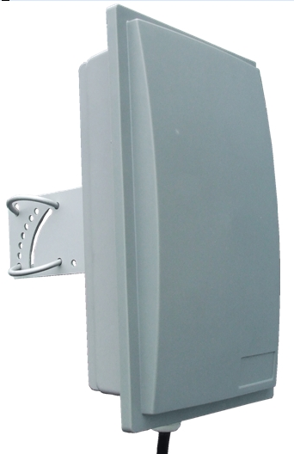
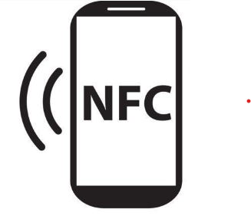
AMP vs NFC
SoC
AMP+
SoC
WiFi AMP
AMP-

