Slide 1
LPI Static Preamble Puncturing
Apr 2024
Authors:
Name | Affiliation | Phone | email
Pelin Salem | Cisco Systems |  | pmohamed@cisco.com
Brian Hart | Cisco Systems |  | brianh@cisco.com
Malcolm Smith | Cisco Systems
Juan Carlos Zuniga | Cisco Systems
Stephen Orr | Cisco Systems
Jerome Henry | Cisco Systems

Slide 2
The Promise of Static Preamble Puncturing
P20
S20
S40
P20
S20
S40
X
X
X
P
I
I
-62 dBm
CCA-CatchAll
-62 dBm
CCA-CatchAll
Key: I = interference, P = Punctured subchannel
Static preamble puncturing was first introduced in 11ax and was enhanced in 11be
  Now possible with SU or OFDMA PPDUs, and for sounding
The promise was: If an incumbent needed protection or there was persistent interference, which would prevent full bandwidth transmission, Static Preamble Puncturing would still permit full bandwidth transmission, albeit with the affected subchannels disabled.

Slide 3
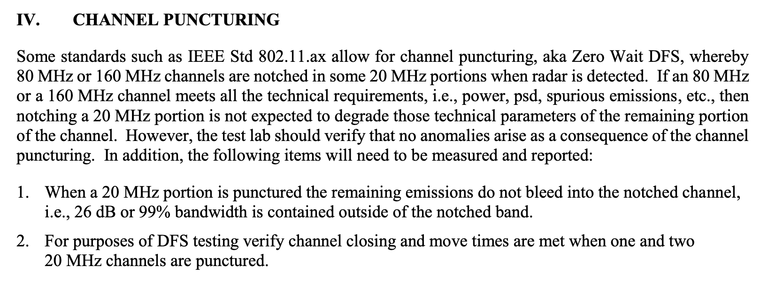
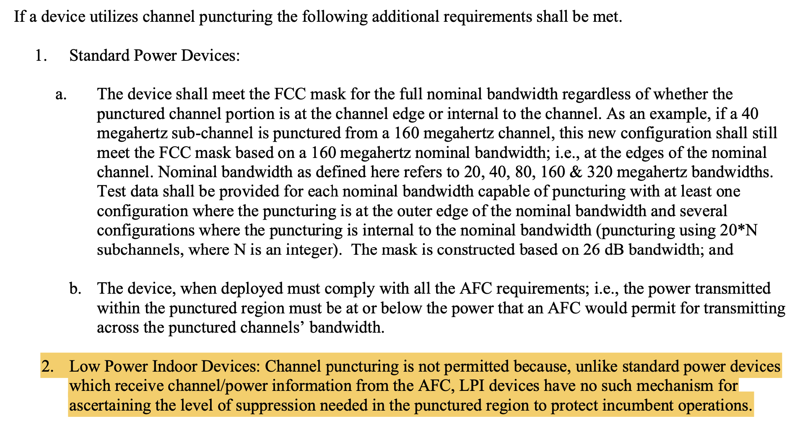
Current FCC Regulations for Preamble Puncturing in 6GHz
Note the Preamble Puncturing is not allowed with LPI BSSs (clause 2 at bottom right)
Subsequent communications provide only partial relaxation here (see next slide)
789033 D02 General UNII Test Procedures New Rules v02r01
987594 D02 U-NII 6 GHz EMC Measurement v02r01
FCC: Federal Communications Commission
DFS: Dynamic Frequency Selection
EMC: Electromagnetic Compatibility
AFC: Automatic Frequency Control
LPI: Low Power Indoor

Slide 4
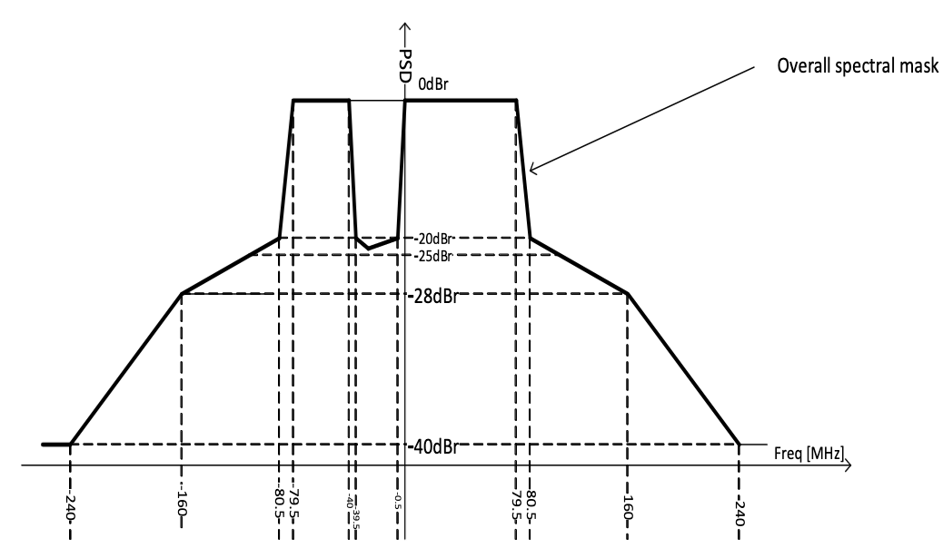
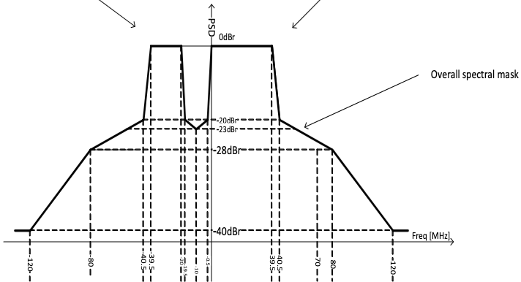
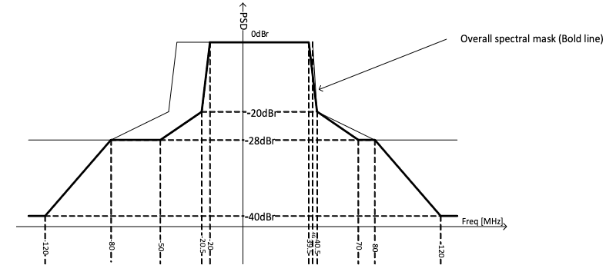
IEEE Transmit Spectral Masks and FCC Requirement
0.477 MHz
99% OBW
+79.523 MHz
99% OBW
-19.679 MHz
99% OBW
+39.679 MHz
+0.328 MHz
+39.672 MHz
-79.672 MHz
99% OBW
-40.328 MHz
Case 1: 80 MHz EHT PPDU with the lowest 20 MHz subchannel punctured (P-U-U-U)
-39.938 MHz
99% OBW
-20.062 MHz
Case 2: 160 MHz EHT PPDU with the second lowest 40 MHz subchannel punctured (U-P-U-U)
Case 3: 80 MHz EHT PPDU with the lowest 20 MHz subchannel punctured (U-P-U-U)
IEEE Transmit spectral masks for various EHT PPDUs with different punctured subchannels fit
the FCC requirement of 99% occupied bandwidth fitting outside the punctured channel
(i.e., ±0.5 𝑀𝐻𝑧 ≅1%).
(Transmit Spectral Mask drawings – Source: IEEE P802.11be/D5.0, November 2023)

Slide 5
Simple Representation of Static Preamble Puncturing
For EIRP PSD in an 80 MHz BSS:
AP calculates max TX PSD for clients per 20 MHz channels from the AFC frequency response minus 6 dB, then signals these values in the EIRP PSD fields in the Transmit Power Envelope element.
P20
S20
20 of S40
(S40-lo)
20 of S40
(S40-hi)
A = AFC frequency response - 6 dB
X
B = A - X
Basic algorithm: Populate each EIRP PSD value with the integration of each black line over its 20 MHz:
EIRP PSD = black line + 10*log₁₀(20MHz/1MHz)

Slide 6
Summary of Static Preamble Puncturing FCC Rules
Incorporating additional communications
Standard Power (SP):
  Puncturing is allowed; devices protect incumbents by keeping their emissions below the limits provided by AFC system.
Low Power Indoors (LPI):
  Puncturing is allowed for network optimization purposes: e.g., persistent interference in some part of the channel like another 20 MHz-only BSS.
  Puncturing is NOT allowed in the case of contention protocol testing. This means that a BSS needs to completely vacate a subchannel once incumbents are detected there (e.g., by lowering the BSS bandwidth)
Dynamic Frequency Selection (DFS):
  Puncturing is allowed; need to ensure 99% BW. However, the 99% BW of 802.11 PPDUs excludes channels where DFS-triggering signals are found.

Slide 7
Modified CCA/CS can be a solution for puncturing in LPI
Key:
P: Punctured channel
I: Interference
Traditional CCA:
Modified CCA:
P20
S20
S40
P20
S20
S40
P
-42 dBm
-62 dBm
CCA-CatchAll
-62 dBm
I
CCA-CatchAll
I
Transmission allowed
I
Transmission allowed
P20
S20
S40
P20
S20
S40
P
P
I
-42 dBm
I
-62 dBm
I
CCA-CatchAll
-62 dBm
CCA-CatchAll
Transmission allowed
Transmission disallowed
Traditional physical carrier sense is backstopped by detection of any signal above a fixed threshold, -62 dBm
The CCA-CatchAll threshold can be modified per subchannel, and a raised/relaxed threshold for punctured channels provides balanced collision protection.
Specifically, the CCA-CatchAll threshold can be raised by a fixed amount such as 20 dB as shown above (or by the same amount as the STA’s puncture depth).

Slide 8
Summary
11be does not perform CCA over punctured subchannels
… and the FCC currently does not permit Static Preamble Puncturing in LPI BSSs as an allowed method to protect incumbents
  If an incumbent occupies the upper or lower half of an 80 MHz channel, the LPI BSS bandwidth drops to 40 MHz
  If an incumbent occupies the upper or lower half of a 160 MHz channel, the LPI BSS bandwidth drops to 80 MHz
However, we see good prospects for FCC allowing Static Preamble Puncturing with modified CCA in LPI BSSs to protect incumbents
  De-sensed CCA, rather than no CCA, over the punctured subchannels
  To unlock 60 MHz BSSs (etc) instead of falling to 40 MHz.
  To unlock 120-140 MHz BSSs instead of falling to 80 MHz.
Clients that support the modified CCA scheme can occupy the full (albeit punctured) BSS bandwidth instead of a fraction of it.

Slide 9
Strawpoll
To help regulators permit LPI BSSs to use Static Preamble Puncturing as a sufficient method to protect incumbents, do you agree to add the following text to the 11bn SFD:
  11bn shall define a mode of operation where transmission on punctured subchannels is conditional on performing de-sensed CCA (details TBD)
  Y / N / A

